Slide 1
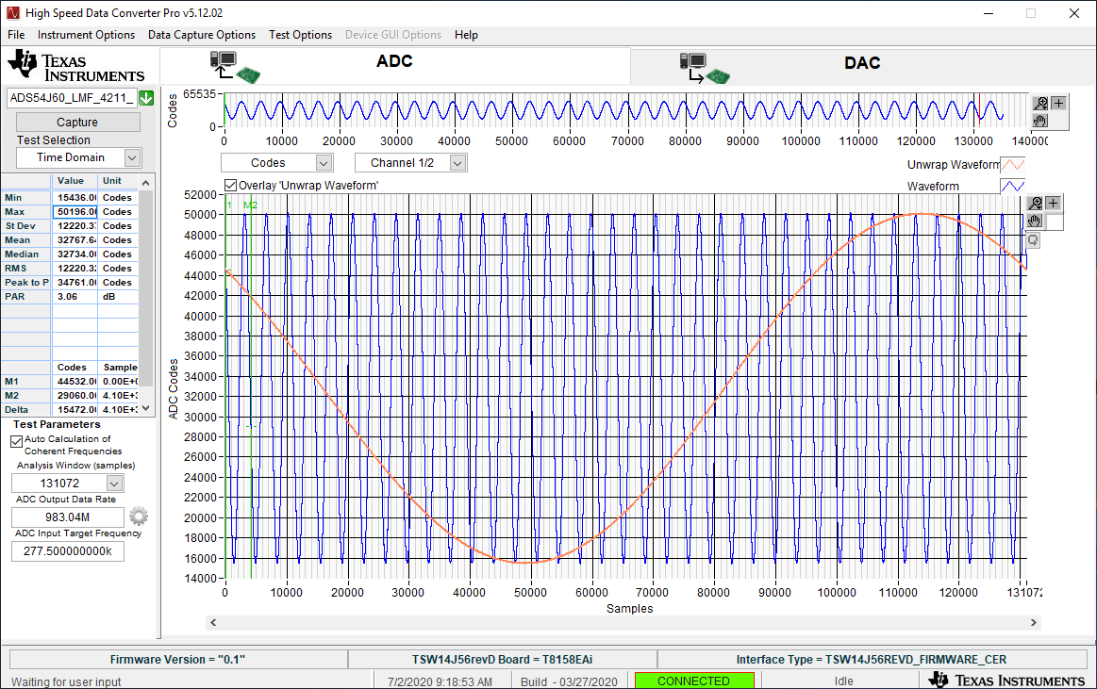
Click on “Overlay Unwrap Waveform”

