Slide 1
KCU105 ADC34J45 Interface Instructions

Slide 2
Setup the hardware as shown below

Slide 3
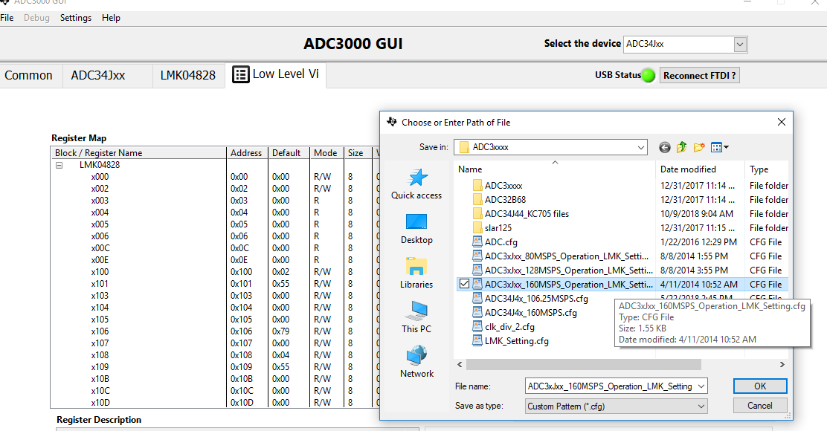
Open the ADC GUI and load the config file shown below

Slide 4
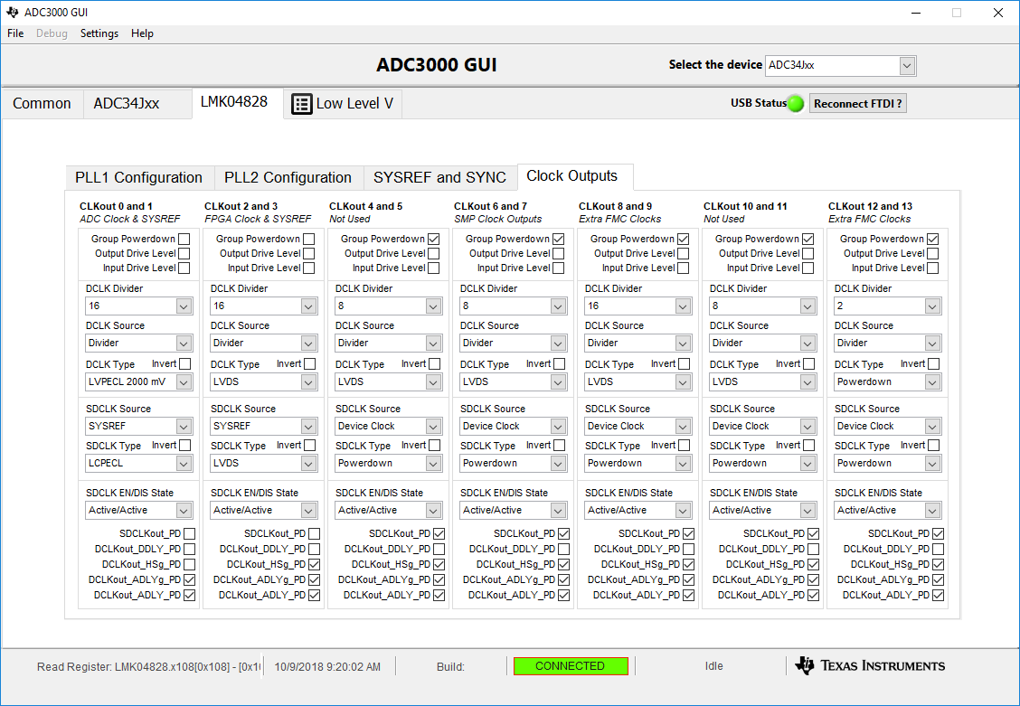
Go to the following Tab and change the CLKOUT 2 and 3 divider to 16.

Slide 5
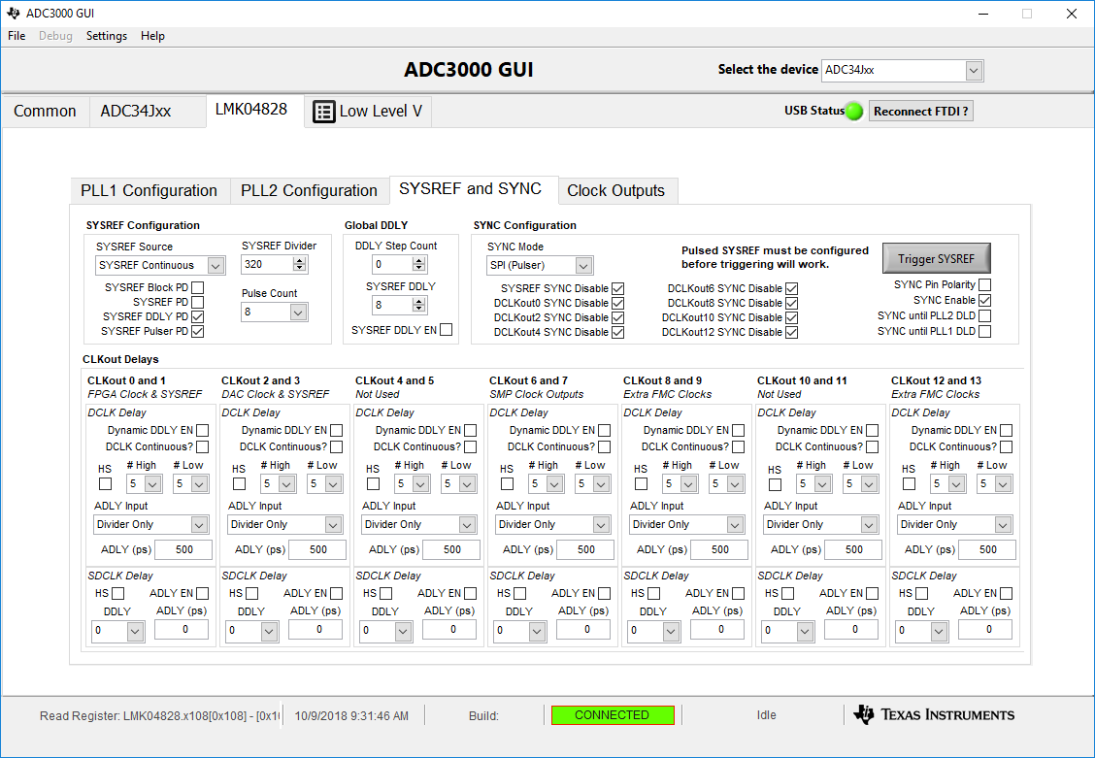
Verify SYSREF Divider is set to 320

Slide 6
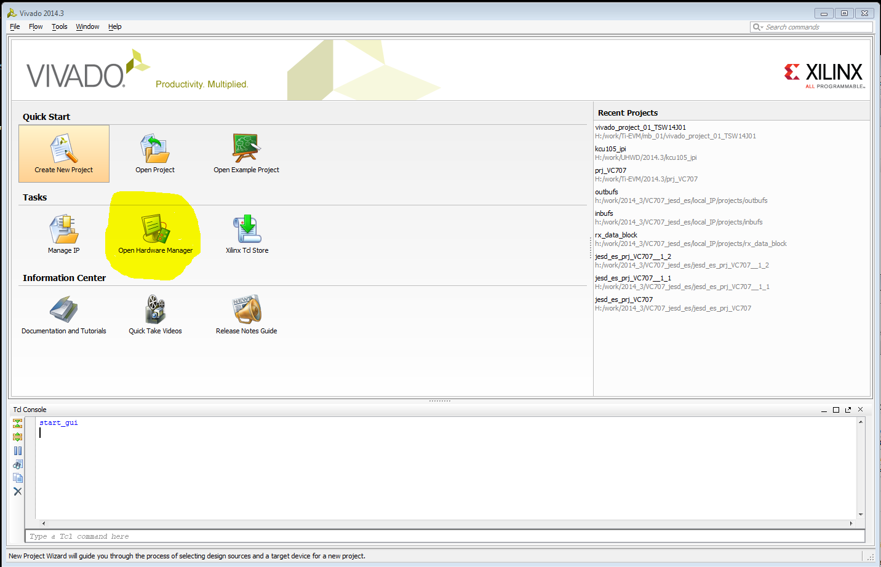
Now download the firmware using Vivado v2016.1 Open Hardware Manager

Slide 7
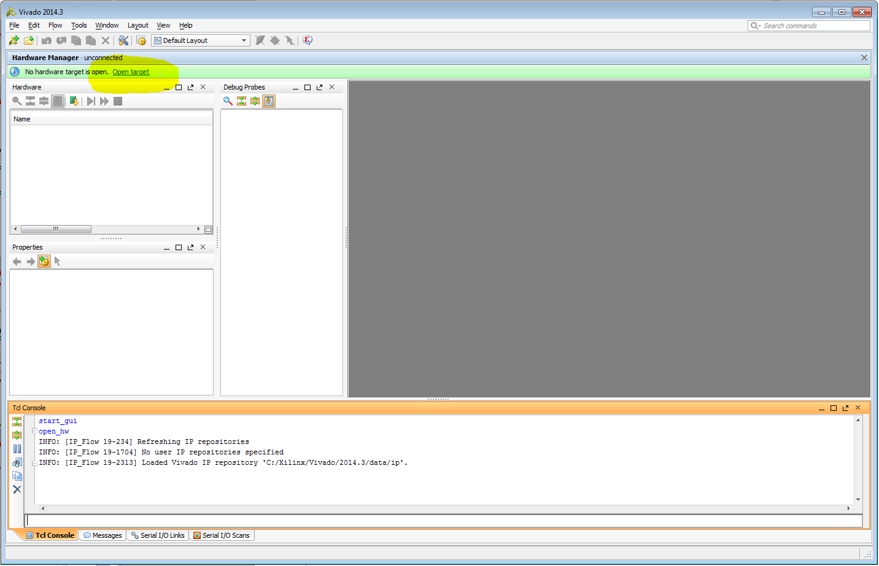
Once open select “Open Target” then “Open New Target” from the drop down list

Slide 8
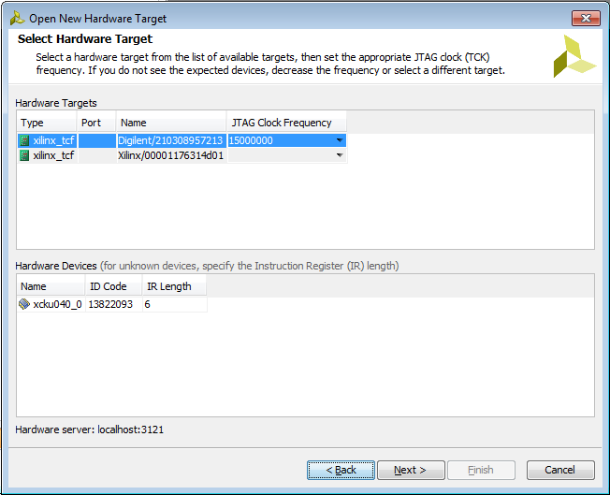
Click Next twice and you should se the following.
Click Next again then Finish.

Slide 9
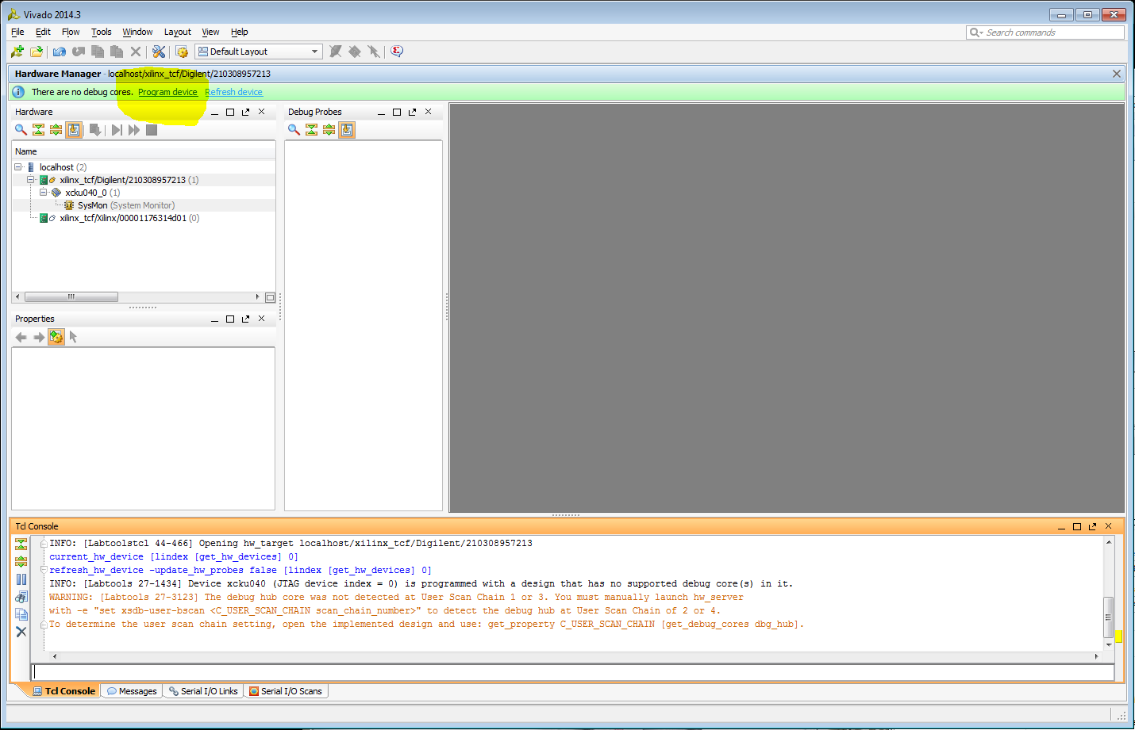
Now select “Program Device” and xku040_0 from the drop down list

Slide 10
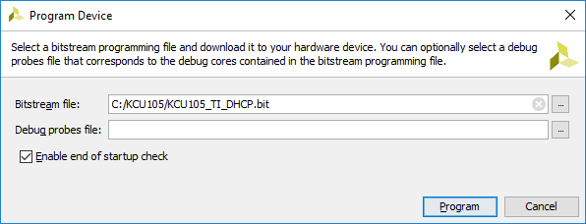
Now select the Bit file and click Program

Slide 11
Set Ethernet IP

Slide 12
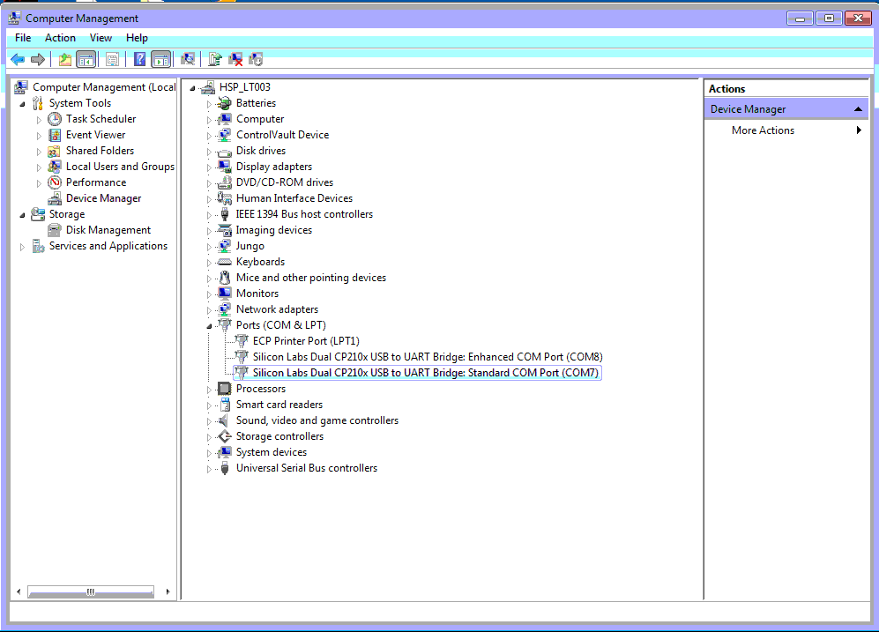
Open Device manager and check for the COM ports.
In this case, we have COM Port 8 (Enhanced) and COM Port 7 (Standard)

Slide 13
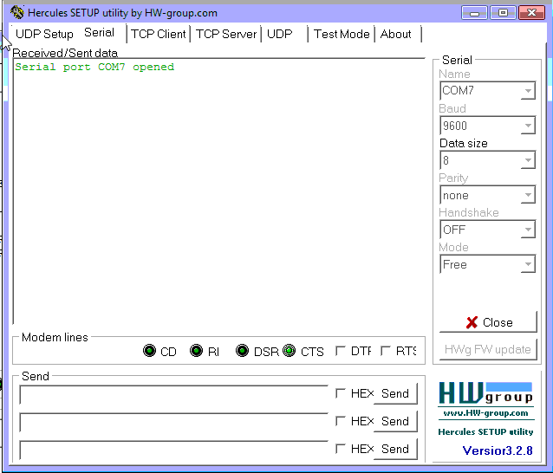
Open both the COM ports using any Utility (like Hercules). For Standard COM Port(in this case COM port 7), make sure of the below settings while opening the port.

Slide 14
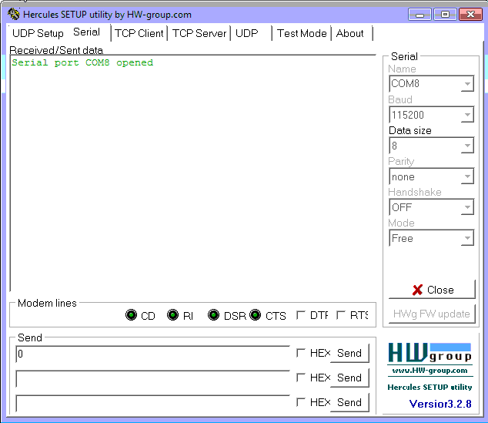
For Enhanced COM Port(in this case COM Port 8), make sure of the below settings while opening the port.

Slide 15
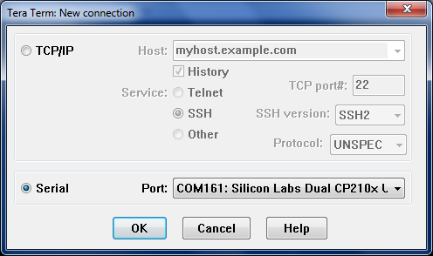
For Enhanced COM Port(in this case COM Port 161), make sure of the below settings while opening the port.

Slide 16
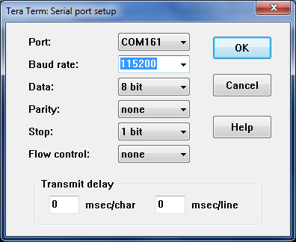
Set Baud rate to 115200

Slide 17
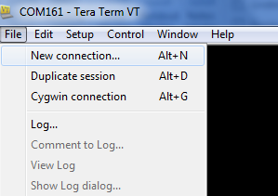
In the Tera Terminal window, select ”File” then “New connection” to open a second terminal.

Slide 18
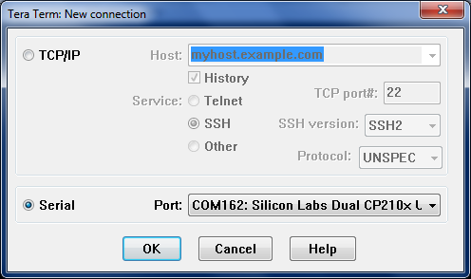
Click on “Serial” then select the “standard” port as shown below. In this example, the COM Port is 162.

Slide 19
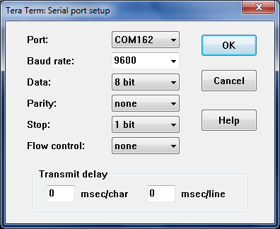
Make sure the port settings are as shown below

Slide 20
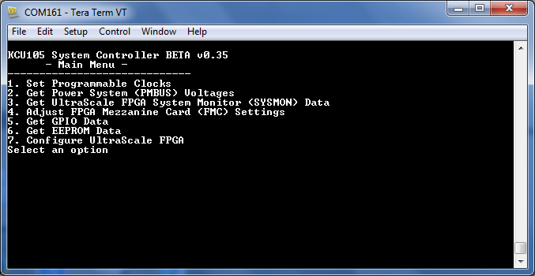
Connect Ethernet cable, power up KCU105

Slide 21
Enhanced COM Port
Once firmware is downloaded, we need to set the FMC voltage to 1.8v in the enhanced port.
To do that, in the Hercules where we have opened the Enhanced COM port, enter 0 to go the Main menu
The main menu items will be displayed. Enter 4 to Adjust FPGA Mezzanini Card (FMC) settings
Again enter 4 to Set FMC VADJ to 1.8V.
To read the voltage value, go back to the main menu by entering 0. Then enter 2 to “Get the Power system Voltages” and enter 7 to “Get the VADJ1D8 voltage”.

Slide 22
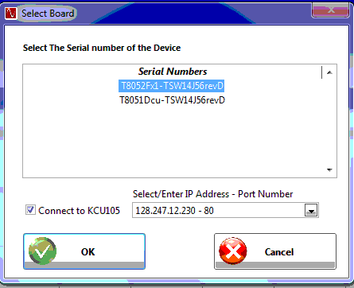
Open HSDC Pro and specify the IP address to connect

Slide 23
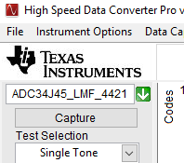
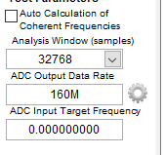
Select the INI from the dropdown and set the ADC Output Data rate to 160M and the Analysis Window samples to 32768

Slide 24
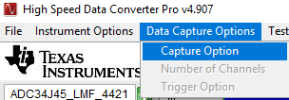
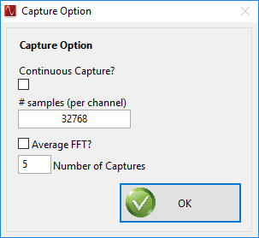
Click on “Data Capture Options” and set the # samples (per channel) to 32768

Slide 25
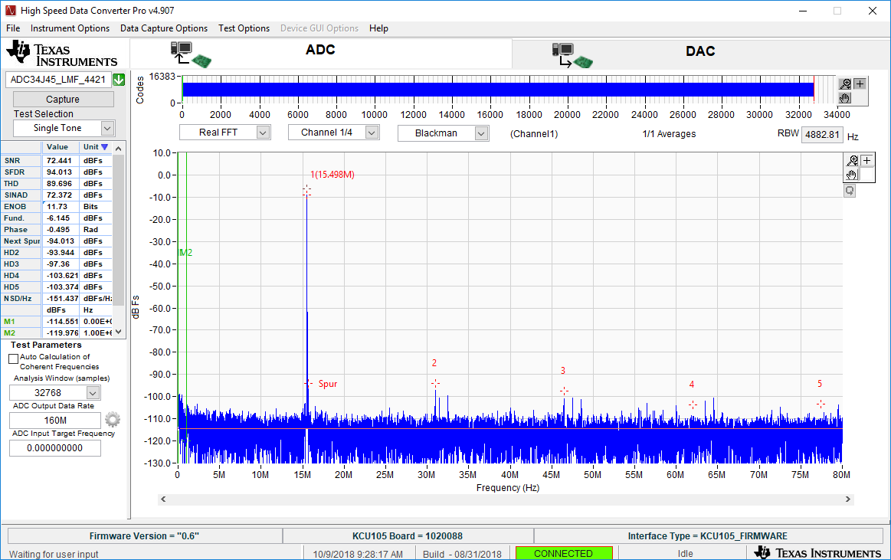
Hit Capture in HSDC Pro. If there is a time out issue, reload the firmware, reconnect HSDC Pro, and try capturing again.

