Slide 1
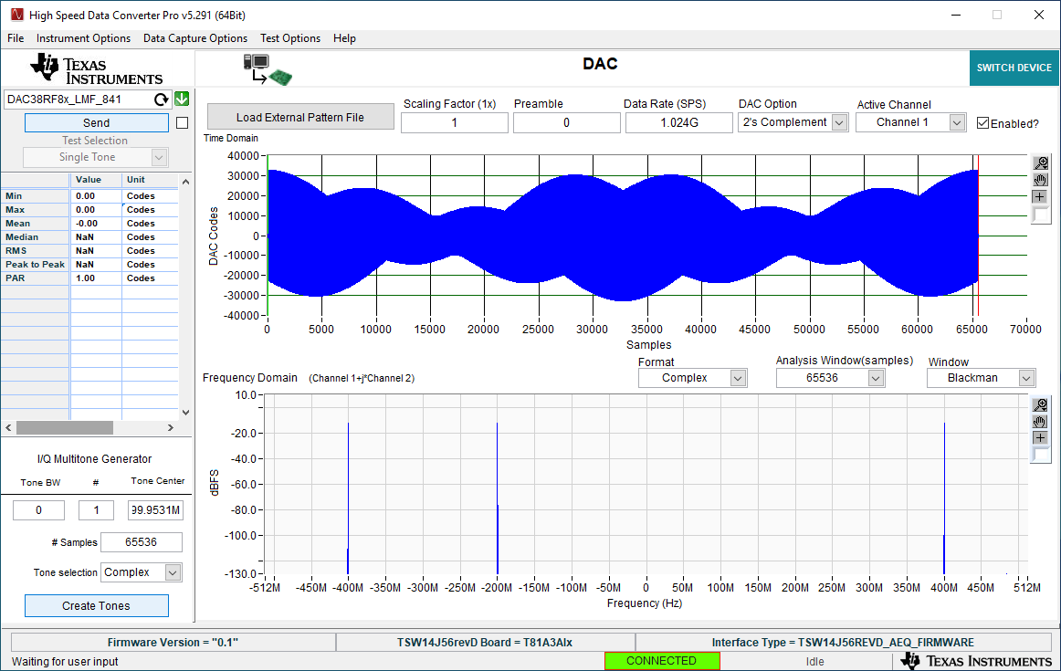
Using file JIMDATA1.csv

Slide 2
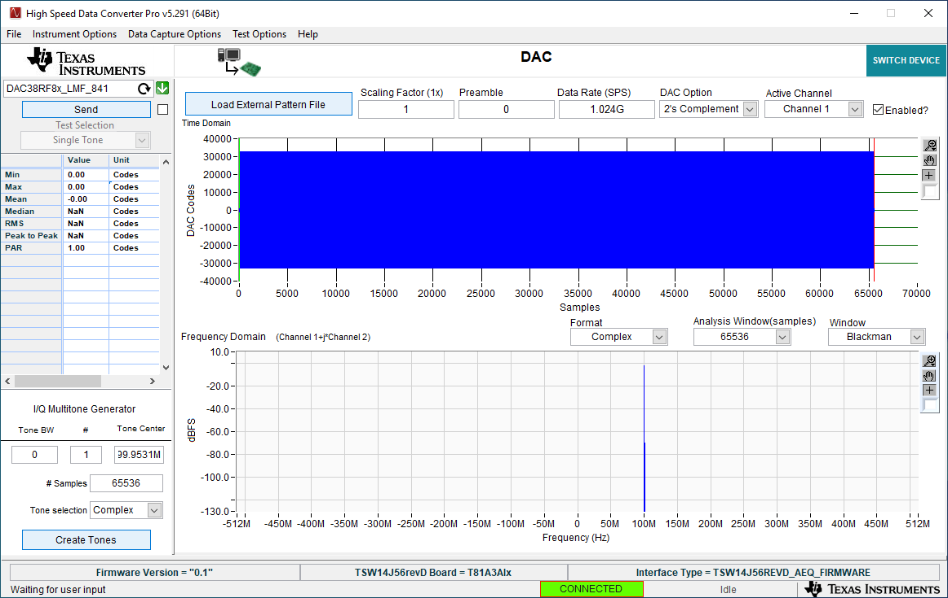
100MHz tone using I/Q Multitone Generator

