Slide 1
DAC38J84 EVM Quick Start Guide

Slide 2
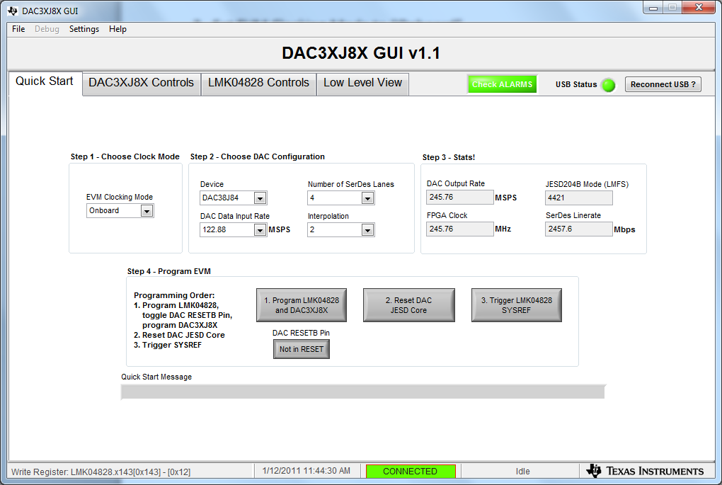
3. Set EVM Clocking Mode to “Onboard”
4. Set DAC Data Input Rate to “122.88”
5. Set Number of SerDes Lanes to “4”
6. Set Interpolation to “2”

Slide 3
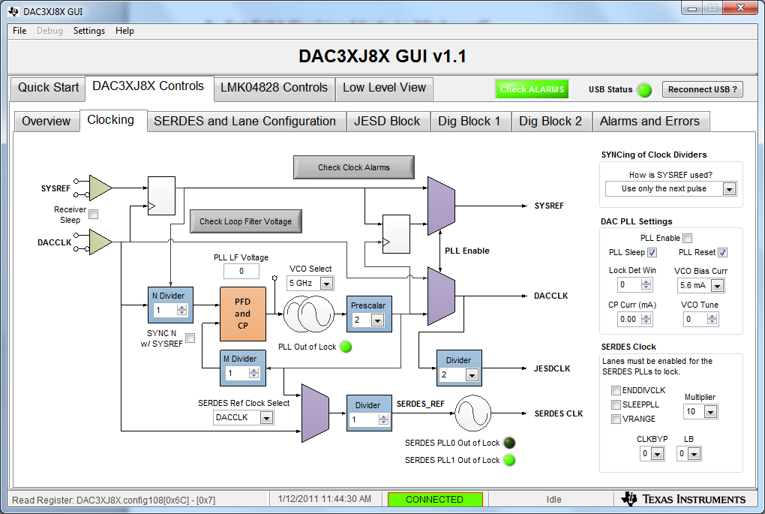
3. Set EVM Clocking as shown below

Slide 4
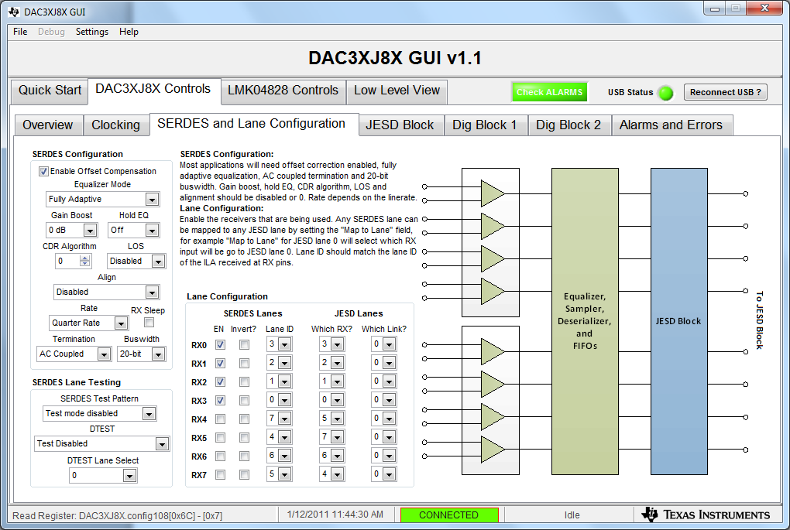
3. Set serdes lane configuration as shown below

Slide 5
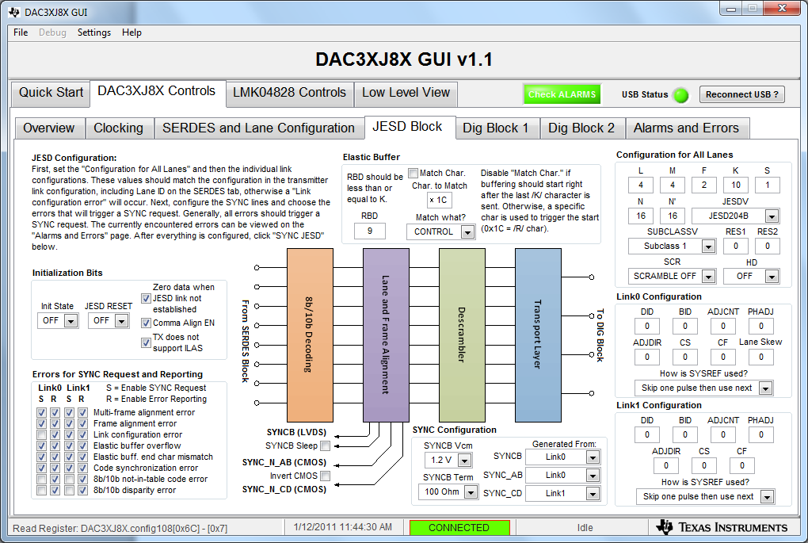
3. Set DAC JESD parameters as shown below

Slide 6
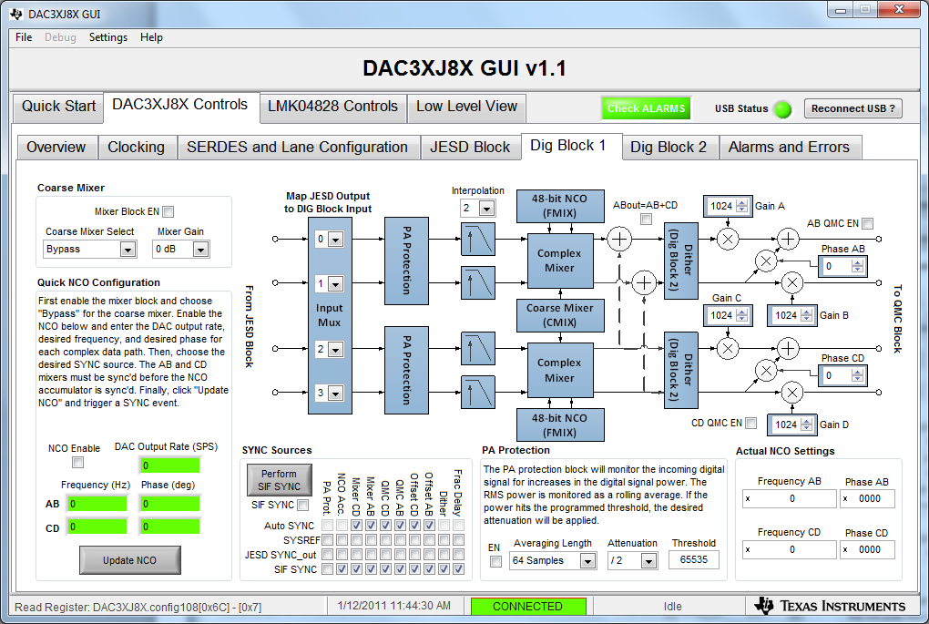
3. Set DIG Block 1 as shown below.

Slide 7
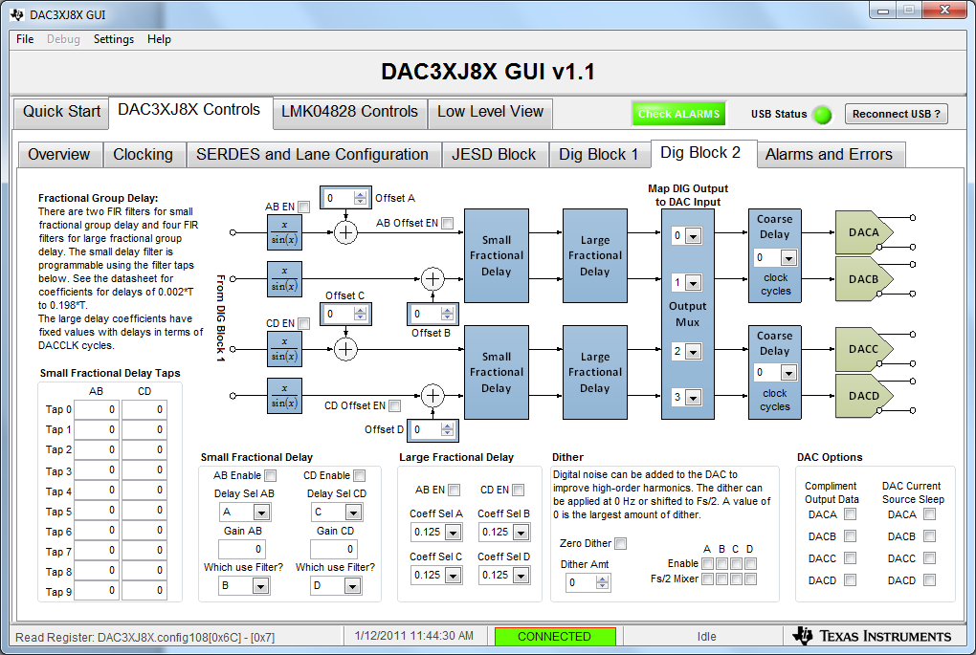
3. Set DIG Block 2 as shown below.

Slide 8
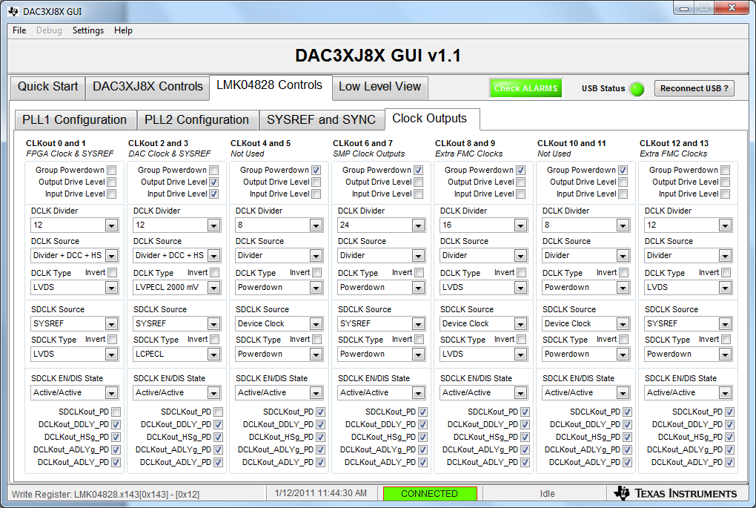
3. Set clk0 to div by 12 for FPGA reference clock = 245.76MHz
4. Set clk12 to div 12 for FPGA core clock = 245.76MHz

Slide 9
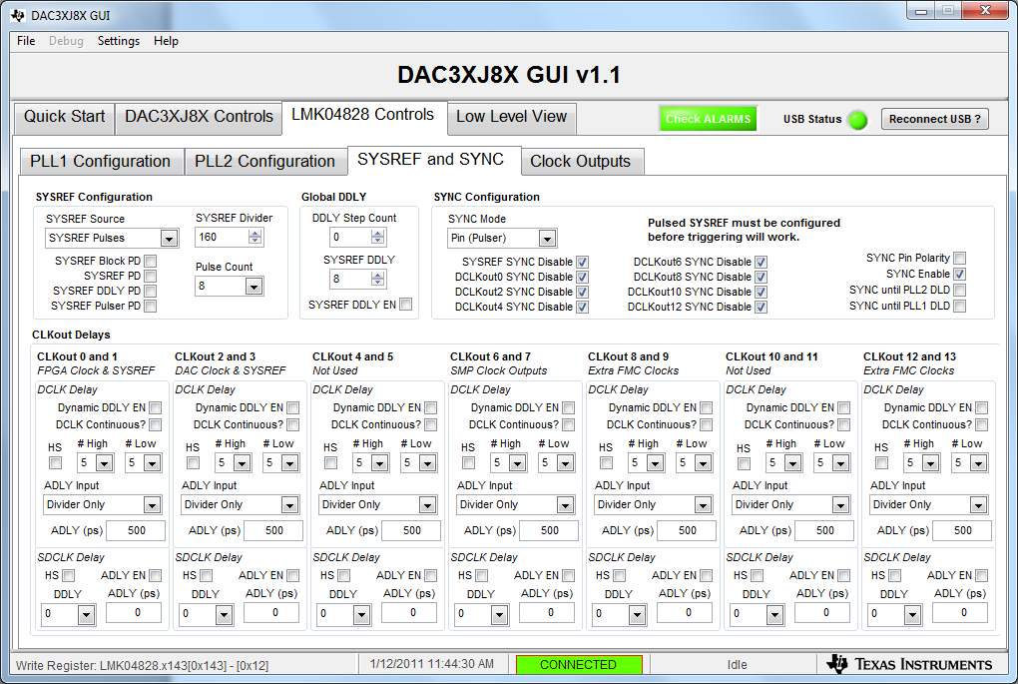
3. Set SYSREF Divider = 160 for 18.432MHz clock

Slide 10
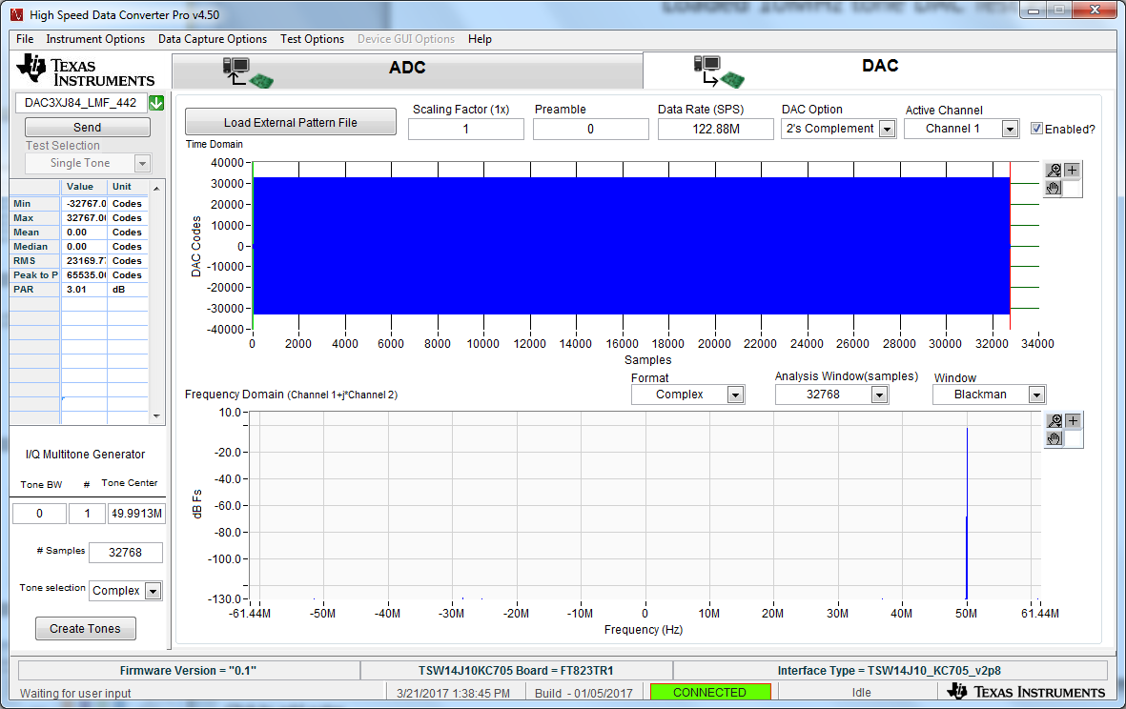
Loaded 50MHz tone DAC Test Pattern
10

Slide 11
The KC705 status LED’s shall look as follows:
D7 – Blinking
D6 – Blinking
D5 – Blinking
D4 – on
D3 – off
D2 – off
D1 – off
D0 – on

Slide 12
Go back to the DAC38J8x GUI
1. Click on button 2 called “Reset DAC JESD Core”
2. Click on button 3 called “Trigger LMK04828 SYSREF”

Slide 13
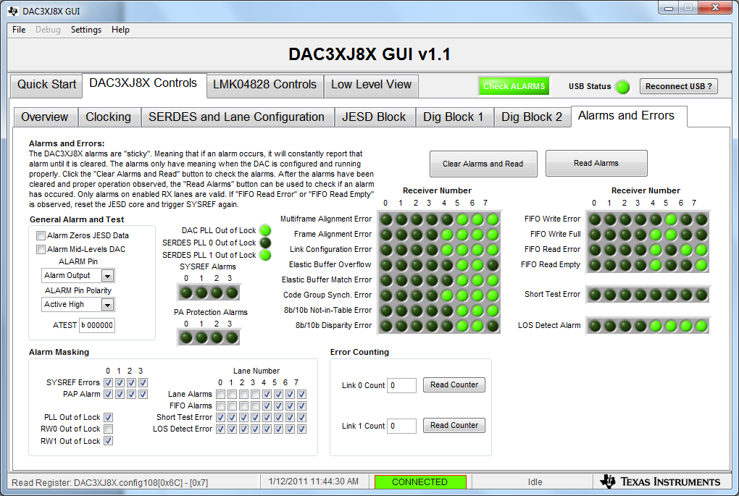
Alarm status

Slide 14
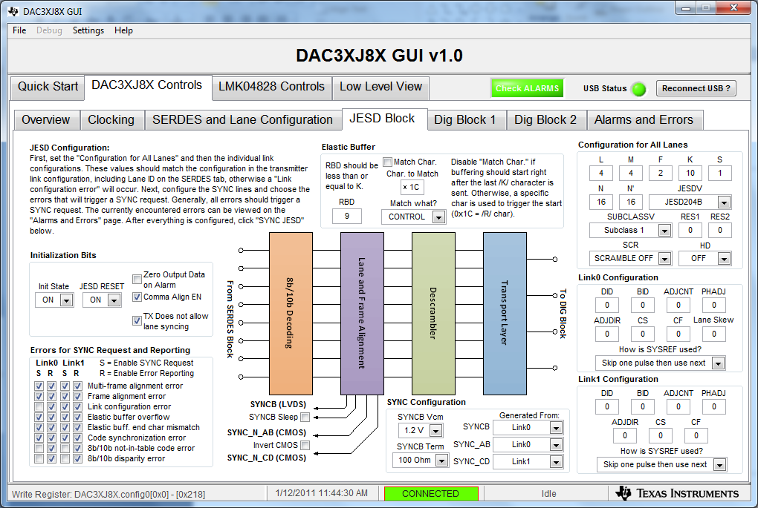
JESD Block

Slide 15
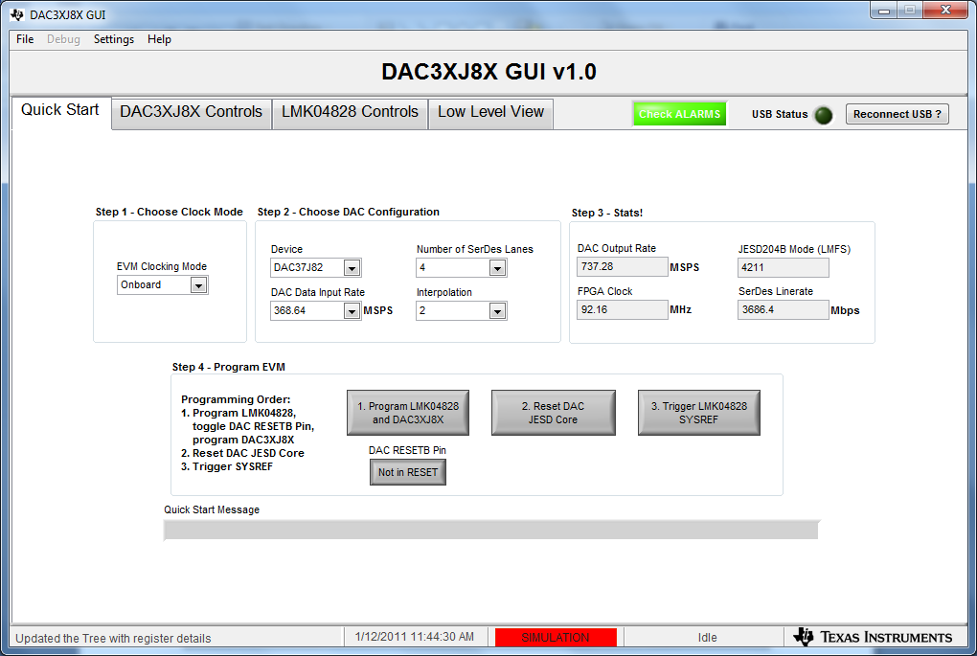
Int x2

Slide 16
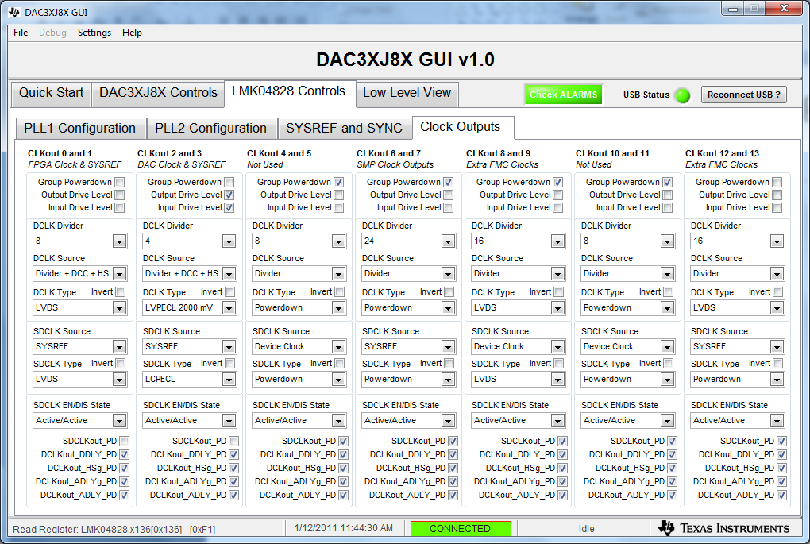
Must reload firmware after making any clk changes.

