Slide 1
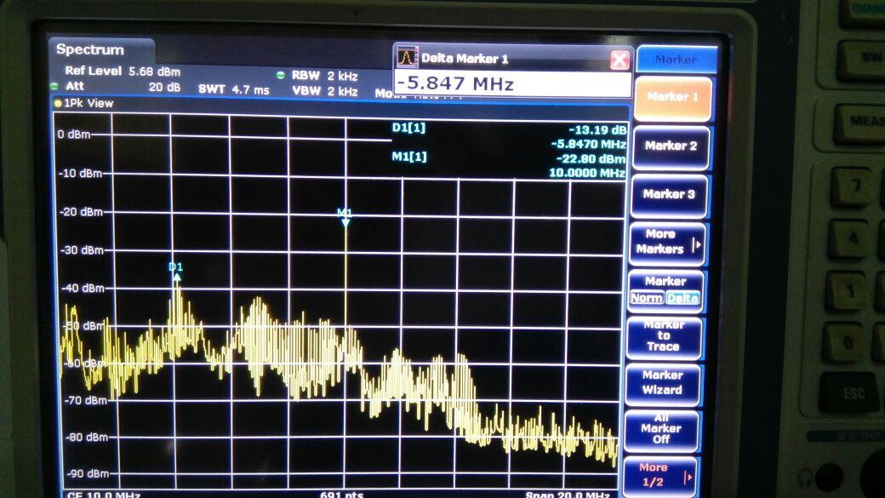
@10MHz span 20MHz 25ohm TRF isolated

Slide 2
25ohm trf isolated span 614MHz

Slide 3
50ohm @10mhz span 20mhz

Slide 4
50ohm 614MHz span @10MHz

