Slide 1
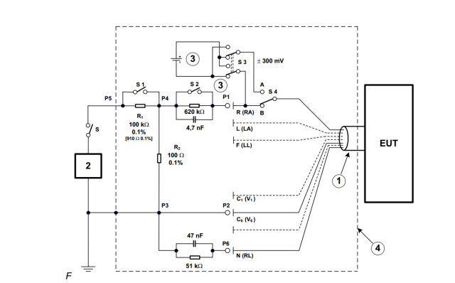
Test Setup – Circuit Diagram

Slide 2
Test Setup – Notes
Input Amplitude: 8 V_{PP}
Input Frequency: 10 Hz, 40 Hz, 100 Hz
Input Source: Audio Precision, Unbalanced GND output
Samples Collected: 4,096
Expected Output: 8 V_{PP} * [102.88 / (102.88 + 100k)] = 8.22 mV_{PP}
Hardware: ADS1298RECGFE-PDK
Electrode Configuration:
RA connected to P1 and IN2N
LA, LL, V1 – V6 shorted to P2 and IN2P
RLD connected to P6

Slide 3
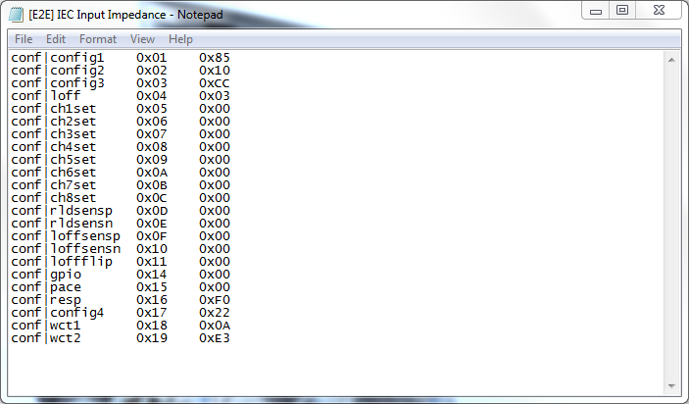
Test Setup – Register Settings

Slide 4
S2 closed, 10 Hz, 8.23 mV_{PP}

Slide 5
S2 closed, 10 Hz, -39.75 dB

Slide 6
S2 closed, 40 Hz, 8.16 mV_{PP}

Slide 7
S2 closed, 40 Hz, -39.83 dB

Slide 8
S2 closed, 100 Hz, 7.83 mV_{PP}

Slide 9
S2 closed, 100 Hz, -40.19 dB

Slide 10
S2 open, 10 Hz, 8.22 mV_{PP}

Slide 11
S2 open, 10 Hz, -39.76 dB

Slide 12
S2 open, 40 Hz, 8.45 mV_{PP}

Slide 13
S2 open, 40 Hz, -39.52 dB

Slide 14
S2 open, 100 Hz, 9.17 mV_{PP}

Slide 15
S2 open, 100 Hz, -38.81 dB

