Slide 1
JESD204B RX Standard ~SYNC Request and Error Notification

Slide 2
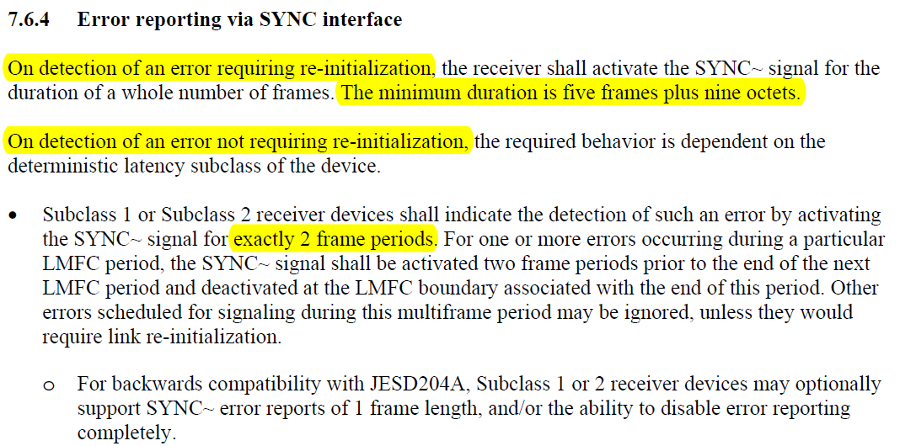
JESD204B RX Standard Section 7
The JESD204B Standard Section 7 highlighted the three main functionality of SYNCB or ~SYNC signal
  Request Synchronization upon initialization
  Synchronization request upon errors requiring re-initialization
  Detection of an error not requiring re-initialization

Slide 3
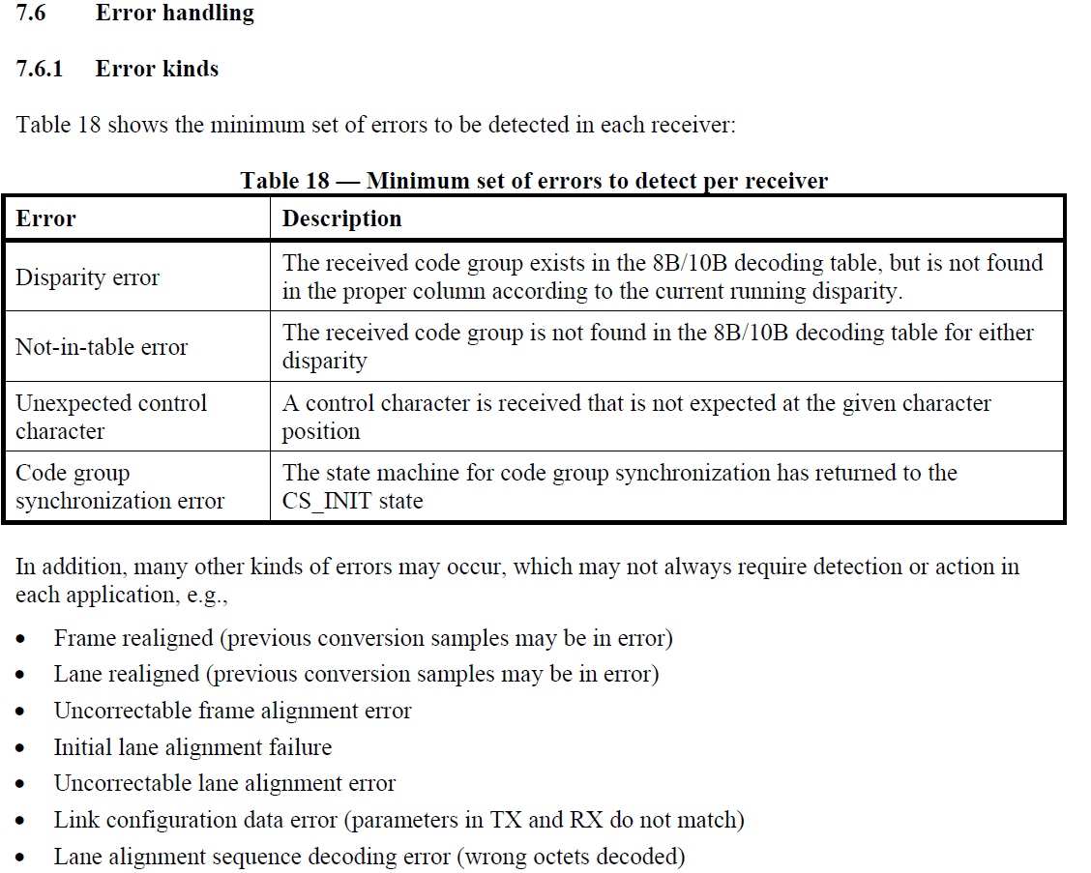
JESD204B Errors
Minimum Required
Optional Error Reporting

Slide 4
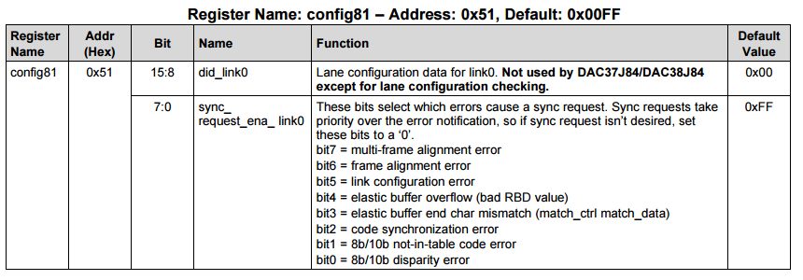
  SYNC REQUEST
  Synchronization request upon errors requiring re-initialization
~SYNC
5 frame + 9 octets
Minimum Required per JESD204B standard. Other selection depends on application requirement. TI recommends customers to evaluate their applications needs. For maximum reliability, select all of settings.

Slide 5
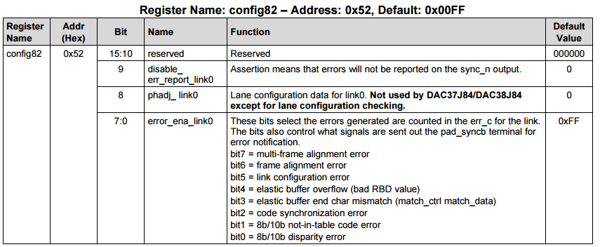
  Error Reporting
  Detection of an error not requiring re-initialization
~SYNC
2 Frames
Selection depends on application requirement. For instance, the selection may be all settings not selected by “SYNC_REQUEST”

Slide 6
JESD204B RX Standard
Error Notification via Other Interfaces

Slide 7
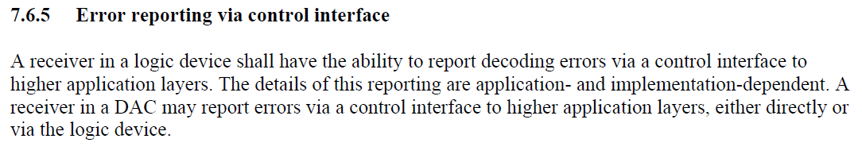
JESD204B Section 7.6.5
Other non-JESD204B interface errors

Slide 8
DAC38J84 Alarm Structure

Slide 9
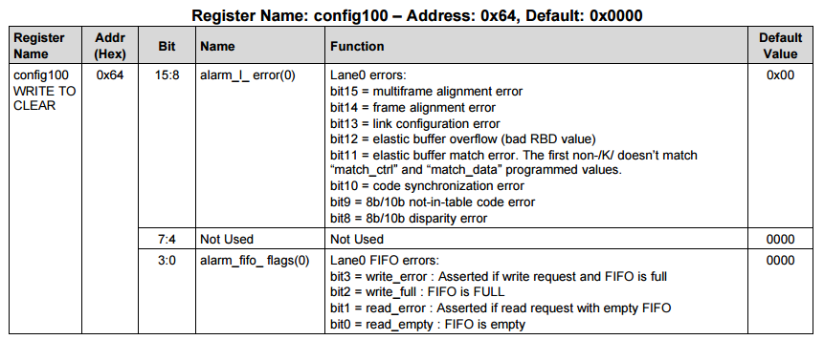
0x64 to 0x6B Lane Alarms
Shared alarm with standard JESD204B Link0 Level. This is the individual lane level.
For reliable JESD204B bring-up, TI recommends a full JESD204B initialization upon detection of these alarms
TI recommends a full JESD204B initialization upon detection of these alarms

Slide 10
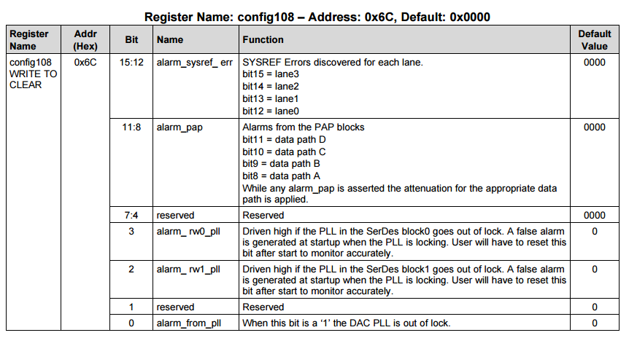
SYSREF Alarms
Please mask bit15-13 since these are link3 to link1 alarms. Not used.
For reliable JESD204B bring-up, TI recommends a full JESD204B initialization upon detection of these alarms
Link3 - not supported
Link2 - not supported
Link1 - typically not used
Link0 - used all the time
Mask in config5
Not used

Slide 11
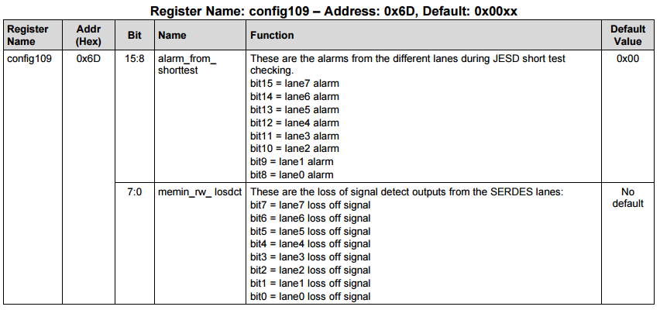
LOS Alarms
JESD short test alarm.
Not used in normal operation
For reliable JESD204B bring-up, TI recommends a full JESD204B initialization upon detection of these alarms

