Slide 1
DAC39J84 Test

Slide 2
DAC39J84 Test
Test Setup:
2560MHz external clock to J17
Test conditions:
Fdac = 2560Msps Clk
NCO = 300MHz

Slide 3
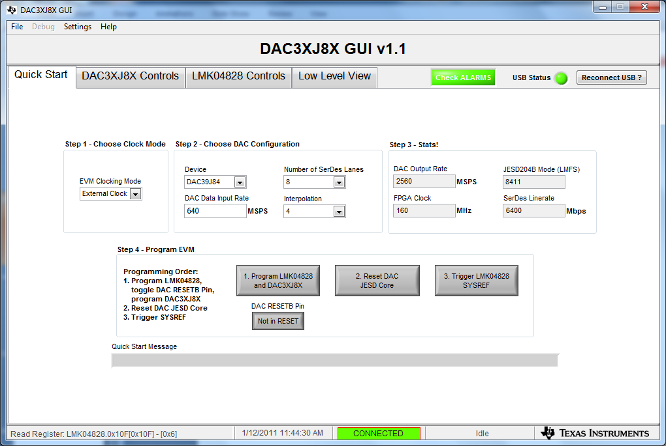
DAC39J84EVM GUI.

Slide 4
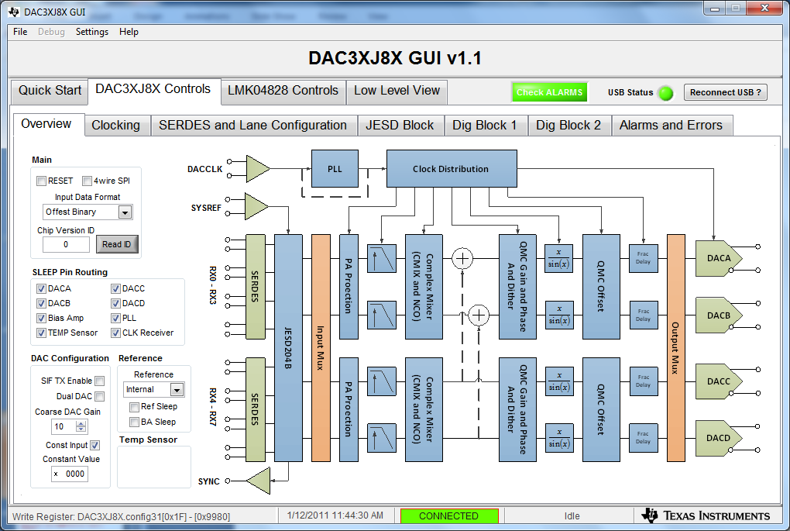
Click on “Overview “ tab
1. Select the “Const Input” box.
2. Set the ”Constant Value” to 0000.
3. Set “Input Data Format” to “Offset Binary.

Slide 5
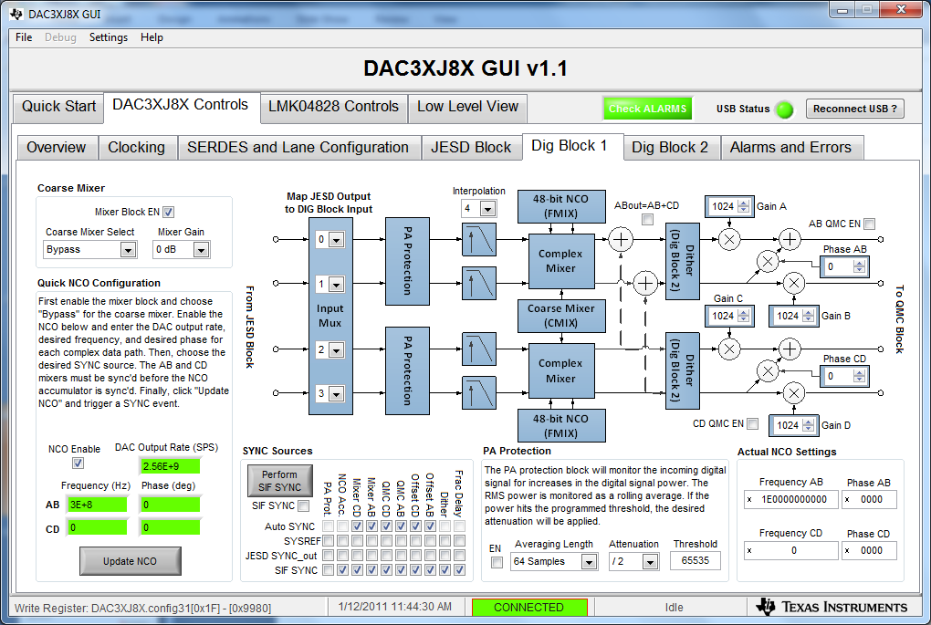
Select DAC3xJ8X Controls, then “Dig Block 1” tab.
1. Enable “Mixer Block En” and “NCO Enable”.
2. Enter 2560MHz for DAC Output Rate.
3. Enter 300MHz for AB Frequency.
4. Click on “Update NCO” and “Perform SIF SYNC”.

Slide 6
DAC output is now a 300MHz tone.

Slide 7
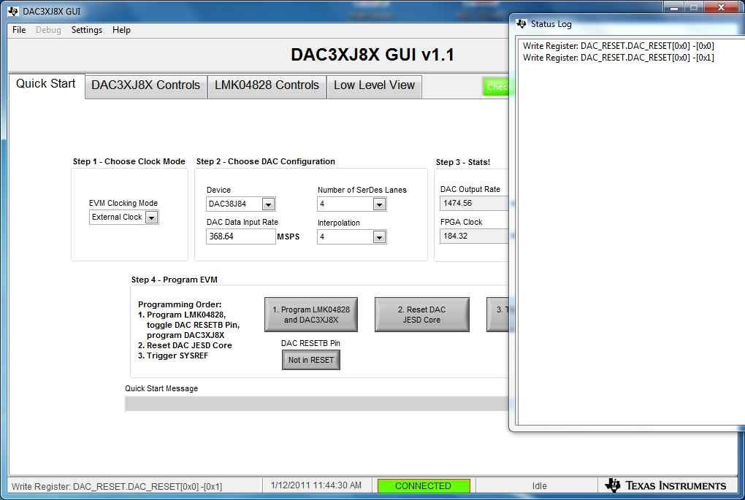
Writes done by clicking on “Not in Reset” twice.

Slide 8
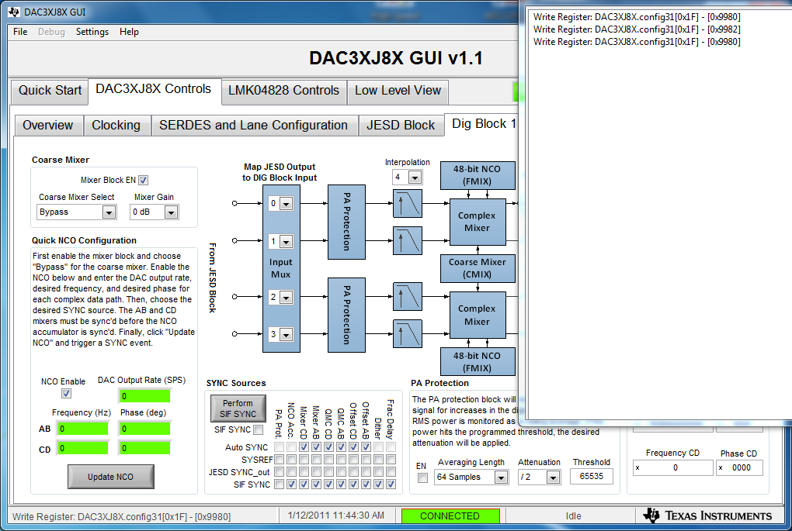
Writes done by clicking on “Perform SIF SYNC”.

