Slide 1
ADS42JB69 Driving Sysref, Sync from LVDS driver

Slide 2
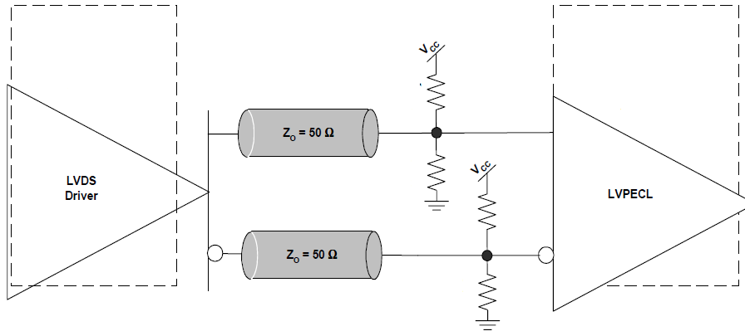
Driving sync and sysref with LVDS driver
R1 = 183Ω
R2 = 68Ω
R1 = 183Ω
R2 = 68Ω
Method chosen : DC coupling

Slide 3
Specs and Calculations
LVDS, Vcm = 1.2V
LVPECL, Vcm = 0.9V ( for ADS42JB69)
Vcc = 3.3V
To set Vcm to 0.9V,
3.3*R2/(R1+R2) = 0.9 - (1)
For 50Ω termination
R1*R2/(R1+R2) = 50 - (2)
Solving equation (1) & (2), yields
R1 = 183.3Ω & R2 = 68.75Ω

