Slide 1
ADS54J66 Test

Slide 2
ADS54J66
Test Setup:
Ramp test mode
Test conditions:
Fs = Int Clk (491.52MHz)
Mode 8
LMFS = 4421
LMK = LMK_Config_LMF_4841_491p52_MSPS.cfg
ADS54J66_LMF_4421

Slide 3
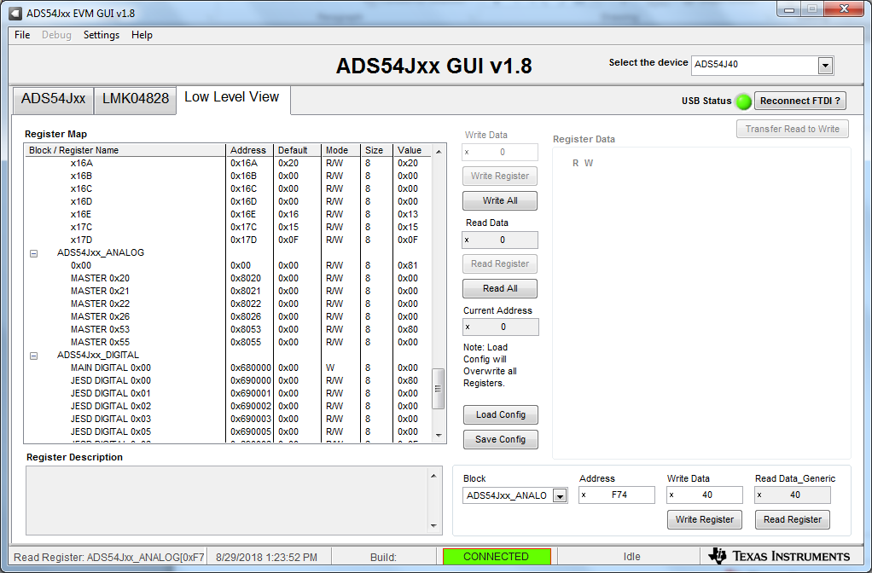

Write 0x40 to page 0x0F address 0x74 to enable ramp

Slide 4
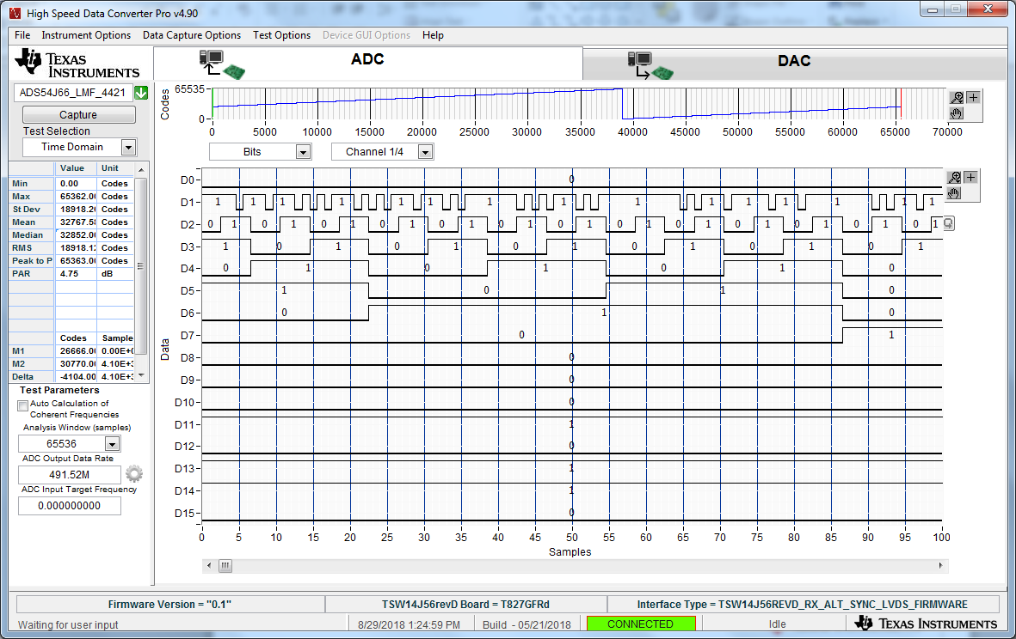
Ramp pattern

Slide 5
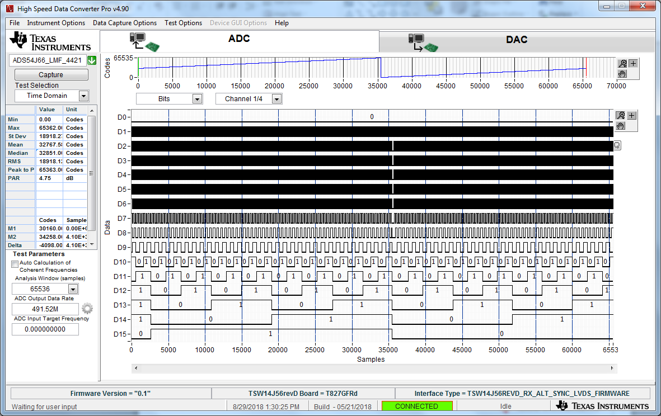
Ramp pattern

Slide 6
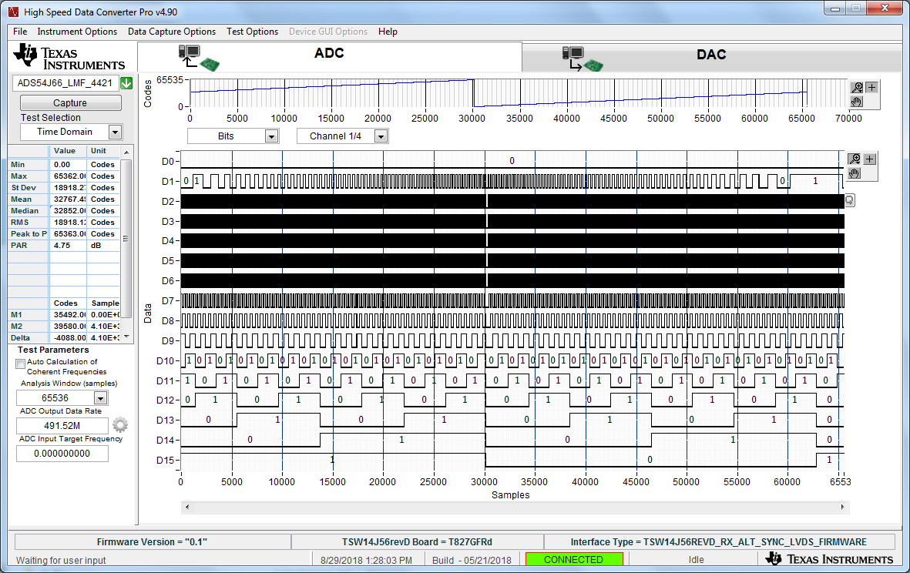
Interleave engine disabled (page 0x6100, address 0x18 data 0x03)

Slide 7
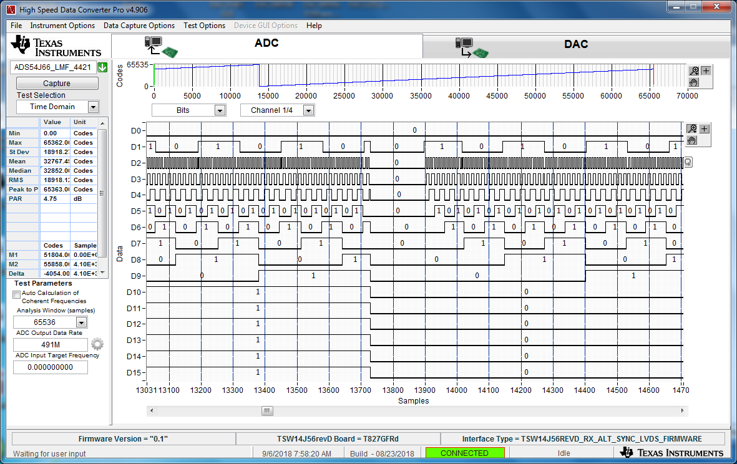
Interleave engine disabled (page 0x6100, address 0x18 data 0x03)

