Slide 1
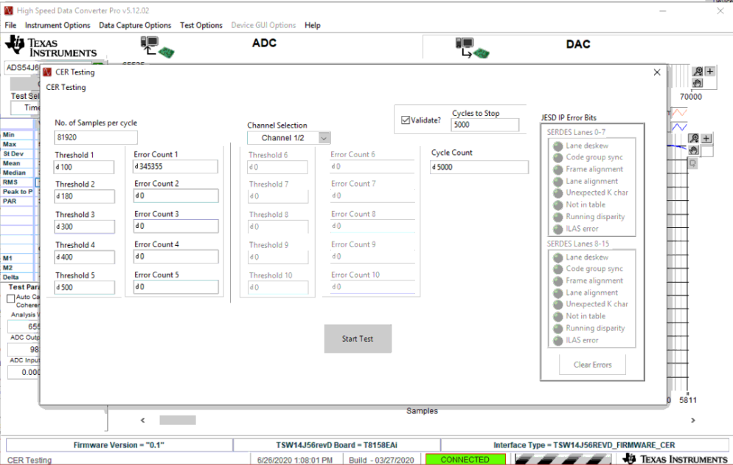
Sine Wave testing ( Fin = 276 Khz , INI = ADS54J60_LMF_4211_CER _offset_binary,
(Keep the device in Offset binary mode)

Slide 2
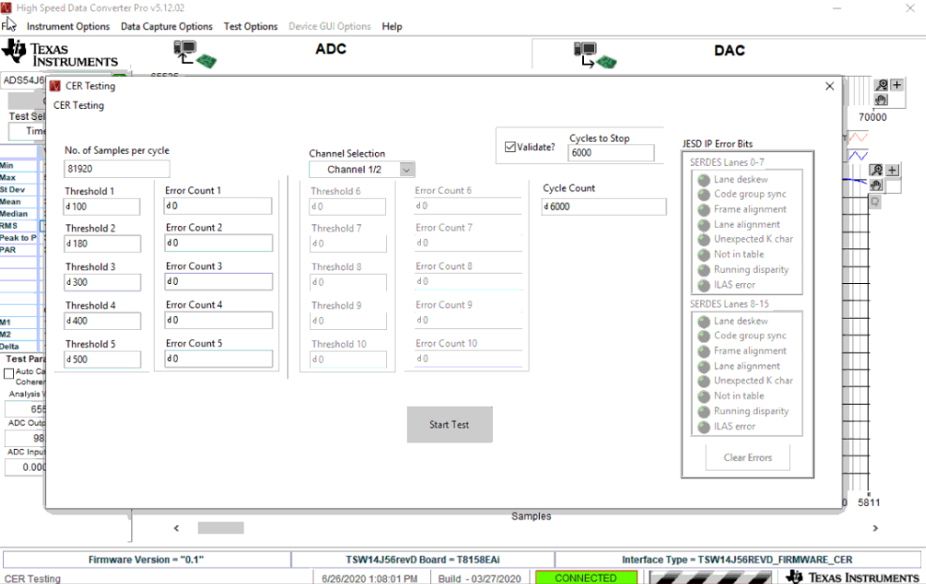
Transport Layer testing
Number of samples can be any multiple of 32 (since the test pattern repeats itself for every 32 samples), Here 81920 is a multiple of 32

Slide 3
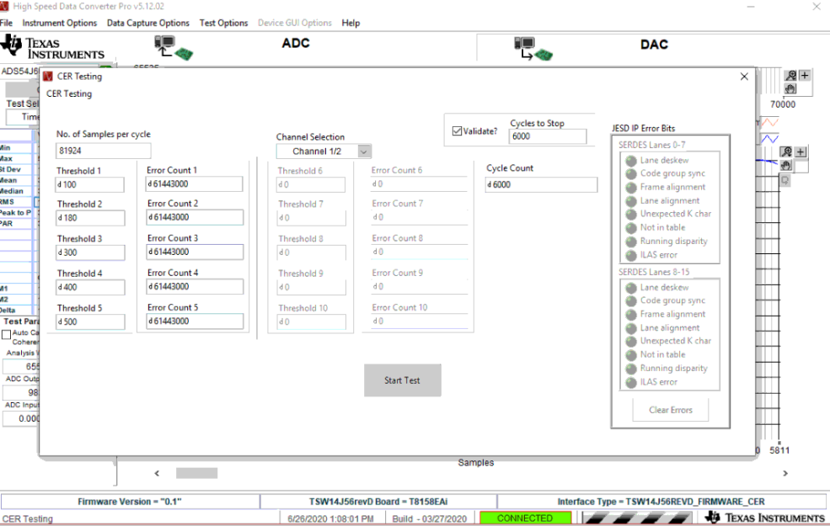
Transport Layer test - 2
Now try with non-multiple of 32 for same Test pattern mode. You will get errors.
Example, Here 81924 is not a multiple of 32

