Slide 1
JESD204B Overview
e2e.ti.com (TI Support Forum)
April 2016

Slide 2
Abstract
The introduction of the JESD204B interface for use between data converters and logic devices has provided many advantages over previous generation LVDS and CMOS interfaces – including simplified layouts, skew management, and deterministic latency. However understanding this interface and applying it to a signal chain design may seem like a daunting task. This presentation will give an overview of the important aspects of this interface and how it is used in real world applications.

Slide 3
Content
- JESD204B History, Pros and Cons
- Timing Signals/Terminology
- Layers
- Deterministic Latency
- Subclass 0, 1, 2
- Configuration Parameters
- Additional Information
- Summary
Notes:
0.5

Slide 4
What is JESD204B?
A standardized serial interface between data converters (ADCs and DACs) and logic devices (FPGAs or ASICs)
  Serial data rates up to 12.5 Gbps
  Mechanism to achieve deterministic latency across the serial link
  Uses 8b/10b encoding for SerDes synchronization, clock recovery and DC balance
The greatest benefit of JESD204B is the drastic simplification of PCB layout due to reduced I/O count and reduced overall board area (from traces and device package size)
JESD204B is a must for high density systems!
Notes:
The JESD204B standard provides a method to interface one or more data converters to logic device, such as a FPGA or ASIC over a high speed serial interface in place of a parallel interface which requires many more traces.
This updated interface now has the capability to run up to 12.5Gbps per serial pairs, usually called lanes. The lanes from a converter that are connected to the logic device is called a link. Each lane has its own embedded clock and with the use of special characters created by the 8b/10b encoding, provides a robust, framed serial data interface.
Reduces number of data I/O traces Allows for smaller data converters, which minimizes board area required Uses lane buffering to lessen the lane matching requirement
Allows for a faster interface, as LVDS is limited to about 1.6Gbps Most new high speed converters are going to this standard.

Slide 5
JEDEC Solid State Technology Association
created
JEDEC Standard JESD204
Serial Interface for Data Converters
The JESD204B standard can be downloaded from the JEDEC website
You will need to register an account to get access to the standard (this is free)
http://www.jedec.org/standards-documents/results/jesd204
The document contains a list of acronyms/keywords at the beginning with definitions for each.
TI Information – NDA Required
Notes:
This is a 147 page document
Many figures, tables , ect in this document are from this document.

Slide 6
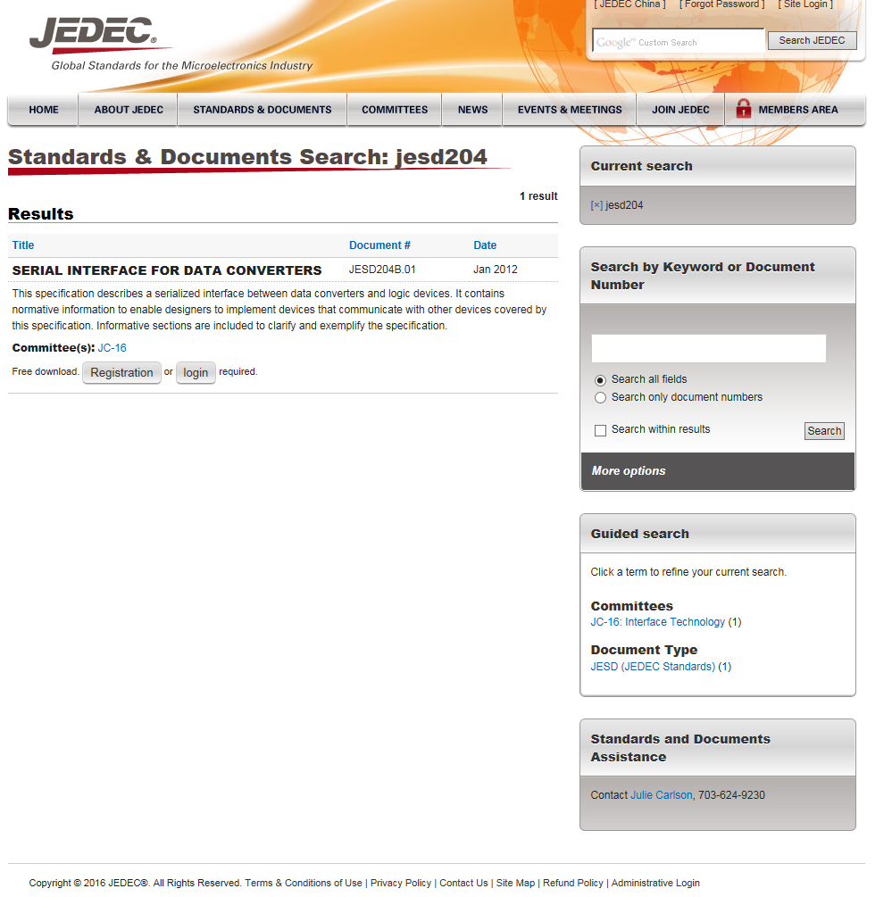
TI Information – NDA Required
Notes:
1

Slide 7
History of JESD204B Specification
JESD204 was first introduced in 2006 as the next-generation digital interface for high-speed data converters to replace LVDS
Revision A (2008) added support for multiple lanes and revision B (2012) added support for deterministic latency and faster speeds
Revision C in work (up to 32 high speed Serdes, 28Gbps interface)
 | JESD204 | JESD204A | JESD204B
Introduced | 2006 | 2008 | 2011
Max Rate | 3.125 Gbps | 3.125 Gbps | 12.5 Gbps
Multiple Lanes? | No | Yes | Yes
Multi-Lane Synchronization | No | Yes | Yes
Multi-Device Synchronization | No | Yes | Yes
Deterministic Latency | No | No | Yes
Harmonic Clocking | No | No | Yes
Source: An early look at the JEDEC JESD204B third-generation high-speed serial interface for data converters
(published 8/11/2011) by Maury Wood of NXP Semiconductors, JEDEC JESD204B TG Chairman

Slide 8
JESD204B Advantages
The high data rates of the SerDes lanes greatly increases data throughput which reduces the total number of lanes required
  Reduces data lanes and required number of pins
    Example: 125 MSPS, quad, 16-bit ADC:
  Reduces overall device package size
    DAC34SH84: 196 ball BGA (12mm x 12mm)
    DAC38J84: 144 ball BGA (10mm x 10mm)
  Can reduce required FPGA package size too!
Interface | CMOS | DDR LVDS | SLVDS | JESD204B including SYNC
# Clock Pins | 4 | 4 | 4 | 0
# Data Pins | 64 | 64 | 16 | 8 @ 2500 Mbps
Total Pins | 68 | 68 | 20 | 8
And 67% faster!
Source: Why JESD204B may solve a lot of your system design headaches
(published 11/19/2012) by Thomas Neu of TI
Notes:
Example compares Quad 16 bit ADC

Slide 9
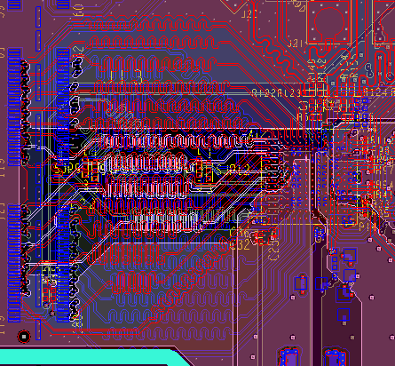
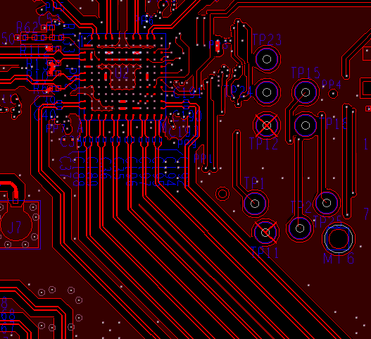
JESD204B Advantages
DAC34SH84 (LVDS)
Simplifies PCB routing
  Does not require data trace length matching
    Eliminates need for “squiggles” to match lengths
    Requires less total routing area
  Lanes can be swapped in the FPGA (or possibly in the device) to avoid having to crisscross traces to improve signal integrity and simplify routing
32 lanes
750 MSPS
DAC
DAC38J84 (JESD204B)
DAC
8 lanes
1.25 GSPS

Slide 10
JESD204B Disadvantages
FPGA coding is much more complex than previous interfaces
May require buying JESD204B IP from FPGA vendor
Latency across the SerDes link may be greater than could be achieved with LVDS or CMOS
High SerDes rates require more careful routing and may require more expensive PCB materials
Troubleshooting the interface is more complicated than LVDS or CMOS

Slide 11
JESD204 Timing Signals/Terminology
TI Information – NDA Required
Notes:
1

Slide 12
JESD204 Timing Signals/Terminology
Device Clock
System clock from which the device’s frame, sampling, LMFC clocks are derived (externally applied)
SYSREF (subclass 1 only)
Timing phase reference from which LMFC clocks are generated in subclass 1 implementations (externally applied)
  Source synchronous with device clock
  Rising edge event sampled by device clock determines LMFC alignment
  Periodic, Gapped-periodic, One-shot types
  Required for Deterministic Latency
  SYSREF = LMFC/n (n is a positive integer)
TI Information – NDA Required
Notes:
1

Slide 13
JESD204 Timing Signals/Terminology (cont.)
SYNC
Receiver to Transmitter. Used for device synchronization.
  Synchronization requests
  Subclass 2 implementations use SYNC as a phase reference for LMFC
  Options for distributing SYNC to multiple devices
  Standard defines SYNC~ (active low) signaling
TI Information – NDA Required
Notes:
0.5

Slide 14
JESD204 Timing Signals/Terminology (cont.)
  Frame Clock
    The frame coming out of the transport layer is aligned to the frame clock (device internal for subclass 1 & 2).
    As per JESD204B standard, frame clock period in all the TX and RX devices
    must be identical.
Sample Clock
Clock used to sample data (device internal)
  f_{S} = f_{FRAME} * S ( S = # samples per Frame)
  Local Multi-frame Clock (LMFC) f_{LMFC} = f_{FRAME} / K
    LMFC is aligned to a multi-frame boundary which in turn consists of K number of frames.
    In order to synchronize transmission on all lanes (single or multipoint link), LMFC of
    all the converter devices are aligned with the LMFC of logic device (FPGA).
    All TX and RX devices in a system must have identical LMFC period (device internal).
TI Information – NDA Required
Notes:
0.5

Slide 15
JESD204 Timing Signals/Terminology
CGS: Code Group Synchronization
  Process by which the octets are aligned via during transmission of /K/ symbols.
  Minimum duration for a sync request is 5 frames plus nine octets.
ILAS: Initial Lane Alignment Sequence
  Process by which the frames and multi-frames are aligned.
RBD: RX Buffer Delay
  Elastic Buffer release time is “RBD” frames after LMFC boundary.
  RBD = K is max, but lots of latency. RBD should be minimized for low latency link.
TI Information – NDA Required

Slide 16
JESD204 Timing Signals/Terminology
Important parameters associated with transport layer include
  L # of lanes per converter device
  M # of converters per device
  F # of octets per frame (per lane)
  S # of samples per converter per frame clock cycle
  K # of frames per multiframe
  CS # of control bits per conversion sample
Control bits can either be appended after the LSB of every sample or all the bits for different samples can be sent bundled together
TI Information – NDA Required

Slide 17
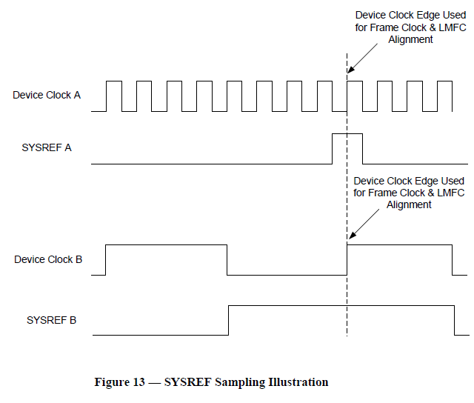
Anatomy of JESD204B System
Lanes of
Multi-
Point
data link
ADC(TX)
FPGA(RX)
ADC
Transport Layer
Data Layer
Data Layer
Transport Layer
Apps
Layer
Frame Clock
LMFC
SYNC~
LMFC
Frame Clock
÷
÷
÷
÷
SYSREF A
SYSREF B
Jitter Cleaner
Device clock A
Device clock B
The only thing that matters for JESD204B subclass 1 is SYSREF to Device Clock timing for the same device. Not SYSREF to SYSREF.
Device clock to device clock timing is application dependent.
Device Clock A
SYSREF A
Device Clock B
SYSREF B
Notes:
17
Anatomy of JESD204B System - Understand the building blocks in physical space.
- Logic Device (FPGA)
- Converters (ADC/DAC)
- Data traces (Color Code = Pink)
- Clocking Device
- Device Clock / Sample Clock (Color Code = Blue)
- SYSREF (Color Code = Green)
- Other SYSTEM stuff.
- SYNC~
- Frame Clock
- LMFC

Slide 18
JESD204 Layers
TI Information – NDA Required
Notes:
0.5

Slide 19
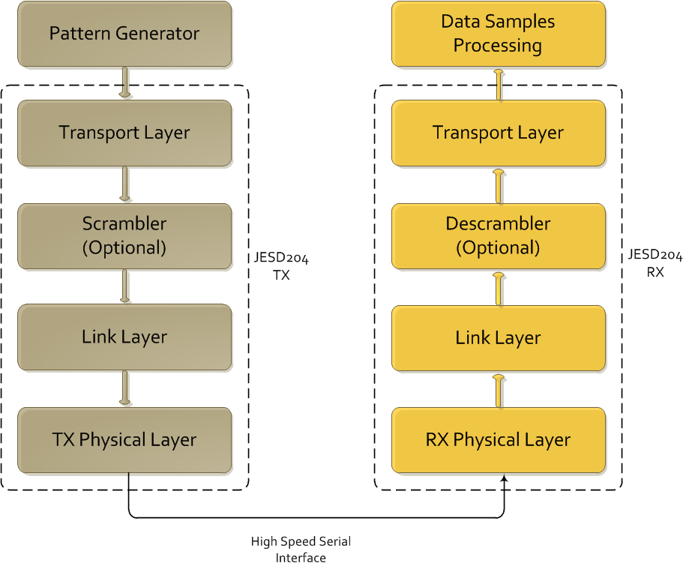
JESD204 Layers
TI Information – NDA Required
Notes:
0.5

Slide 20

Example Functional Diagram for data transmission and reception between two devices on the link
TX device (ADC or FPGA)
Parallel–to
-serial
mapping
8B/10B encoding and character insertion for lane alignment
Clock
Source
Device Clock
SYSREF Clock
SYSREF Clock
SYNC~
Device Clock
8B/10B decoding and character detection for lane alignment
serial–to
-parallel
mapping
RX device (DAC or FPGA)

Slide 21
Transport Layer Overview
Maps the data → octets → frames consisting of multiple octets
Adds optional control bits to samples if needed
  Control bits can be used to communicate status information, mark an inactive converter on the link or control receiver operation
Distinguishes the possible combinations of device/links/lanes/etc.
  Single converter connected to single lane link
  Single converter connected to multiple lanes link
  Multiple converters in a converter device connected to a single lane link
  Multiple converters in a converter device connected to multiple lanes link
TI Information – NDA Required
Notes:
1

Slide 22
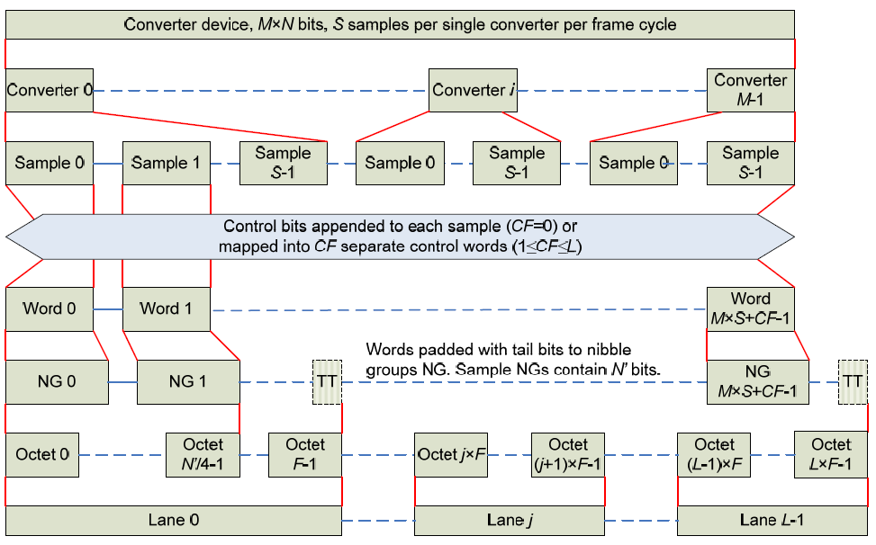
Transport Layer Overview
TI Information – NDA Required
Notes:
1

Slide 23
Transport Layer Parameters
Important parameters associated with transport layer include
  L # of lanes per converter device
  M # of converters per device
  F # of octets per frame (per lane)
  S # of samples per converter per frame clock cycle
  CS # of control bits per conversion sample
TI Information – NDA Required
Notes:
1

Slide 24
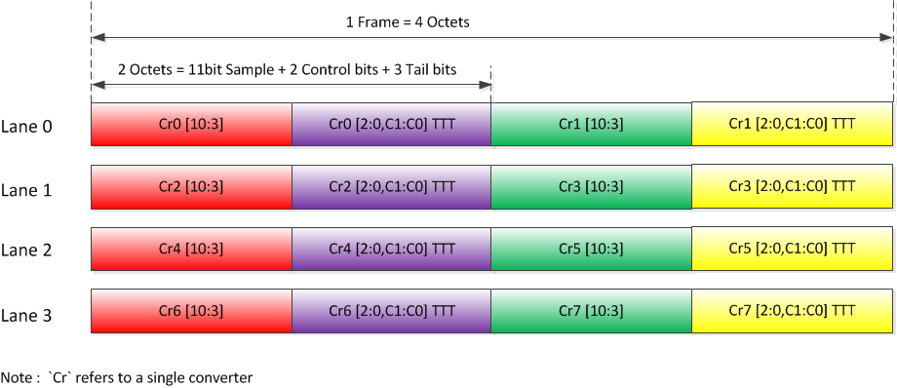
Transport Layer Example
Example: 11-bit octal ADC converter
L = 4, M = 8, F = 4, S = 1, CS = 2
TI Information – NDA Required
Notes:
2

Slide 25
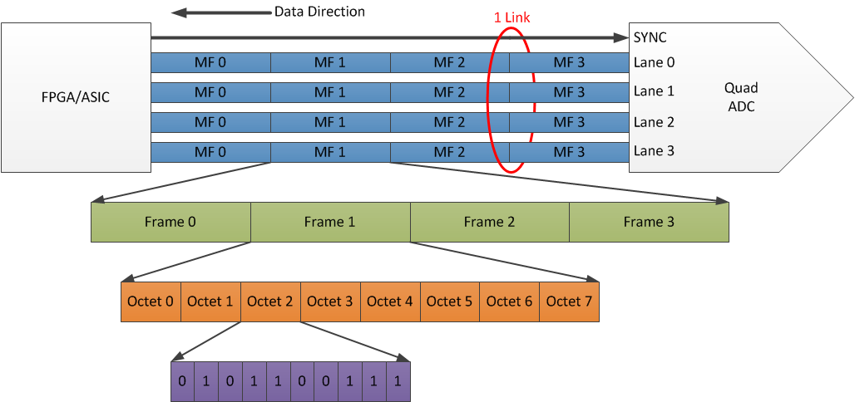
Breaking Down the Terms (16b Quad ADC)
Highest Level
What is the “LMFK” for this link?
L = 4, M = 4, F = 8, K = 4
Lowest Level
What is “S”?
S = 4

Slide 26
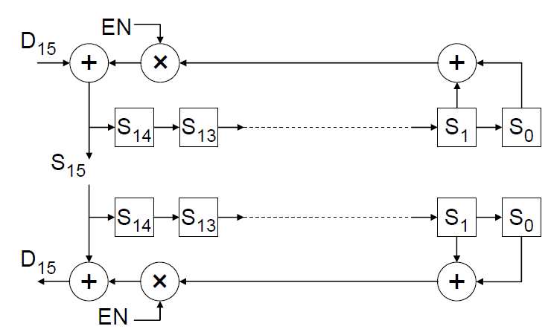
Scrambling
Scrambling randomizes data and spreads the spectral content to reduce spectral peaks that could cause EMI and interference problems
Transport layer output may be optionally scrambled with the polynomial: 1 + x¹⁴ + x¹⁵
Does not add latency, done concurrently with other stages of processing
TI Information – NDA Required
Notes:
1

Slide 27
Data Link Layer
8b/10b encoding
Link Establishment
  Code Group Synchronization (CGS)
  Initial Lane Alignment (ILA) and Frame Synchronization
Link Monitoring using control symbols
TI Information – NDA Required
Notes:
0.5

Slide 28
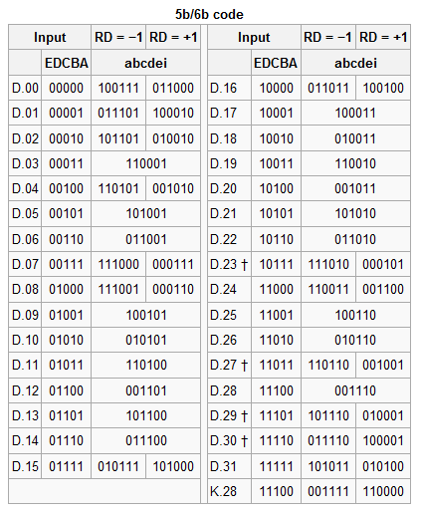
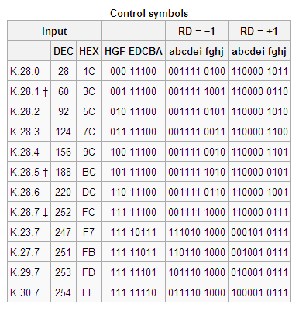
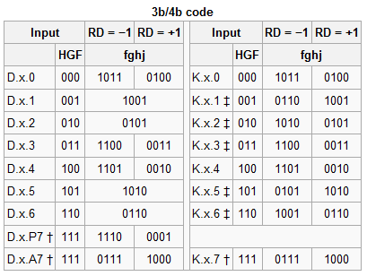
Data Link Layer: 8b/10b Encoding
Encodes 8-bit “octets” into 10-bit symbols
Octet to symbol mapping depends on running disparity (RD)
Coding provides many bit-transitions to enable Clock Data Recovery (CDR) techniques
DC balancing enables AC coupling
TI Information – NDA Required
Notes:
1

Slide 29
Data Link Layer: Link Establishment
Link Establishment accomplishes TX and RX synchronization
  Code Group Synchronization (CGS)
  Initial Lane Alignment and Frame Synchronization
  Data Transmission
TI Information – NDA Required
Notes:
2

Slide 30
Data Link Layer: Code Group Synchronization
During CGS, the RX aligns with the 10-bit symbol boundary of the transmitted symbols
Synchronization Procedure:
  Receiver generates synchronization request by asserting SYNC~ signal
  In response, transmitter sends K28.5 comma symbols
  After receiving 4x K28.5 symbols on all lanes, the RX de-asserts SYNC~
  RX aligns frame boundary to next non-K28.5 symbol (Initial Frame Synchronization)
TI Information – NDA Required
Notes:
1

Slide 31
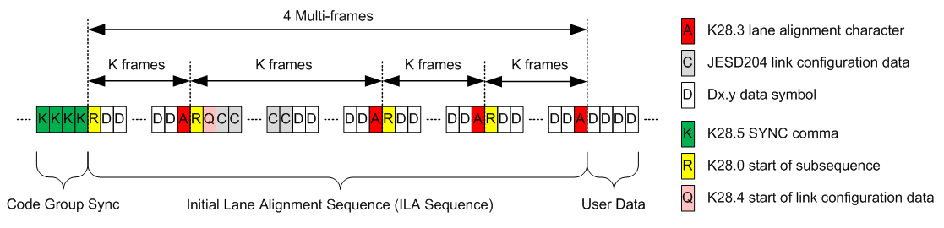
Data Link Layer: Initial Lane Synchronization
Lanes are synchronized using initial lane alignment (ILA) sequence
TX transmits ILA on next multi-frame boundary following CGS
ILA is 4 multi-frames min, containing configuration parameters and alignment symbols (A). 2nd multi-frame contains link config information
ILA is never scrambled, even if scrambling is enabled
ILA information may be verified by the Rx, or it can be ignored if the Rx already expects a certain format
TI Information – NDA Required
Notes:
1

Slide 32
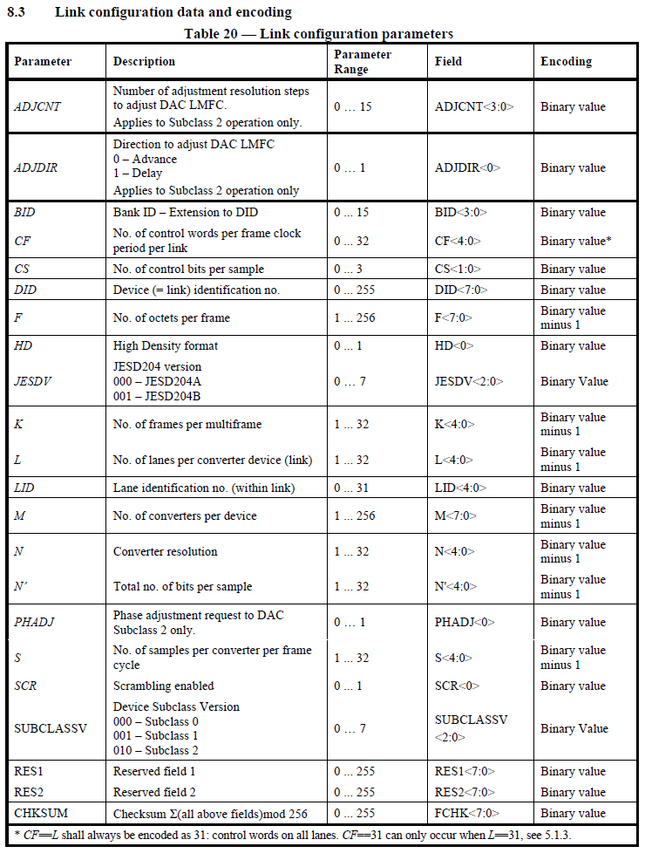
Link Configuration Data
(Parameters for the Initial Frame Alignment)

Slide 33
Data Link Layer: Frame Alignment Monitoring
Transmitter sends out user data after ILA sequence
Alignment characters are inserted into data stream in special conditions to re-check alignment
  If last octet in 2 successive frame are equal → transmitter replaces latter octet with K28.7 symbol (scrambling disabled)
  If last octet of a multi-frame is equal to last octet in previous frame → replace latter octet with K28.3 symbol
Receiver “undoes” the special character replacement
Receiver will re-align it’s frame clock to alignment characters under certain conditions or report an error
Texas Instruments converter devices support both the monitoring and correction of lane alignments
TI Information – NDA Required
Notes:
1

Slide 34
Error Reporting
  Standard lists the following four errors which must be detected by each receiver.
    8B/10B disparity error
    8B/10B not-in-table code error
    Control character in wrong position
    Code Group Synchronization error
  Texas Instruments JESD204B DAC core in addition generates ensuing RX errors
    Multi-frame alignment error
    Frame alignment error
    Elastic buffer overflow (indicative of bad RBD value)
    Link configuration error (TX and RX parameters do not match)
    Some of the errors can be made to retrigger the synchronization request
TI Information – NDA Required

Slide 35
Physical Layer: Serial Lanes
The physical layer defines the performance of the data transfer and electrical interfaces dominated by the SERDES, CDR and driver/receiver blocks
Point-to-point, unidirectional serial interface
AC vs. DC compliance
JESD204B defines 3 signal speed-grade variants
Parameter | LV-OIF-Sx15 | LV-OIF-6G-SR | LV-OIF-11G-SR
Data Rates | 312.5Mbps – 3.125Gbps | 312.5Mbps - 6.375Gbps | 312.5Mbps – 12.5Gbps
Differential Output Voltage | 500 – 1000 (mV) | 400 – 750 (mV) | 360 – 770 (mV)
Output Rise or Fall Time (20% - 80% into 100Ω load) | ≥ 50 (ps) | ≥ 30 (ps) | ≥ 24 (ps)
Bit Error Rate (BER) | ≤ 1e-12 | ≤ 1e-15 | ≤ 1e-15
Notes:
1

Slide 36
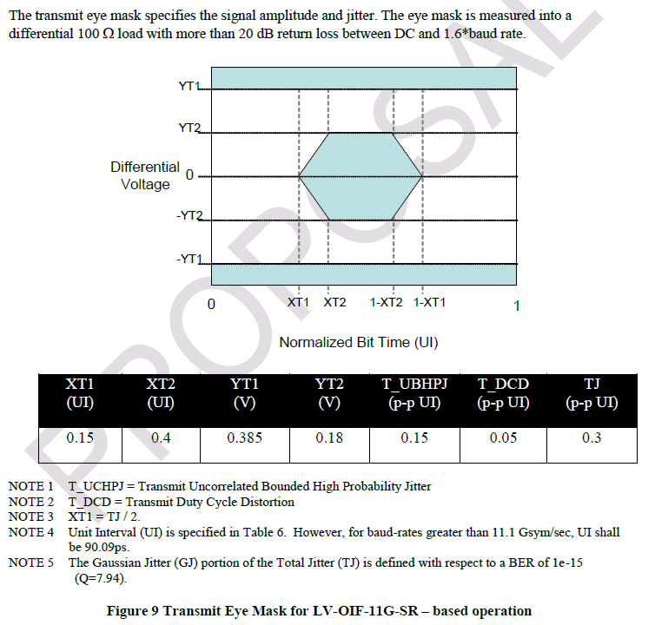
Physical Layer: Serial Lanes
Signaling scheme generally known as interface is low voltage differential Current Mode Logic (CML)
Intended to support interconnects up to 200mm (~8 in) long
Random Jitter
Random jitter plus Deterministic Jitter (ISI)
Bit-Error Rate
Notes:
0.5

Slide 37
Deterministic Latency
Notes:
1

Slide 38
Deterministic Latency: Justification
Applications are often sensitive to the variation of system latency
  Synchronous sampling
  Multi-channel phase array alignment
  Gain control loop stability
JESD204 and JESD204A do not achieve known/constant latency across the link across temp/supply/reboot variation
Providing support for devices with internal clock dividers introduces potential for even more latency uncertainty
Notes:
1

Slide 39
Deterministic Latency: Achieved
JESD204B achieves deterministic latency: known/constant latency
  Subclass 0: DL not achieved (JESD204A)
  Subclass 1: DL achieved using SYSREF with strict timing
  Subclass 2: DL achieved using SYNC~ with strict timing
Deterministic Latency achieved with these architecture features
  SYSREF or SYNC~ are used to provide a deterministic reference phase to all devices for synchronization
  LMFC provides a low frequency reference to avoid frame clock phase ambiguity in the presence of link delay changes
  RX has an “elastic buffer” that absorbs link delay variation
Texas Instruments recommends/supports subclass 1
  LMFC phase easier to control with source synchronous SYSREF than with system synchronous SYNC~
Notes:
1

Slide 40
Deterministic Latency: General Requirements
Elastic buffer must be large enough to store data
  Buffer size is determined by link delay
LMFC period must be longer than the longest link delay
  K parameter (frames/multi-frame) determines LMFC period
  1 < K < 32
  17 < K*F < 1024
Receiver buffers serial data on all lanes until “release opportunity”
  Release opportunity is ‘RBD’ frames after LMFC boundary
  Link latency = RBD frame clock cycles
  Simplest case RBD = K → release opportunity on LMFC boundary
  Link latency may be minimized by setting RBD < K
Notes:
1

Slide 41
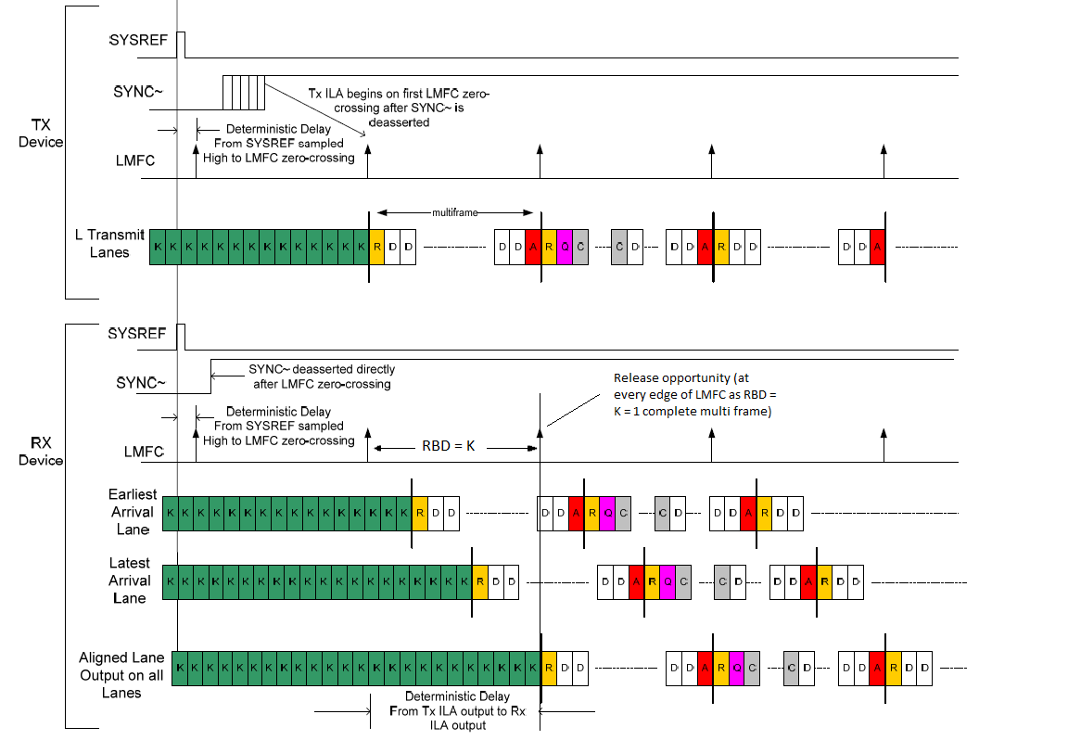
4. All lanes are released on the next LMFC edge and are now aligned
2. After SYNC is received, all lanes send ILAS on next LMFC edge
3. Each lane starts buffering it’s data when it receives the start of ILAS symbol (R)
1. Subclass 1 - SYSREF is used to align LMFCs
K – comma symbols
R - start of ILAS MF
A - end of ILAS MF
D - data
Q – start of config data
C – config data
TI Information – NDA Required
Notes:
RBD = Receiver Buffer Delay

Slide 42
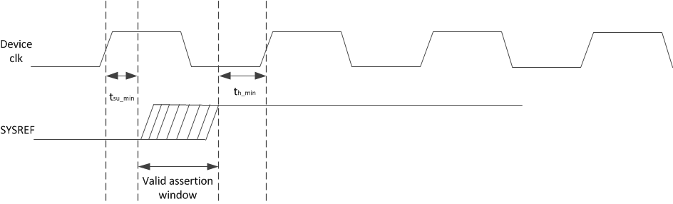
Deterministic Latency: Subclass 1 Requirements
SYSREF must meet setup/hold time with respect to the device clock
SYSREF may be shared for multiple devices as long as there is a deterministic relationship between the derived LMFCs of all devices

Slide 43
SYSREF Signal Types
Periodic
  SYSREF always ON with periodic edges
  Risk of interferer spurs near IF due to SYSREF
Gapped-Periodic
  Send periodic edges for a brief pulse of time
  No spurs
One-Shot
  Single SYSREF pulse and then leave in logic-low state
  No spurs
Frame and LMFC alignment is based on most recent SYSREF rising edge (event) detected
Disabling and gating the SYSREF signal may be employed
TI Information – NDA Required
Notes:
1

Slide 44
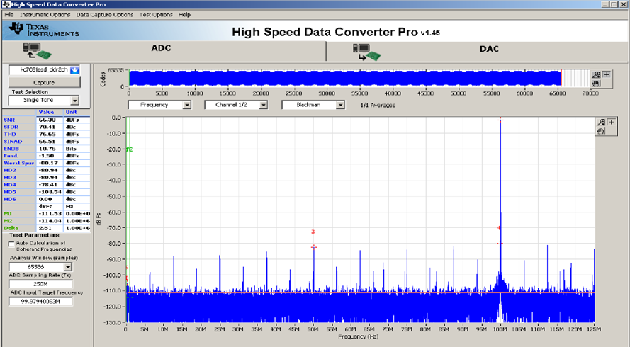
TSW14J56 Capture with SYSREF enabled
TI Information – NDA Required
Notes:
1

Slide 45
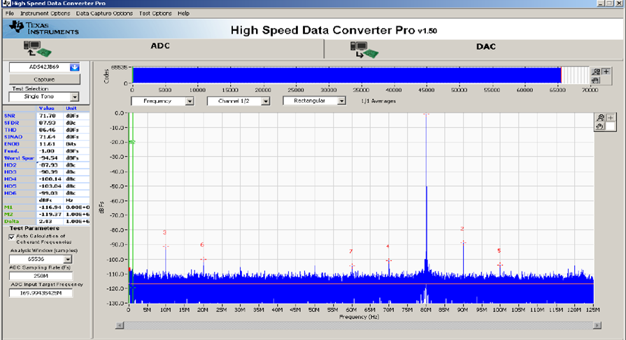
TSW14J56 Capture with SYSREF disabled
TI Information – NDA Required
Notes:
1

Slide 46
Subclass 0, 1, 2

Slide 47
Subclass 0, 1, 2
Three device subclasses have been defined. Each subclass uses a different link synchronization method.
  Subclass 0: Deterministic latency not supported. Backward compatible with JESD204A. No defined method for aligning local multi-frame clocks. Uses SYNC~ signal.
  Subclass 1: Deterministic latency is supported. Uses SYSREF clock to align local multi-frame clocks to device clocks in both TX and RX devices. May use SYNC~ signal to initiate a lane alignment sequence.
  Subclass 2: Deterministic latency supported. Uses SYNC~ to align local multi-frame clocks.

Slide 48
JES204B Subclasses: 0
Backward compatible with JESD204A but supports high line rates
No support for deterministic (known/constant) latency
Supports alignment of multiple lanes/device
Multi-device synchronization requires strict frame clock frequency and tight SYNC~ setup/hold timing
SYNC~ of subclass 0 has special timing requirements for error reporting
Mixing subclass 0 with subclass 1, 2 devices requires special SYNC~ error reporting considerations
TI Information – NDA Required
Notes:
1

Slide 49
JES204B Subclasses: 0
TX device
Clock
Source
Frame Clock
SYNC~
Data
Frame Clock
RX device
Critical Timing Path for: Synchronization
TI Information – NDA Required
Notes:
0.5

Slide 50
JES204B Subclasses: 1
Each device has an internal frame and local multi-frame clock
  Frame clock achieves serial transfer of symbols
  Local multi-frame clock (LMFC) achieves known latency
Requires the SYSREF signal
  SYSREF must be source synchronous with the device clock (critical)
  Phase of SYSREF events determine frame clock and local multi-frame clock alignments
Deterministic latency achieved
Supports alignment of multiple lanes/device
Multi-device synchronization achieved with close attention to device clock and SYSREF distribution
SYNC~ used for synchronization but is not timing critical
TI Information – NDA Required
Notes:
1

Slide 51
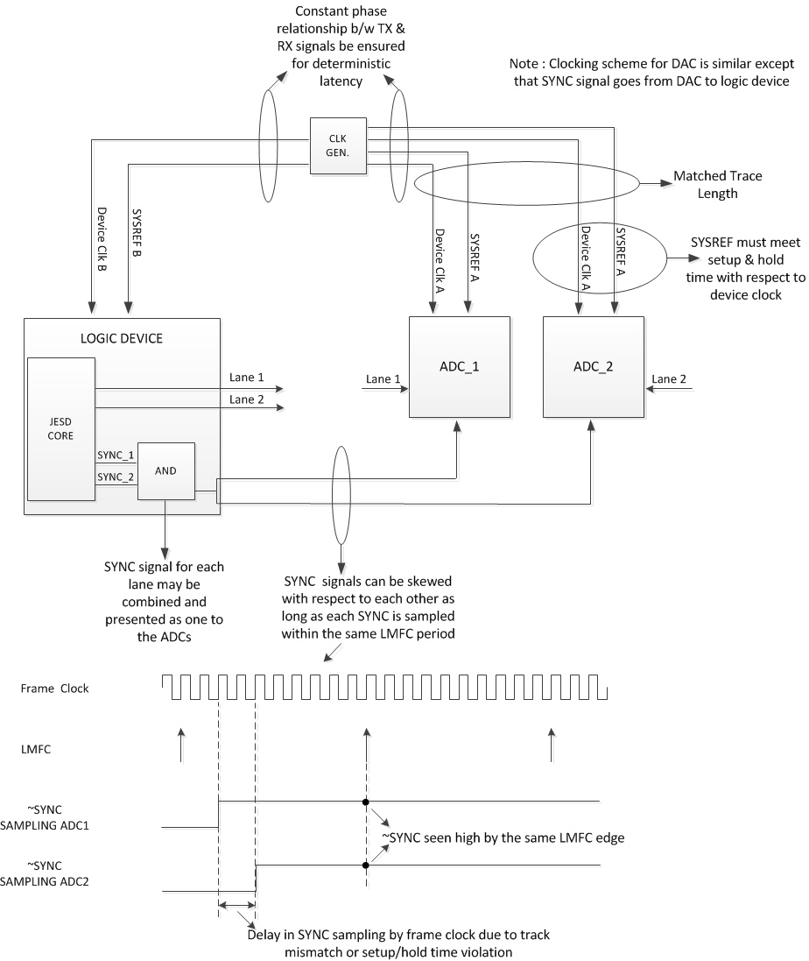
Clocking Scheme - Subclass 1
TI Information – NDA Required

Slide 52
JES204B Subclasses: 2
Each device has an internal frame and local multi-frame clock
  Same as subclass 1
SYNC~ signal used for synchronization and deterministic latency
  SYNC~ must be system synchronous with the device clock (critical)
  Phase of SYNC~ events determine frame clock and local multi-frame clock alignments
Deterministic latency achieved
Supports alignment of multiple lanes/device
Multi-device synchronization achieved with close attention to device clock and SYNC~ distribution
Since meeting setup and hold time becomes a challenge at higher sampling rates, it is recommended, as per standard, to use Subclass 1 for speeds above 500MSPS for both ADC and DAC.
TI Information – NDA Required
Notes:
1

Slide 53
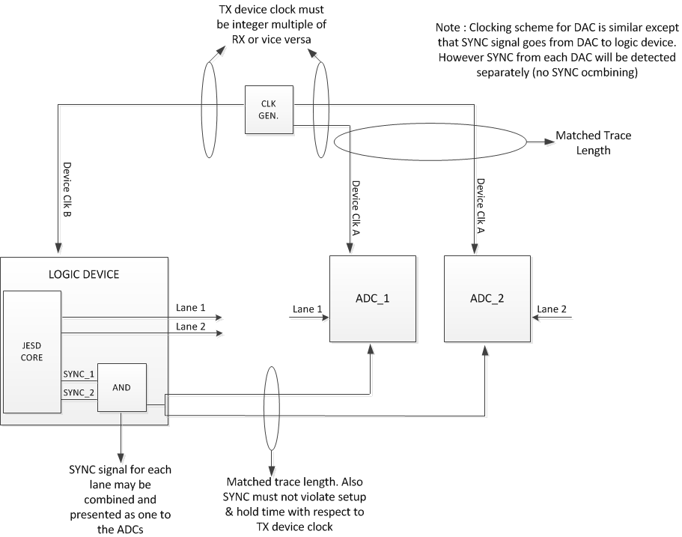
Clocking Scheme – Subclass 2

Slide 54
Configuration Parameters
TI Information – NDA Required

Slide 55
Key Configuration Parameters and Equations
L = number of lanes per converter device
M = number of converters per device
F = number of octets per frame (per lane)
S = number of samples per frame
F_{S} = Converter sample rate
K = # of frames per multi-frame
LMFC = Local Multiple Frame Clock
Serial Line rate = Serdes speed
Serial Line Rate = F_{S} * 10 * F [bits/lane] (Note: # lanes influences F parameter)
LMFC = Fs/K [max SYSREF frequency]
Known as LMFS parameter,
Found in device data sheets
1 < K < 32
17 < F*K < 1024
TI Information – NDA Required

Slide 56
Configuration Parameters
ADS42JB49EVM LMFS = 4211 example (Board default values)
L = 4 lane / device
M = 2 converters / device
F = 1 octet / frame
F_{S} = 250MHz (max) (device clock)
K = 20
Line rate = fs * 10 * F = 250 * 10 * 1 = 2500 MHz
LMFC = Fs/K = 250/20 = 12.5MHz
SYSREF = LMFC/n (n is a positive integer)
SYSREF = 12.5MHz, 6.25MHz, 3.125Mhz, etc…
TI Information – NDA Required

Slide 57
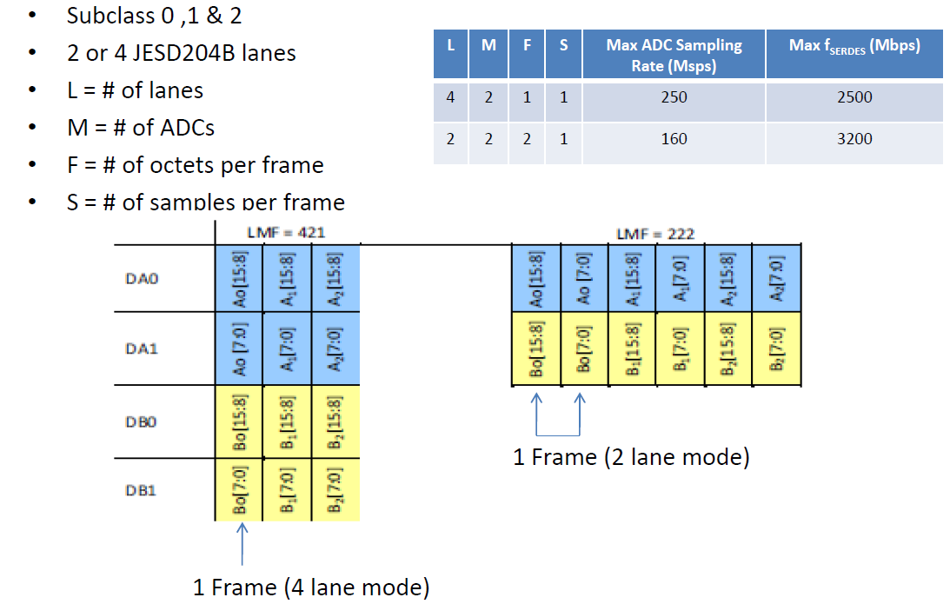
Configuration Parameters
(ADS42JB69 data sheet ex.)
TI Information – NDA Required

Slide 58
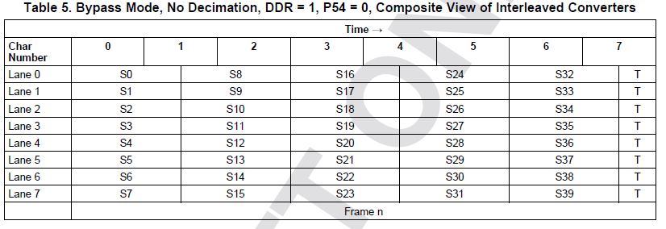
Configuration Parameters (ADC12J4000 ex.)
LMFS = 8885
TI Information – NDA Required

Slide 59
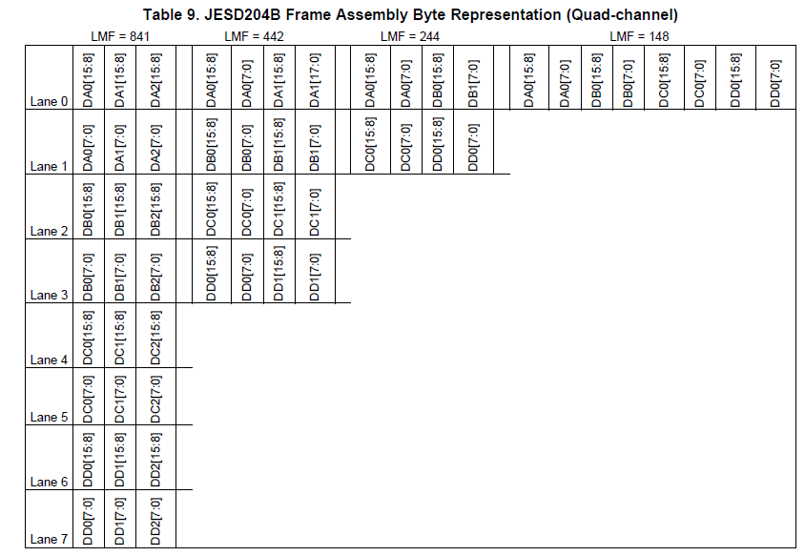
Configuration Parameters (DAC38J84 ex.)
TI Information – NDA Required

Slide 60
Configuration Parameters
  Additional TX parameters (DACs)
  BUF_SIZE : Size of the receiver elastic buffer (fixed by silicon)
  RBD : Receiver buffer delay (adjustable)
  SCR : Enable/Disable descrambling
  sync_req_ena : Register to enable various re-synchronization triggers
TI Information – NDA Required

Slide 61
Additional Information
TI Information – NDA Required

Slide 62
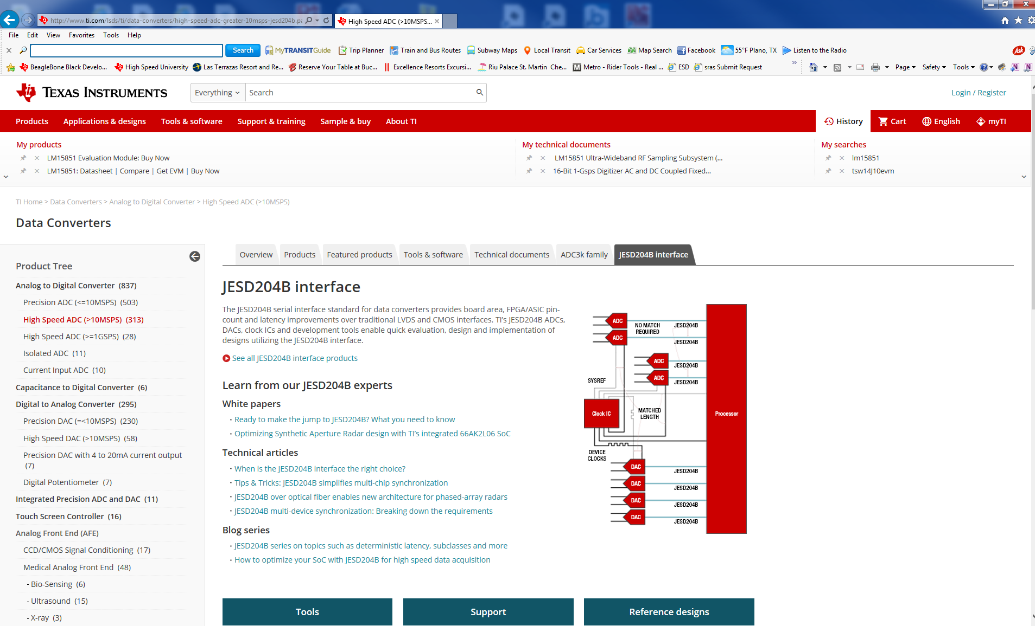
www.ti.com, select data converters, then High Speed ADC, then JESD204B Interface

Slide 63
JESD204B Blogs
https://e2e.ti.com/blogs_/b/analogwire/archive/2014/07/30/jesd204b-understanding-the-protocol
https://e2e.ti.com/blogs_/b/analogwire/archive/2014/08/27/jesd204b-how-to-bring-up-your-link
https://e2e.ti.com/blogs_/b/analogwire/archive/2014/09/24/jesd204b-determining-your-link-configuration
https://e2e.ti.com/blogs_/b/analogwire/archive/2014/10/24/jesd204b-understanding-subclasses-part-1
https://e2e.ti.com/blogs_/b/analogwire/archive/2014/10/31/jesd204b-understanding-subclasses-part-2
https://e2e.ti.com/blogs_/b/analogwire/archive/2014/12/22/jesd204b-what-is-deterministic-latency-why-do-i-need-it-how-do-i-achieve-it
https://e2e.ti.com/blogs_/b/analogwire/archive/2015/01/16/jesd204b-how-to-calculate-your-deterministic-latency
https://e2e.ti.com/blogs_/b/analogwire/archive/2015/02/27/jesd204b-how-to-measure-and-verify-your-deterministic-latency
https://e2e.ti.com/blogs_/b/analogwire/archive/2015/03/20/jesd204b-serial-link-quality-tradeoffs-and-tools-for-optimization
Generic search of ti.com for JESD204B will bring up more material such as videos, TI Designs, etc…
Altera and Xilinx links:
http://www.ti.com/ww/en/xilinx/pg_jesd204b.html
http://www.ti.com/ww/en/Altera/pg_jesd204b.html
Lamarr + HSP converters
http://www.ti.com/sitesearch/docs/universalsearch.tsp?searchTerm=K2L%20jesd204b#linkId=1&src=top

Slide 64
Summary
  JESD204: Standard serial data interface for data converters
  JESD204B subclasses offer 3 implementation variations
  Transport Layer defines data framing into serial lanes
  Link layer defines encoding, synchronization and data monitoring
  Physical layer defines the electrical and timing performance
  Deterministic latency achieved with subclasses 1, 2 and is required for known/constant latency through link
TI Information – NDA Required

