Slide 1
DAC38RF89 Test

Slide 2
DAC38RF89 41380 Test
Test Setup:
3200MHz external clock to J1
Fdac = 3200Msps
Int 1X
IF = 100MHz
1 TX real mode
LMFS = 4138

Slide 3
Board Setup using 2 clock sources

Slide 4
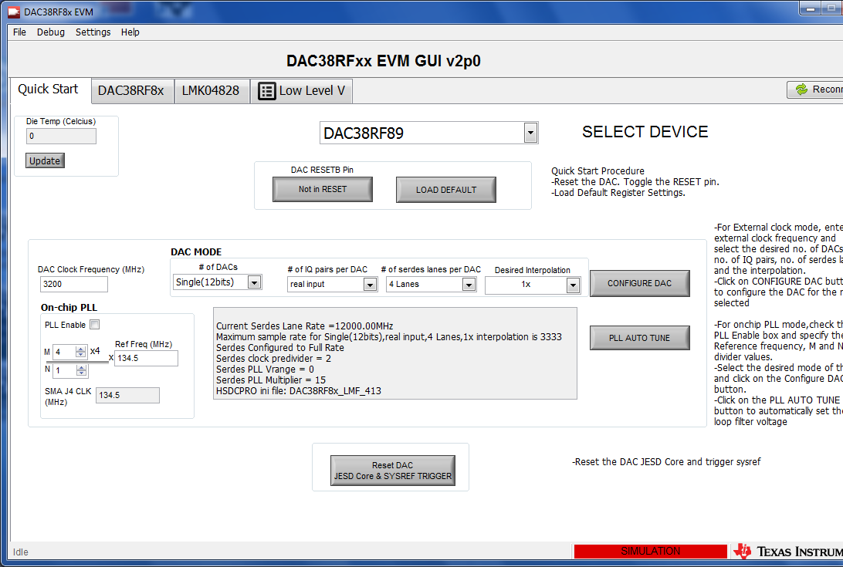
DAC38RFxx EVM GUI

Slide 5
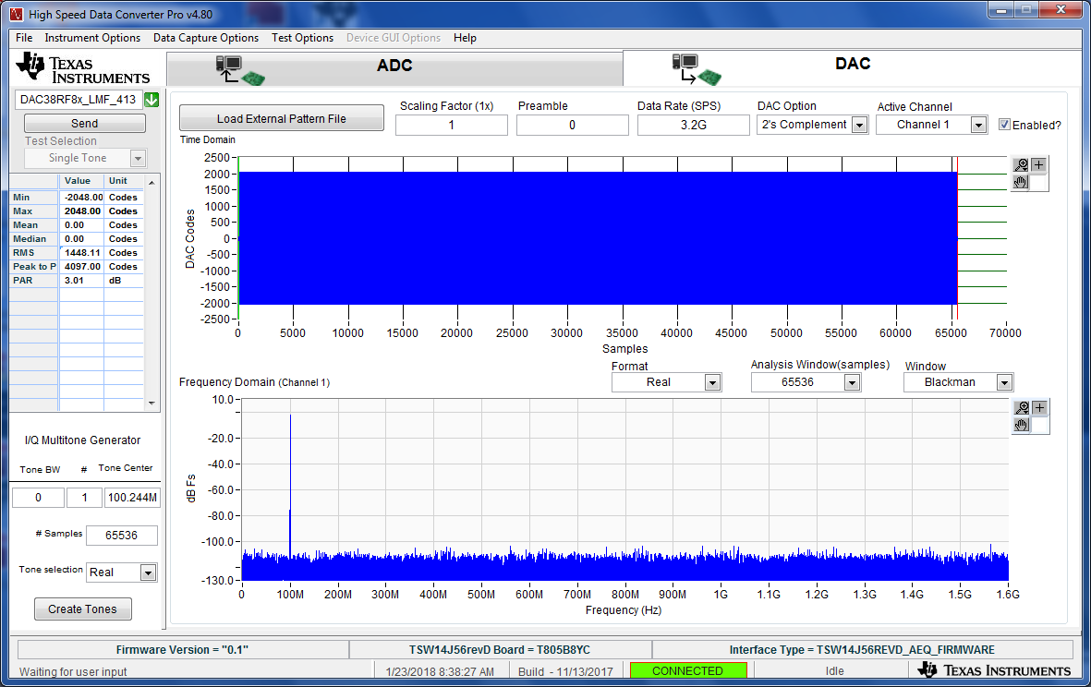
HSDC Pro GUI Settings

