Slide 1
DAC38J84 EVM LMK04828 Dual Nested 0 Delay PLL Setting
Kang Hsia
01/12/2016

Slide 2
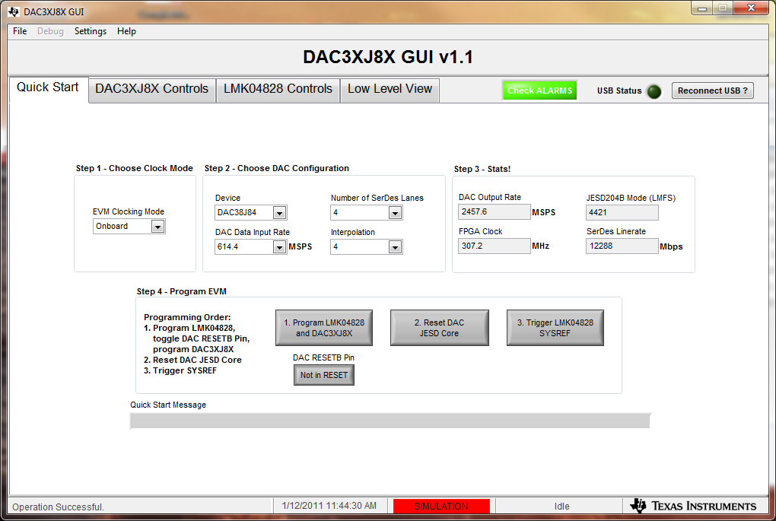
DAC38J84 Operating Mode
442 Mode, F = 2, K = 10. (Note: K depends on system setting)

Slide 3
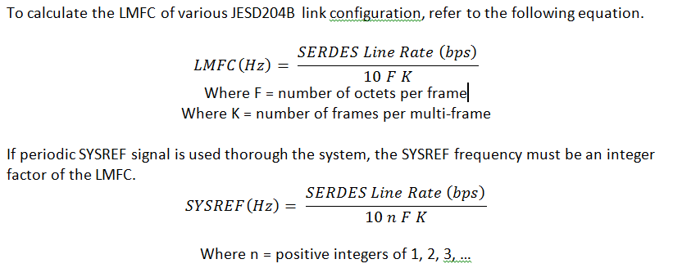
LMFC and SYSREF Calculation
SERDES = 12288Mbps
F = 2
K = 10
LMFC = 12288/10/2/10 = 61.44MHz

Slide 4
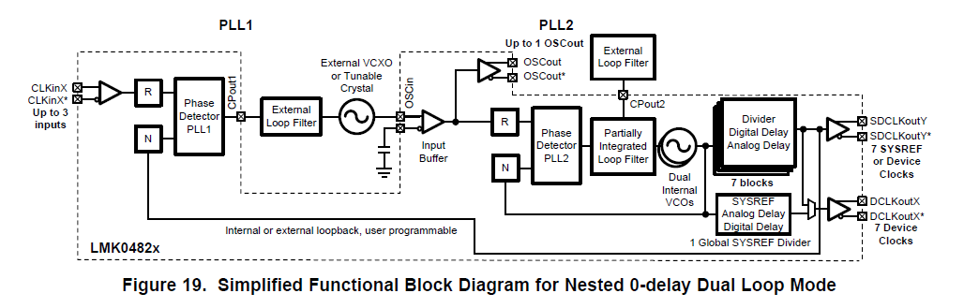
EVM 1 and EVM 2 LMK04828 Nest 0 Delay Dual Loop Mode
Note: feedback loop forces PFD1 = SYSREF = Reference Input
PFD2 = 61.44MHz
Crystal = 122.88MHz
R =1
PFD1 = SYSREF = Reference Input
R =1
N =1
N =10
PFD1 61.44MHz = SYSREF
VCO = 2457.6MHz
P = 2
Input 61.44MHz
Reference input is split and delay matched
PFD1 = SYSREF = Reference Input

Slide 5
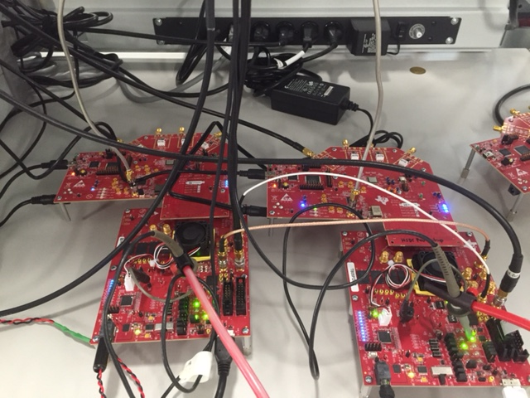
EVM Setup
Input 61.44MHz
Reference input is split and delay matched

Slide 6
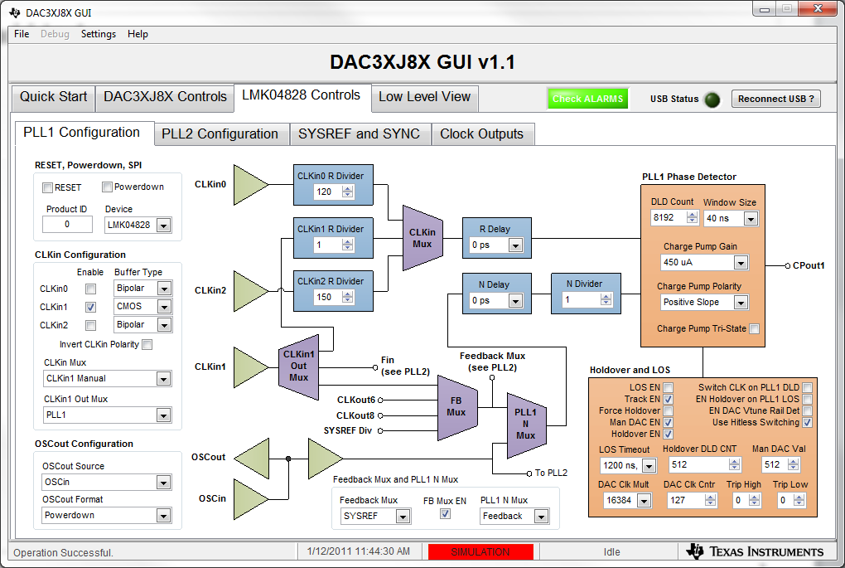
PLL 1 Config

Slide 7
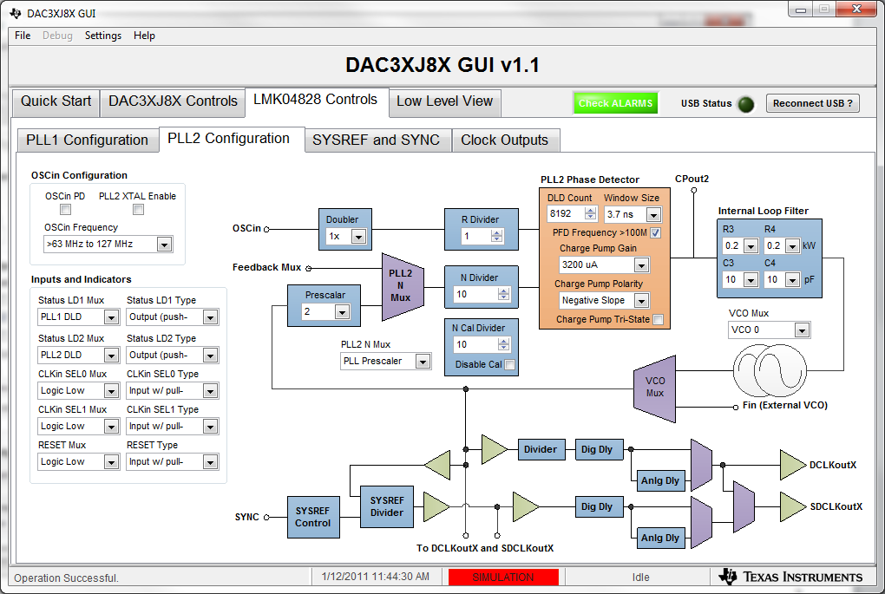
PLL 2 Config

Slide 8
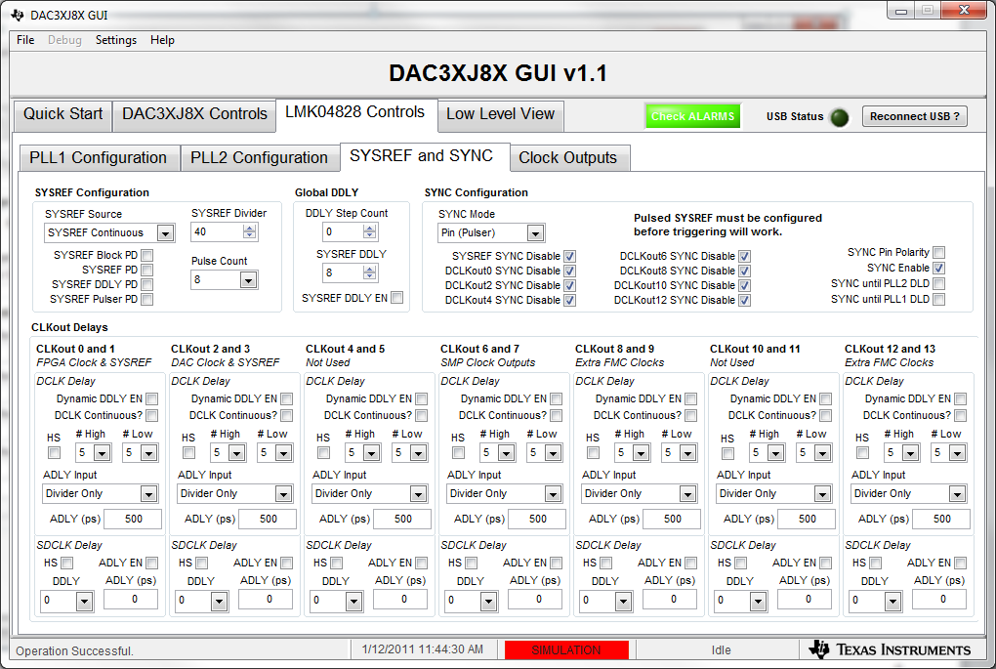
SYSREF Programming

Slide 9
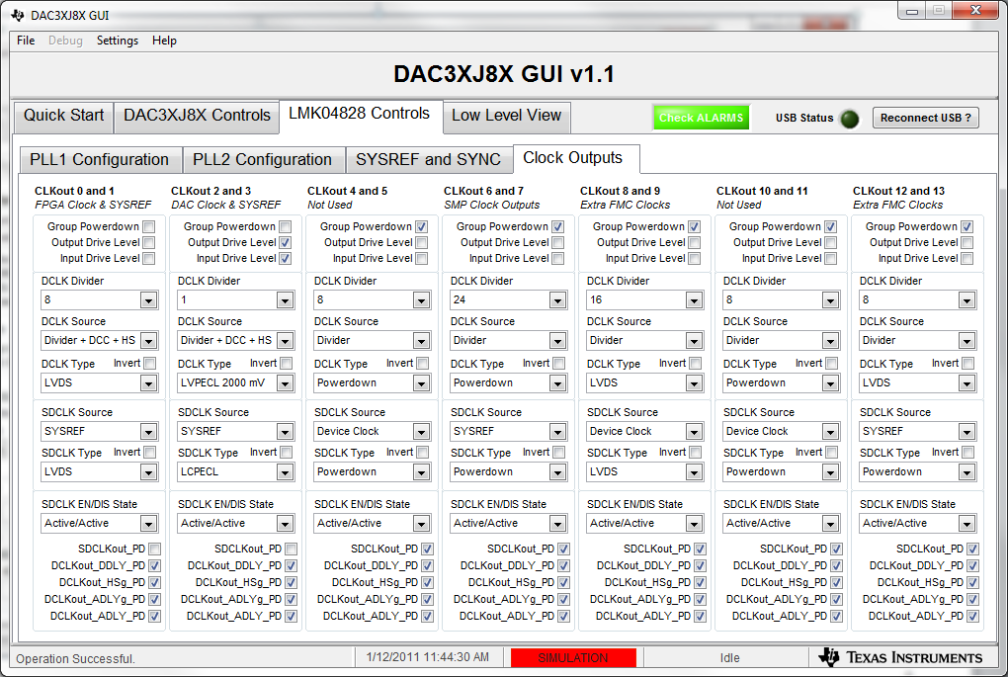
Clock Output

