Slide 1
DAC3174 Pattern Test Feature
6/1/14
rmp

Slide 2
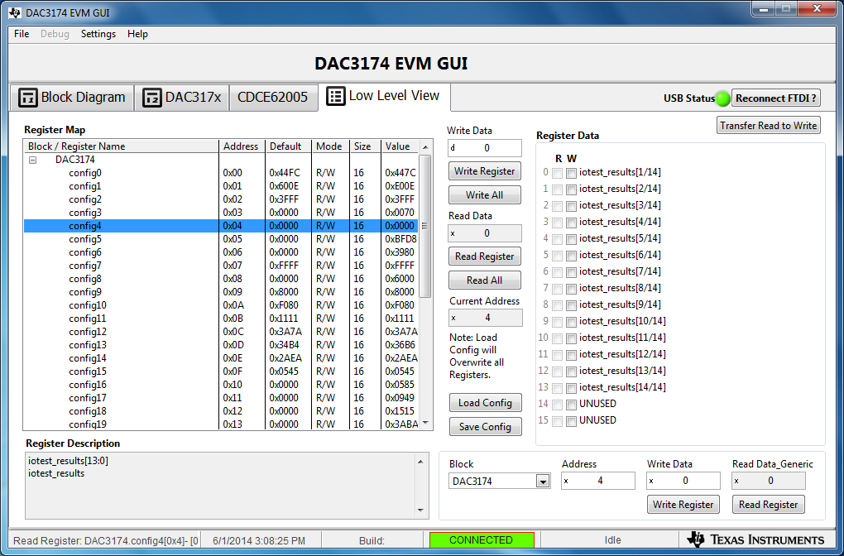
Config4 reports which bits are in error.
Writing to config4 clears reported errors. Then Read Register to see if there are new errors detected.

Slide 3
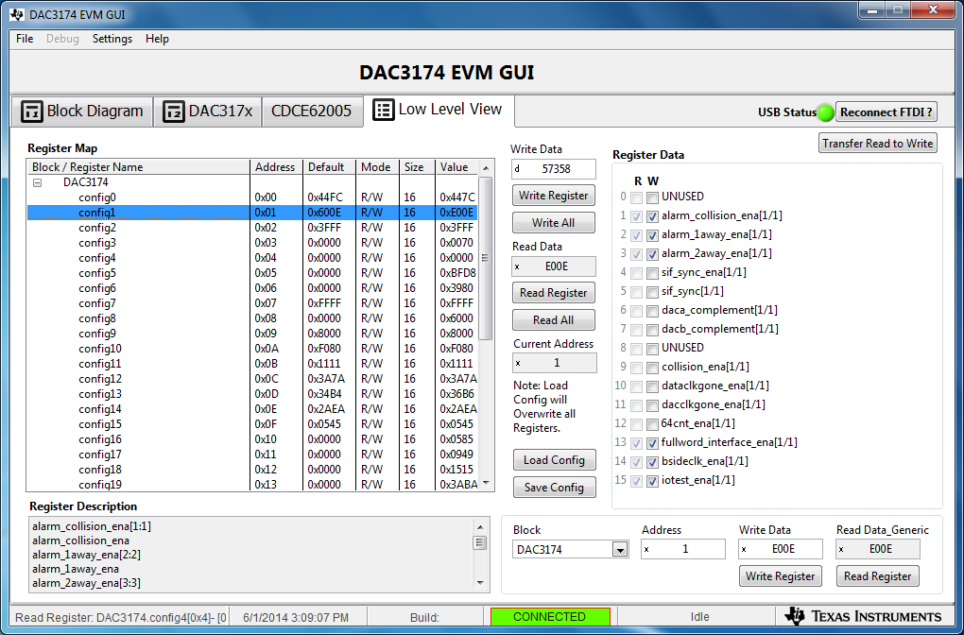
Config1 has bit to enable pattern test feature

Slide 4
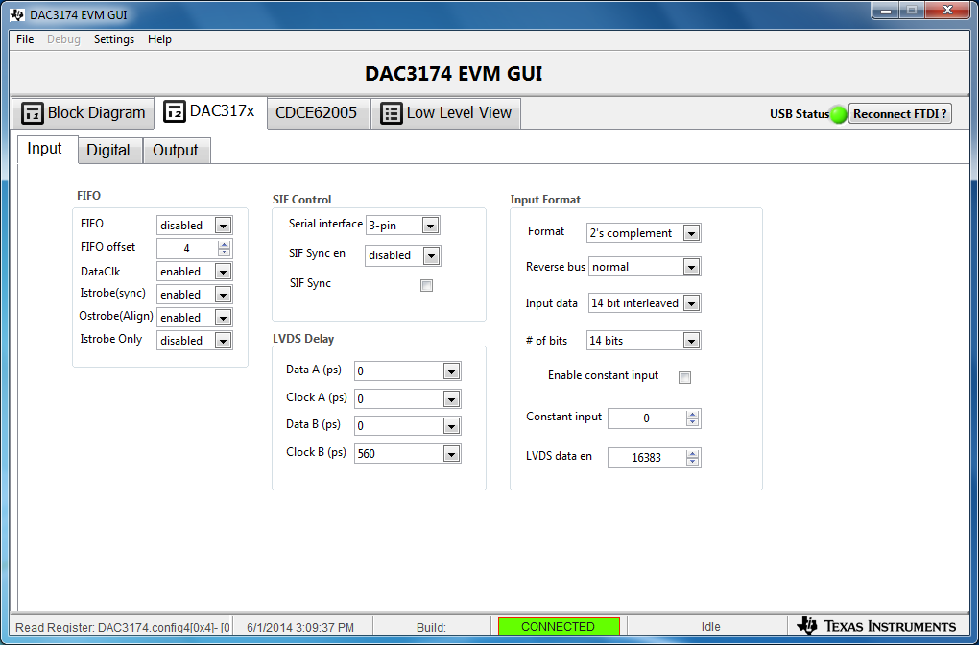
In single bus, delay for ‘clock A’ is really delay for SYNC
Pattern made for offset binary, but at present need to set for 2’s comp on the tools, both DAC GUI and HSDCPro. Need to investigate why.

Slide 5
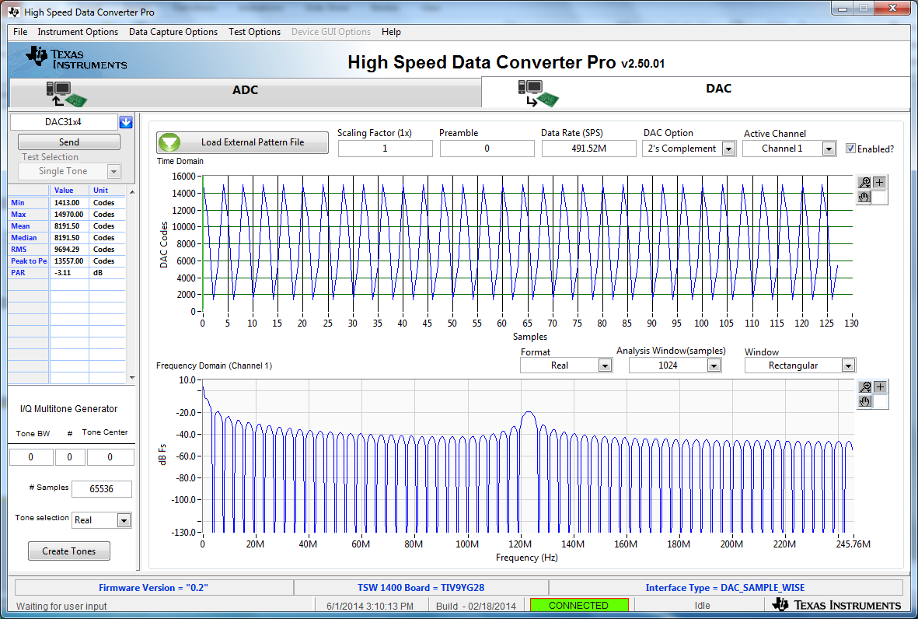
HSDCPro – use Load External Pattern File button and then press Send.

Slide 6
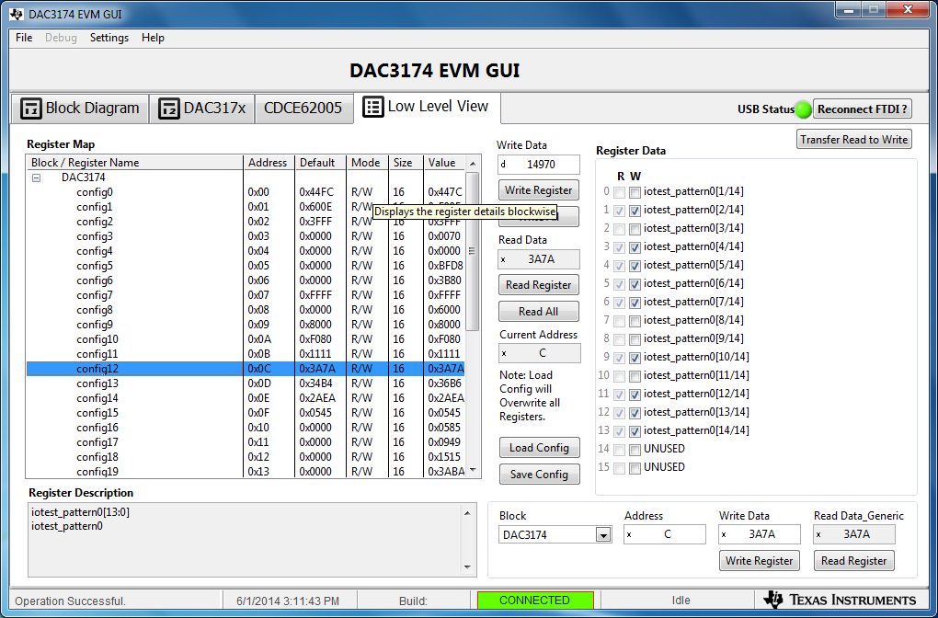
Default patterns start in config12

Slide 7
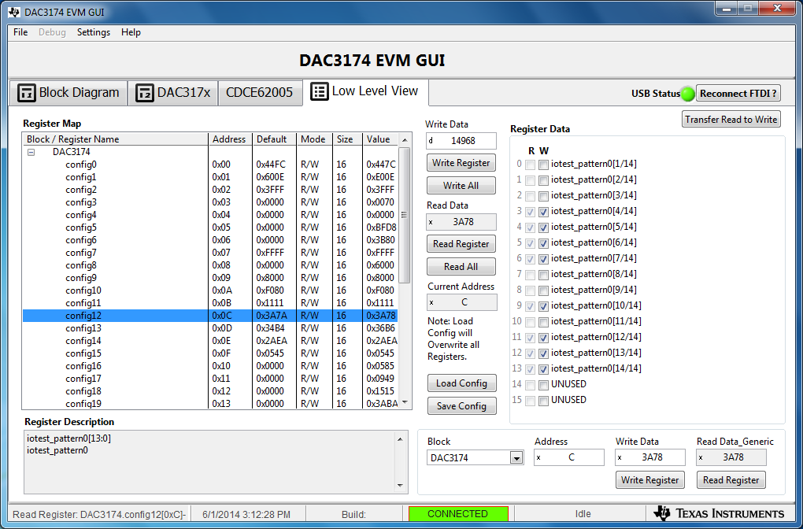
Introduce an intentional error in pattern0

Slide 8

Result of intentional error

Slide 9
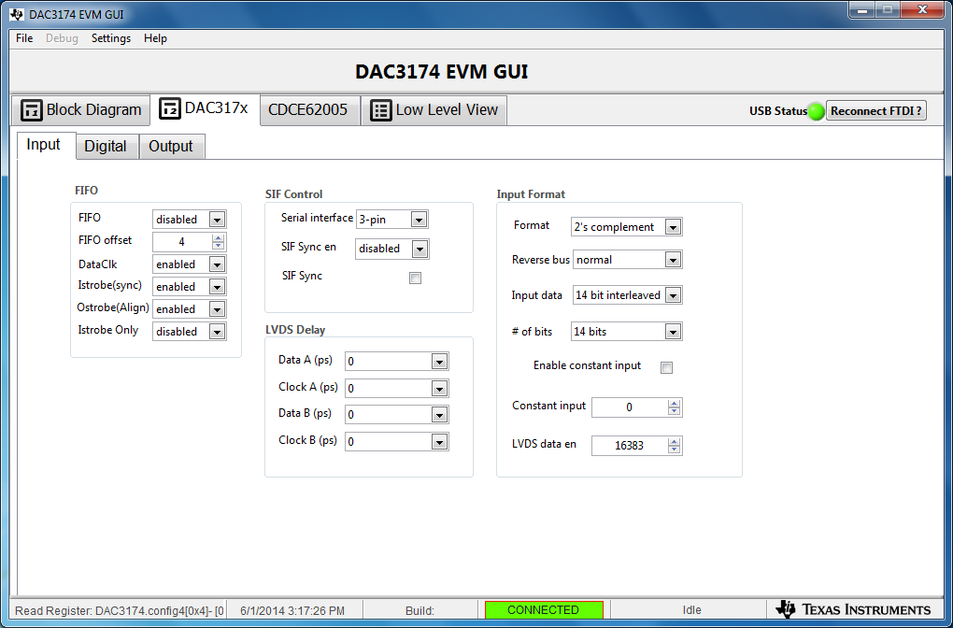
Back to default pattern, introduce timing error

Slide 10

Result of timing error

Slide 11
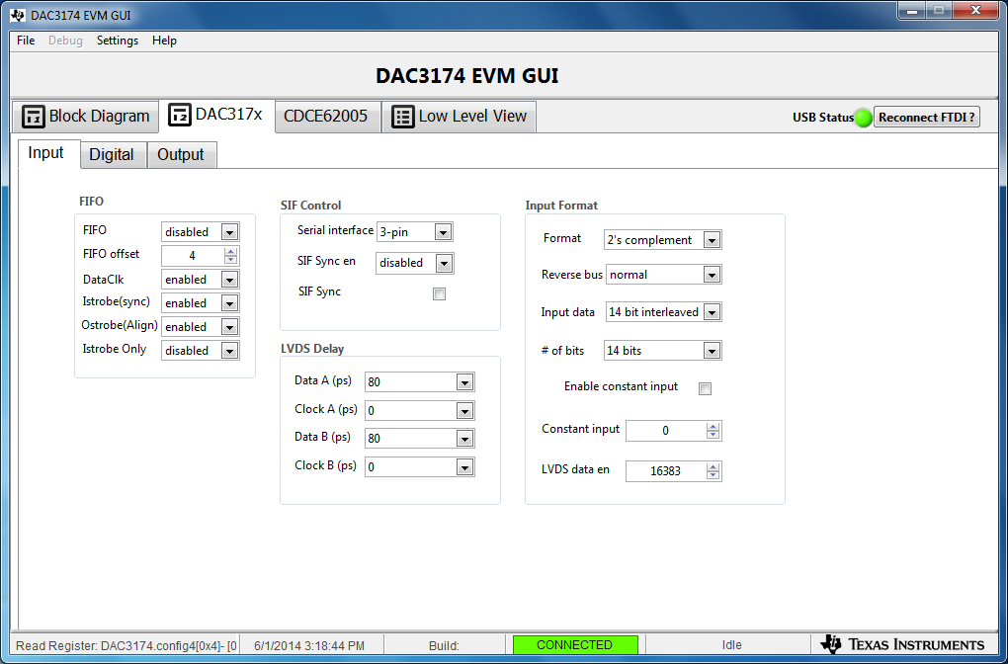
Introduce more timing error

Slide 12

Result of more timing error

Slide 13

If offset binary/2’s complement is not set right for pattern, then msb will be in error

Slide 14
Additional Notes
Pattern file for HSDCPro is a two column csv file, on length modulo 8 samples. (Some number of patterns, repeated. The example file had 256 samples, the 8 sample pattern repeated 32 times.)
HSDCPro sends the first column of samples in the csv file to Channel A of the DAC, the second column to Channel B. Since the single-clocked sample bus is interleaved between channel A and channel B, the first pattern goes in the first column, second pattern in the second column, third pattern back to first column, etc.
HSDCPro expects the 14 bits to be msb-justified in a 16b word. (The decimal value of the pattern * 4). Thus the DAC3174 default pattern is:
59880 | 56024
43944 | 5396
5652 | 9508
21588 | 60136

