Slide 1
High-Speed Serial Link Layout Recommendations –
For high-speed JESD ADCs and DACs

Slide 2
Differential vs Single-Ended Routing
Differential routing provides improved EMI and crosstalk performance over single-ended traces. This is especially useful for dense layouts with many signal lines.
Recommendations
Either single-ended or differential can be used, but you should stick with one or the other for the full length.
For instance, if the signal coming out of the transmitter is differential then route the signal differential all the way to the receiver.
Do not come out of the transmitter differential then split into single-ended traces and then come back to differential at the receiver. Each split will create a discontinuity in the trace impedance.
For most designs, there is no reason to deviate away from differential routing for the high-speed serial link signals.

Slide 3
Routing of Differential Traces
Recommendations:
Keep the distance between the differential traces (S) constant over the entire trace length
Keep the length of the individual traces of the differential pair the same to minimize skew and phase differences.
For tightly coupled differential traces (S = W), keep the distance (D) between adjacent signals and other objects or routing greater than 3 to 5 times the width (W) of the trace (D > 3 * W).
For loosely coupled differential traces (S > 2 * W) or single-ended traces keep adjacent signals away at a distance of 3 to 5 times the height of the dialectric (D > 3 * H).
Tightly coupled traces have better crosstalk performance but more loss.

Slide 4
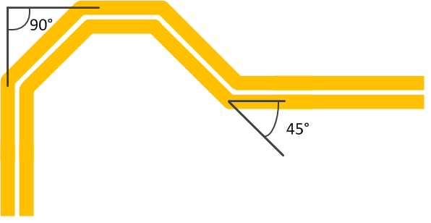
Bends in Differential Traces
Bends are generally okay. They will introduce an impedance mismatch, but it is negligible compared to other sources of mismatches.
Bends will introduce a mismatch between the individual traces of a differential pair.
Recommendations:
Use bends in the opposite direction to correct for mismatches.
Use 45° bends rather than 90° bends. To make a 90° bend, use two 45° bends.
Rounded bends can also be used but it may be harder to control the spacing of the traces throughout the bend.

Slide 5


Mismatches Between the Individual Traces of a Differential Pair
Mismatches between the individual traces will cause a skew between the positive and negative signals of the differential pair. This will decrease the opening of the data eye.
Recommendations:
If the mismatch is created by a bend, then a bend in the opposite direction will fix the mismatch. Otherwise, use jog-outs to increase the length of one side.
Use multiple small jog-outs instead of one large jog-out. Jog-outs will cause an impedance mismatch.
Equal number of bends in each direction
Multiple small jog-outs to fix mismatch

Slide 6

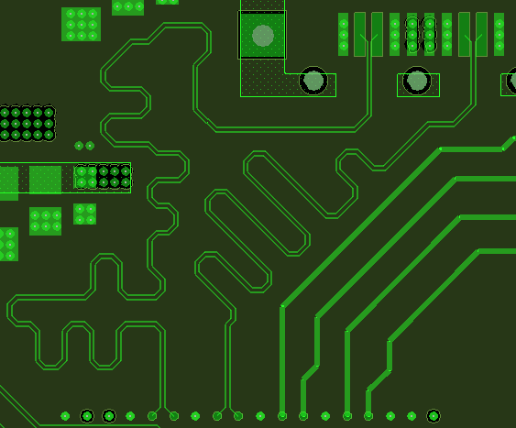
Wiggles to Match Trace Lengths
Wiggles are used to match the lengths of multiple differential pairs.
Recommendations:
Wiggles should follow the recommendations for bends given previously.
Rule of thumb: keep the diameter of the wiggle at least 3 times trace width.
Use an equal number of turns in each direction to keep the traces of the differential pair matched.
Lanes of matched length are not necessary for the JESD204b standard. Large mismatch between lanes can result in higher latency.
D > 3xW
Wiggles used to match the length of two differential pairs

Slide 7
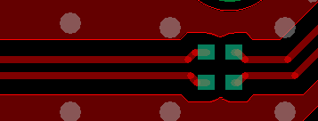
PCB Recommendations (Differential Pairs)
Route differential signal as tightly coupled microstrip or stripline lanes (S<=W)
100 Ω differential impedance
Avoid 90° turns
Reduces +/- trace mismatch
Reduces impedance discontinuity
Recommend 0201 series components (AC coupling) to minimize impedance discontinuity of pads
Routing on inner layers (stripline) has advantages:
Better impedance control
No speed issues with Nickel plating
Less interference/emissions
0201 AC coupling capacitors
Via stitching

Slide 8
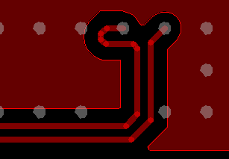
PCB Recommendations (Trace Matching)
Device Clock, SYSREF, SYNC~, and serial lanes must be between matched +/- traces
Device Clock and SYSREF pairs must be matched to each other
Serial lanes need NOT match to each other
Use wiggles to match the lengths of multiple differential pairs.
Keep radius of the wiggle > 3 times trace width
Use equal number of turns in each direction
Use small jog-outs to correct +/- trace mismatch
Matched Dev. Clock and SYSREF pairs
R > 3xW
Jog-out matches +/- traces

Slide 9
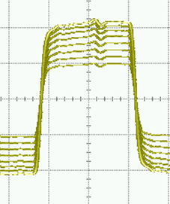
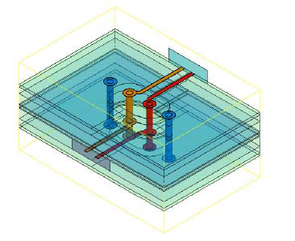
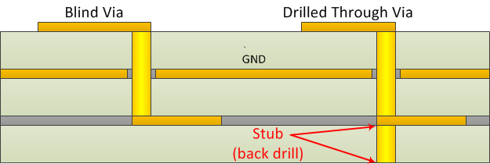
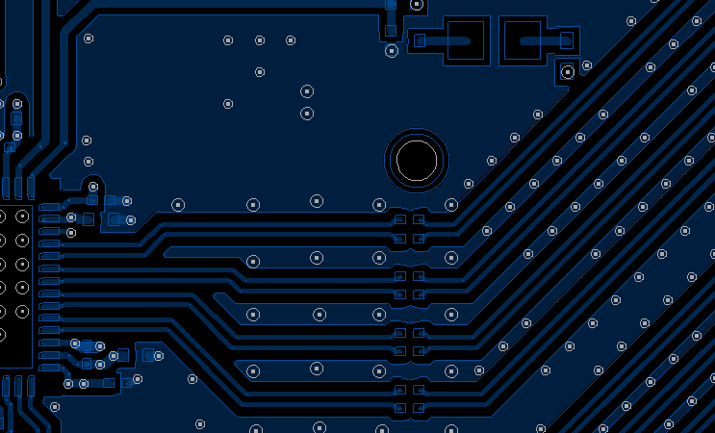
PCB Recommendations (Vias)
Vias in the signal path create impedance discontinuities that result in signal reflections/degradation
Simulate signal path with vias to determine signal integrity before manufacturing
Avoid changing layers where possible, but use adjacent grounding vias where layer change is necessary to provide return current path
Via stitch along sensitive differential signal paths
Use blind vias or back-drilling to eliminate via stubs
Waveform “blip” due to via in the signal path
Adjacent GND vias
Via stitching

Slide 10
Vias in the Signal Path
A via will present an impedance discontinuity resulting in reflections and a degradation of the signal.
Recommendations:
If vias are used, keep the via delay short compared to the rise time of the signal to minimize reflections.
Vias can be compensated by adding ground vias close by for the return current.
Avoid stubs from vias to inner layers by having them back drilled. Alternatively, blind vias are a better choice to eliminate stubs.
Simulate the signal path with the vias to determine signal integrity before manufacturing the board.
Source: High Speed Mezzanine Card (HSMC) Specification (Altera)

Slide 11
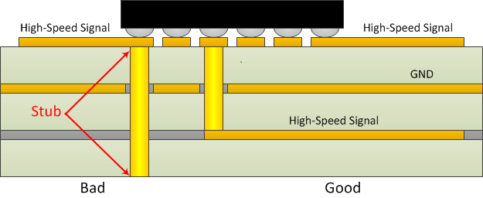
In-Pad Vias for BGA Package
Recommendations:
If In-Pad vias are used with a BGA package and the high-speed serial link signal is coming from an inner layer, follow the recommendations from the previous slide.
If the signal is routed to the ball of the package without going through a via, remove the via from these pins.
In pad vias on low speed signals and ground and power are fine and will help to dissipate device heat.

Slide 12
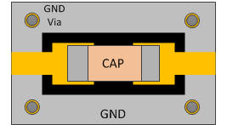
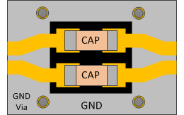
Component Pads in the Signal Path
Pads will add capacitance and therefore an impedance mismatch
Recommendations:
Generally, the only need for components in the signal path is DC blocking capacitors. Try to avoid other components for gigabit connections.
For gigabit connections, use 0201 components when possible, including the DC blocking capacitors. A value of 0.1 uF is recommended.
Excess capacitance can be limited by clearing the ground plane underneath the component. Use SI simulation to determine the required amount.
Cap with cleared GND plane and vias
Differential DC blocking caps with cleared GND plane and vias
Source: High Speed Mezzanine Card (HSMC) Specification (Altera)

Slide 13
Reference Planes
Recommendations:
Use a single ground plane as the signal reference.
Do not put splits in the reference plane underneath the signals. The return current for high-speed signals will follow the trace on the reference plane. A split will require the return current to travel around the split.
Keep analog signals separate from digital signals, however a single ground plane is fine. During routing, split the ground plane at the DAC or ADC into analog and digital planes and route the signal traces in their respective domains. After routing, recombine the two ground planes into one.
If using a stripline trace, place reference planes on both the top and bottom of the trace and do not put splits into either of them.

Slide 14
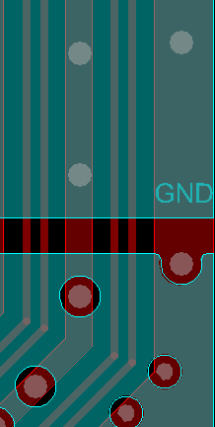
PCB Recommendations (Reference Planes)
Use a ground planes as the signal reference on adjacent layers
Avoid splits in the reference plane underneath signals when possible
Return current for high-speed signals follows trace on the reference plane
Splits require the return current to travel around, increasing loop inductance, coupling, and interference
When reference plane splits under differential signals are necessary:
Minimize split width
Ensure tight coupling of differential pair
Jump split at 90°
Good GND via stitching along channel
Avoid jumping split in vicinity of other noisy signals

Slide 15
PCB Info
Board material
When designing for signal speeds above 3Gbps, special PCB materials with a Df (loss factor) of .004 or less should be used.
Megtron 6
Rogers
Mix high speed material with standard material to save on cost
Route High Speed Serdes traces with special PCB material
Remaining traces routed on 370HR
Board shop has reported that 370HR can be used up to 10GHz with very short traces (1-3 inches)
Suggest running signal integrity simulation before attempting this
Rev D of ADS42JBx9EVM constructed with 370HR only and operates @ 3.125GHz lane rate
For allowable skew between lanes, it depends on the device programming used.
DAC38J84 RBD length can be programmed up to 32 octets which allows up to 32*10 UI intervals
An example test bench setup uses RBD=20, K=20, LMF=841, S=1, HD=1 which allows nearly 200 UI
At 10Gbps, UI is 100pS and 200 UI = 20nS.
With signal delay ~ 154ps/in, this would equal 129 inches! (But deterministic delay would be very large as well)

Slide 16
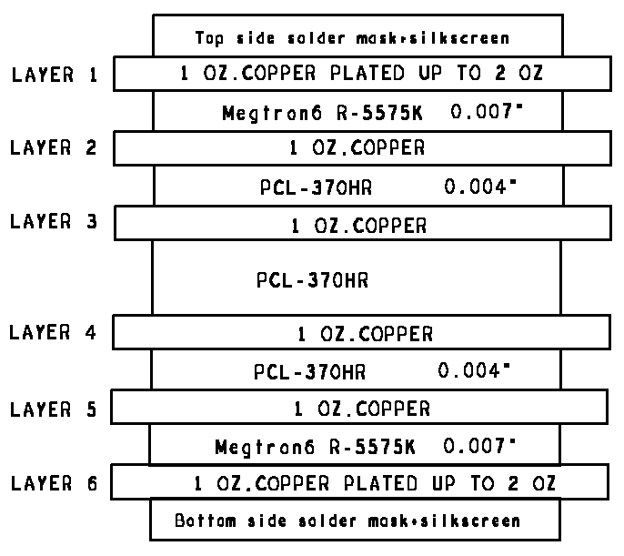
PCB Recommendations (Material/Stack-Up)
Serial lane speeds > 3 Gb/s at length > 8”
Recommend low-loss, good impedance consistency dielectric material
Rogers-4350, Megtron-6.
Use premium dielectric only where needed
Serial lane speeds < 3 Gb/s at length < 8”
Recommend low cost materials
FR4, 370HR
Board shop reports that 370HR can be used up to 10 GHz with very short traces (1-3 inches)
Material QTY $/board
Megtron 6 50 $660
370HR 50 $350

Slide 17

PCB High Speed Material

Slide 18
Summary of Recommendations
Always take steps to minimize impedance discontinuities, meaning that the traces should be uniform from source to load.
Use differential routing for most designs and stick to it for the full trace length.
Keep the differential trace spacing constant and the individual traces within the pair equal length.
Keep adjacent traces and objects a sufficient distance away to avoid crosstalk.
Only use bends of 45°. Use two 45° bends for 90° turns.
Use multiple small jog-outs to correct mismatch between traces of a differential pair.
Avoid stubs from vias by backdrilling or using blind vias. Add ground vias close by to account for return currents.
Do not split the reference planes underneath the signals.

