Slide 1
JESD204B Overview
e2e.ti.com (TI Support Forum)
July 2014

Slide 2
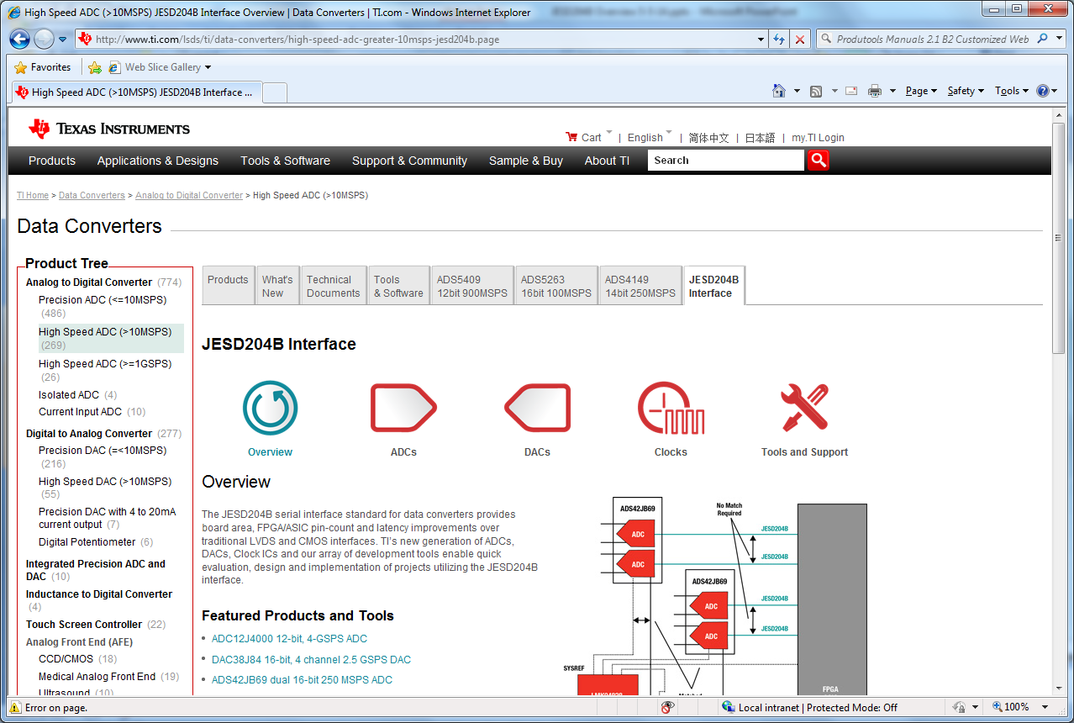
www.ti.com, select data converters, then High Speed ADC, then JESD204B Interface

Slide 3
Outline
JESD204 A & B History
Timing Signals
Transport Layer, Scrambler, Data Link Layer, Control Symbols, and Physical Layer
Deterministic Latency
Subclass 0, 1, 2
Configuration Parameters
Error Reporting
Timing Signals
Notes:
0.5

Slide 4
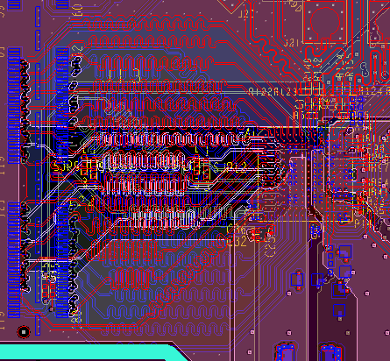
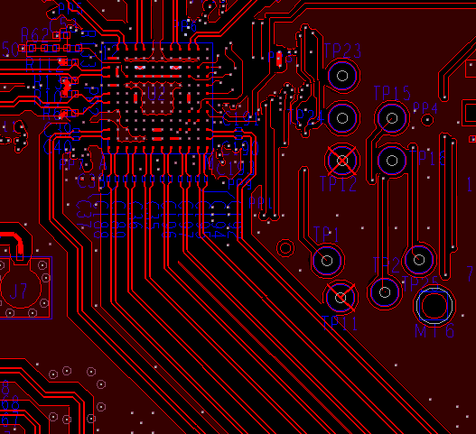
Introduction: Why JESD?
In LVDS and CMOS systems, package size, board area and power consumption dominated by output buffers rather than the data converter.
DAC
DAC
TI Information – NDA Required
Notes:
0.5

Slide 5
JEDEC (Joint Electron Device Engineering Council)
now called
JEDEC Solid State Technology Association
created
JEDEC Standard JESD204
Serial Interface for Data Converters
TI Information – NDA Required
Notes:
1

Slide 6
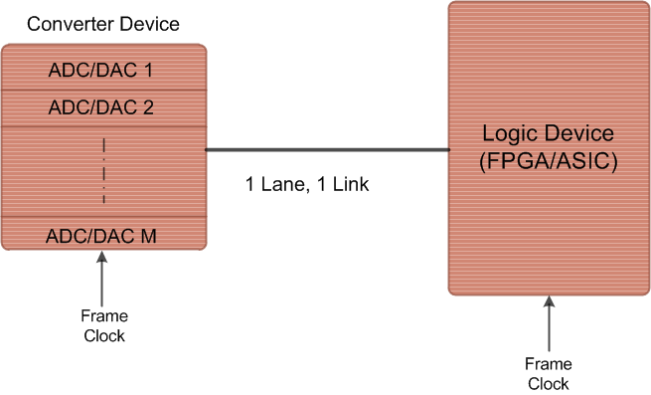
Original Spec
JESD204 – April 2006
Defines a single lane high speed serial link connected to single/multiple
data converters with speed up to 3.125Gbps.
TI Information – NDA Required

Slide 7
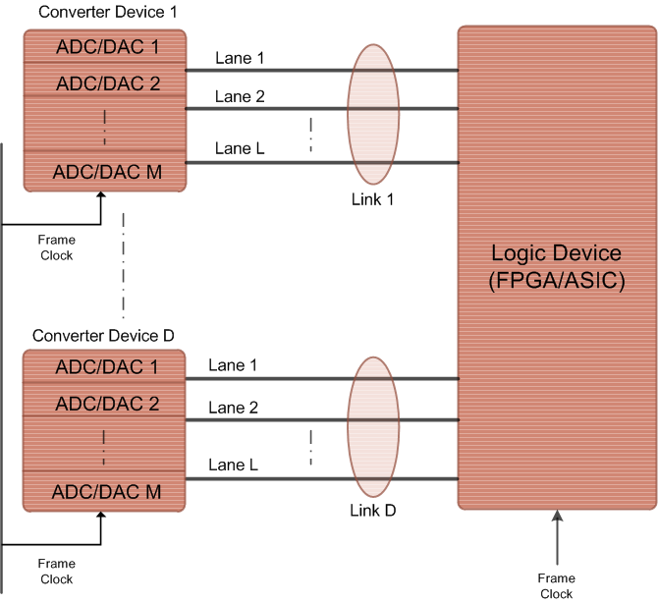
REVISIONS
JESD204A – April 2008
Revision A extends the support to multiple aligned lanes with multipoint link. Maximum supported speed is the same, 3.15Gbps.
TI Information – NDA Required

Slide 8

JESD204B – July 2011
Subclasses: 0 (backward compatible), 1, 2
Support for Deterministic Latency
Frame clock changed to device clock
Serial lanes speeds up to 12.5Gb/s
TI Information – NDA Required
Notes:
0.5

Slide 9
JESD204 Timing Signals/Terminology
Device Clock
System clock from which the device’s frame, sampling, LMFC clocks are derived (externally applied)
SYSREF
Timing phase reference from which LMFC clocks are generated in subclass 1 implementations (externally applied)
  Source synchronous with device clock
  Rising edge event sampled by device clock determines LMFC alignment
  Periodic, Gapped-periodic, One-shot types
TI Information – NDA Required
Notes:
1

Slide 10
JESD204 Timing Signals/Terminology
  Frame Clock (Core CLK)
    The frame coming out of the transport layer is aligned to the frame clock.
    As per JESD204B standard, frame clock period in all the TX and RX devices
    must be identical.
  Sample Clock
    Sample clock is aligned to a sample boundary.
    If there is only one sample per converter in a single frame cycle, then sample clock
    is the same as frame clock.
    If there are multiple samples per converter per frame clock cycle, then sample clock
    is an integer multiple of the frame clock.
  Local Multiframe Clock (LMFC) K * Frame Clock
    LMFC is aligned to a multiframe boundary which in turn consists of K number of frames.
    In order to synchronize transmission on all lanes (single or multipoint link), LMFC of
    all the converter devices are aligned with the LMFC of logic device.
    All TX and RX devices in a system must have identical LMFC period.
TI Information – NDA Required
Notes:
0.5

Slide 11
JESD204 Timing Signals/Terminology
SYNC
Receiver to Transmitter. Used for device synchronization and link error reporting
  Synchronization requests
  Subclass 2 implementations use SYNC as a phase reference for LMFC
  Options for distributing SYNC to multiple devices
  Standard defines SYNC~ (active low) signaling
TI Information – NDA Required
Notes:
0.5

Slide 12
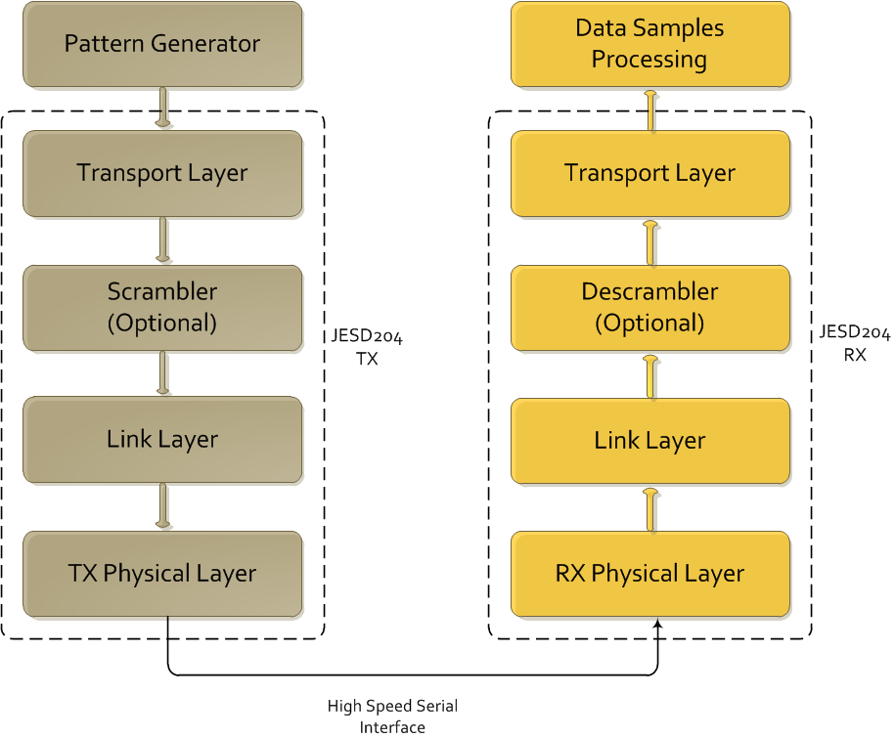
JESD204 Layers
TI Information – NDA Required
Notes:
0.5

Slide 13

Example Functional Diagram for data transmission and reception between two devices on the link
TX device (ADC or FPGA)
Parallel–to
-serial
mapping
8B/10B encoding and character insertion for lane alignment
Clock
Source
Device Clock
SYSREF Clock
SYSREF Clock
SYNC~
Device Clock
8B/10B decoding and character detection for lane alignment
serial–to
-parallel
mapping
RX device (DAC or FPGA)

Slide 14
Transport Layer Overview
Maps the data → octets → frames consisting of multiple octets
Adds optional control bits to samples if needed
  Control bits can be used to communicate status information, mark an inactive converter on the link or control receiver operation
Distinguishes the possible combinations of device/links/lanes/etc.
  Single converter connected to single lane link
  Single converter connected to multiple lanes link
  Multiple converters in a converter device connected to a single lane link
  Multiple converters in a converter device connected to multiple lanes link
TI Information – NDA Required
Notes:
1

Slide 15
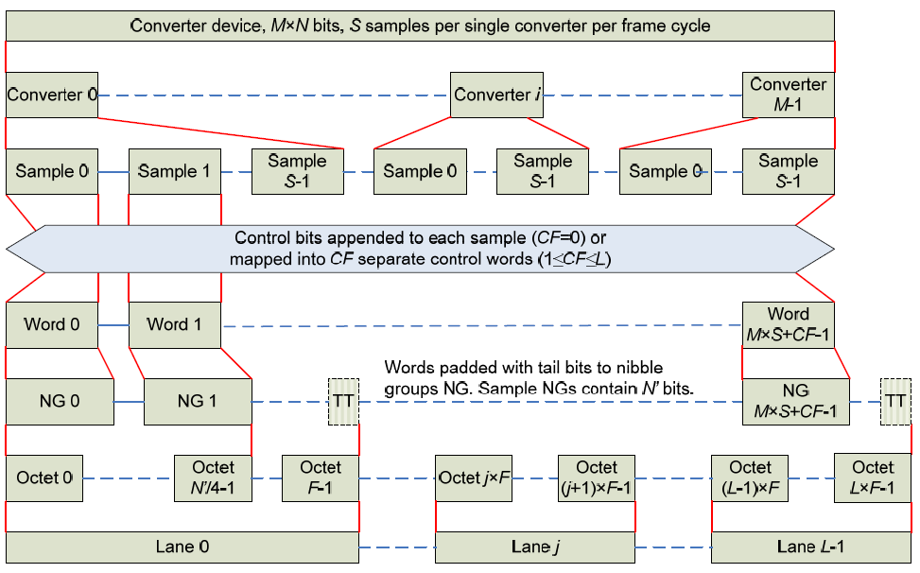
Transport Layer Overview
TI Information – NDA Required
Notes:
1

Slide 16
Transport Layer Parameters
Important parameters associated with transport layer include
  L # of lanes per converter device
  M # of converters per device
  F # of octets per frame (per lane)
  S # of samples per converter per frame clock cycle
  CS # of control bits per conversion sample
TI Information – NDA Required
Notes:
1

Slide 17
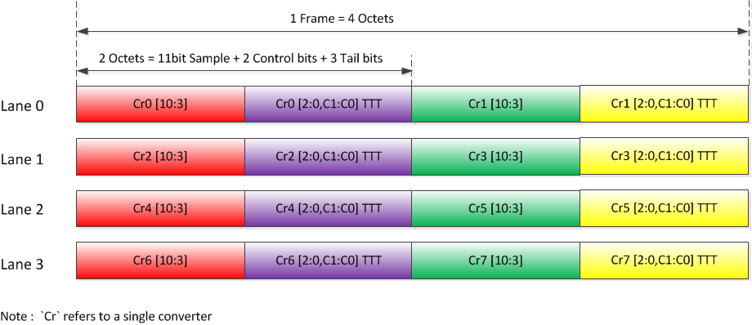
Transport Layer Example
Example: 11-bit octal ADC converter
L = 4, M = 8, F = 4, S = 1, CS = 2
TI Information – NDA Required
Notes:
2

Slide 18
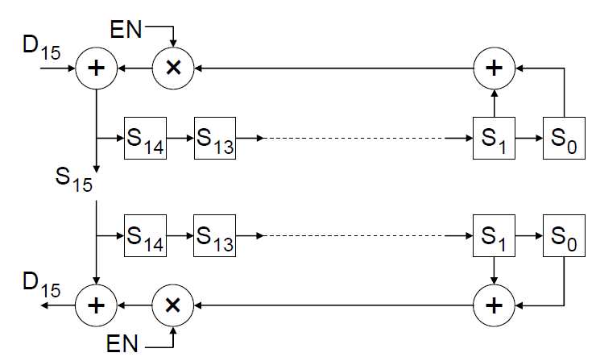
Scrambling
Scrambling randomizes data and spreads the spectral content to reduce spectral peaks that could cause EMI and interference problems
Transport layer output may be optionally scrambled with the polynomial: 1 + x¹⁴ + x¹⁵
The RX descrambler self-synchronizes after receiving only two octets
TX supports early-synchronization option that allows descrambler to self-synchronize during ILA
TI Information – NDA Required
Notes:
1

Slide 19
Data Link Layer
8b/10b encoding
Link Establishment
  Code Group Synchronization (CGS)
  Initial Lane Alignment (ILA) and Frame Synchronization
Link Monitoring using control symbols
TI Information – NDA Required
Notes:
0.5

Slide 20
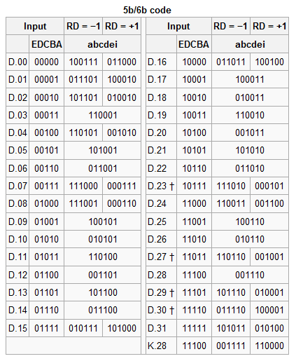
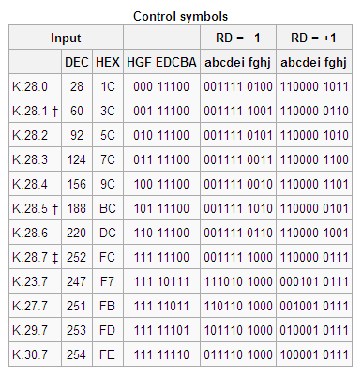
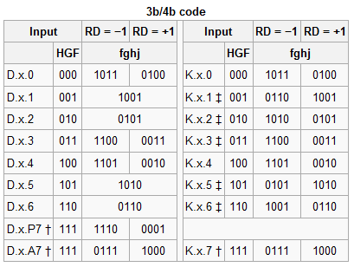
Data Link Layer: 8b/10b Encoding
Encodes 8-bit “octets” into 10-bit symbols
Octet to symbol mapping depends on running disparity (RD)
Coding provides many bit-transitions to enable CDR techniques
DC balancing enables AC coupling
TI Information – NDA Required
Notes:
1

Slide 21
Data Link Layer: Link Establishment
Link Establishment accomplishes TX and RX synchronization
  Code Group Synchronization (CGS)
  Initial Lane Alignment and Frame Synchronization
TI Information – NDA Required
Notes:
2

Slide 22
Data Link Layer: Code Group Synchronization
During CGS, the RX aligns with the 10-bit symbol boundary of the transmitted symbols
Synchronization Procedure:
  Receiver generates synchronization request by asserting SYNC~ signal
  In response, transmitter sends K28.5 comma symbols
  After receiving 4x K28.5 symbols on all lanes, the RX de-asserts SYNC~
  RX aligns frame boundary to next non-K28.5 symbol (Initial Frame Synchronization)
If link has multiple lanes, then SYNC~ signal for all lanes in a link must be combined and presented simultaneously to the transmitter
TI Information – NDA Required
Notes:
1

Slide 23
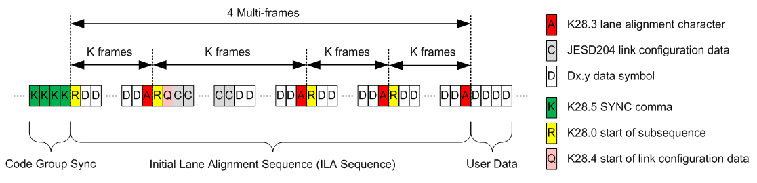
Data Link Layer: Initial Lane Synchronization
Lanes are synchronized using initial lane alignment (ILA) sequence
TX transmits ILA on next multi-frame boundary following CGS
ILA is 4 multi-frames, containing configuration parameters and alignment symbols (A)
ILA is never scrambled, even if scrambling is enabled
ILA information may be verified by the Rx, or it can be ignored if the Rx already expects a certain format
TI Information – NDA Required
Notes:
1

Slide 24
Data Link Layer: Frame Alignment Monitoring
Transmitter sends out user data after ILA sequence
Alignment characters are inserted into data stream in special conditions to re-check alignment
  If last octet in 2 successive frame are equal → transmitter replaces latter octet with K28.7 symbol (scrambling disabled)
  If last octet of a multi-frame is equal to last octet in previous frame → replace latter octet with K28.3 symbol
Receiver “undoes” the special character replacement
Receiver will re-align it’s frame clock to alignment characters under certain conditions or report an error
Texas Instruments converter devices support both the monitoring and correction of lane alignments
TI Information – NDA Required
Notes:
1

Slide 25
Error Reporting
  Standard lists the following four errors which must be detected by each receiver.
    8B/10B disparity error
    8B/10B not-in-table code error
    Control character in wrong position
    Code Group Synchronization error
  Texas Instruments JESD204B DAC core in addition generates ensuing RX errors
    Multiframe alignment error
    Frame alignment error
    Elastic buffer overflow (indicative of bad RBD value)
    Link configuration error (TX and RX parameters do not match)
    Some of the errors can be made to retrigger the synchronization request as specified by setting the corresponding bit in sync_req_ena configuration parameter.
TI Information – NDA Required

Slide 26
Physical Layer: Serial Lanes
The physical layer defines the performance of the data transfer and electrical interfaces dominated by the SERDES, CDR and driver/receiver blocks
Point-to-point, unidirectional serial interface
AC vs. DC compliance
JESD204B defines 3 signal speed-grade variants
Parameter | LV-OIF-Sx15 | LV-OIF-6G-SR | LV-OIF-11G-SR
Data Rates | 312.5Mbps – 3.125Gbps | 312.5Mbps - 6.375Gbps | 312.5Mbps – 12.5Gbps
Differential Output Voltage | 500 – 1000 (mV) | 400 – 750 (mV) | 360 – 770 (mV)
Output Rise or Fall Time (20% - 80% into 100Ω load) | ≥ 50 (ps) | ≥ 30 (ps) | ≥ 24 (ps)
Bit Error Rate (BER) | ≤ 1e-12 | ≤ 1e-15 | ≤ 1e-15
Notes:
1

Slide 27
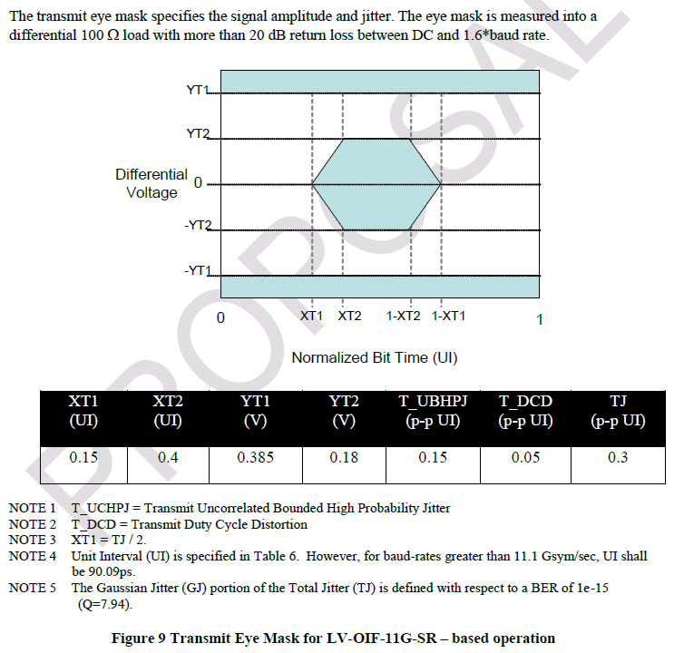
Physical Layer: Serial Lanes
Signaling scheme generally known as interface is low voltage differential Current Mode Logic (CML)
Intended to support interconnects up to 200mm (~8 in) long
Random Jitter
Random jitter plus Deterministic Jitter (ISI)
Bit-Error Rate
Notes:
0.5

Slide 28
Deterministic Latency: Justification
Applications are often sensitive to the variation of system latency
  Synchronous sampling
  Multi-channel phase array alignment
  Gain control loop stability
JESD204 and JESD204A do not achieve known/constant latency across the link across temp/supply/reboot variation
Providing support for devices with internal clock dividers introduces potential for even more latency uncertainty
Notes:
1

Slide 29
Deterministic Latency: Achieved
JESD204B achieves deterministic latency: known/constant latency
  Subclass 0: DL not achieved (JESD204A)
  Subclass 1: DL achieved using SYSREF with strict timing
  Subclass 2: DL achieved using SYNC~ with strict timing
Deterministic Latency achieved with these architecture features
  SYSREF or SYNC~ are used to provide a deterministic reference phase to all devices for synchronization
  LMFC provides a low frequency reference to avoid frame clock phase ambiguity in the presence of link delay changes
  RX has an “elastic buffer” that absorbs link delay variation
Texas Instruments recommends/supports subclass 1
  LMFC phase easier to control with source synchronous SYSREF than with system synchronous SYNC~
Notes:
1

Slide 30
Deterministic Latency: General Requirements
Elastic buffer must be large enough to store data
  Buffer size is determined by link delay
LMFC period must be longer than the longest link delay
  K parameter (frames/multiframe) determines LMFC period
  1 < K < 32
  17 < K*F < 1024
Receiver buffers serial data on all lanes until “release opportunity”
  Release opportunity is ‘RBD’ frames after LMFC boundary
  Link latency = RBD frame clock cycles
  Simplest case RBD = K → release opportunity on LMFC boundary
  Link latency may be minimized by setting RBD < K
Notes:
1

Slide 31
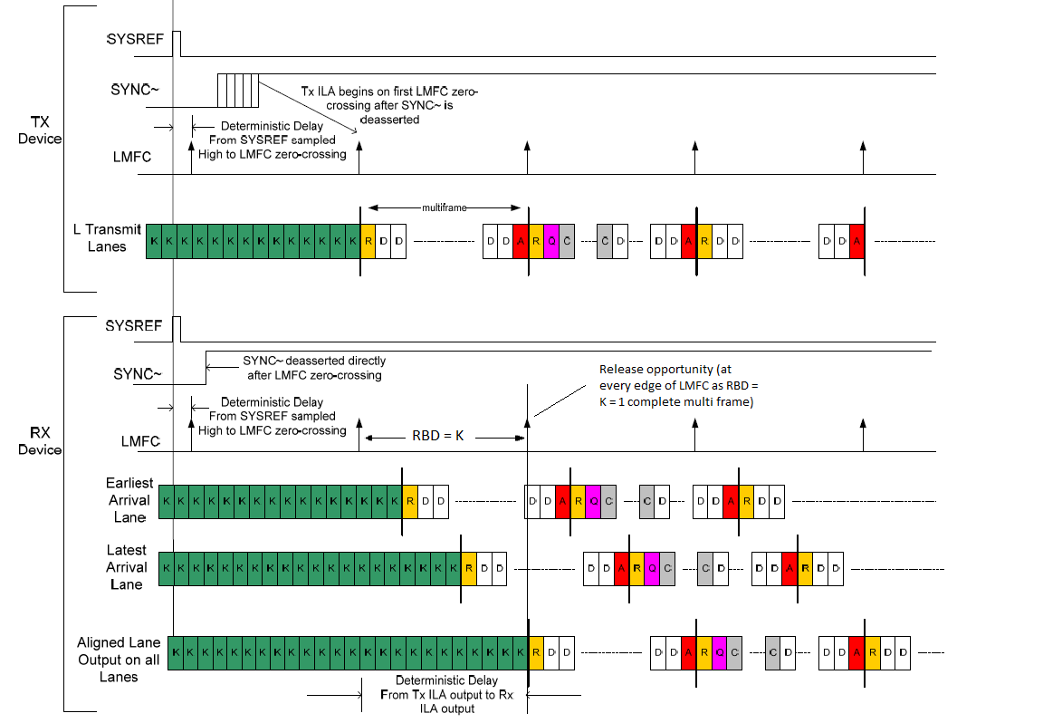
4. All lanes are released on the next LMFC edge and are now aligned
2. After SYNC is received, all lanes send ILAS on next LMFC edge
3. Each lane starts buffering it’s data when it receives the start of ILAS symbol (R)
1. Subclass 1 - SYSREF is used to align LMFCs
K – comma symbols
R - start of ILAS MF
A - end of ILAS MF
D - data
Q – start of config data
C – config data
TI Information – NDA Required

Slide 32
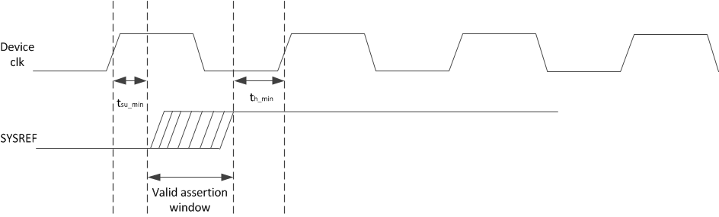
Deterministic Latency: Subclass 1 Requirements
SYSREF must meet setup/hold time with respect to the device clock
SYSREF may be shared for multiple devices as long as there is a deterministic relationship between the derived LMFCs of all devices

Slide 33
SYSREF Signal Types
Periodic
  SYSREF always ON with periodic edges
  Risk of interferer spurs near IF due to SYSREF
Gapped-Periodic
  Send periodic edges for a brief pulse of time
  No spurs
One-Shot
  Single SYSREF pulse and then leave in logic-low state
  No spurs
Frame and LMFC alignment is based on most recent SYSREF rising edge (event) detected
Disabling and gating the SYSREF signal may be employed
TI Information – NDA Required
Notes:
1

Slide 34
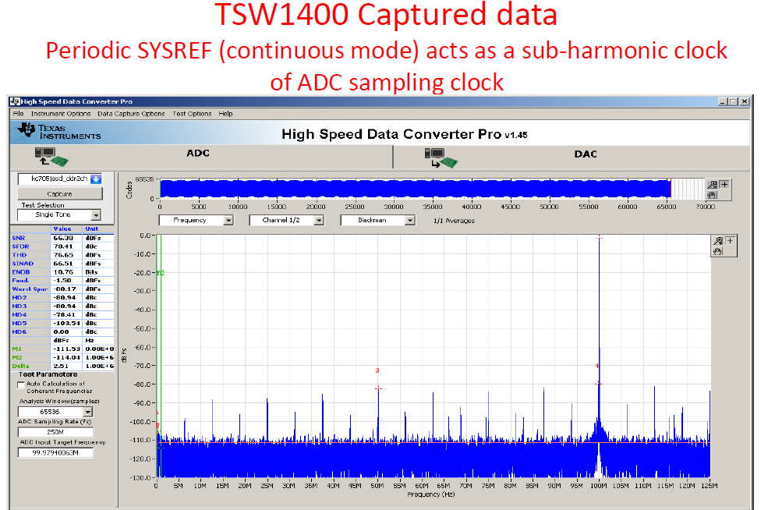
TI Information – NDA Required
Notes:
1

Slide 35
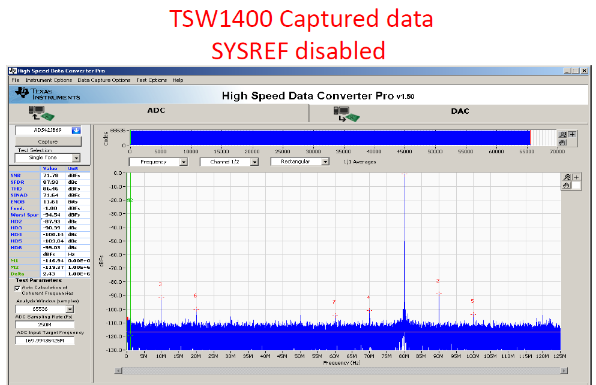
TI Information – NDA Required
Notes:
1

Slide 36
Subclass 0, 1, 2
Three device subclasses have been defined. Each subclass uses a different link synchronization method.
  Subclass 0: Deterministic latency not supported. Backward compatible with JESD204A. No defined method for aligning local multi-frame clocks. Uses SYNC~ signal.
  Subclass 1: Deterministic latency is supported. Uses SYSREF clock to align local multi-frame clocks to device clocks in both TX and RX devices. May use SYNC~ signal to initiate a lane alignment sequence.
  Subclass 2: Deterministic latency supported. Uses SYNC~ to align local multi-frame clocks.

Slide 37
JES204B Subclasses: 0
Backward compatible with JESD204A but supports high line rates
No support for deterministic (known/constant) latency
Supports alignment of multiple lanes/device
Multi-device synchronization requires strict frame clock frequency and tight SYNC~ setup/hold timing
SYNC~ of subclass 0 has special timing requirements for error reporting
Mixing subclass 0 with subclass 1, 2 devices requires special SYNC~ error reporting considerations
TI Information – NDA Required
Notes:
1

Slide 38
JES204B Subclasses: 0
TX device
Clock
Source
Frame Clock
SYNC~
Data
Frame Clock
RX device
Critical Timing Path for: Synchronization
TI Information – NDA Required
Notes:
0.5

Slide 39
JES204B Subclasses: 1
Each device has an internal frame and local multi-frame clock
  Frame clock achieves serial transfer of symbols
  Local multi-frame clock (LMFC) achieves known latency
Requires the SYSREF signal
  SYSREF must be source synchronous with the device clock (critical)
  Phase of SYSREF events determine frame clock and local multi-frame clock alignments
Deterministic latency achieved
Supports alignment of multiple lanes/device
Multi-device synchronization achieved with close attention to device clock and SYSREF distribution
SYNC~ used for synchronization but is not timing critical
TI Information – NDA Required
Notes:
1

Slide 40
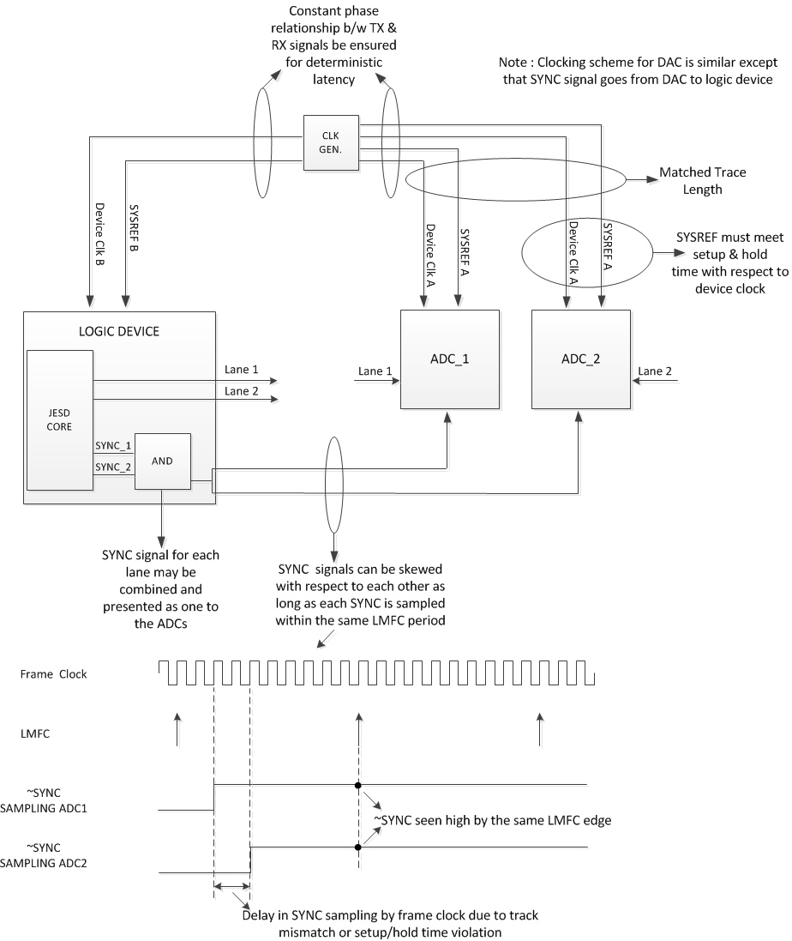
Clocking Scheme - Subclass 1
TI Information – NDA Required

Slide 41
JES204B Subclasses: 2
Each device has an internal frame and local multi-frame clock
  Same as subclass 1
SYNC~ signal used for synchronization and deterministic latency
  SYNC~ must be system synchronous with the device clock (critical)
  Phase of SYNC~ events determine frame clock and local multi-frame clock alignments
Deterministic latency achieved
Supports alignment of multiple lanes/device
Multi-device synchronization achieved with close attention to device clock and SYNC~ distribution
Since meeting setup and hold time becomes a challenge at higher sampling rates, it is recommended, as per standard, to use Subclass 1 for speeds above 500MSPS for both ADC and DAC.
TI Information – NDA Required
Notes:
1

Slide 42
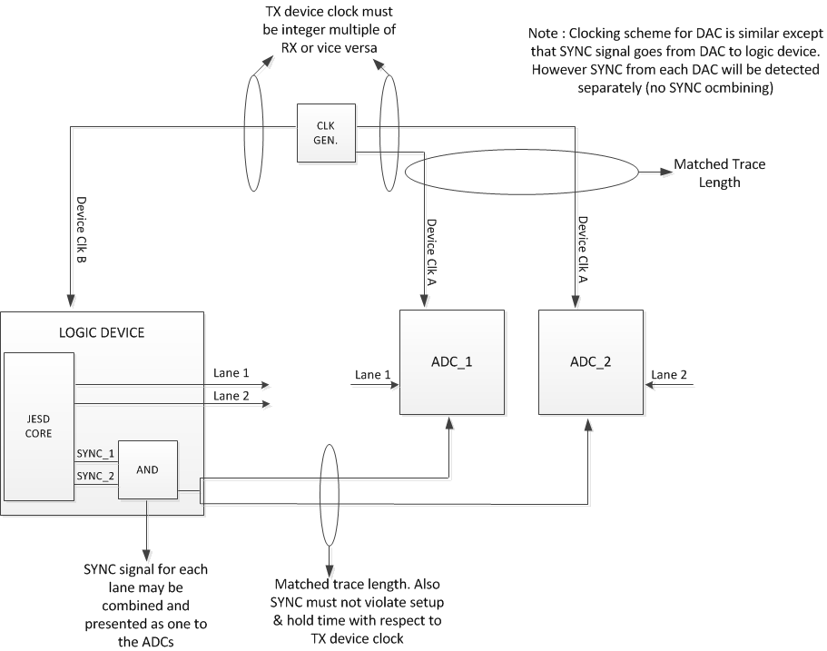
Clocking Scheme – Subclass 2

Slide 43
Key Configuration Parameters and Equations
L = number of lanes per converter device
M = number of converters per device
F = number of octets per frame (per lane)
S = number of samples per frame
f_{S} = Converter sample rate
K = # of frames per multiframe
LMFC = Local Multiple Frame Clock
Serial Line rate = Serdes speed
Serial Line Rate = f_{S} * 10 * F/S [bits/s/lane] (Note: # lanes influences F parameter)
f_{LMFC} = f_{S} / (K * S) [max SYSREF frequency]
Known as LMFS parameter,
Found in device data sheets
1 < K < 32
17 < F*K < 1024
TI Information – NDA Required

Slide 44
Configuration Parameters
ADS42JB49EVM LMFS = 4211 example (Board default values)
L = 4 lane / device
M = 2 converters / device
F = 1 octet / frame
S = 1 sample/frame
f_{S} = 250MHz (max) (device clock)
K = 20
Line rate = fs * 10 * F/S = 250 * 10 * 1/1 = 2500 MHz
LMFC = fs/ (K * S) = 250/20 = 12.5 MHz
SYSREF = 12.5MHz, 6.25MHz, 3.125Mhz, etc…
TI Information – NDA Required

Slide 45
Configuration Parameters
ADC42JB49EVM LMFS = 2221 example
L = 2 lanes / converter device
M = 2 converters
F = 2 octet / frame
S = 1 sample/frame
f_{S} = 156.25MHz (max) (device clock)
K = 20
Line rate = fs * 10 * F/S = 156.25 * 10 * 2/1 = 3125 MHz
LMFC = fs/K = 156.25 / 20 = 7.8125 MHz
SYSREF = 7.8125 MHz, 3.90625 MHz, etc…
TI Information – NDA Required

Slide 46
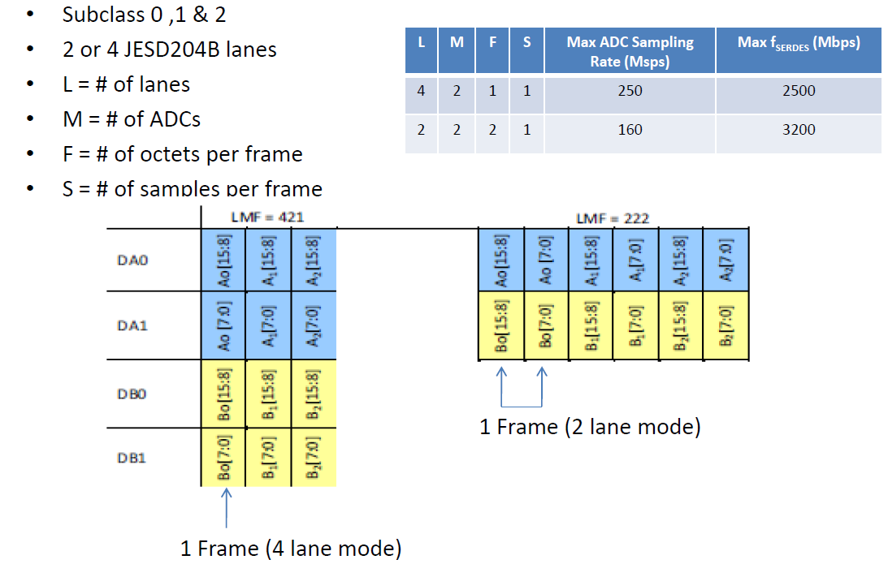
Configuration Parameters
(ADS42JB69 data sheet ex.)
TI Information – NDA Required

Slide 47
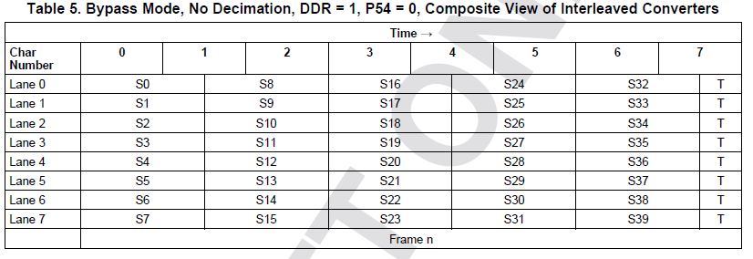
Configuration Parameters (ADC12J4000 ex.)
LMFS = 8885
TI Information – NDA Required

Slide 48
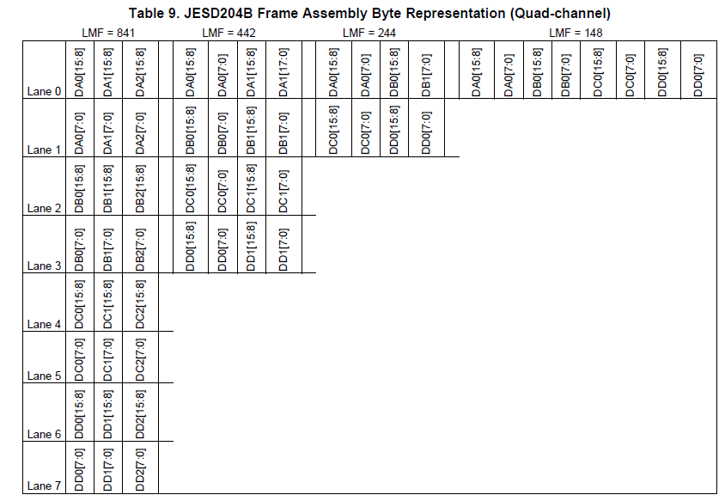
Configuration Parameters (DAC38J84 ex.)
TI Information – NDA Required

Slide 49
Configuration Parameters
  Additional TX parameters (DACs)
  BUF_SIZE : Size of the receiver elastic buffer (fixed by silicon)
  RBD : Receiver buffer delay (adjustable)
  SCR : Enable/Disable descrambling
  sync_req_ena : Register to enable various re-synchronization triggers
TI Information – NDA Required

Slide 50
Summary
  JESD204: Standard serial data interface for data converters
  JESD204B subclasses offer 3 implementation variations
  Transport Layer defines data framing into serial lanes
  Link layer defines encoding, synchronization and data monitoring
  Physical layer defines the electrical and timing performance
  Deterministic latency achieved with subclasses 1, 2 and is required for known/constant latency through link
TI Information – NDA Required

