Slide 1
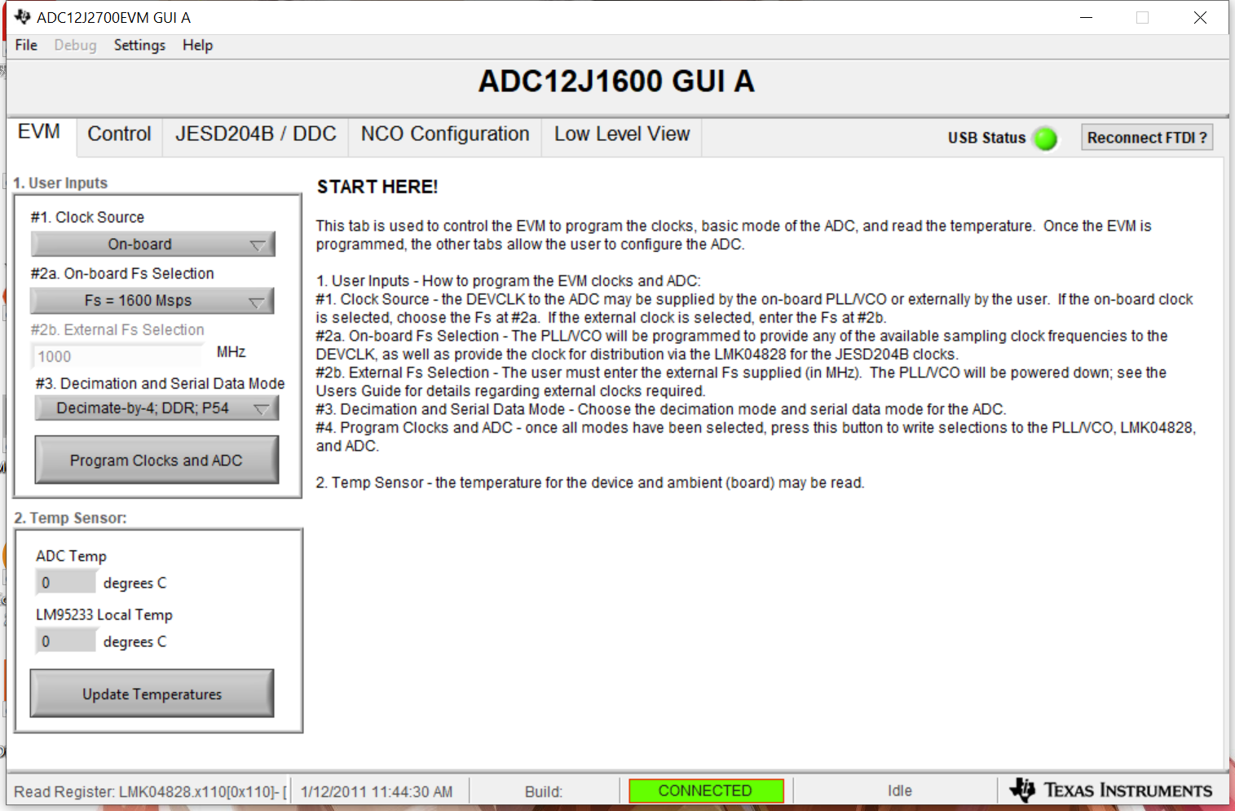
ADC12J1600 Configuration

Slide 2
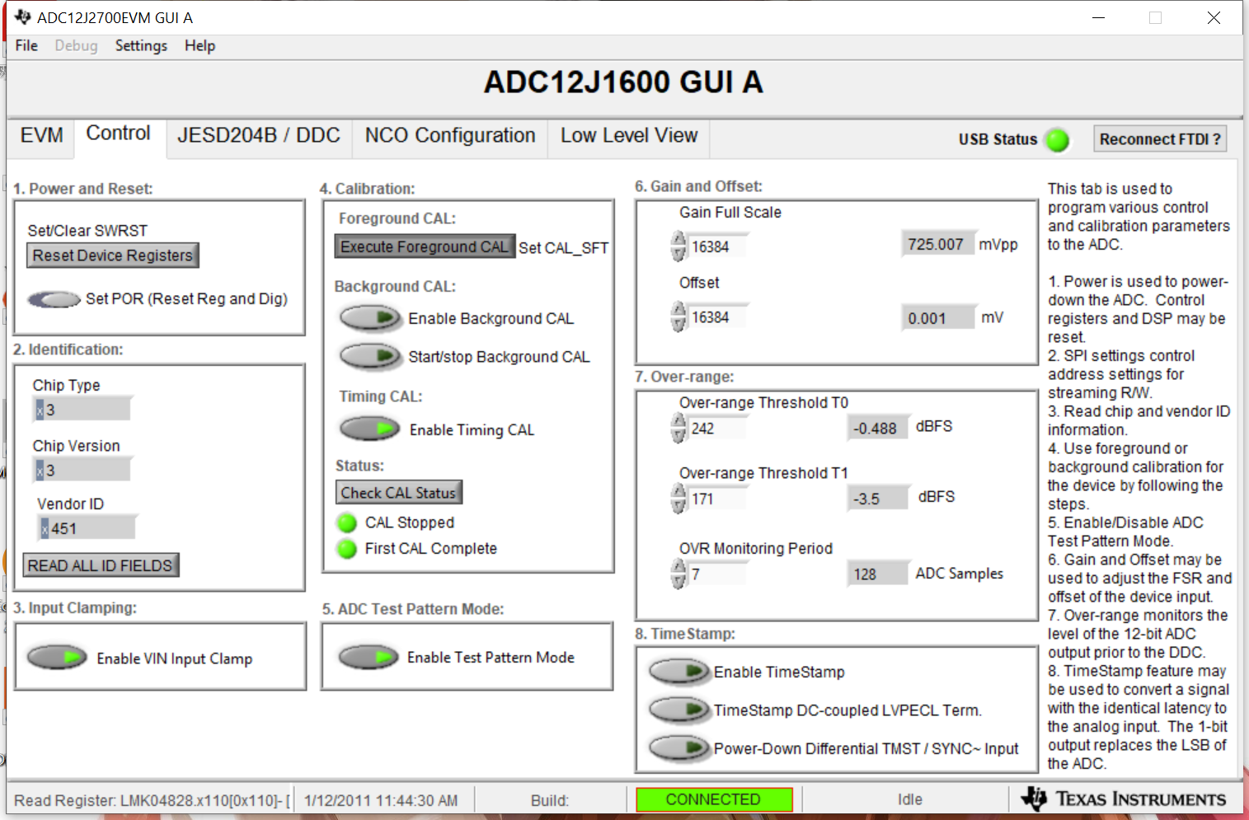

Slide 3
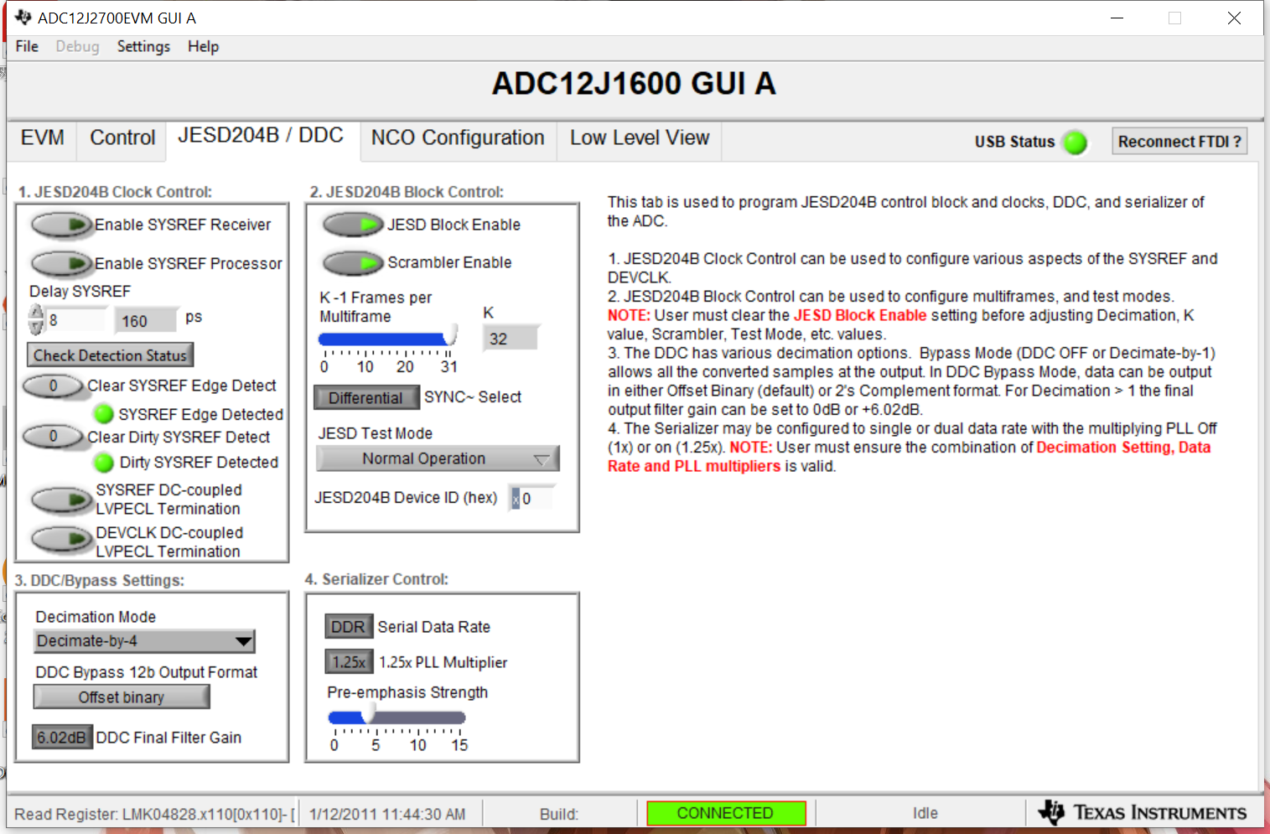

Slide 4
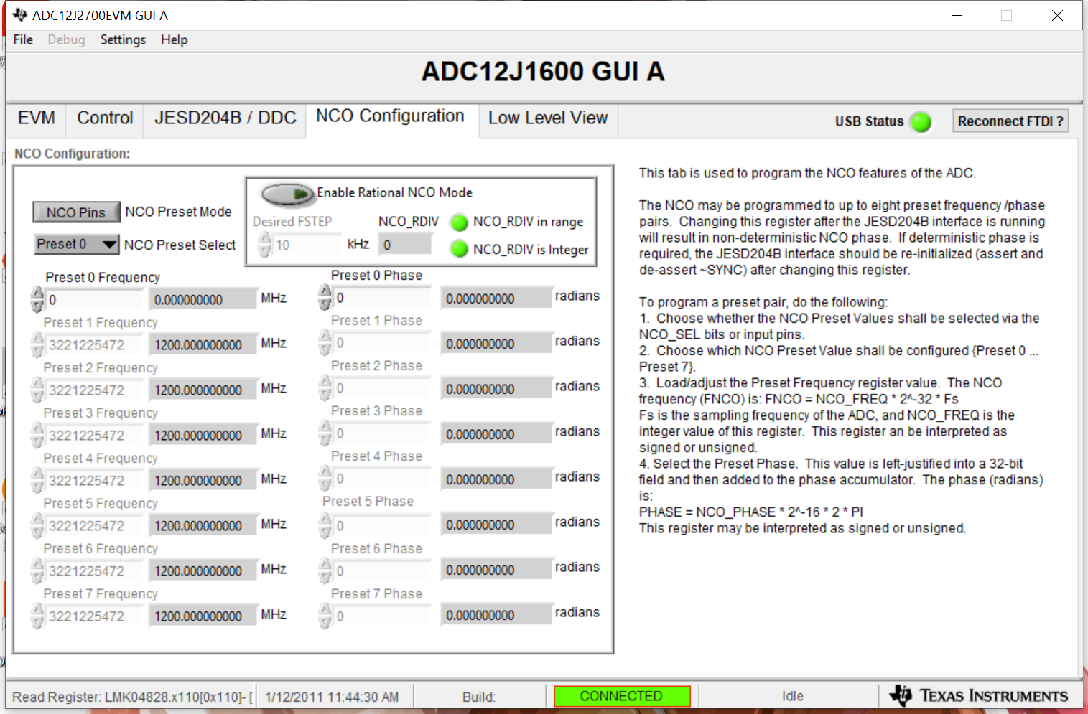

Slide 5
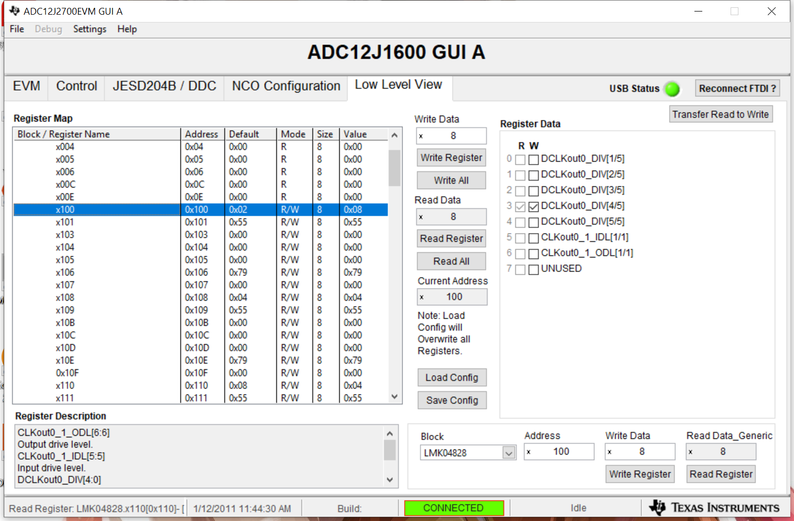

Slide 6
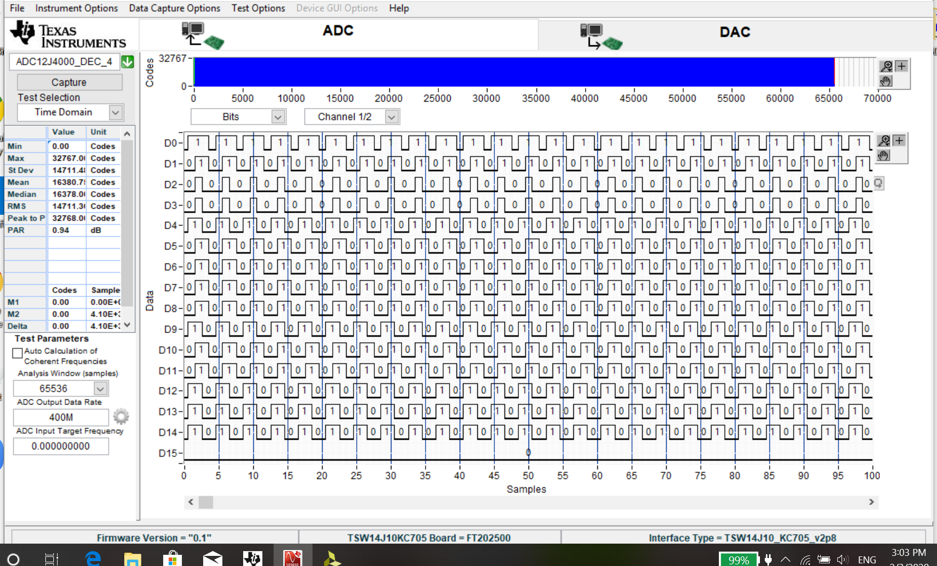
Captured Data on HSDC Pro(ADC Test Pattern)

Slide 7
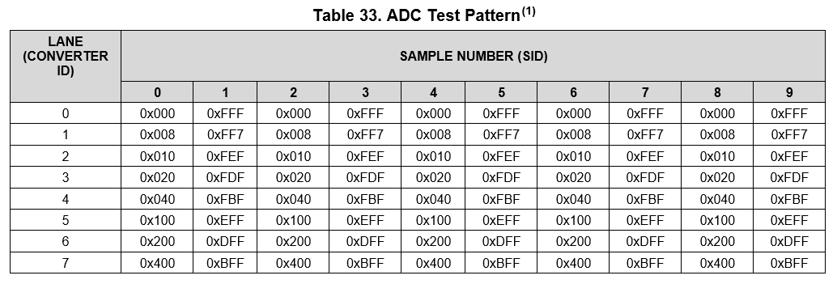
ADC Test Pattern

Slide 8
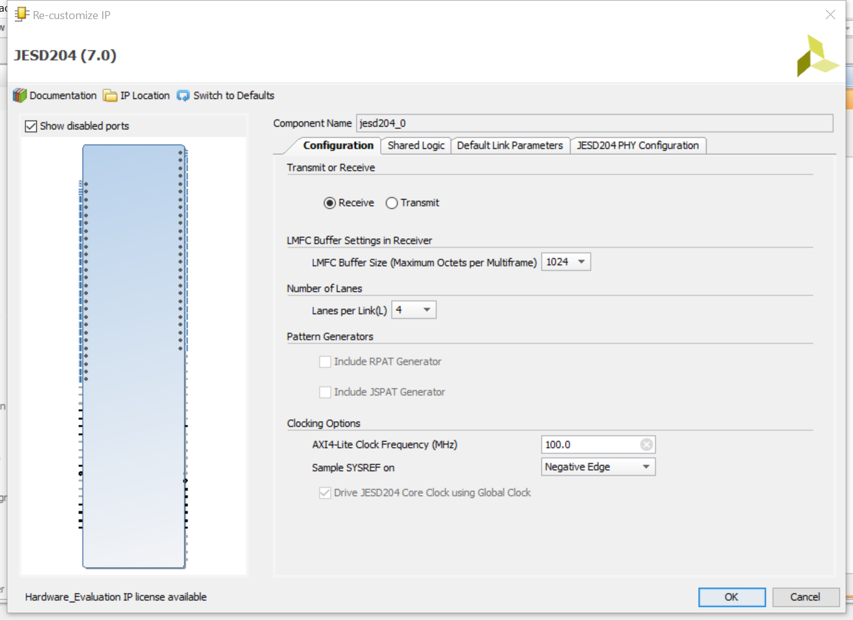
JESD Configuration on KC705

Slide 9
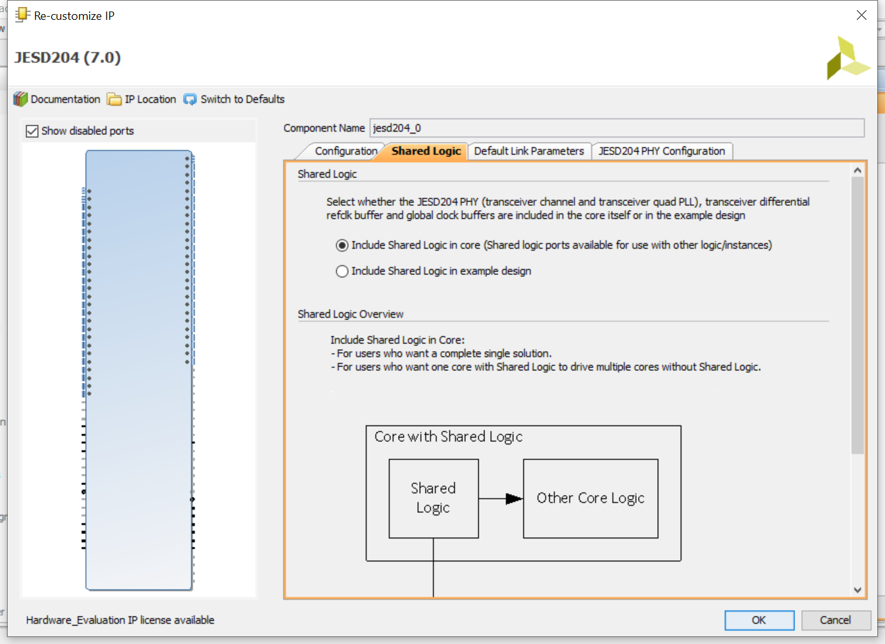

Slide 10
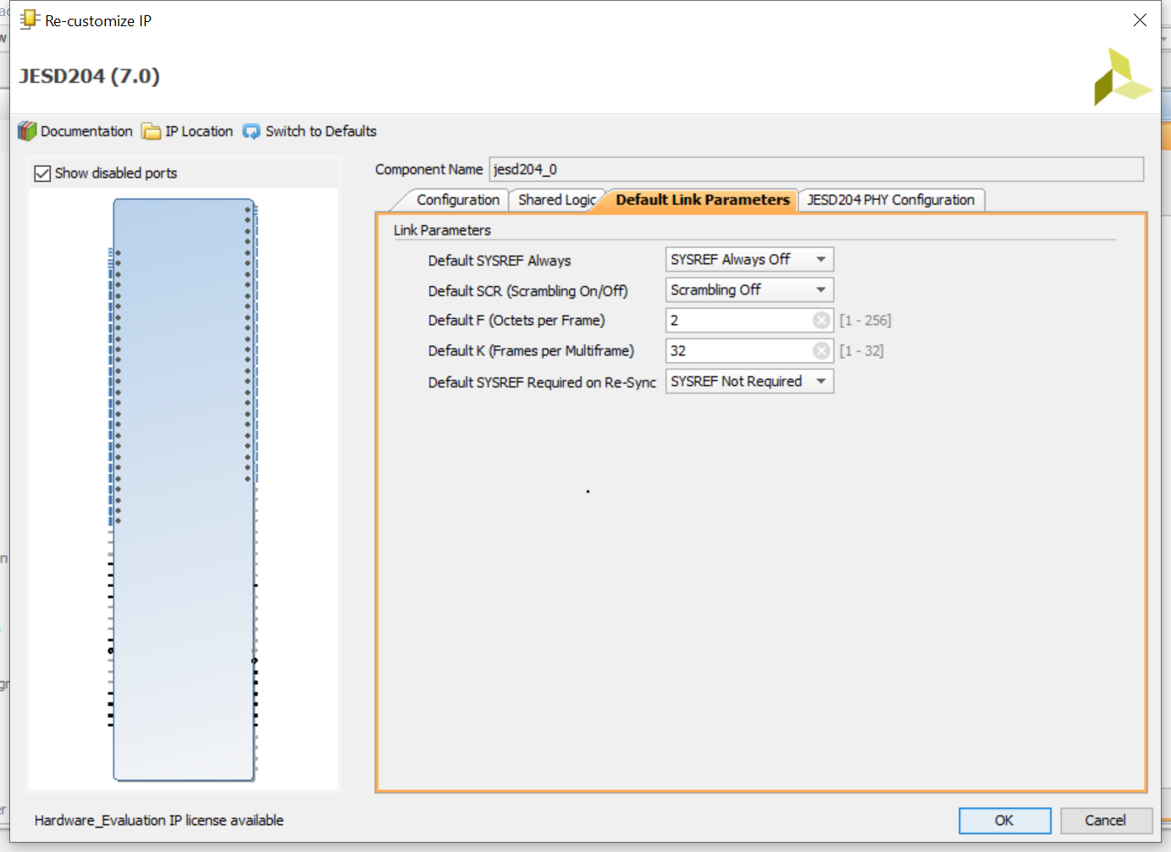

Slide 11
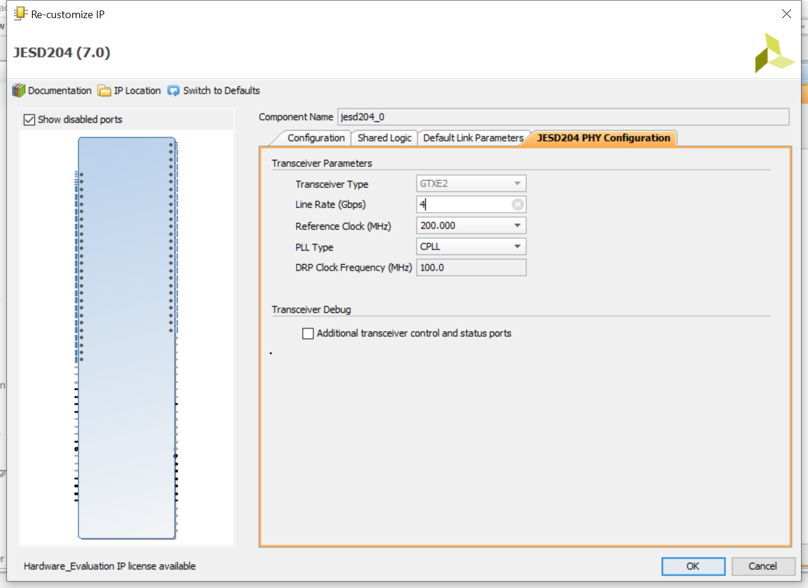

Slide 12
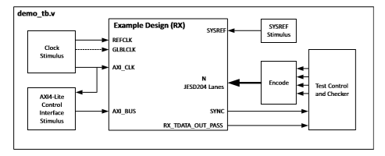
Layout of JESD Project on FPGA

Slide 13
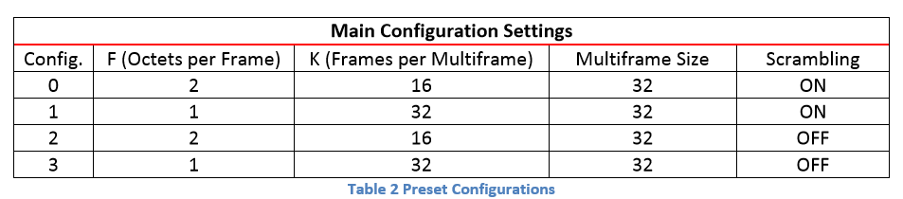
The ref_clk and core_clk(glb_clk) are provided by ADC12J1600, An AXI_Controlled and Sys_ref stimulus generator which come from Xilinx providing JESD204_demo project are included. It can configure the JESD core as below:
Configuration 0 is set there.

Slide 14
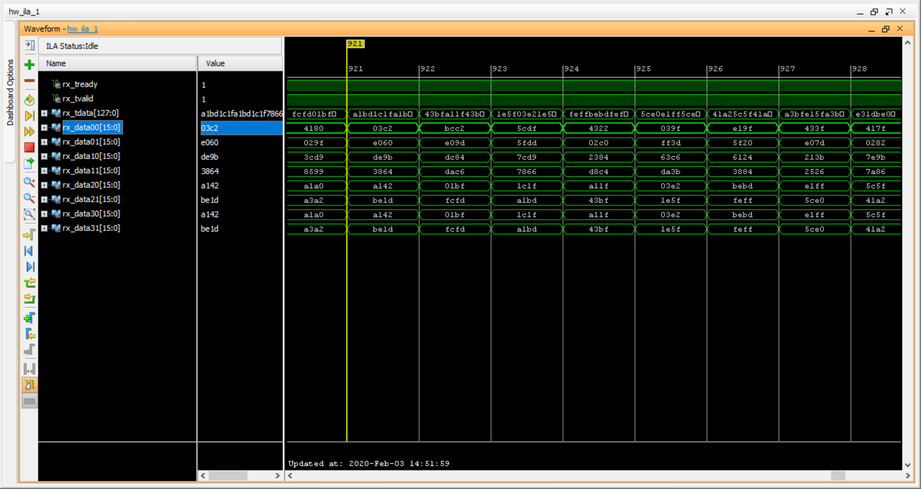
Testing results on FPGA

Slide 15
Here, rx_data00 represents the first sample on lane0, rx_data01 represents the second sample on lane0;
Rx_data10 represents the first sample on lane1, rx_data11 represents the second sample on lane1;
The rest can be done in the same manner.
The

