Slide 1
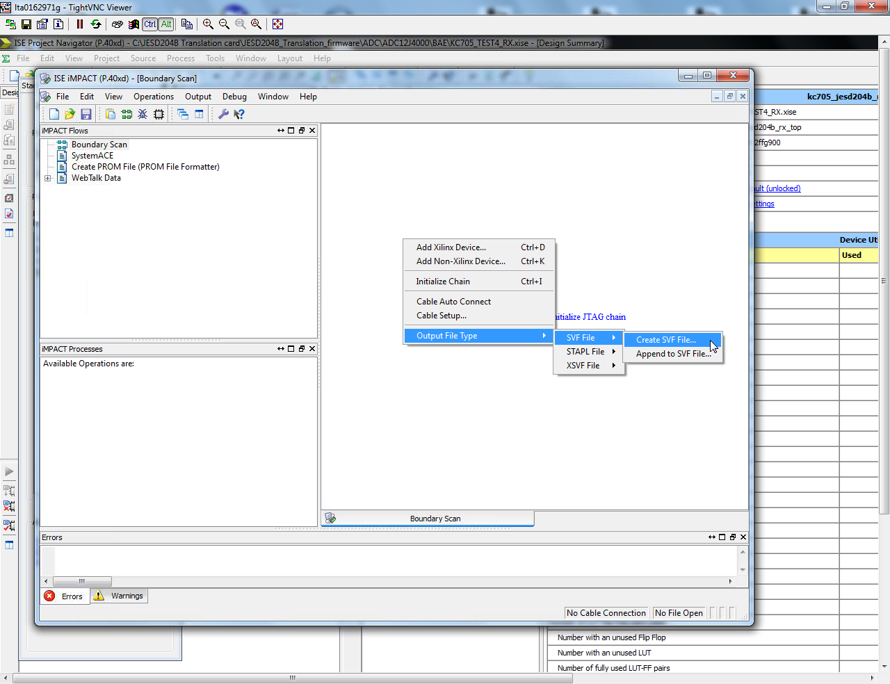
Open iMPACT then click on “Boundary Scan”. Next go to “Output File Type > SVF File > Create SVF File” as shown below.

Slide 2
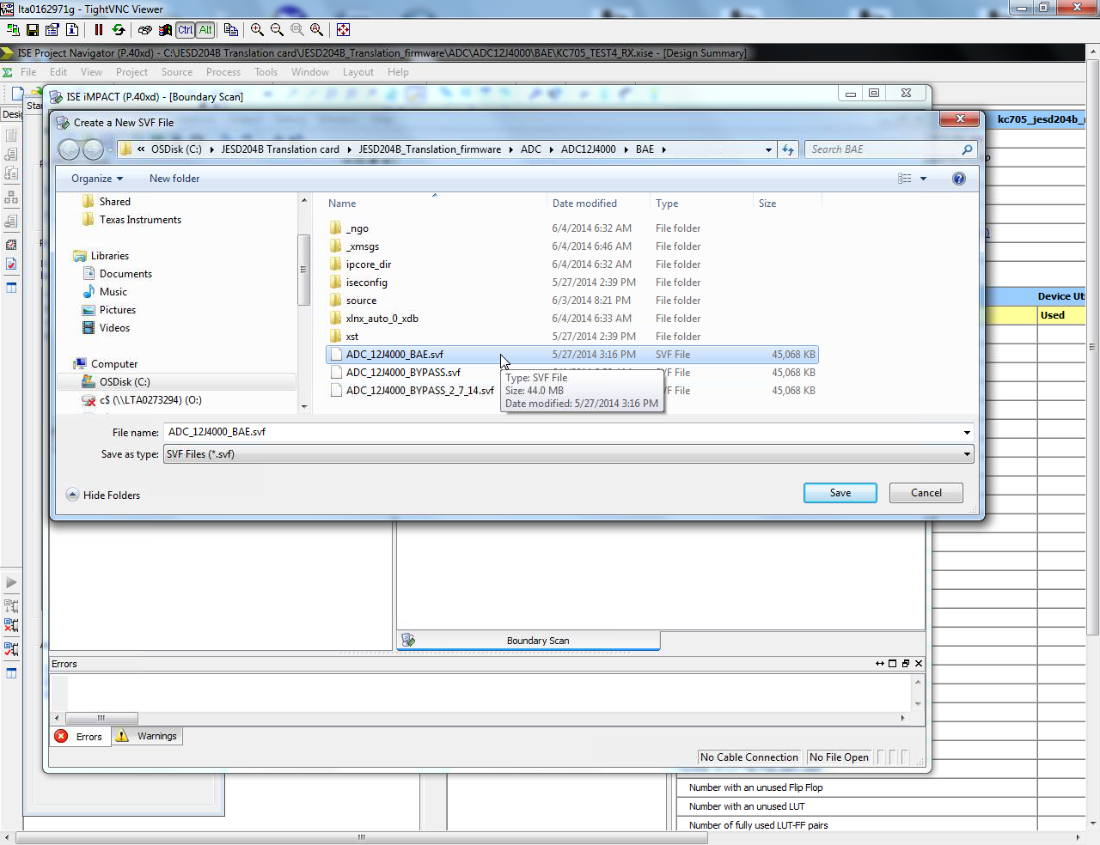
Enter a SVF file name.

Slide 3
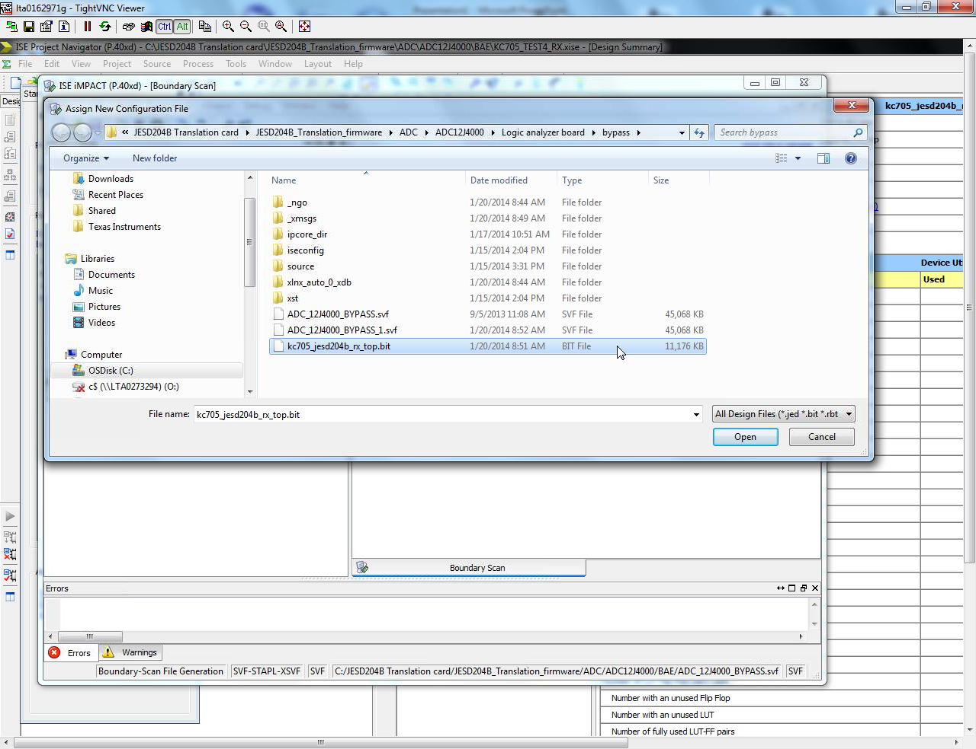
Navigate to the bit file to be used. Click on “Open”.

Slide 4
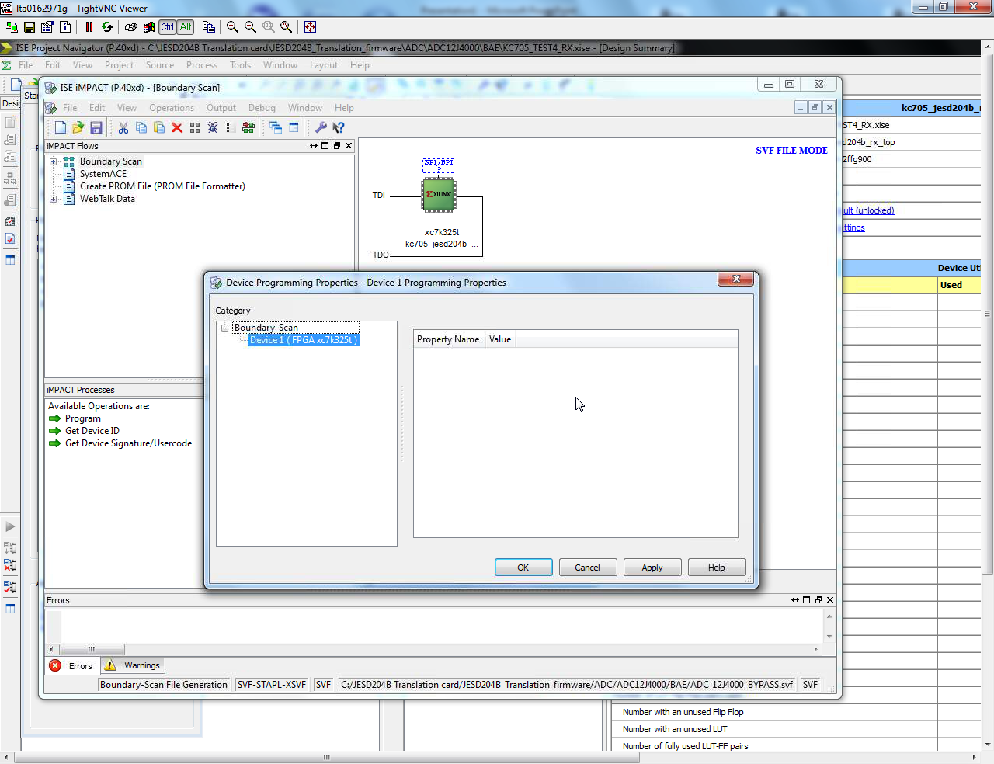
Left click on the green block and select OK.

Slide 5
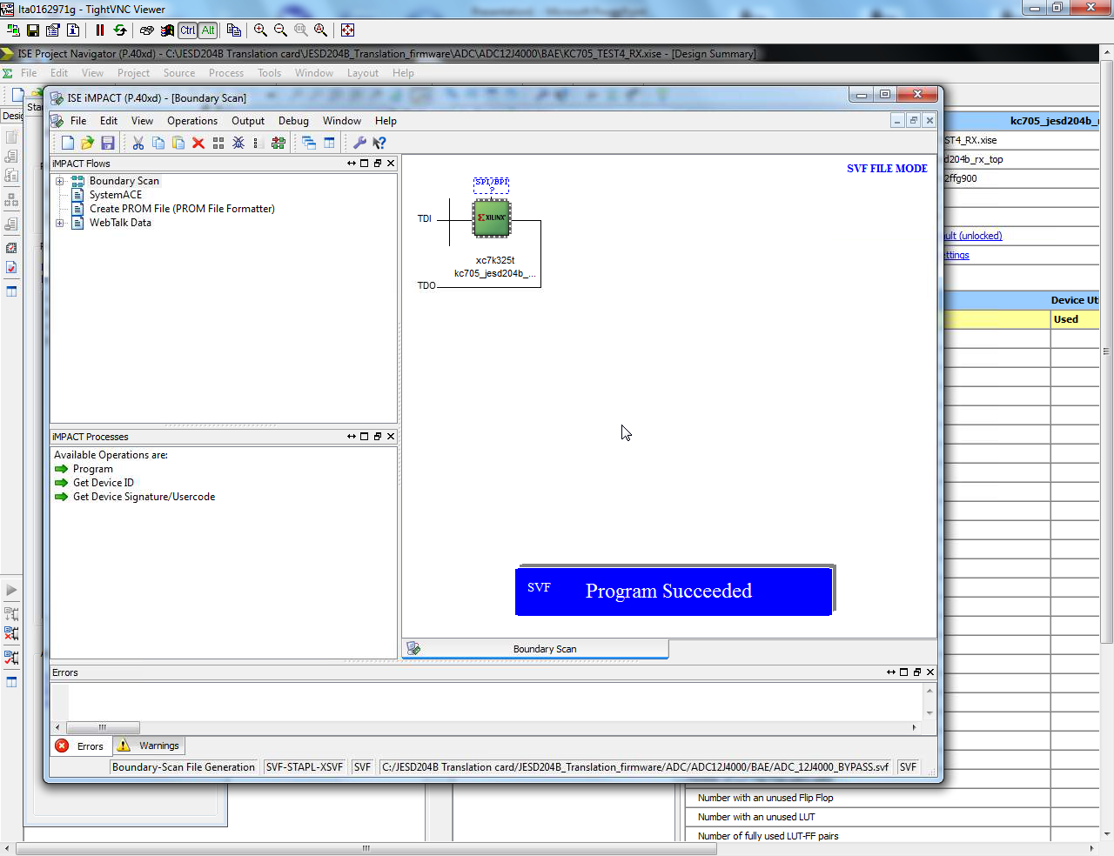
Software will generate SVF file.

Slide 6
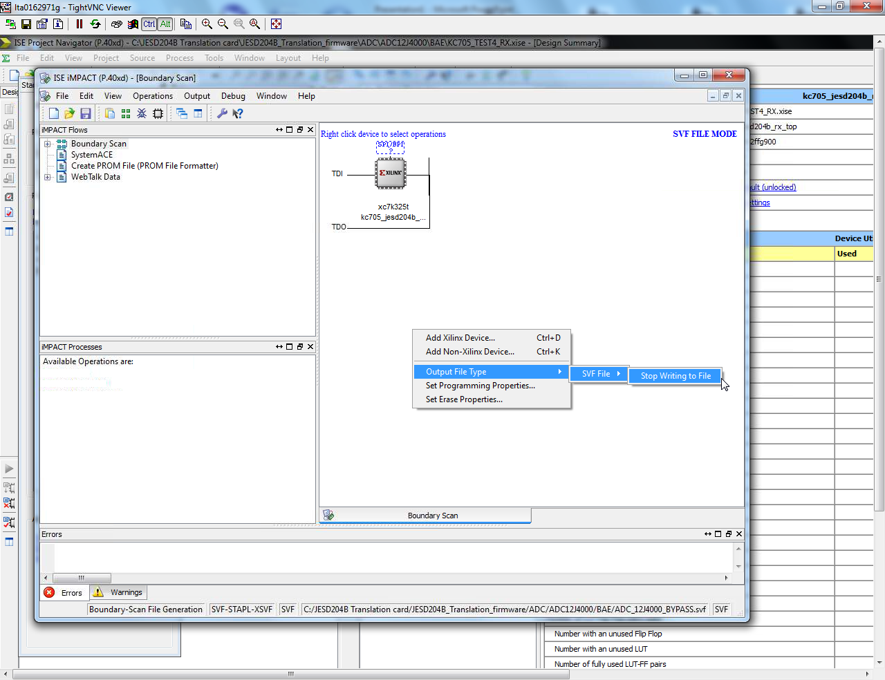
Click on background and select “Stop Writing to File”, as shown below.

Slide 7
You should now have a valid SVF file the HSDC Pro can use.

