Slide 1
ADS7841 SAR Input Model
(6/1/17)
SAR ADC Applications, Texas Instruments

Slide 2
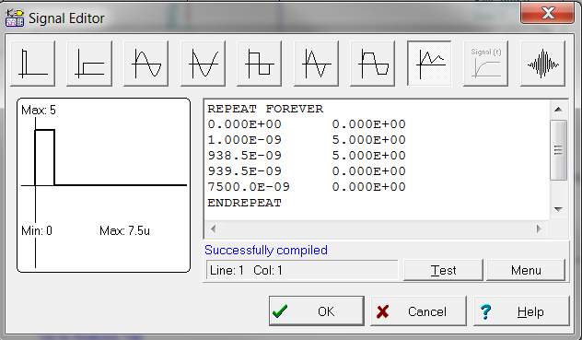
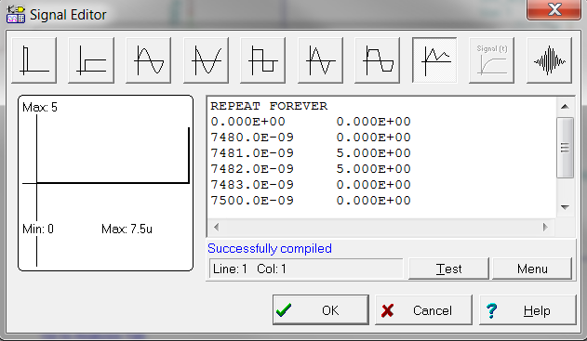
ADS7841 SAR Input Model & Op Amp Circuit
To observe ADC sample cap value
settles to within ½ LSB of input
Voltage Controlled Switch (VCS) to control sample cap charging period (= acq time)
VCS for end of conversion reset (discharges sampling cap)
Sampling Capacitor
(25p as specified in DS)
Acquisition time setup: Controls SW on and off period
End of conversion reset setup

Slide 3
Transient Simulation
Input to ADC across Charge bucket filter
Error in ADC settling sampled signal
Op amp output
Input to ADC sample and hold capacitor
Acquisition switch control
Conversion switch control
When tacq =5V SW_acq is closed.
Verror and Voa must settle in this window

