Slide 1
Frame and Multi-Frame Error

Slide 2
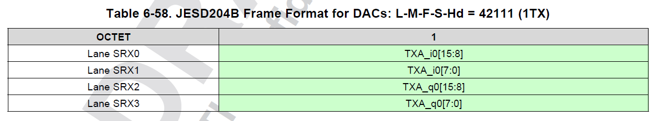
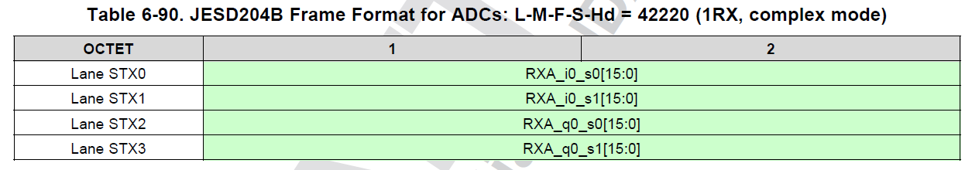
Frame and Multi-Frame Setup
Frame (F): a set of consecutive octets in which the position of each octet can be identified by reference to a frame alignment signal.
Example below show the frame format for TXDAC of 42111 mode and RXADC of 42220 mode.
Multi-frame (K) : a set of consecutive frames in which the position of each frame can be identified by reference to a multiframe alignment signal
JESD204B standard specify maximum of K = 32.

Slide 3
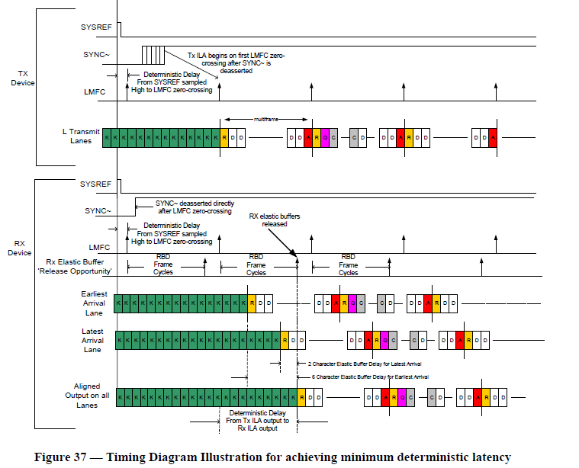
Illustration of Frame and Multi-frame in JESD204B Link
Frame is highlighted in blue
Multi-frame is highlighted in red
Copyright: JEDEC Solid State Technology Association
JESD204B Standard 04/2008

Slide 4
Reason for Frame and Multi-frame Boundary
Frame boundary is needed for both the JESD204B transmitter and JESD204B receiver to have pre-determined way to “process” the bit packing and octet packing of the data octets. This is performed in the transport layer of the JESD204B specification.
Multi-frame boundary is needed such that the JESD204B transmitter and JESD204B receiver can perform logics in the data path using their own perspective “local clock”. This is the local multi-frame clock (or LMFC), which defines the logical processing clock to process the data octets.
The ideas is that the LMFC of each perspective JESD204B block can have known, well-defined, and deterministic delay between the data source and data receiver. The clocks do not have to have absolute delay defined in order to simplify clocking solution.
The deterministic delays can be absorbed by the release buffer in the JESD204B receiver.

Slide 5
Frame Alignment Alarm
Frame alignment monitoring is constantly performed by check that replacement characters /F/ and /A/ arrive at expected positions in the frame and multiframe.
When these characters are received, they are replaced with actual data.
If they are consistently received at unexpected positions, then frame alignment error or the multiframe alignment error would be triggered to indicate the alignment has been lost.
Frame alignment correction is *not* supported. Therefore, the host need to perform re-alignment and resynchronization of the JESD204B link based on alarm feedback
The following sections of the JESD204B Standard highlights the Frame and Multi-frame Alignment:
  7.2 Initial Frame Synchronization
  Figure 45 – State Machine for Frame Synchronization in Receivers Supporting Re-initialization
  7.3 Frame Alignment Monitoring and Correction
  7.4 Initial Lane Synchronization
  7.5 Lane Alignment Monitoring and Correction
  8.2 Initial Lane Alignment Sequence
  8.3 Link Configuration Data and Encoding
  5.3.3.4 Frame Alignment Monitoring and Correction.

Slide 6
Possible Source of Frame Alignment and Multi-Frame Alignment Alarms
“Drift” of SYSREF reset of LMFC over time.
  SYSREF reset of LMFC change in the “periodic” time instance over time.
  The overall LMFC boundary changes and potentially cause alignment errors.
  The SYSREF can be programmed to be ignored in the JESD204B logics of the , both TXDAC and RXADC
“Drift” of the clock source to various logics.
“Drift” of incoming data on the JESD204B transmitter over time.
The incoming data are sufficiently periodic and not sufficiently random. The character replacement rules for the /A/ and /F/ characters are not exercised sufficiently, and hence the periodic frame and multi-frame are not checked frequently.
Incorrect initialization of the logical block in the JESD204B transmitter. The JESD204B IP was not reset properly upon start-up. Glitch occurs after various temperature cycle.

Slide 7
Link Configuration Error

Slide 8
Overview of Link Configuration Data
The frame alignment block of the JESD204B RX IP performs the initial frame synchronization, verification of the link configuration parameters, and frame alignment monitoring.
When the initial lane alignment sequence arrives in this block, the first non-/K/ character is marked as the first octet of the first frame. The link configuration data is expected to arrive in the second multiframe. This block verified that the JESD204B TX lanes are programmed with the same configuration as the JESD204B RX lane.
Any mismatches in the configuration parameter would trigger the link configuration error.
See next slide for better pictorial representation.

Slide 9
Initial Lane Alignment JESD204B Configuration Check Location
Link configuration data is expected to arrive on the second multi-frame of the initial lane alignment sequence. See blue area for detail. Basically the second /R/ indicates the ILAS
Copyright: JEDEC Solid State Technology Association
JESD204B Standard 04/2008

Slide 10
Initial Lane Alignment JESD204B Configuration Check
Each lane should have unique lane ID that is tied to the physical lane.
Correct programming of the ILAS configuration are needed for both side of the JESD204B link (i.e. ASIC/FPGA and DAC logic) in order for the ILAS check to be successful.

Slide 11
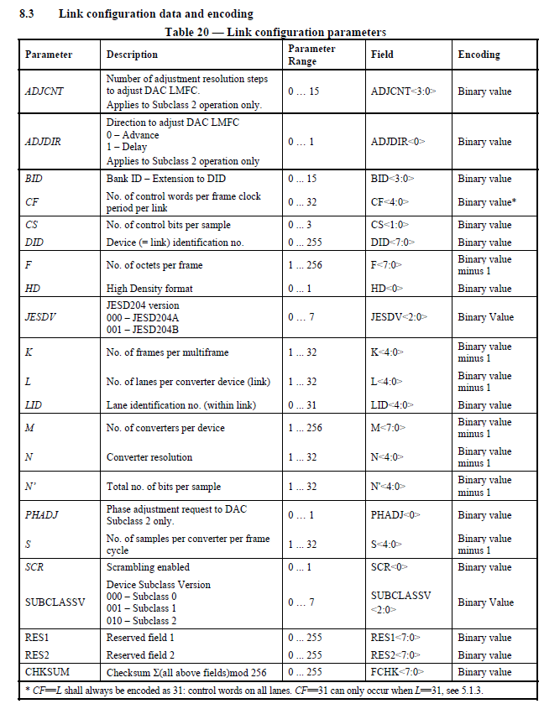
Overview of the JESD204B Link Configuration
Link Configuration Data Requirement
Configuration for Link Configuration Check
Programmer Tool
Copyright: JEDEC Solid State Technology Association
JESD204B Standard 04/2008

Slide 12
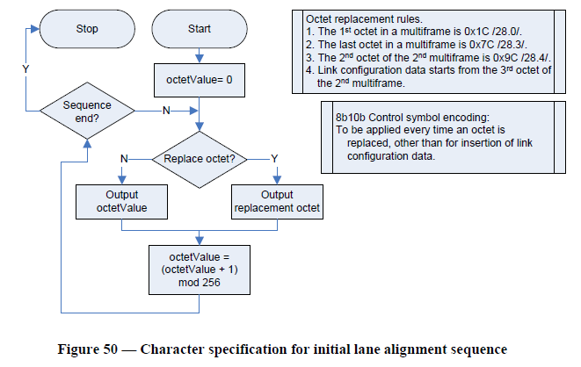
Error Handling and Things to Check
If link cannot be established, try to ignore ILAS check in SYNC_REQUEST to check if the JESD204B link can be established properly.
  Note the keyword is “ignore”, not skip. Skipping the ILAS will default to subclass 0 mode, which is not supported by .
Check the ASIC/FPGA ILAS setting and sequence.
Probe the SERDES line with high speed scope to trigger on first non-K28.5 character to decode the ILAS sequence
Go through the sequence to see if the octets are properly replaced for ILAS
Run link layer test to test for ILAS sequence.
Copyright: JEDEC Solid State Technology Association
JESD204B Standard 04/2008

Slide 13
Elastic Buffer Overrun

Slide 14
DAC JESD204B K value Setting
For the DAC JESD204B logics, the number of octets in RBD buffer is 64 octets.
  More octets requires more logics for the RBD buffer, which consumes silicon area and power consumption.
  64 octets of RBD buffer is used in most of the TI DAC JESD204B logics (and most of the FPGA HDL implementation)
F = number of octets per frame
K = number of frames in multi-frame
64/F = optimal number of values within the RBD buffer
  For instance, in TX = 44210 mode, F = 2. The optimal K set to allow full-usage of RBD buffer is 64/2 = 32, or K = 32.

Slide 15
DAC JESD204B K value Setting
K greater than 64/F can be allowed. However, not all spaces in the RBD will be valid. A sweep of the optimal RBD value is required.
  For instance, for TX setting of 24410 mode, F = 4. The optimal range of RBDs are 64/4 = 16.
  However, K = 32 can still be set.
  The optimal range of 16 is within the K = 32 if K = 32 is set.
The valid range of RBD depends on system delay such as SERDES traces, SYSREF delay, SYNC delay, etc
The valid RBD range may be from 0 to 15, 1 to 16, 2 to 17, or even 17 to 32, etc. The length of range would be the same, however, the starting or ending point may be different depending system parameters.

Slide 16
DAC JESD204B K Value Setting
Setting K value to be the minimum:
  Pros:
    Easy to find the optimal RBD range. Most of the time, RBD range is greater than or equal to K.
    Lowest latency across JESD204B. The LMF clock is set by the K value. The lower the K, the faster than LMF clock
  Cons:
    The FPGA or ASIC may not support lowest value of Ks. The system clock is the LMF clock, and may need to run faster with lower K values

Slide 17
RBD Adjustment Location

Slide 18
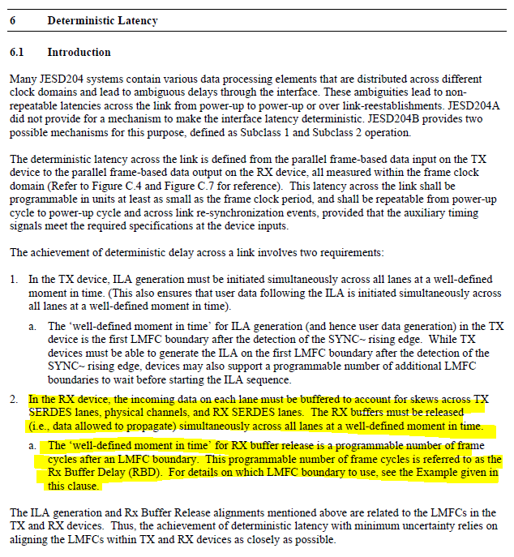
JESD204B Specification
Copyright: JEDEC Solid State Technology Association
JESD204B Standard 04/2008

Slide 19
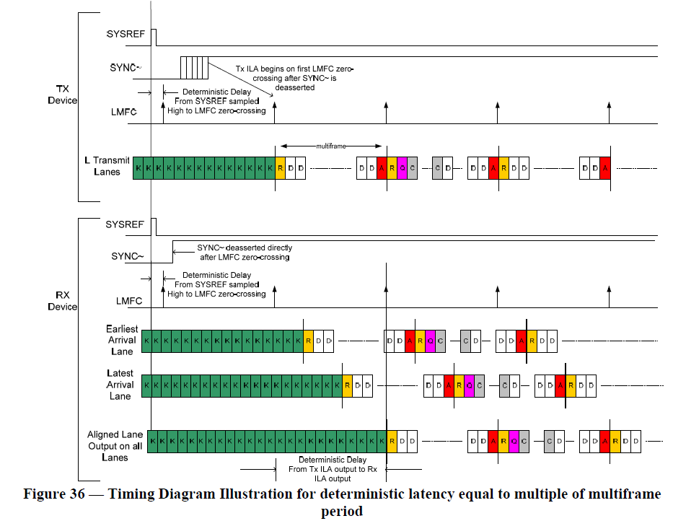
RBD used to be released on Multi-frame (K)
Copyright: JEDEC Solid State Technology Association
JESD204B Standard 04/2008

Slide 20
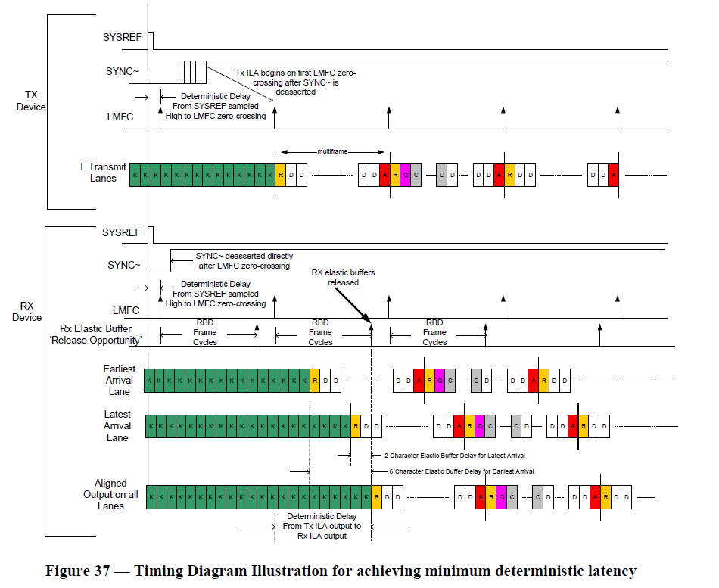
RBD used for minimum deterministic latency
Copyright: JEDEC Solid State Technology Association
JESD204B Standard 04/2008

Slide 21
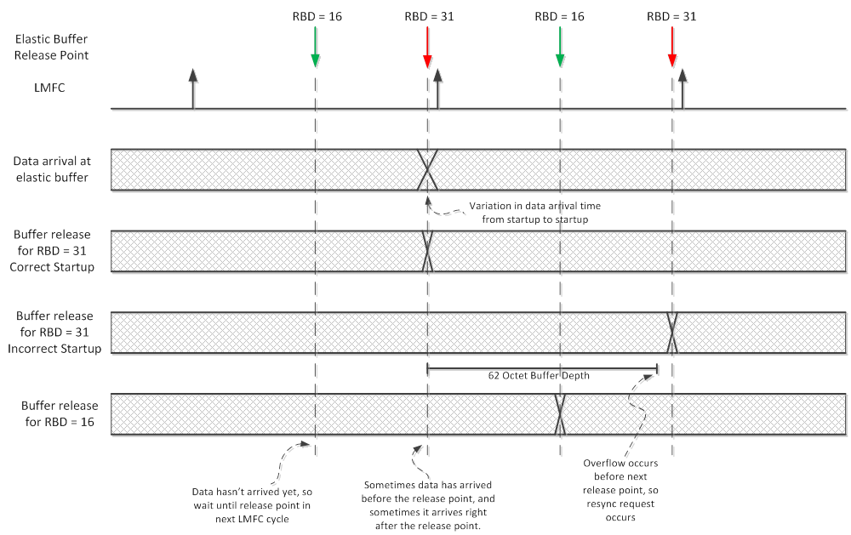
RBD release

Slide 22
Additional Technical Information
Regarding the RBD parameter, setting it to 16 is technically earlier than 31. However, the release points are periodic. There are two conditions for releasing the buffer. First, all lanes must have arrived (meaning the ILA sequence) and raised their “ready” flag. Second, a buffer release point must occur. The release points are periodic and occur RBD frame cycles after every LMFC cycle. If we miss the release point within one LMFC cycle, then the buffer will continue buffering and simply release at the release point in the next LMFC cycle. Since we have observed that data is arriving near the end of an LMFC cycle (because RBD of 31 is showing signs of an incorrect release point), we can simply set RBD to a lower value (e.g. 16) such that the release point will occur 16 frame cycles after the LMFC edge. In this case, changing from RBD of 31 to RBD of 16 causes the buffer to release 17 frame cycles later.
The elastic buffer is 64 octets deep. In 442 mode with K of 32, our multiframe is 64 octets long. We’re seeing the buffer overflow error because data for the earliest lane arrives before the release point and data for the latest lane arrives after the release point causing the elastic buffer release to wait until the next release point in the next multi-frame. Since the release points are periodic at the multiframe rate this means the buffer will need to buffer an additional 64 octets of data. Since the buffer is 62 octets deep we can’t store the additional 64 octets due to missing the release point and therefore the buffer overflows.
http://www.ti.com/lit/ml/slap159/slap159.pdf

Slide 23
Example RBD Sweeps
RBD is swept from 1 to K over 10 times for each RBD setting.
For successful JESD204B bring-up, an “O’ is marked
For unsuccessful JESD204B bring-up with errors and alarms, an “X” is marked.
Valid RBD window can be determined from the table below, and an optimal RBD setting can be determined.
Band X | RBD Value
# | 1 | 2 | 3 | 4 | 5 | 6 | 7 | 8 | 9 | 10 | 11 | 12 | 13 | 14 | 15 | 16 | 17 | 18 | 19 | 20 | 21 | 22 | 23 | 24 | 25 | 26 | 27 | 28 | 29 | 30 | 31 | 32
1 | O | O | O | O | X | X | X | X | X | X | X | X | X | O | O | O | O | O | O | O | O | O | O | O | O | O | O | O | O | O | O | O
2 | O | O | O | X | X | X | X | X | X | X | X | X | O | O | O | O | O | O | O | O | O | O | O | O | O | O | O | O | O | O | O | O
3 | O | O | X | X | X | X | X | X | X | X | X | X | X | O | O | O | O | O | O | O | O | O | O | O | O | O | O | O | O | O | O | O
4 | O | O | O | X | O | X | X | X | X | X | X | X | X | X | O | O | O | O | O | O | O | O | O | O | O | O | O | O | O | O | O | O
5 | O | O | O | X | X | X | X | X | X | X | X | X | X | O | O | O | O | O | O | O | O | O | O | O | O | O | O | O | O | O | O | O
6 | O | O | X | X | X | X | X | X | X | X | X | X | X | O | O | O | O | O | O | O | O | O | O | O | O | O | O | O | O | O | O | O
7 | O | O | O | X | X | X | X | X | X | X | X | X | X | O | O | O | O | O | O | O | O | O | O | O | O | O | O | O | O | O | O | O
8 | O | O | O | O | X | X | X | X | X | X | X | X | X | O | O | O | O | O | O | O | O | O | O | O | O | O | O | O | O | O | O | O
9 | O | O | O | X | X | X | X | X | X | X | X | X | X | X | O | O | O | O | O | O | O | O | O | O | O | O | O | O | O | O | O | O
10 | O | O | O | X | X | X | X | X | X | X | X | X | X | O | O | O | O | O | O | O | O | O | O | O | O | O | O | O | O | O | O | O

Slide 24
Skew Indication of Various Lanes
Key Register: 0x3C in TXDUCP0 page, lane_skew
Measure the lane skew among the lanes within each TXDUC logic (note: this does not go beyond the boundary of the TXDUC and cannot cross the TXDUCs. i.e. cannot measure between skew of DAC-A to DAC-C).
This measurement automatically updates and holds the output value whenever the elastic buffers are released. This could happen repeatedly if the skew causes buffer overflow, which subsequently causes repeated synchronization requests. Only a reset or init-state of the JESD204B RX IP will clear the output.

Slide 25
Elastic Buffer Match Error

Slide 26
Description of Elastic Buffer Match Error
Key Register: 0x84 of TXDUCP0 page Match_Specific
If set to 1b’0, the JESD204B RX buffer will start buffering with the first non-/K/ value and ignore match control character. Programming match_specif to 1b’0 should not be used unless for debugging purpose
If set to 1b’1, the JESD204B RX buffer will start buffering only with /R/ character, immediately followed by /K/ after the completion of CGS
If the first character after the /K/ in the CGS, then the elastic buffer match error will be flagged.

Slide 27
Error Handling and Things to Check
If error occurs, please check the JESD204B TX IP to see if the IP is set to subclass 0 mode as oppose to subclass 1 mode.
Check with high speed scope to see if the actual /R/ is detected after the /K/ characters in the CGS.
Set match_specific to 1b’0 to see if the link establishment can proceed.
Check if the SERDES receivers are detecting any bit errors, especially with the possibility of the SERDES RX being potentially saturated after long period of repeating /K/ patterns.
Minimize the length of /K/ pattern by reducing the length variation and delay variation of the JESD204B lanes and also data logic paths.
Copyright: JEDEC Solid State Technology Association
JESD204B Standard 04/2008

Slide 28
Code Group Synchronization

Slide 29
Code Group Synchronization Check
The lane alignment block performs code group synchronization and implements the elastic buffer.
Code group synchronization is achieved when the lane has received four consecutive /K/ characters successfully after asserting a synchronization request (~SYNC) and then another four valid characters after de-asserting the synchronization request.
If three invalid characters are received within a certain amount of time, code group synchronization would be lost.
This would trigger the code group synchronization error.
See the following JESD204B standard:
  7.1 Code Group Synchronization
  Figure 44 – Receiver State Machine for Code Group Synchronization

Slide 30
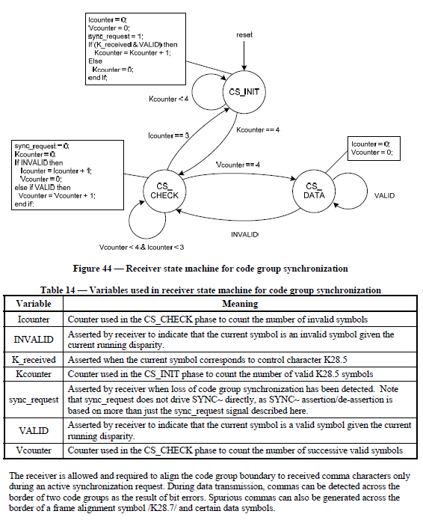
Code Group Synchronization State Diagram
Copyright: JEDEC Solid State Technology Association
JESD204B Standard 04/2008

Slide 31
Error Handling and Things to Check
If error occurs, please check the JESD204B TX IP to see if the IP initialized correctly with proper CGS state machine running
Check with high speed scope to see if the actual /K/ are detected
Run link layer testing to check for validity of the /K/ CGS patterns.
Check if the SERDES receivers are detecting any bit errors, especially with the possibility of the SERDES RX being potentially saturated after long period of repeating /K/ patterns.
Minimize the length of /K/ pattern by reducing the length variation and delay variation of the JESD204B lanes and also data logic paths.
Copyright: JEDEC Solid State Technology Association
JESD204B Standard 04/2008

Slide 32
8B/10B Errors

Slide 33
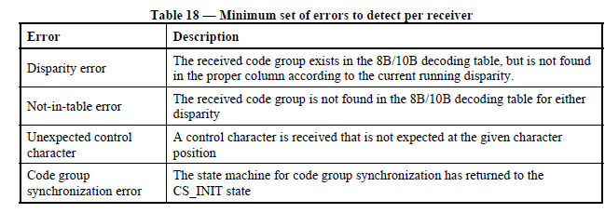
8B/10B Encoding and Decoding Errors
Disparity error: the received code group exists in the 8b/10b decoding table, but is not found in the proper column to the current + or – running disparity.
Not-in-table error: the received code group is not found in the 8b/10b decoding table for either disparity. Usually a true bit error
Copyright: JEDEC Solid State Technology Association
JESD204B Standard 04/2008

Slide 34
Error Handling and Things to Check
If error occurs, please check the JESD204B TX IP to see if the IP initialized correctly with proper 8b/10b coding logics running.
Typically, both 8b/10b not-in-table and 8b/10b disparity occur simultaneously, and indicate general bit error due to the SERDES signal conditioning.
If only 8b/10b disparity occurs, the error may lead to the 8b/10b logic in the JESD204B not being reset properly.
Check with high speed scope to check the eye diagram for SERDES signal quality.
For PG3.0, PRBS pattern such as PRBS7 may be run over period of time for bit error check.
Check if the SERDES receivers are detecting any bit errors, especially with the possibility of the SERDES RX being potentially saturated after long period of repeating pattern.
Copyright: JEDEC Solid State Technology Association
JESD204B Standard 04/2008

