Slide 1
DAC38J84 100MHz NCO test

Slide 2
Hardware Setup
DAC38J84
  Connect output SMA J2 (channel A) to Spectrum Analyzer
  Connect USB cable to J14 and host PC
  Connect the provided +5VDC power supply to J6 (located on bottom)

Slide 3
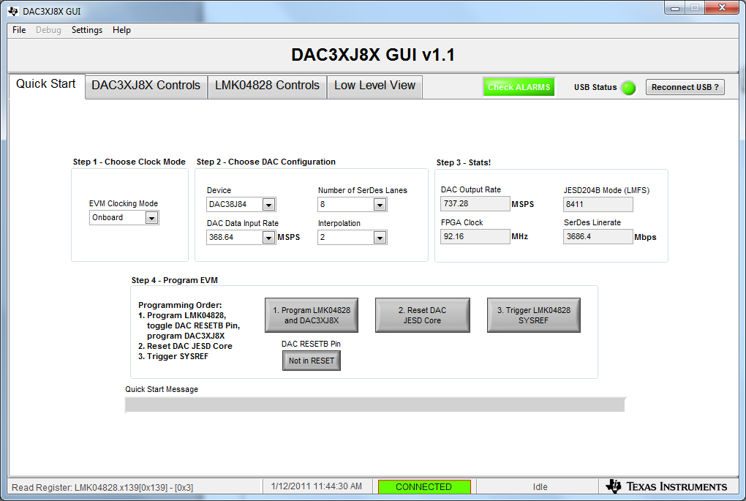
Quick Start settings

Slide 4
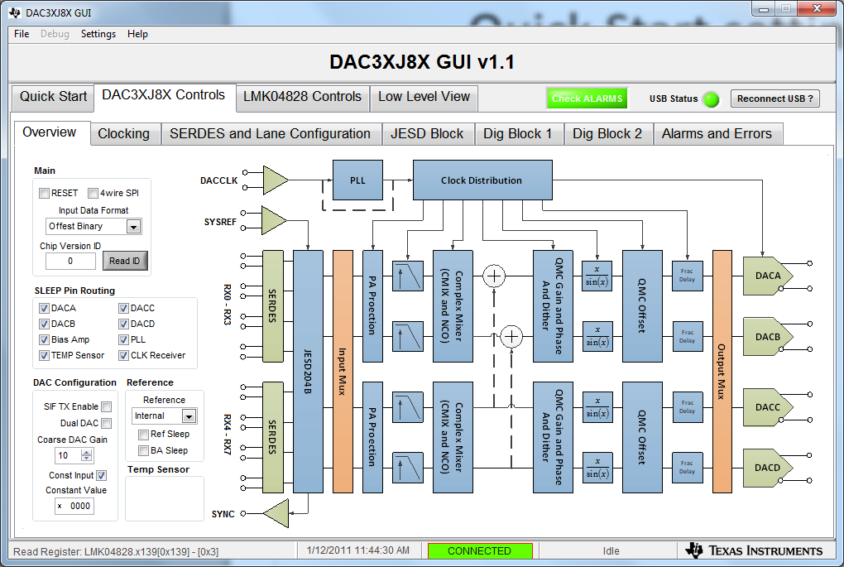
Go to “DAC3XJ8X Controls” tab. Set Input Data Format to “Offset Binary”. Enable “Const Input”.

Slide 5
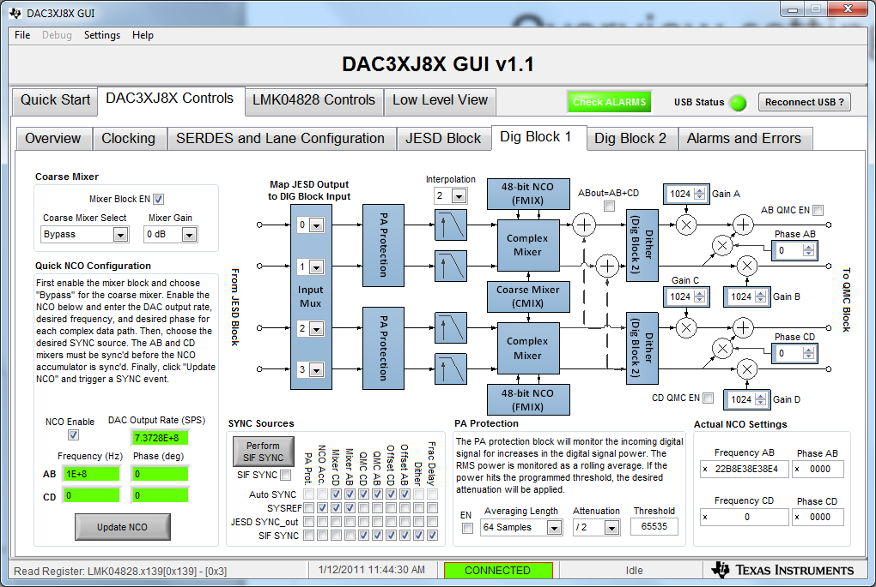
Go to “Dig Block1” tab. Enable “Mixer Block EN” and “NCO Enable”.

Slide 6
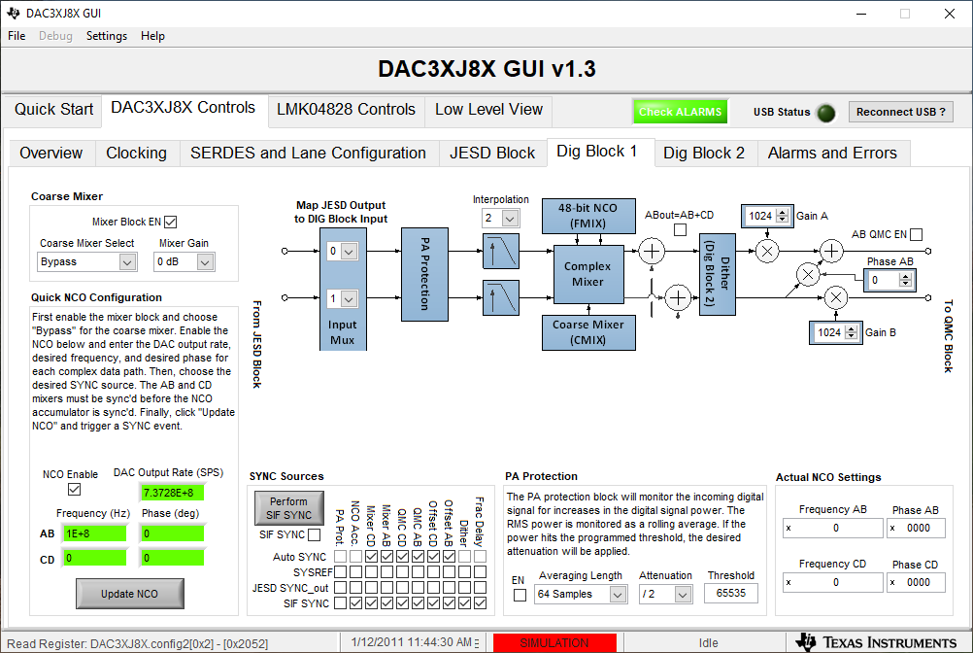
Enter NCO frequency. Enter DAC clock frequency. Click on Update NCO. Click on “Perform SIF SYNC”.

Slide 7
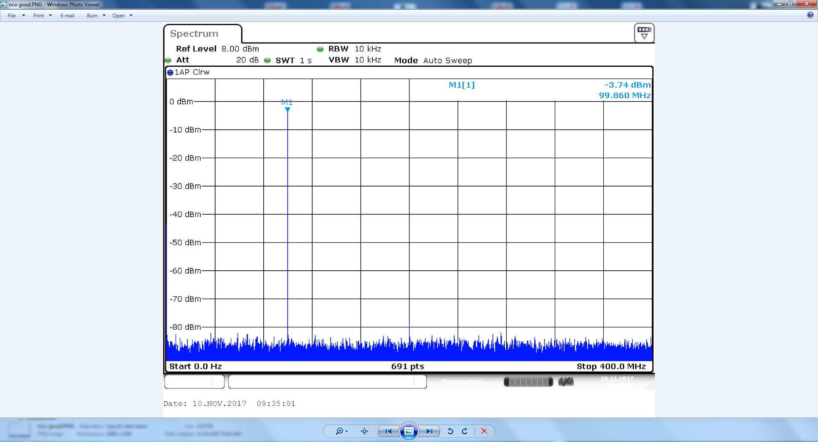
100MHz CW output will now appear at DAC output

