Slide 1
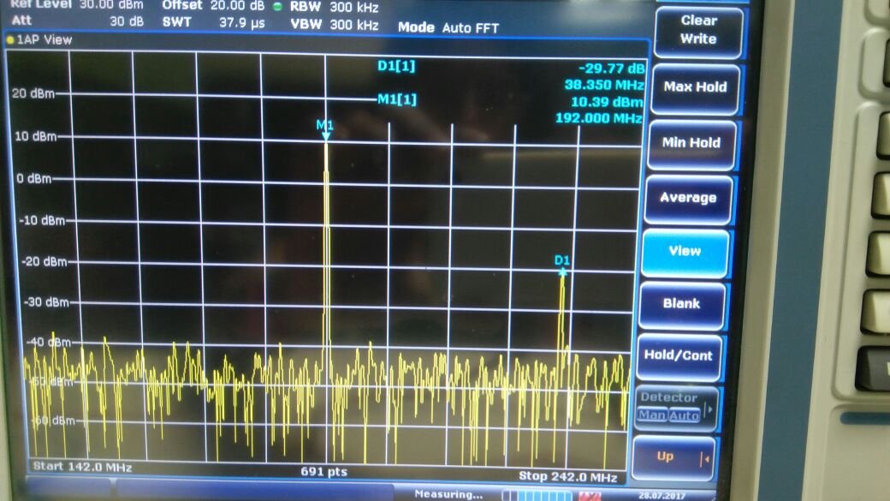
Coarse bits=A, 50homs termination

Slide 2
Coarse bits=A, 25homs termination

Slide 3
Coarse bits=F, 50homs termination

Slide 4
Coarse bits=F, 25homs termination

