Slide 1
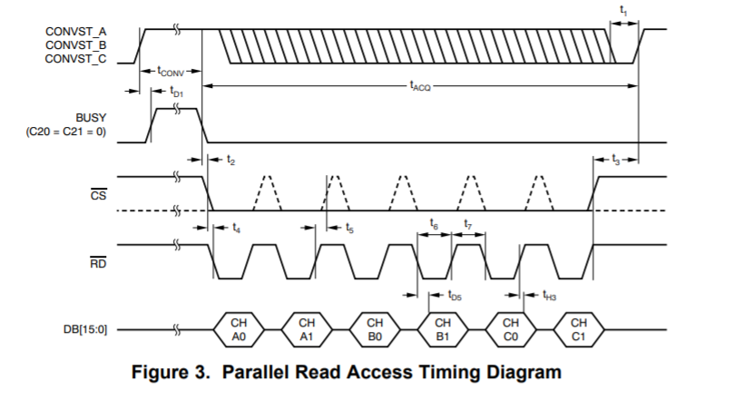
1. The state of DBx-pin before Read Access is started.
2. The state of DBx-pin after Read Access is completed.

