Slide 1
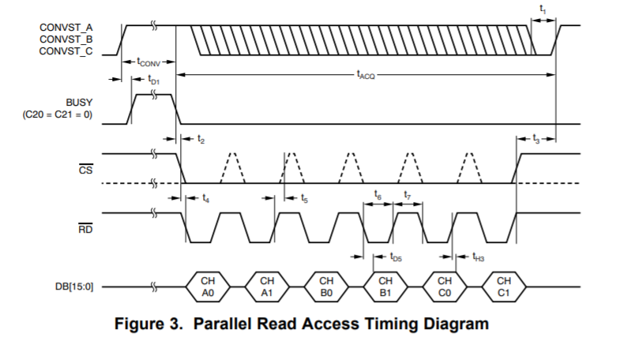
If BUSY is stuck to High due to the certain failure as below and /CS becomes from High to Low and /RD also becomes from High to Low, what the DBx-pin will be?

