Slide 1
DAC3482EVM: 500MHz, PLL On

Slide 2
Load Register File
Load DAC3482_FDAC_500MHZ_2xint.txt

Slide 3
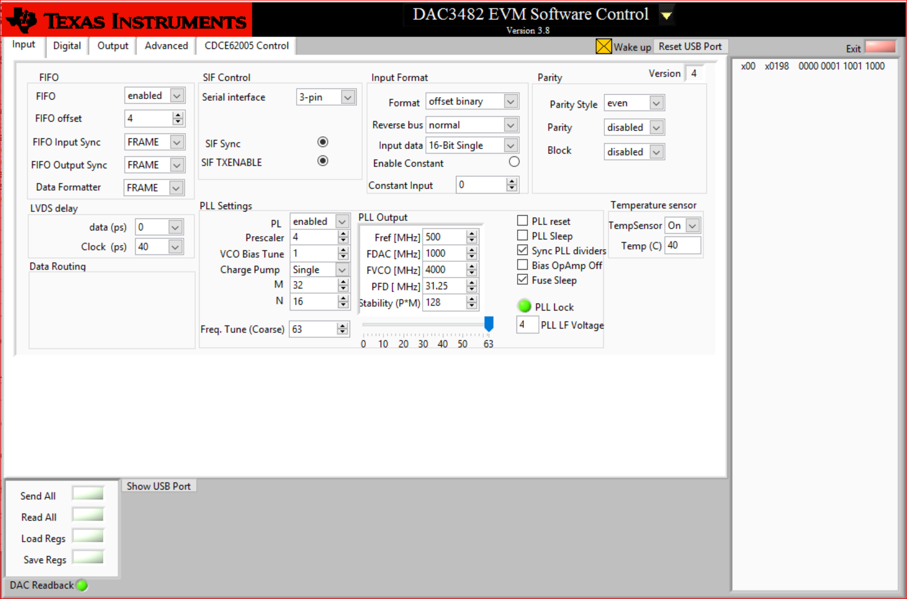
CLK_IN and PLL
J9 CLKIN 500MHz

Slide 4
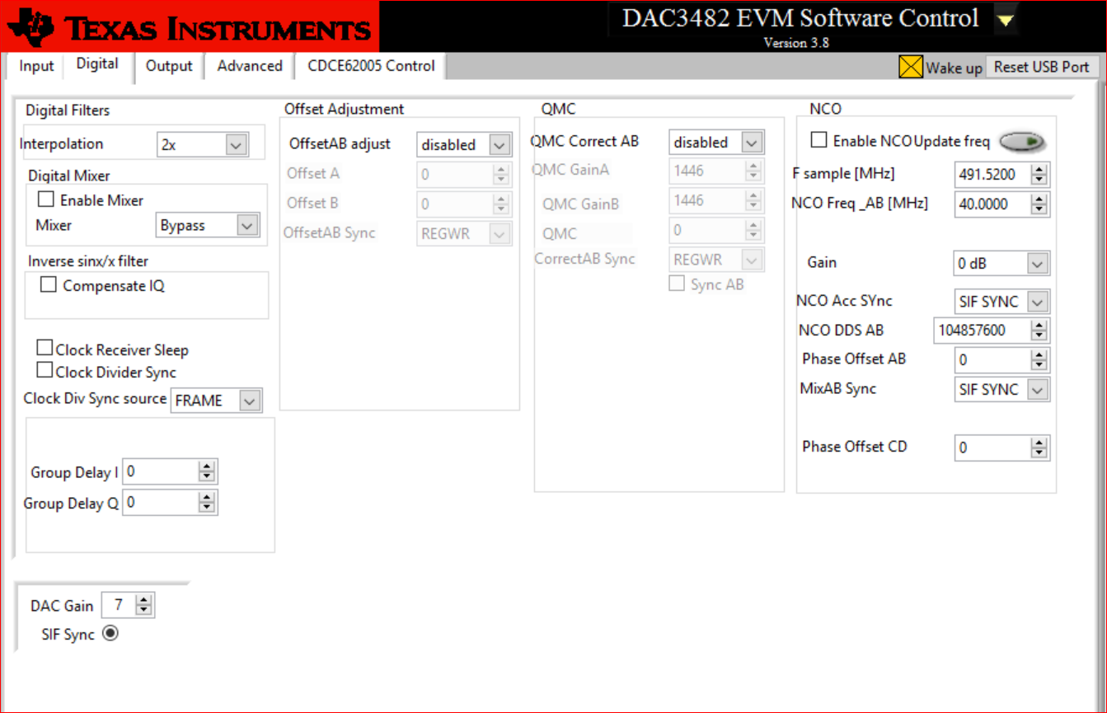
Interpolation
2x interpolation
Takes PLL output (1GHz) and divides by 2.

Slide 5
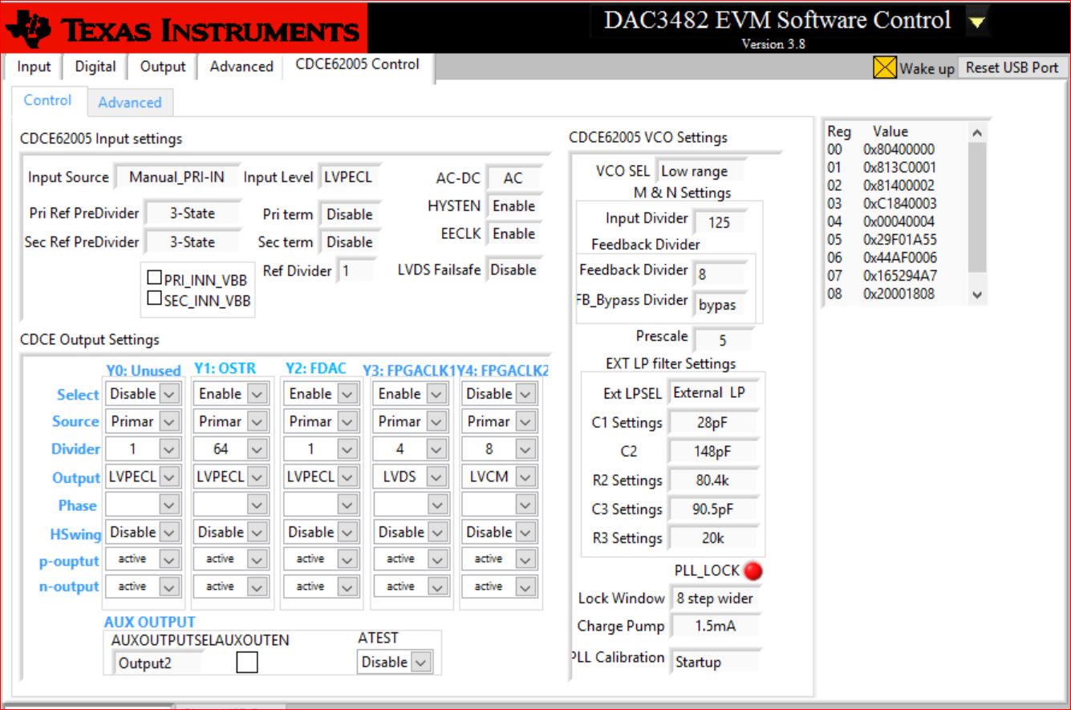
CDCE Control
Change the FPGACLK1 to divide by 4

Slide 6
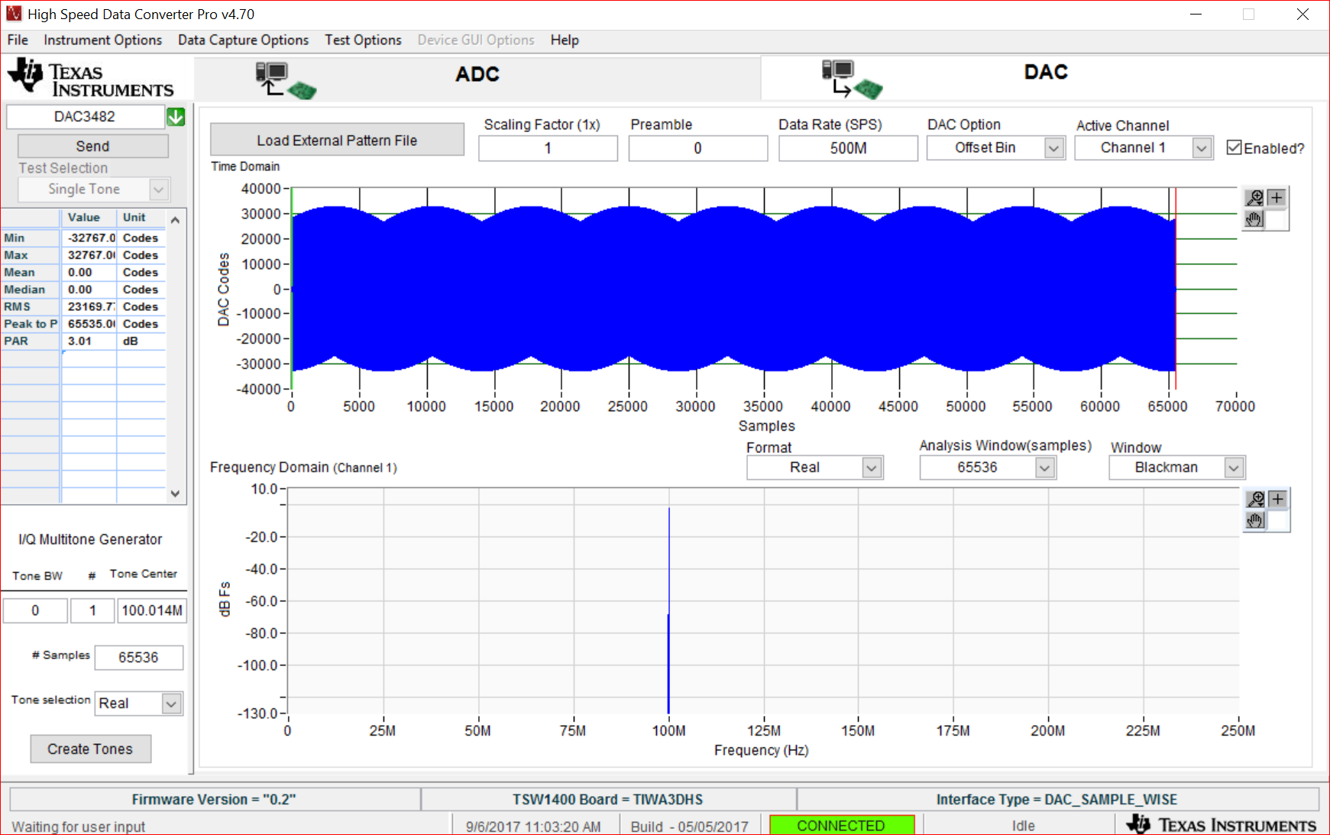
HSDC Pro

