Slide 1
ADS8320EVM-PDK
SNR Measurements
11/01/21

Slide 2
EVM hardware setup
Jumper | Setting
JMP1 | [1-2]
JMP2 | [1-2]
JMP3 | [5-6]
JMP4 | [1-2]
JMP5 | [1-2]
JMP6 | [1-2]

Slide 3
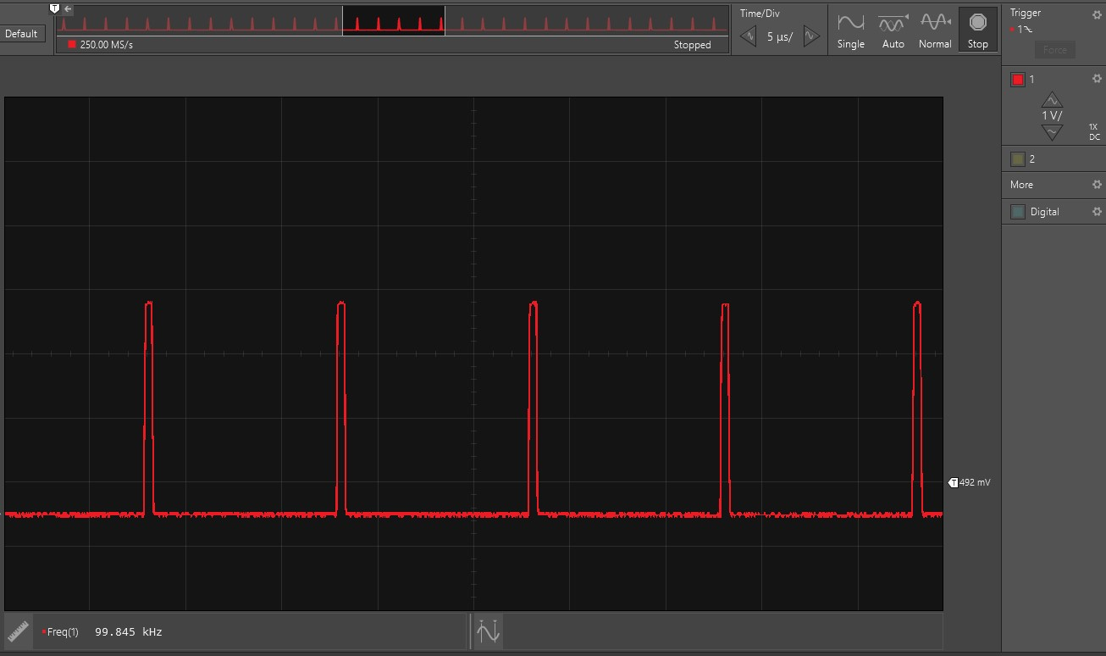
Verified sampling rate

Slide 4
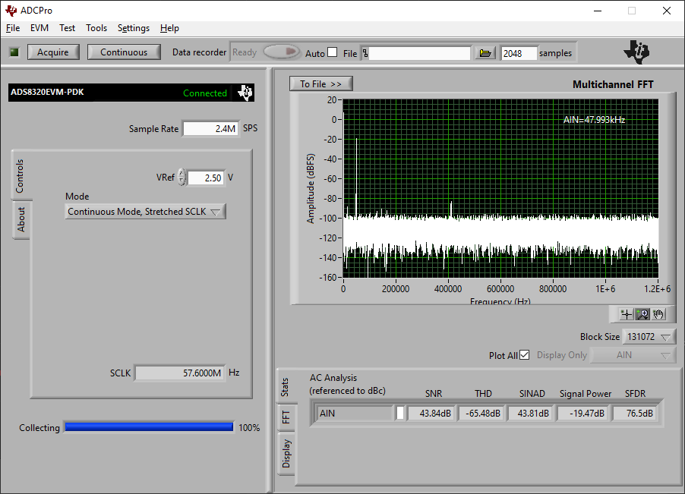
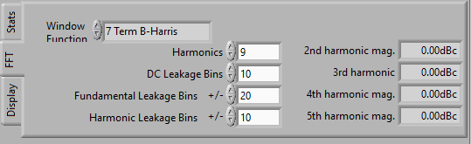
FFT results
FFT bin size calculated based on displayed “Sample Rate”
  2.4 MHz / 131,072 bins = 18.3 Hz / bin
  Adjust FFT bins parameters for more accurate AC analysis
-20 dBFS input
  IN+ = 250 mVpp, 1.25 V offset
  IN- = AGND
  R1 = R4 = 0 Ω, C4 = open

Slide 5

FFT results
FFT bin size calculated based on displayed “Sample Rate”
  2.4 MHz / 131,072 bins = 18.3 Hz / bin
  Adjust FFT bins parameters for more accurate AC analysis
-0.5 dBFS input
  IN+ = 2.36 Vpp, 1.25 V offset
  IN- = AGND
  R1 = R4 = 0 Ω, C4 = open

Slide 6
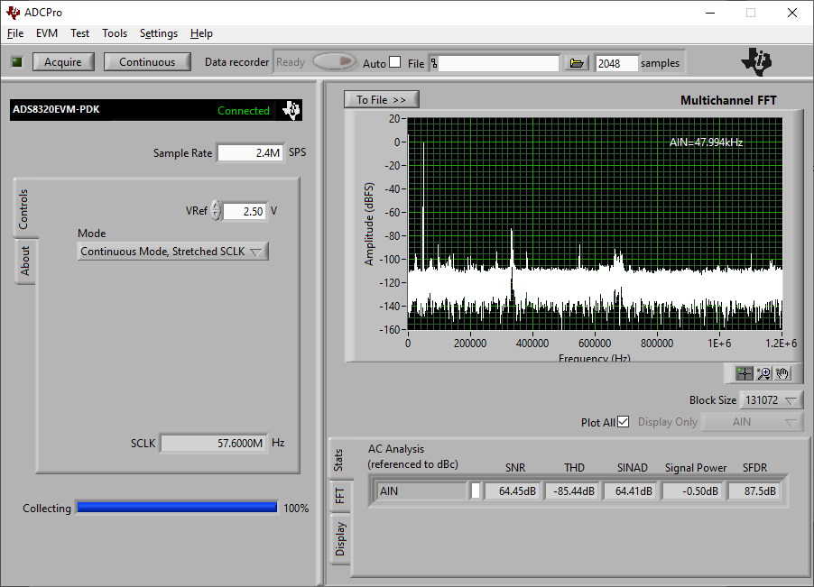
FFT results
FFT bin size calculated based on displayed “Sample Rate”
  2.4 MHz / 131,072 bins = 18.3 Hz / bin
  Adjust FFT bins parameters for more accurate AC analysis
-0.5 dBFS input
  IN+ = 2.36 Vpp, 1.25 V offset
  IN- = AGND
  R1 = R4 = 100 Ω, C4 = 820 pF

Slide 7
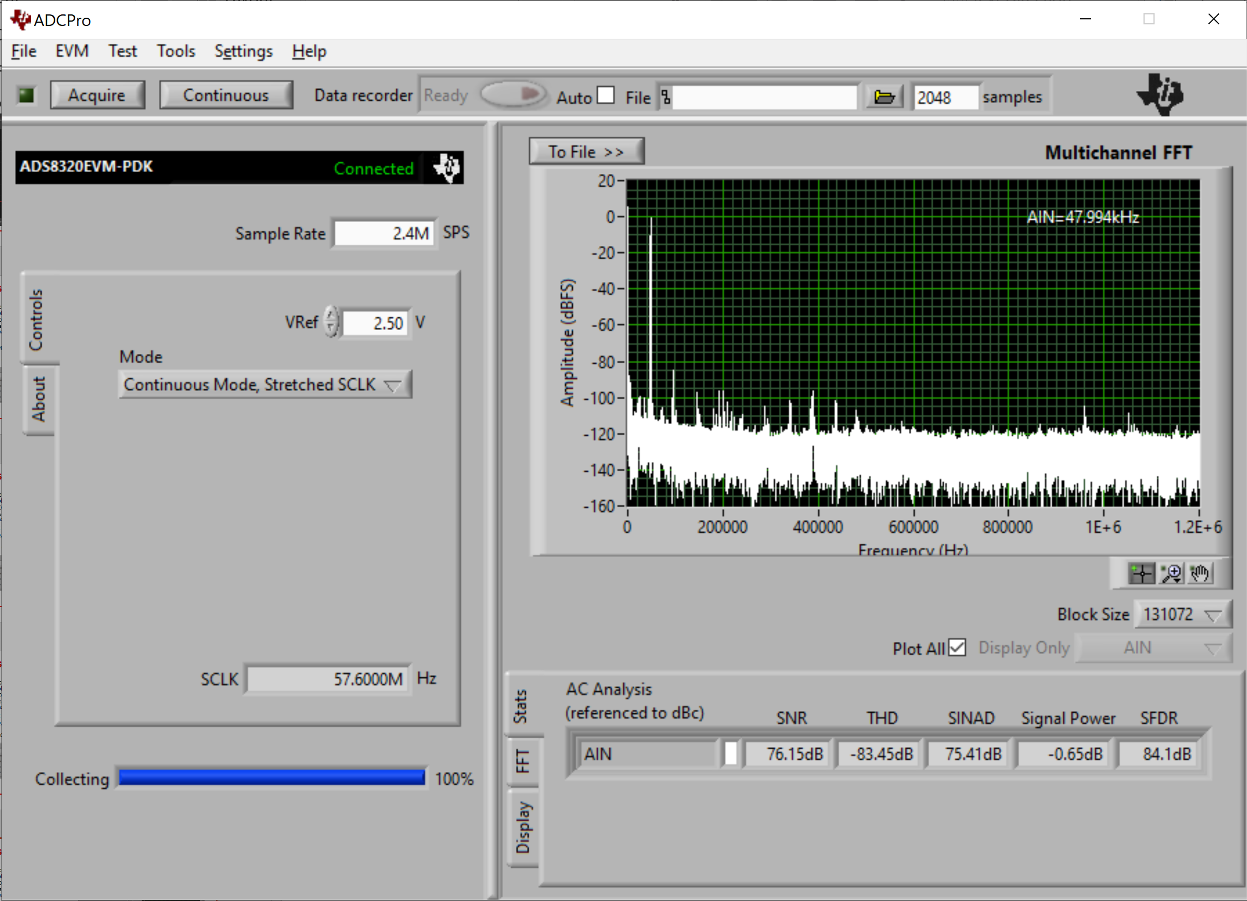
FFT results
FFT bin size calculated based on displayed “Sample Rate”
  2.4 MHz / 131,072 bins = 18.3 Hz / bin
  Adjust FFT bins parameters for more accurate AC analysis
-0.5 dBFS input – pre-amp board
  IN+ = 2.36 Vpp, 1.25 V offset
  IN- = AGND
  R1 = R4 = 100 Ω, C4 = 820 pF
  C2 = C3 = 100 pF

Slide 8
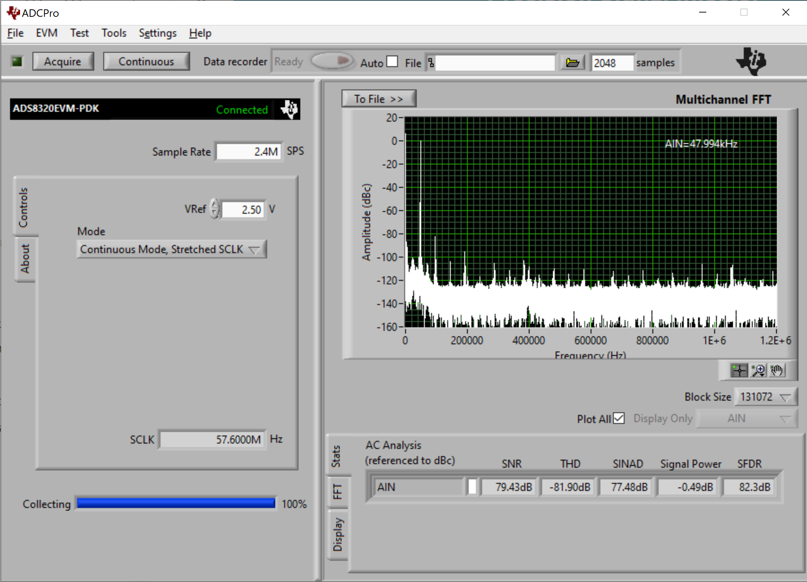
FFT results
FFT bin size calculated based on displayed “Sample Rate”
  2.4 MHz / 131,072 bins = 18.3 Hz / bin
  Adjust FFT bins parameters for more accurate AC analysis
-0.5 dBFS input – pre-amp board
  IN+ = 2.36 Vpp, 1.25 V offset
  IN- = AGND
  R1 = R4 = 100 Ω, C4 = 10 nF
  C2 = C3 = 100 pF

