Slide 1
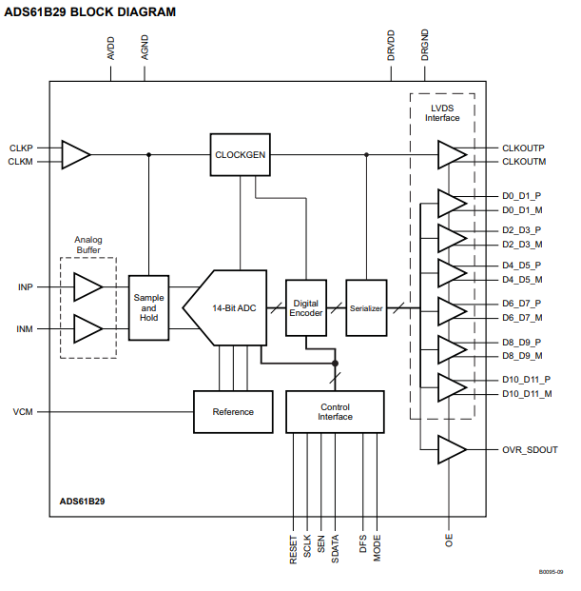
Q1
AVDD： Analog Power
AGND: Analog Ground
DRVDD： Digital Power
DRGND: Digital Ground
AVDD
DRVDD
DRVDD
AVDD
DRVDD
DRVDD
AVDD
AVDD
DRVDD
internal Ref： VCM out
(Created by AVDD)
DRVDD

Slide 2
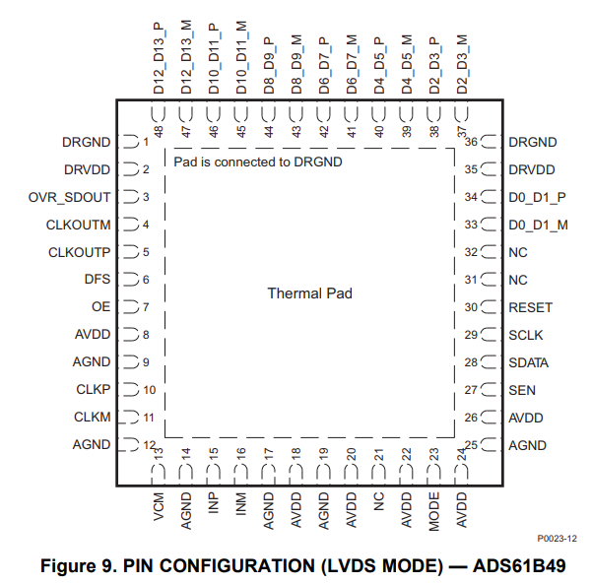
Q1
DRGND
DRVDD： Digital Power
DRGND: Digital Ground
AVDD： Analog Power
AGND: Analog Ground
AGND

Slide 3
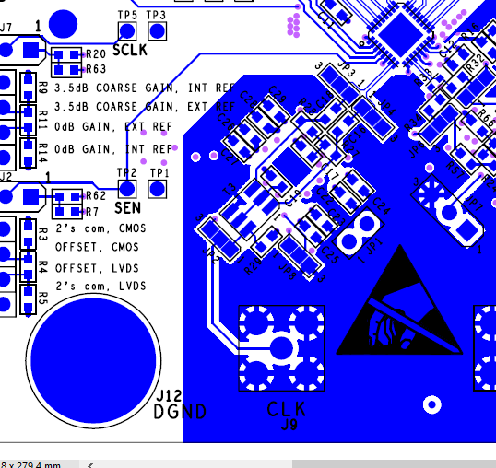
Q2
ADS61xxEVM: SEN pin is on DGND

Slide 4
Q2
■ADS612x Datasheet
■ADSB49 Datasheet

Slide 5
Q3
ADS61xxEVM have single point earth between AGND and DRGND.
Should ADS61B49 set single point earth between AGND and DRGND?

