Slide 1
Setting up the Dac pll

Slide 2
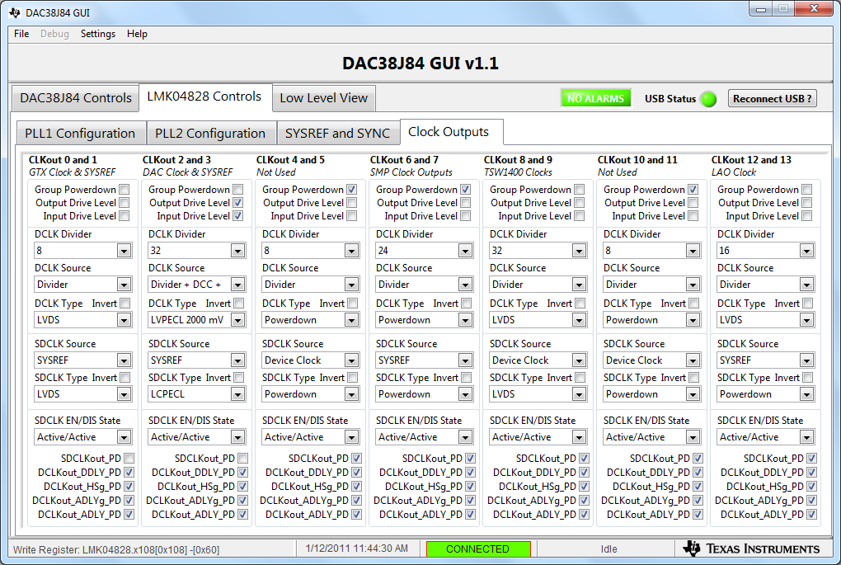
Set the DAC PLL Reference
F_{REF} = 2949.12/32 = 92.16 MHz

Slide 3
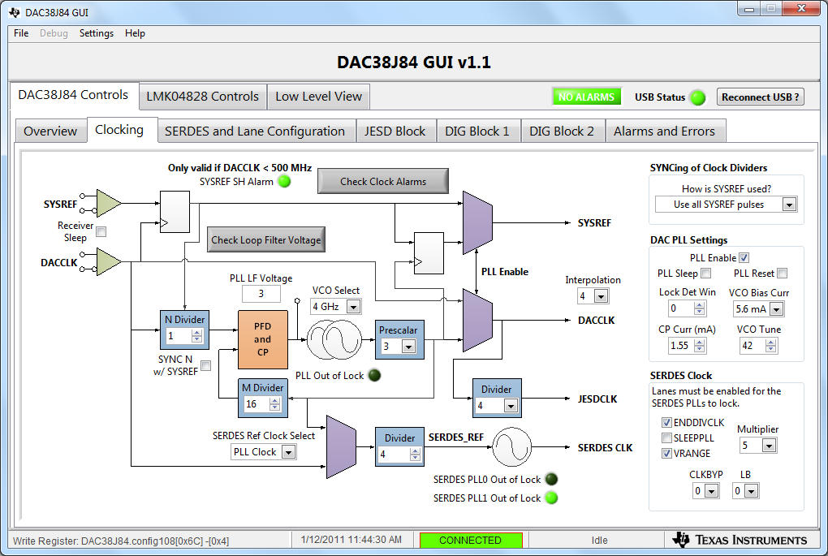
Configuring the DAC PLL

Slide 4
Check Clock Alarms and LF Voltage
The PLL is locked when PLL LF Voltage is 2-5. If the PLL is not locked, vary “VCO Tune”.

