Slide 1
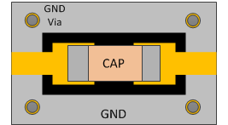
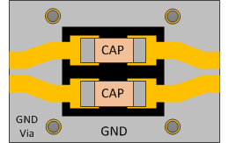
Component Pads in the Signal Path
Pads will add capacitance and therefore an impedance mismatch
Recommendations:
Generally, the only need for components in the signal path is DC blocking capacitors. Try to avoid other components for gigabit connections.
For gigabit connections, use 0201 components when possible, including the DC blocking capacitors. A value of 0.1 uF is recommended.
Excess capacitance can be limited by clearing the ground plane underneath the component. Use SI simulation to determine the required amount.
Cap with cleared GND plane and vias
Differential DC blocking caps with cleared GND plane and vias
1
Source: High Speed Mezzanine Card (HSMC) Specification (Altera)

