Slide 1
ADC12J4000, TSW14J10, VC707 Testing

Slide 2
Test Setup:
Single tone is given as input to the device.
Test conditions:
Fs = internal 4GHz, serdes = 8Gbps
Fin = 551MHz
LMK = 2GHz, clock dist mode
VC707 Ref clock = 400MHz
VC707 Core clock = 200MHz

Slide 3
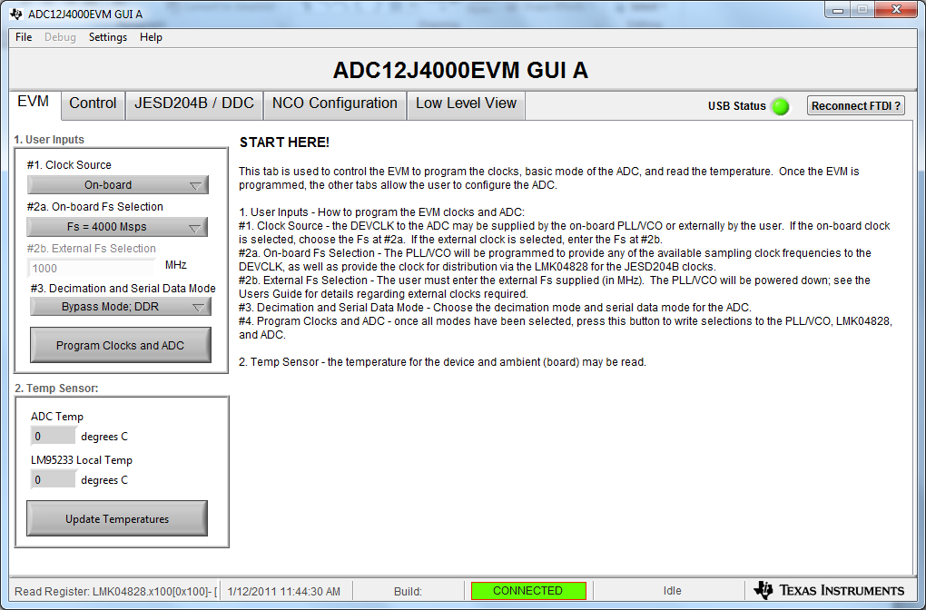
On ADC GUI, load the values as shown below

Slide 4
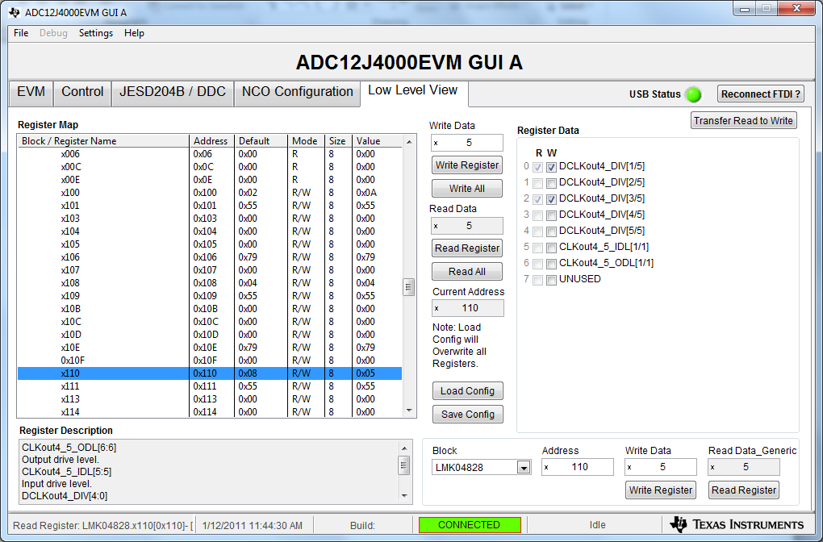
In Low Level View tab, set LMK04828 address 0x110 to 0x05 (div by 5) to set
VC707 REFCLK = 400MHz

Slide 5
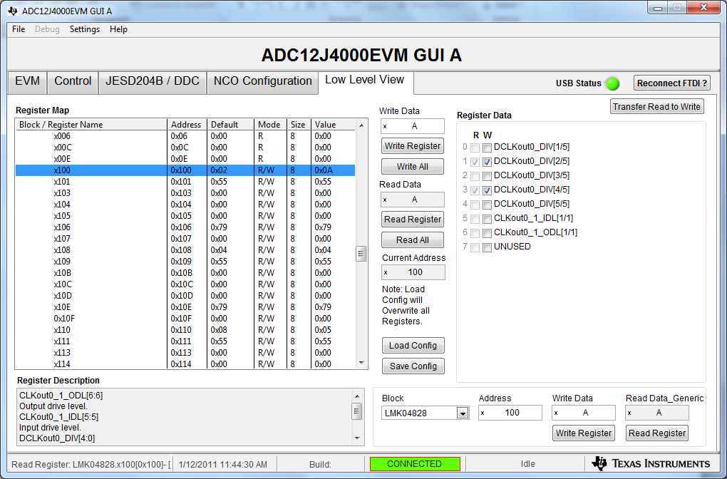
In Low Level View tab, set LMK04828 address 0x100 to 0x0A (div by 10) to set
VC707 Core CLK = 400MHz

Slide 6
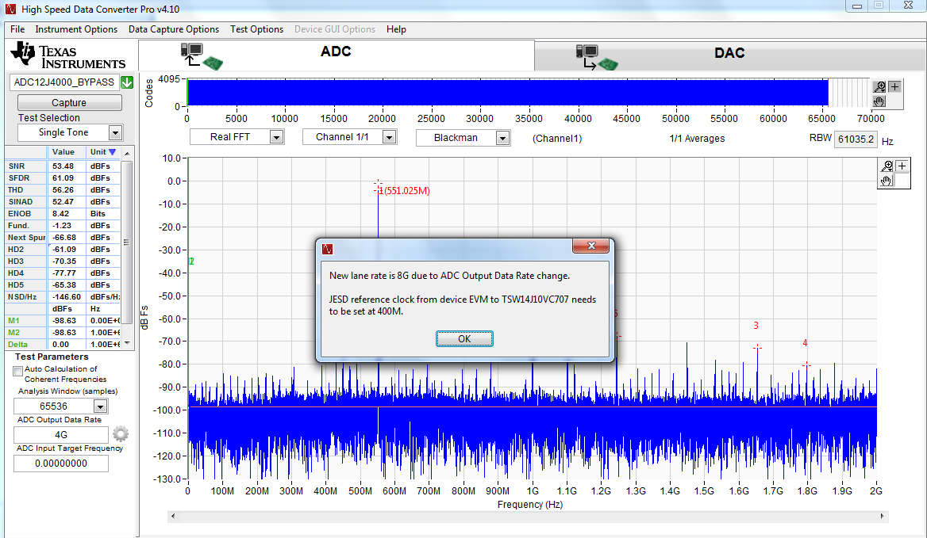
Open HSDCD Pro, select “ADC12J4000_BYPASS”, Enter “4G” for ADC Output Data Rate

Slide 7
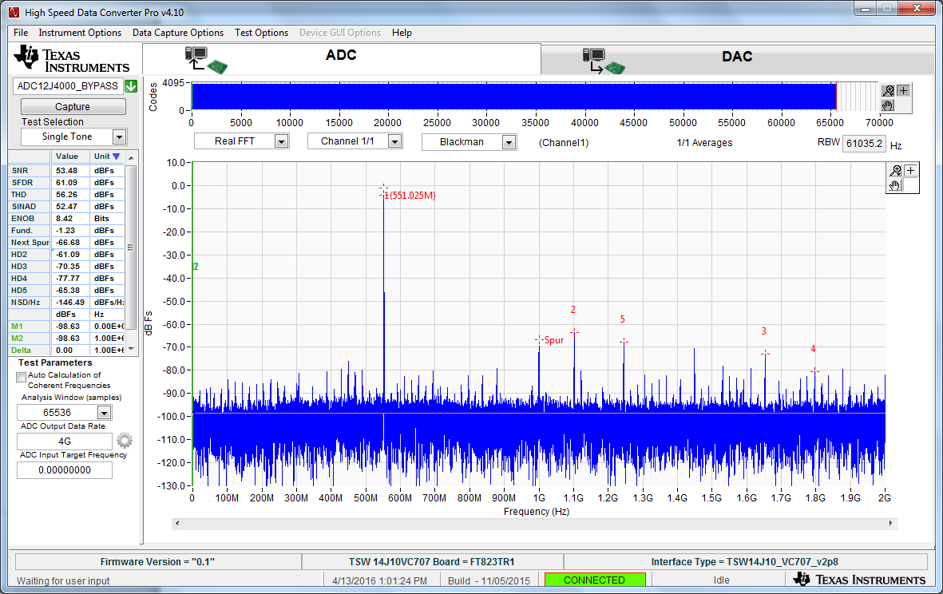
Capture results using a 550MHz input tone

