Slide 1
ADC12J4000, TSW14J10, KC105, Dec 4x

Slide 2
Test Setup:
Single tone is given as input to the device.
Test conditions:
Fs = External 2GHz
Fin = 600MHz
Dec 4 P54 mode
LMK = 1GHz, clock dist mode
KC705 Ref clock = 250MHz (/4 for LMK)
KC705 Core clock = 125MHz (/8 for LMK)
Lane Rate = 5G
V2p8 firmware

Slide 3
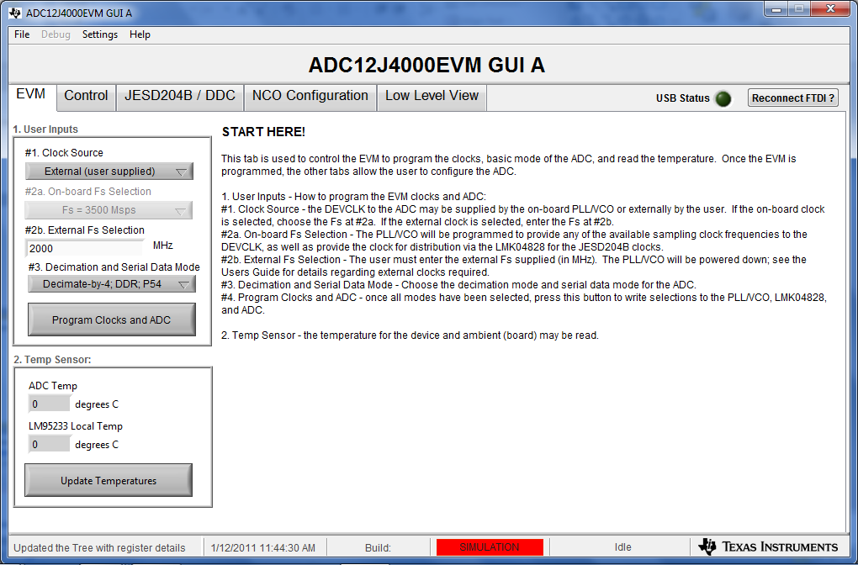
On ADC GUI, load the values as shown below

Slide 4
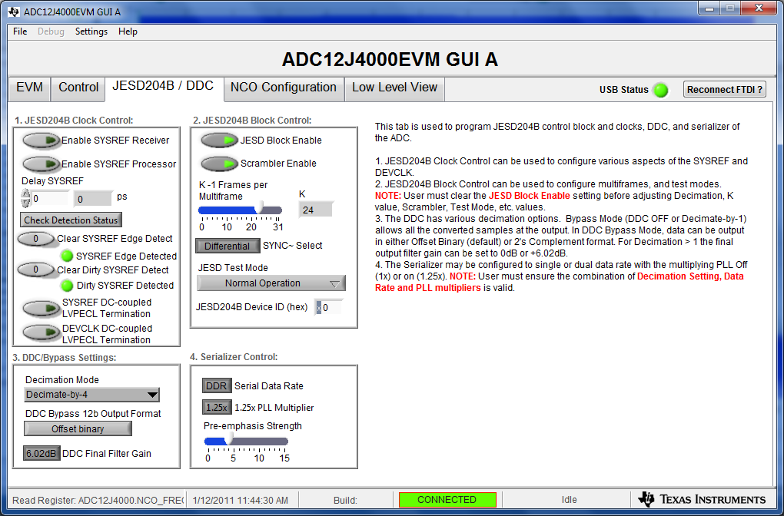
On ADC GUI, load the values as shown below

Slide 5
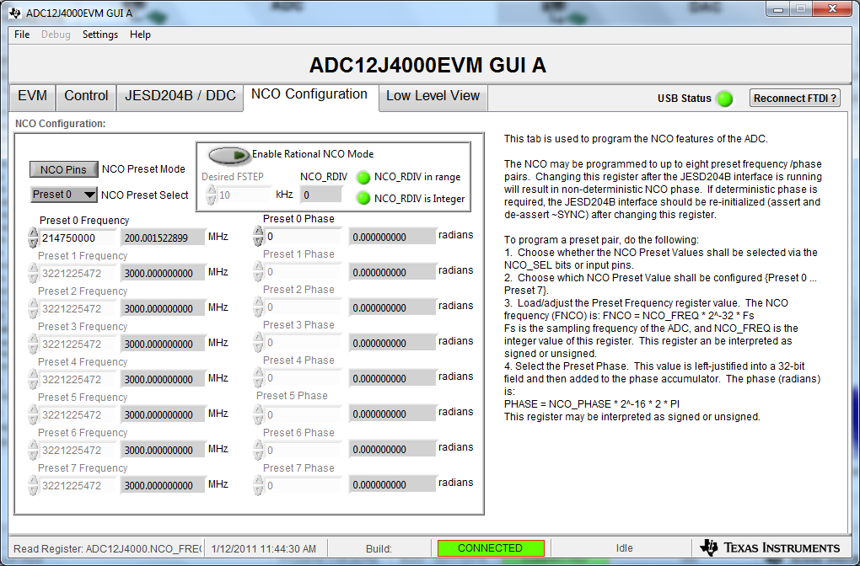
On ADC GUI, load the Preset 0 Frequency value as shown below

Slide 6
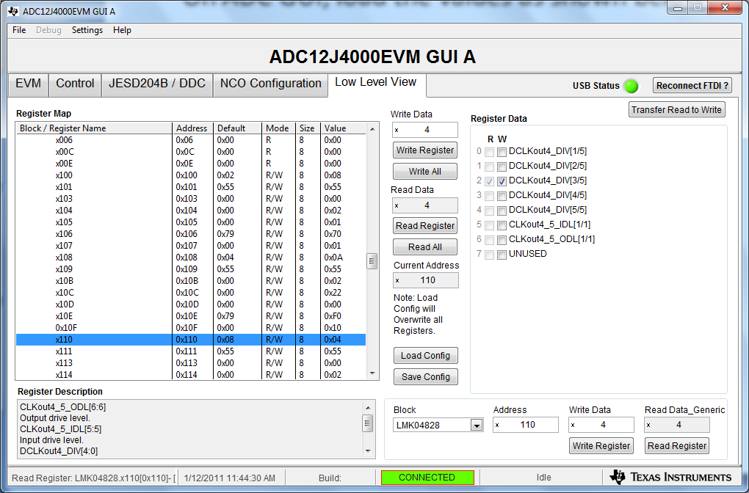
In Low Level View tab, set LMK04828 address 0x110 to 0x04 to set
KC705 REFCLK = 250MHz

Slide 7
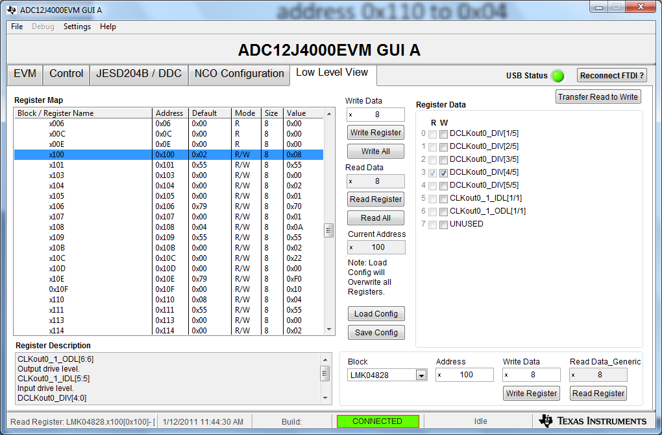
In Low Level View tab, set LMK04828 address 0x100 to 0x08 for KC705 Core CLK = 125MHz

Slide 8
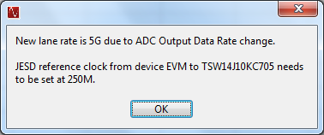
Open HSDCD Pro, select “ADC12J4000_D4_DDR”, Enter “500G” for ADC Output Data Rate

