Slide 1
ADC31JB68EVM Clocking test

Slide 2
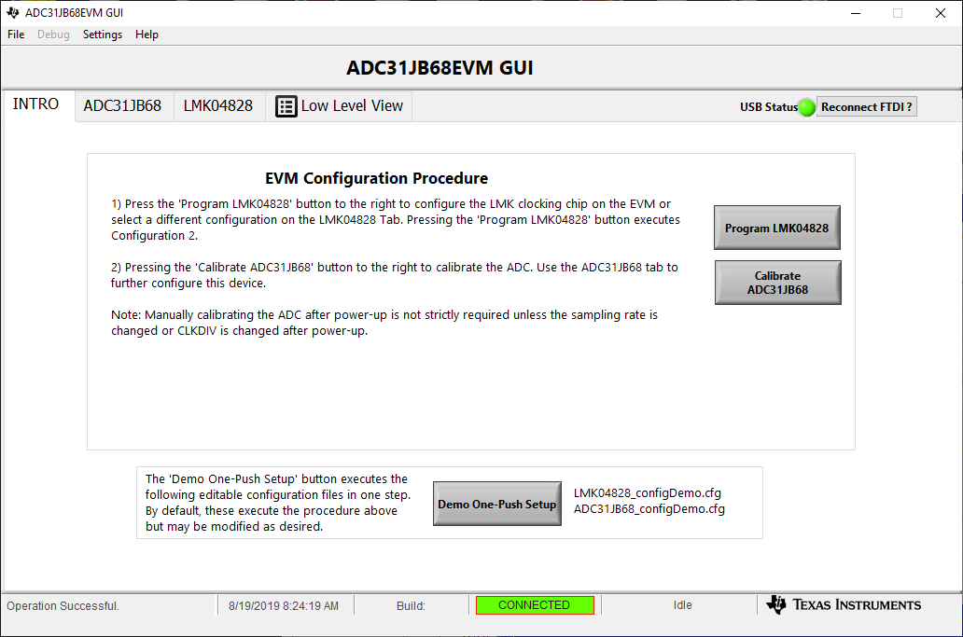
Default Clock Settings

Slide 3
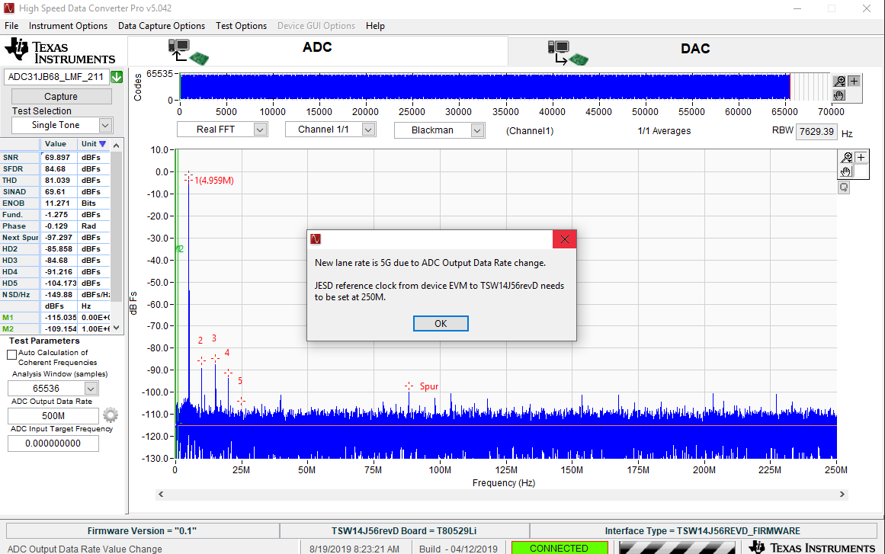
Default Clock Settings 500 MSPS

Slide 4

Default Clock Settings 200 MSPS

