Slide 1
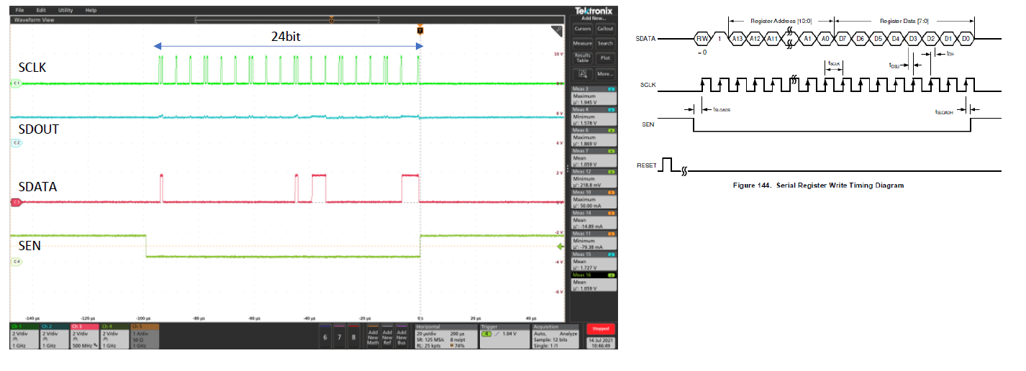
Writing Waveform
0x05 Address 0x01

Slide 2
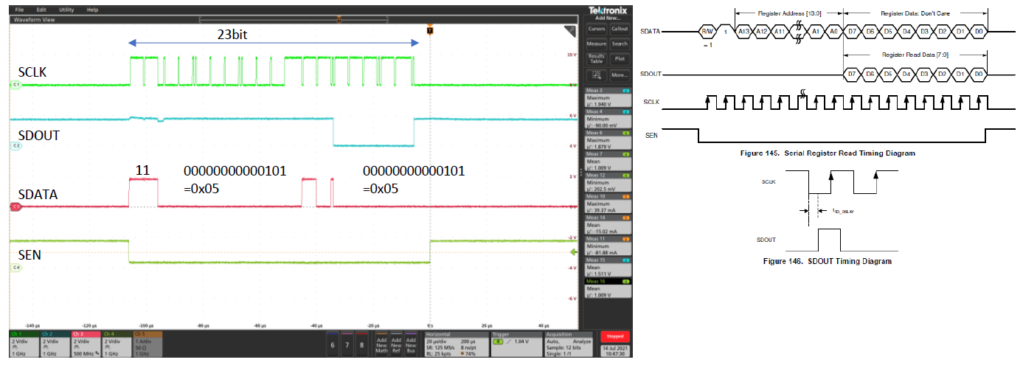
Readng Waveform
0x05 Address 0x01

