Slide 1
ADC32J25EVM Test

Slide 2
ADC32J25 setup
Test conditions:
Fs = 160Msps sample CLK
If = 30MHz
After applying 5V to both boards, press ADC reset switch on ADC32J25EVM

Slide 3
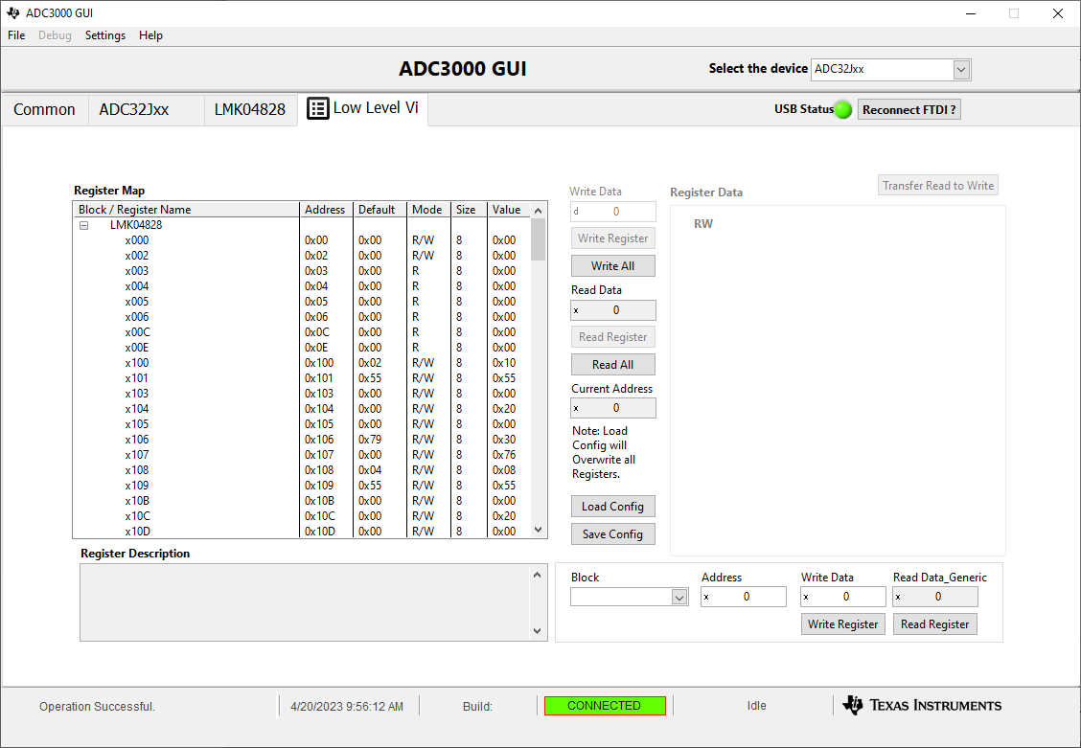
After GUI opens, select ADC32Jxx

Slide 4
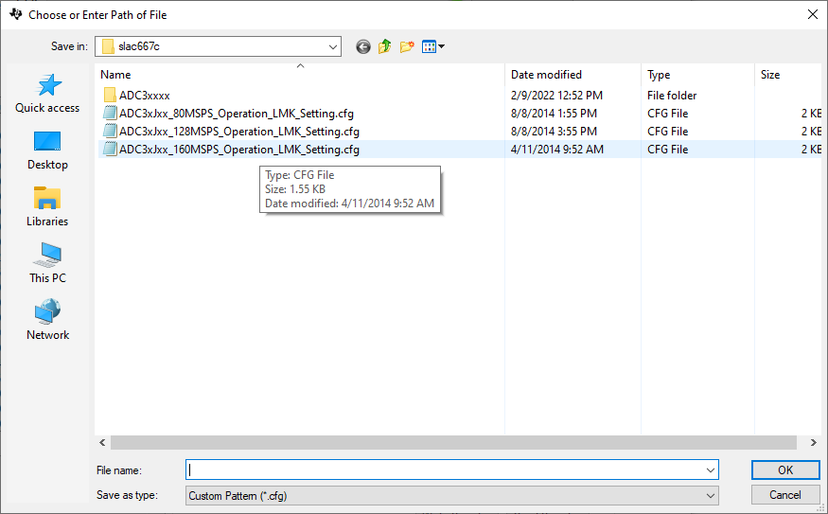
Go to low level view tab and load file called “ADC3xJxx_160MSPS_Operation_LMK_Setting.cfg” as shown below.

Slide 5
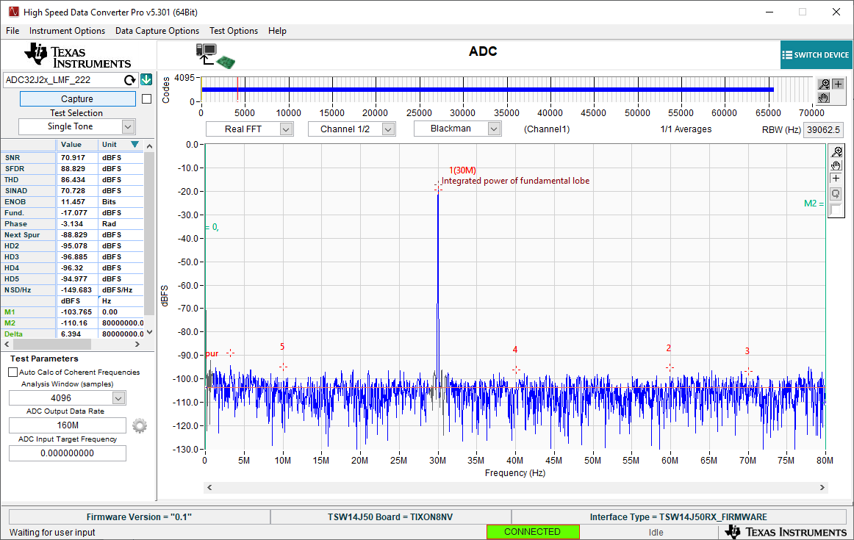
30MHz IF BP filter, CH1

Slide 6
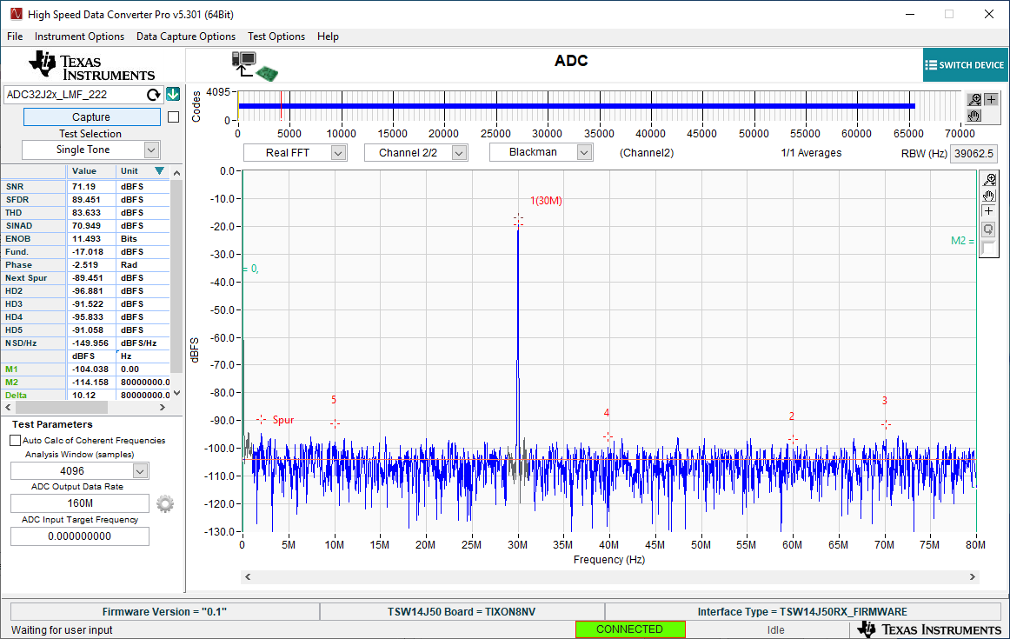
30MHz IF BP filter, CH2

