Slide 1
ADC32RF45 Testing

Slide 2
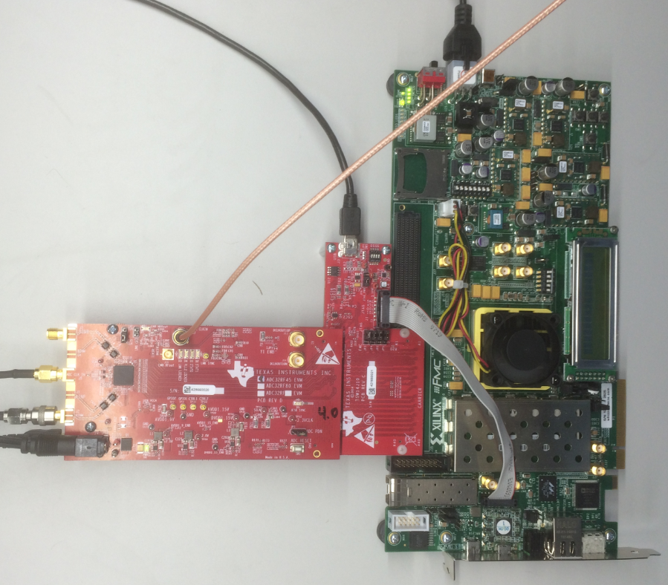
ADC32RF45, TSW14J10, VC707 Setup

Slide 3
Test Setup:
Single tone is given as input to the device.
Test conditions:
Fs = external 2.2GHz
Fin = 600MHz
LMK = 2.2GHz, clock dist mode
Mode = 8224, 14 bit
Ref clock = 550MHz
Core clock = 275MHz

Slide 4
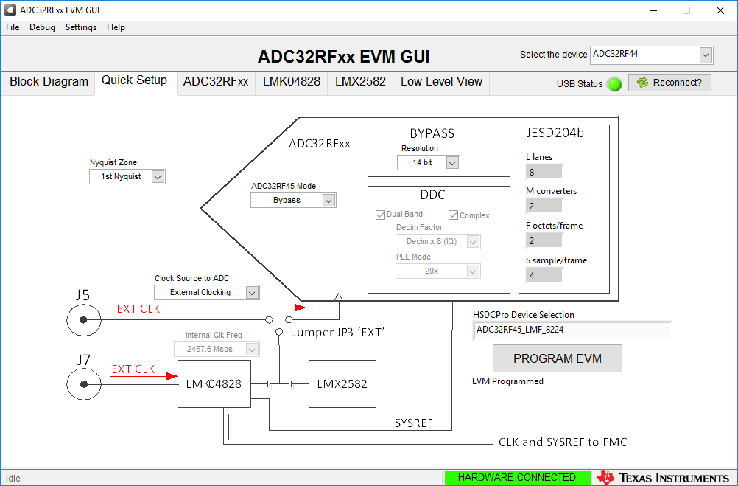
Load the following Quick Setup tab settings and click on “Program EVM”

Slide 5
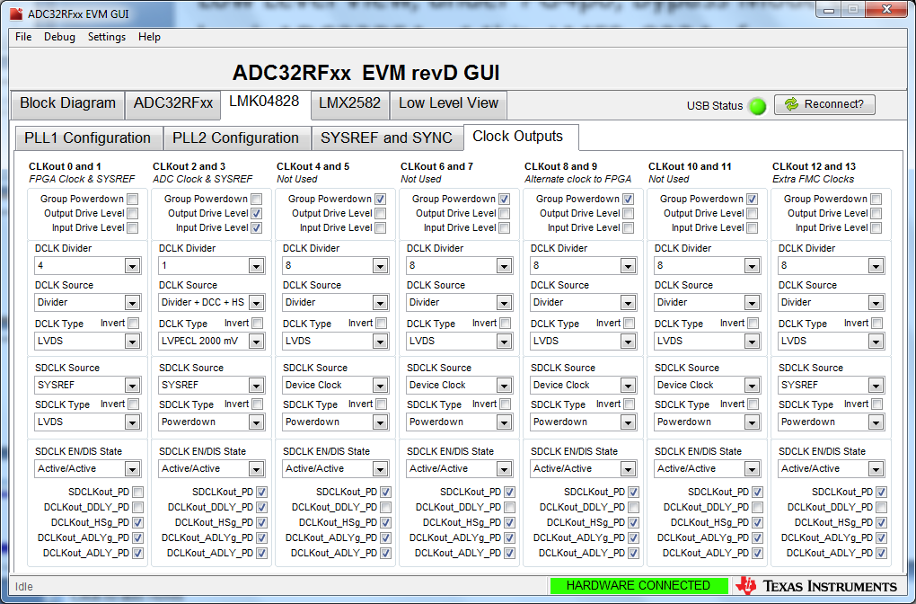
Click on Clock Outputs tab.
Set CLKout 0 divider to 4
Enable CLKout 12. Set the divider to 8, and DCLK type to LVDS

Slide 6
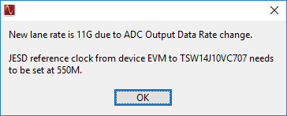
Open HSDCD Pro, select: “ADC32RF45_LMF_8224”
Enter “2.2G” for ADC Output Data Rate

Slide 7
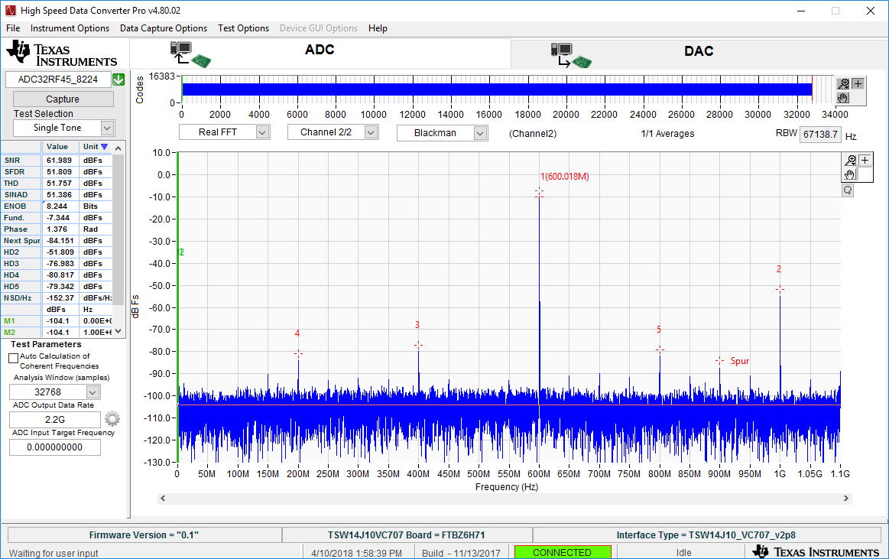
Capture results using a 600MHz input tone

