Slide 1
Enable Test Pattern First
Enable Test Pattern
Write 0x06 0x02 (address data)

Slide 2
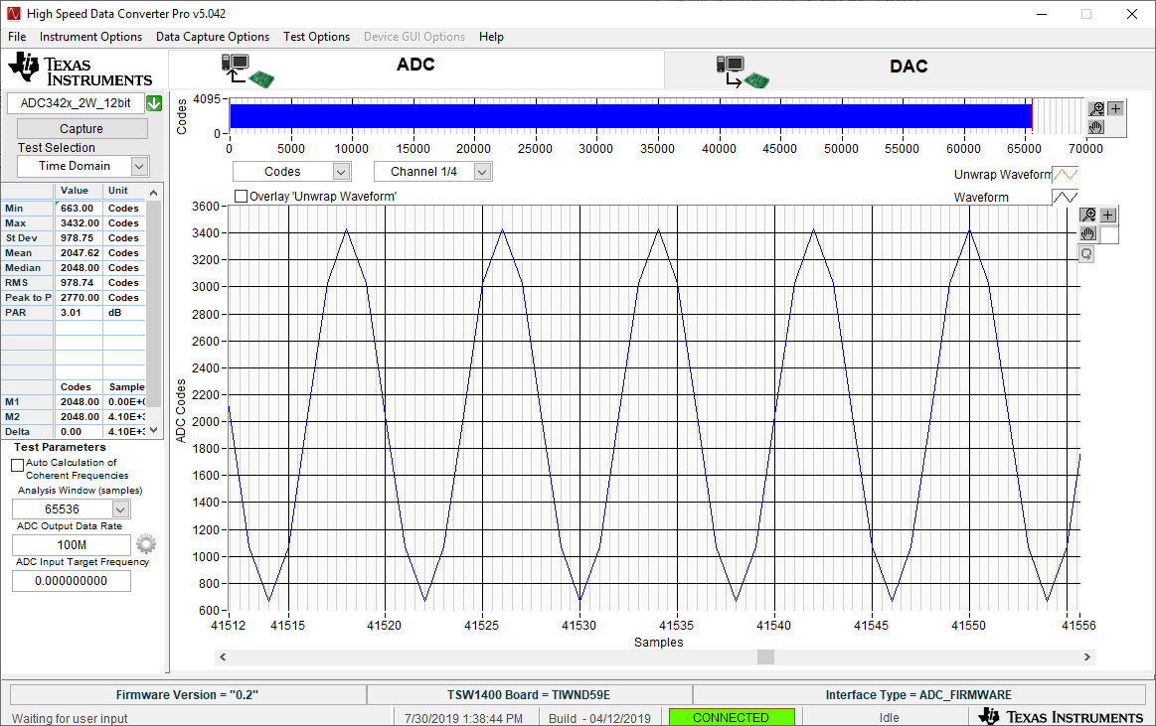
CHA 0x0A 0x90

Slide 3

CHB 0x0A 0x09

Slide 4

CHC 0x0B 0x90

Slide 5

CHD 0x0B 0x09

