Slide 1
ADC3669EVM-DC Data Capture issue

Slide 2
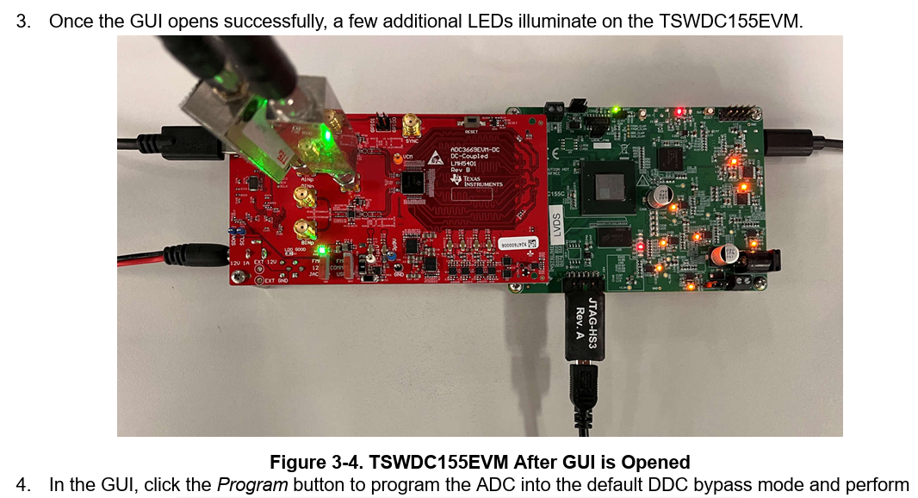
Summary
I attempted to display data in HSDC Pro (High Speed Data Converter Pro) using the TSWDC155EVM together with the ADC3669EVM-DC, but no data is displayed.
I followed the procedure described in Section 2.3, "Hardware Setup," of the EVM User‘s Guide: ADC3669EVM-DC exactly as instructed.
According to Step 3 in Section 3.3, "Using the GUI," several LEDs should illuminate when the GUI launches correctly. However, I do not observe this behavior in my setup.

Slide 3
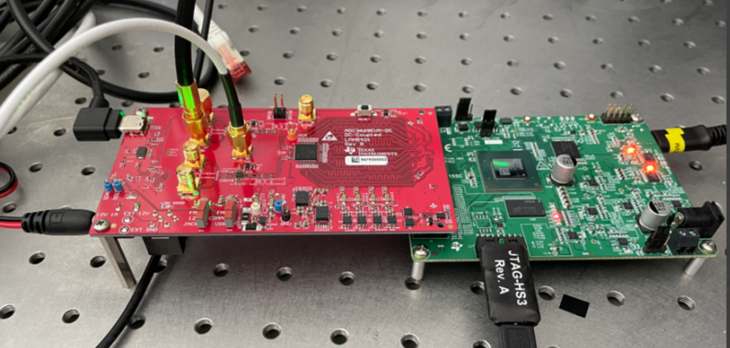
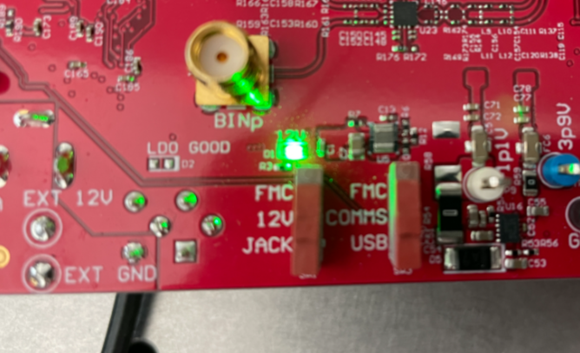
Board appearance
ADC3669EVM-DC
LMH5401
Rev B
TSWDC155EVM
12 V connected to the DC jack side;、 COMMS connected to the USB side.

Slide 4
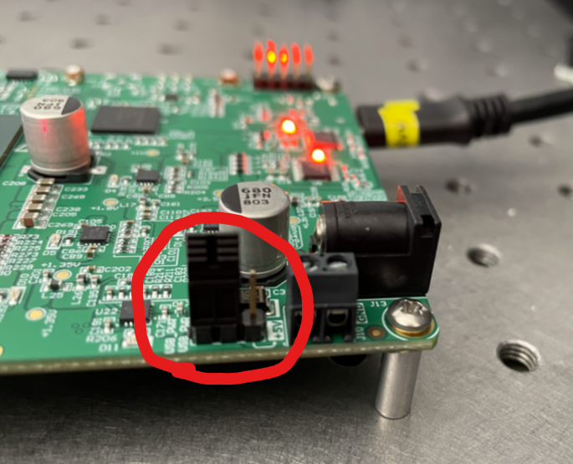
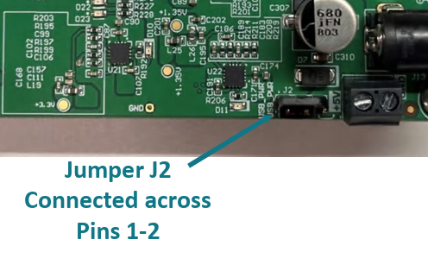
Confirmed Jumper pin
Same position as shown in the user guide

Slide 5
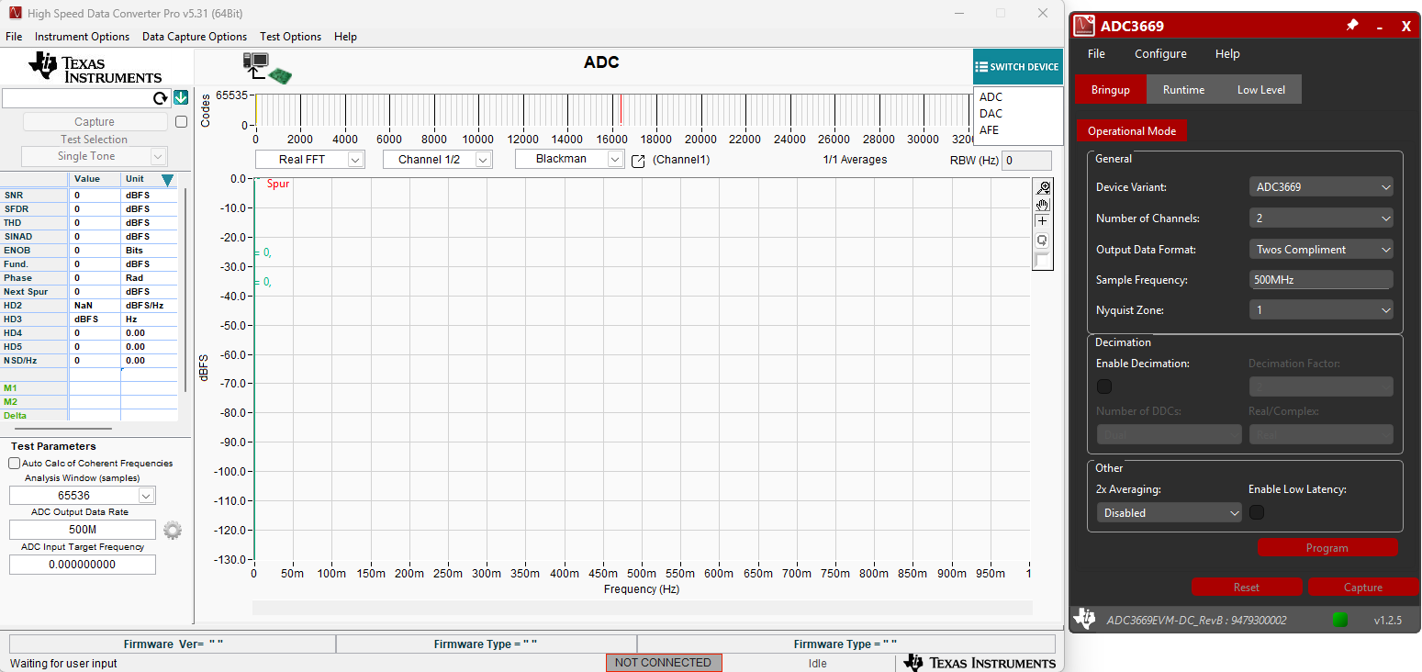
OPEN GUI
The ADC3669 appears to be detected correctly, as the Program and Capture buttons are enabled and can be clicked. However, nothing is displayed in the HSDC Pro GUI after capture. The number of illuminated LEDs is also the same as shown in the "Board Appearance" photo on Page 3 of this slide.

Slide 6
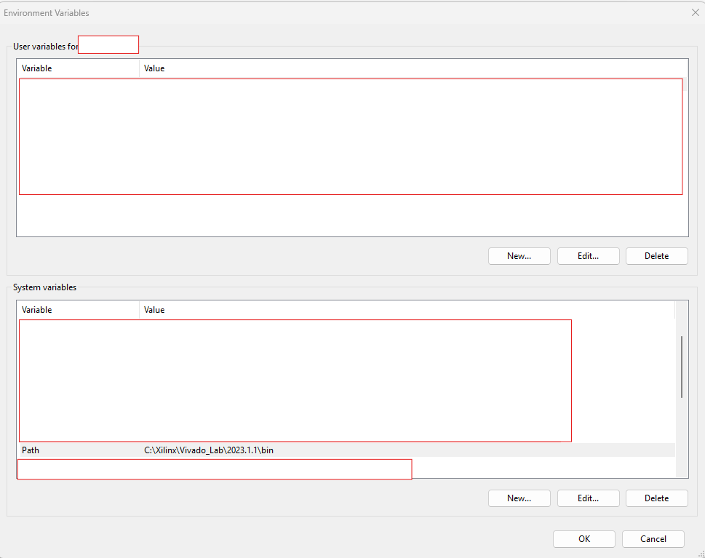
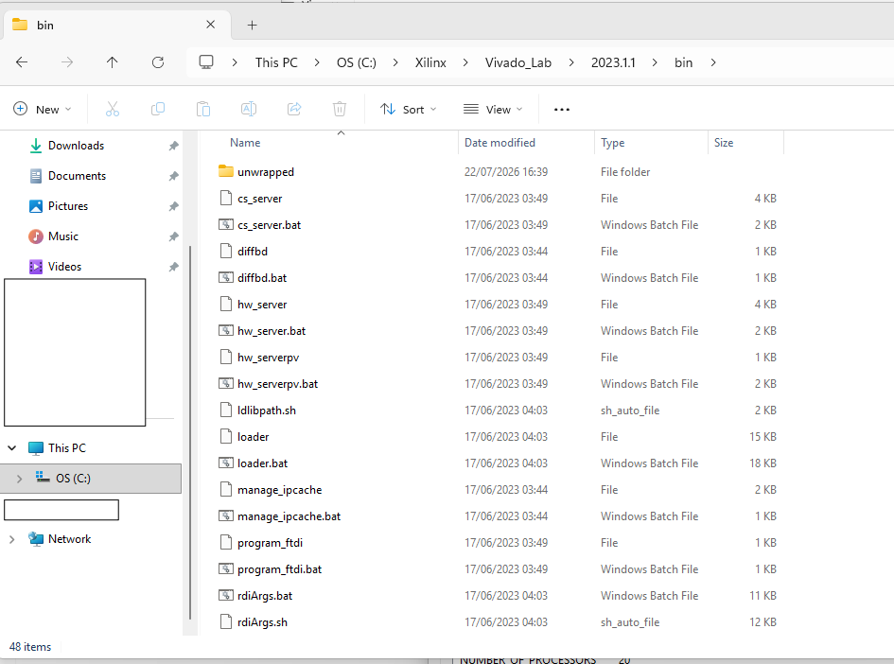
Environment Variables
The environment variables were configured as described in the user guide.

Slide 7
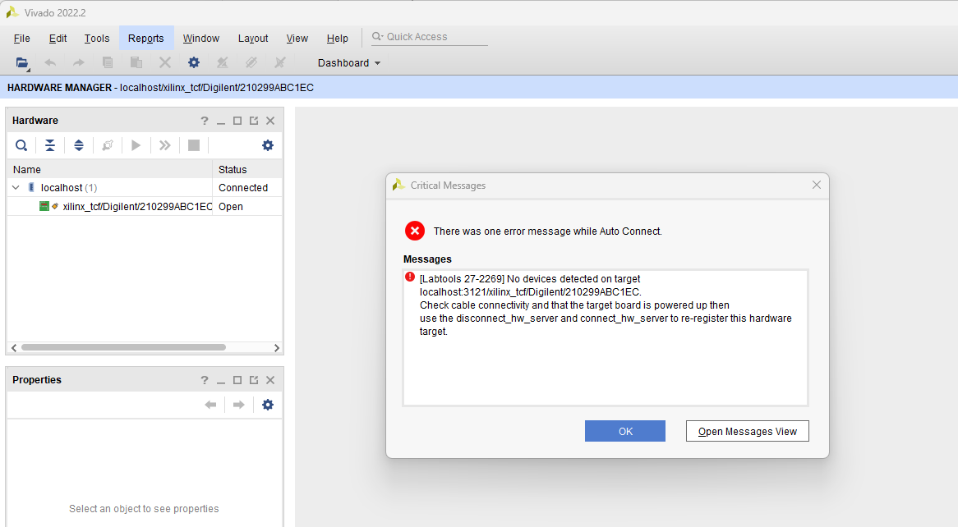
The device is undetected by Vivado
Even when the ADC3669EVM-DC is disconnected and only the TSWDC155EVM is powered on, it is still not recognized by Hardware Manager.
以上

