Slide 1
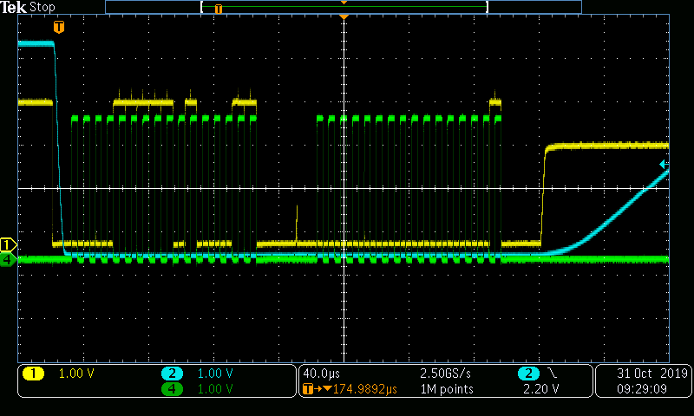
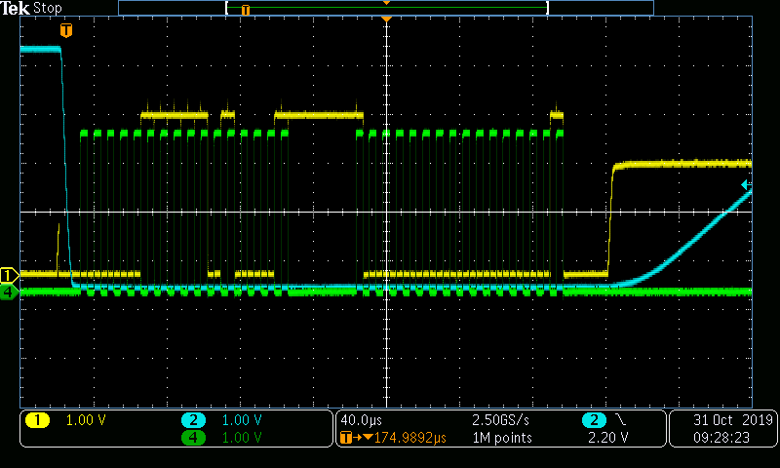
Measurement on ADC122S021
Trackmode
12 bit Data output
12 bit Data output Ch 1
HOT
correct
Trackmode
Trackmode
12 bit Data output Ch 0
12 bit Data output Ch 1
COLD
fail
Trackmode
Scope setting:
Ch.1: ADC Data out
Ch.2: ADC Chip Select
Ch.4: ADC Clock
CKN 311029

