Slide 2
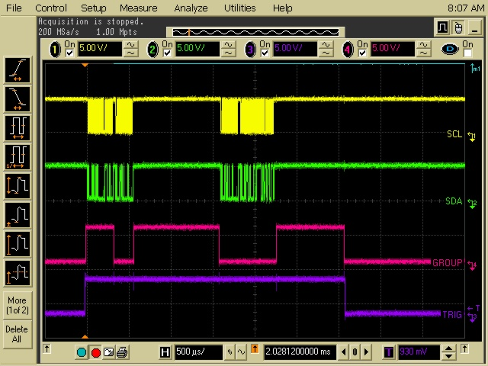
My Delay
(Shortened here to display all on screen.)
Requesting
Data
Initiating One-shot
START/SYNC
Configuring inputs
Normal Working Waveforms

Slide 3
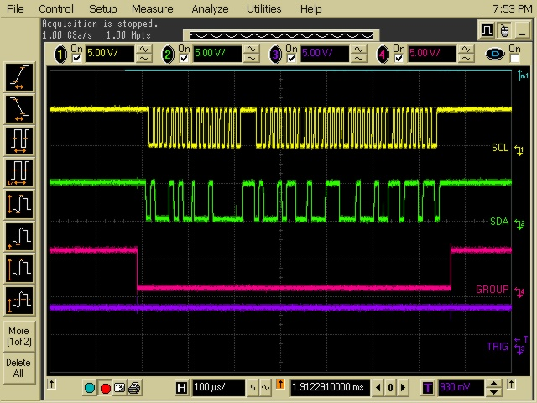
Read Data Command is sent here
Address
Request
Expanded View of the Data Request Section, Normal Working System Waveforms

Slide 4
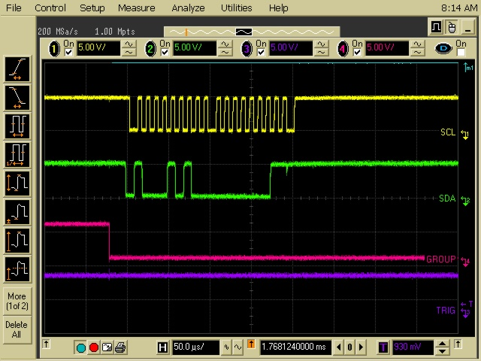
Read Data
Command
should be sent here
Address
request
Looks like the ADS is
is acknowledging
the address request
by pulling low on the
9nth bit of the SCL
45h Address
request
?
Is the ADS holding
the bus low so that
the ucontroller cannot
send the Read Data
command?
Expanded View of Data Request Section Waveforms when it HANGS
(This locks up the I2C library)

