Slide 1
ADS1292 RDATA timing
Customer’s conditions
2 AFEs(ADS1292) used in the system, AFE#1 and AFE#2.
AFE#1 : No issue, 8kSPS synchronized with /DRDY.
AFE#2 : Incorrect data read issue, 500SPS asynchronous with /DRDY(3 times data read per one chance).
The timing to read is once per 10 times of AFE#1 to read at 8kSPS which is every 1.25ms.
It was supposed to be once per 8 times(every 1ms), but the current program has a bug on this.
AFE#2 samples at 2ms, but it sometimes misses to get correct data by RDATA command.
It’s not regularly/periodically, but irregularly.
AFE : Internal clock(512kHz) use with 500kSPS(2ms period).
The AFE#2 doesn’t monitor /DRDY for issuing RDATA
RDATA command is asynchronous with /DRDY.
No use of RDATAC, but RDATA with START pin pulled up(fixed to high level).
RDATA command of 1ms period clock, different from the AFE internal clock, to read data.
  (Issuing RDATA command is asynchronous with /DRDY since it doesn’t monitor /DRDY).
Reading data 3 times at 1ms clock with 125us interval.
They’re aware that the same data will be read.
Schematic of the system :

Slide 2
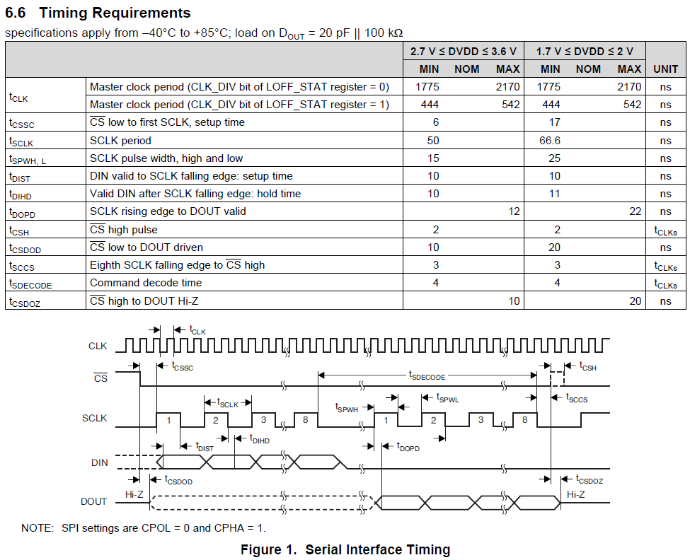

Slide 3
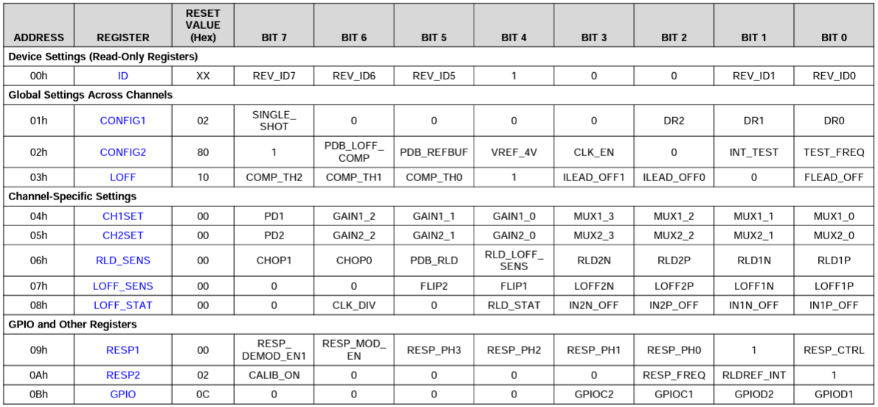

Slide 4
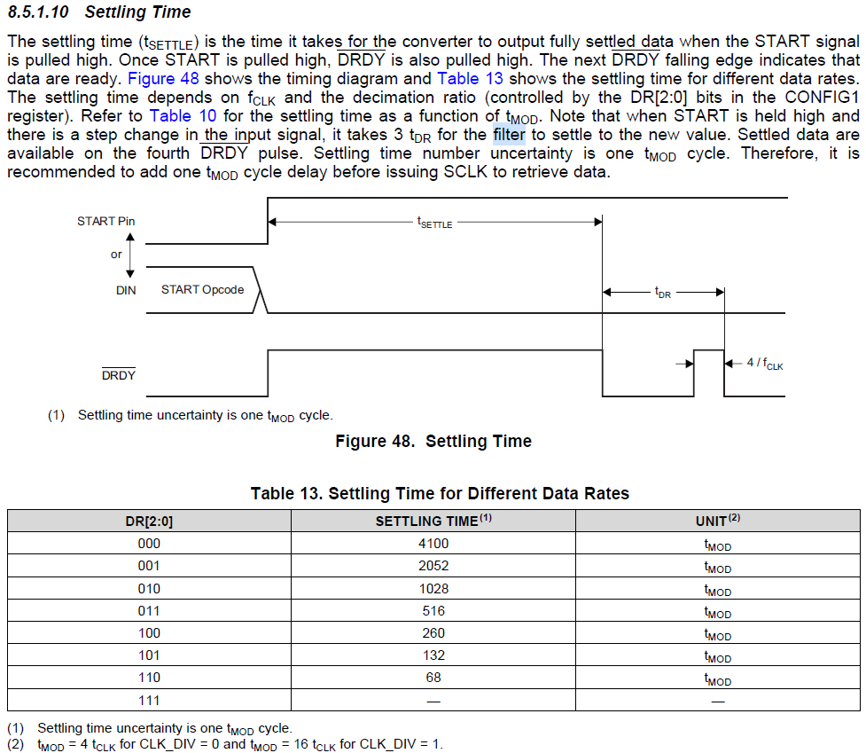
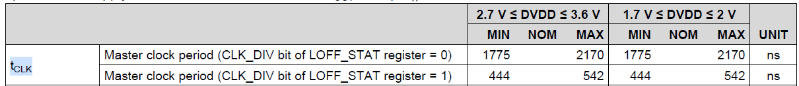
AFE#2
0x06, // CONFIG1 ➡ DR[2:0]=110
0xA0, // CONFIG2
0x90, // LOFF
0x10, // CH1SET
0x90, // CH2SET
0x00, // RLD_SENS
0x00, // LOFF_SENS
0x00, // LOFF_STAT ➡ CLK_DIV=0
0x02, // RESP1
0x03, // RESP2
0x0C // GPIO
tMOD = 4 tCLK = 4 x 2170ns(DVDD=3V)
= 8.68us(max)
tSETTLE = 68 x tMOD = 590.24us(max)

Slide 5
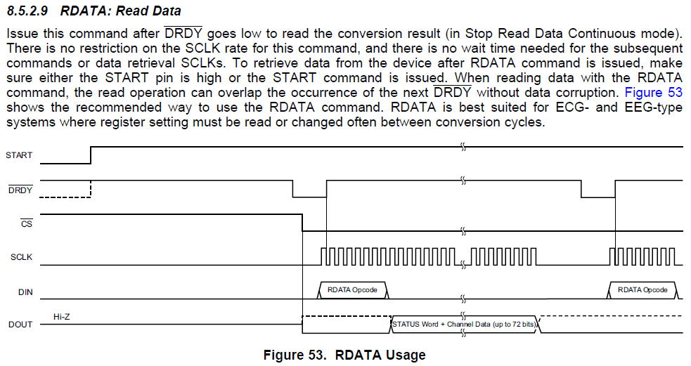

Slide 6
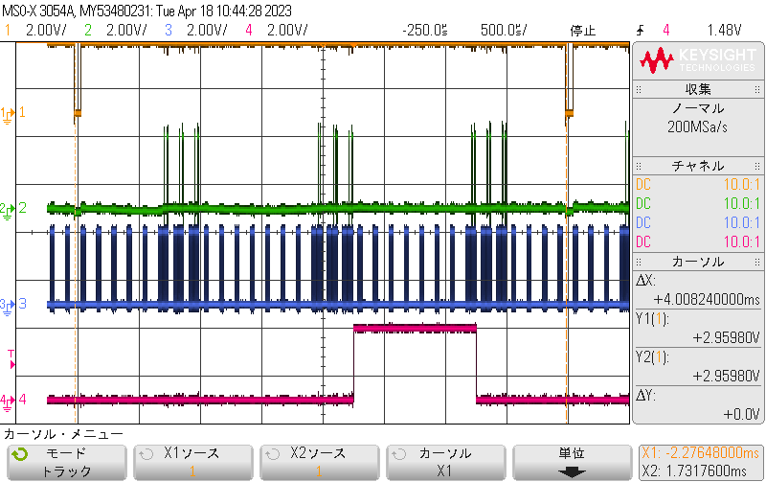
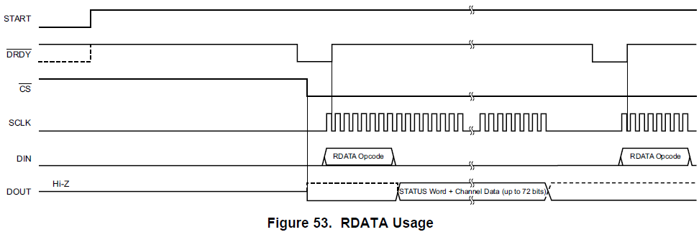
Stop
/DRDY
DOUT
SCLK
RDATA command issued around here.
/DRDY=Hi due to RDATA command
Acquiring
Normal
Channel
Cursor
Just for the flag when the issue happens

Slide 7
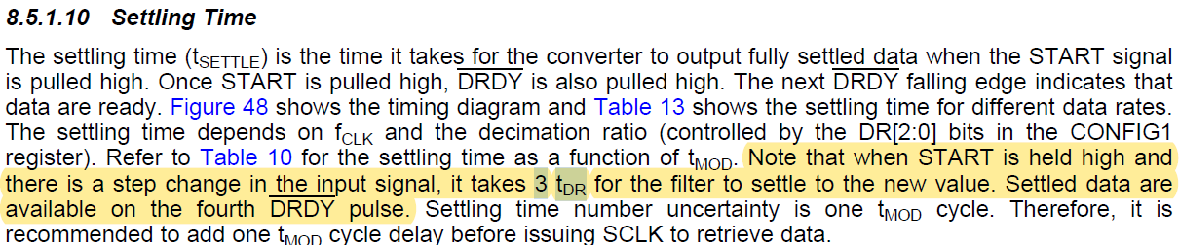
ADS1292 expected read data timing by using RDATA command

