Slide 1
Setup for EVM
Provide 100MHz clock @ 12dBm to CLK_IN SMA.
Provide 5VDC to J10 and return to J12.
Turn on power supply. Supply should draw about 0.6A with the clock running.
In the ADC GUI, enable the “Digital Function Enable”.
Set Test Pattern A and B to “Ramp”.
The GUI shall look as shown in next slide.

Slide 2
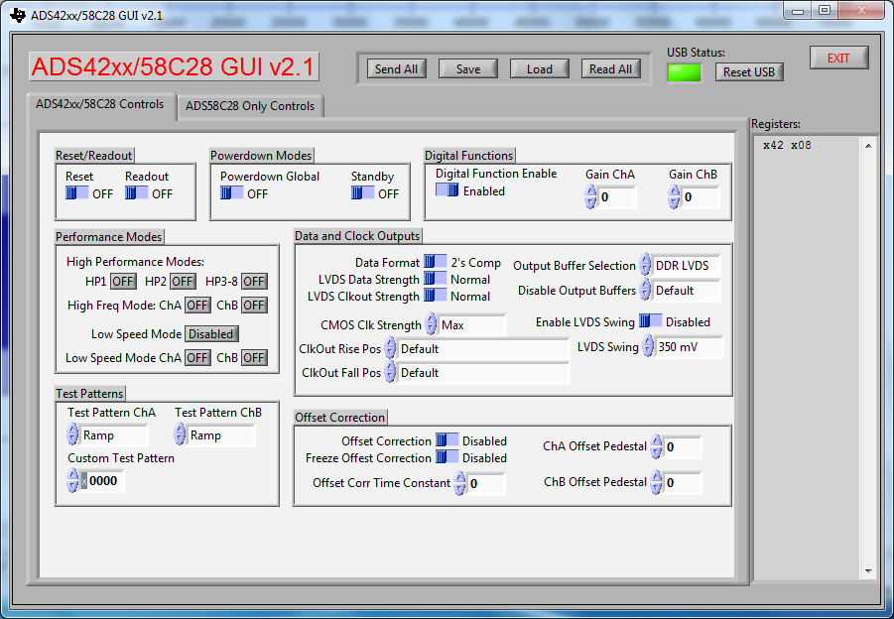
Setup for EVM

Slide 3
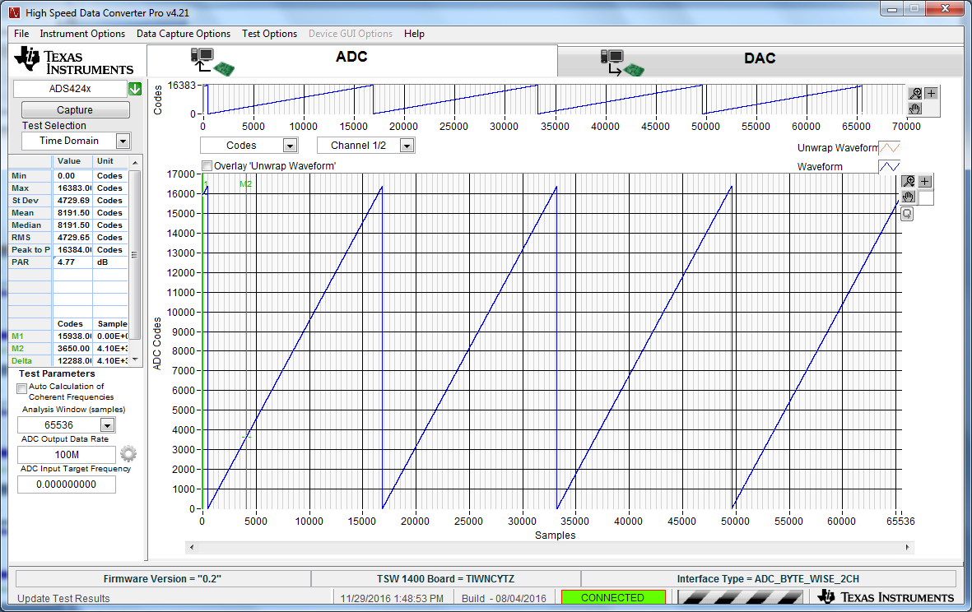
Set ADC Output Data Rate = 100M Set capture mode to “Codes”

