Slide 1
ADS42JB49 Test

Slide 2
ADS42JB46
Test conditions:
After power up, press board reset then load config file called “ADS42JB49_EVM_LMF421_250M.cfg”.
LED D1 and D4 should now turn on.

Slide 3
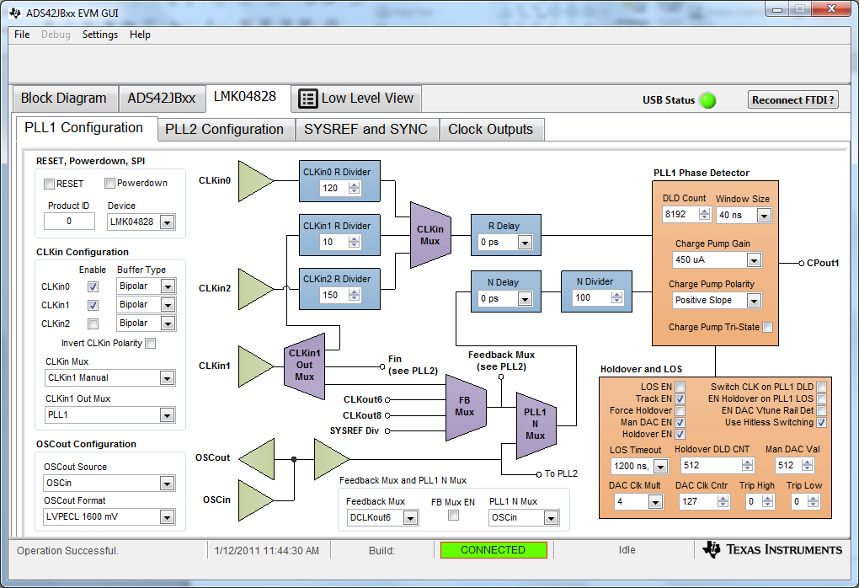
PLL 1 tab

Slide 4
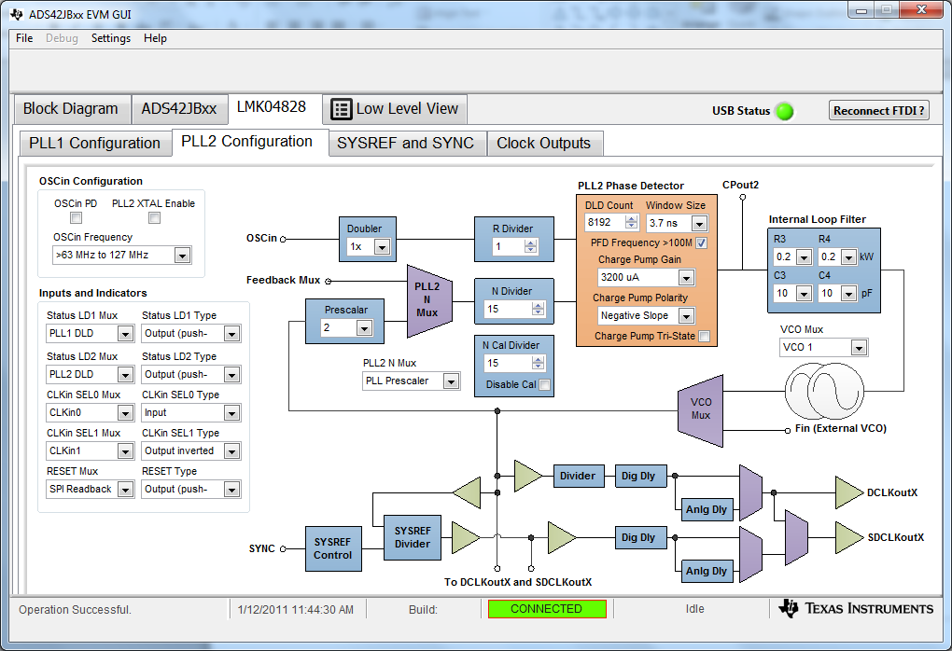
PLL 2 tab

Slide 5
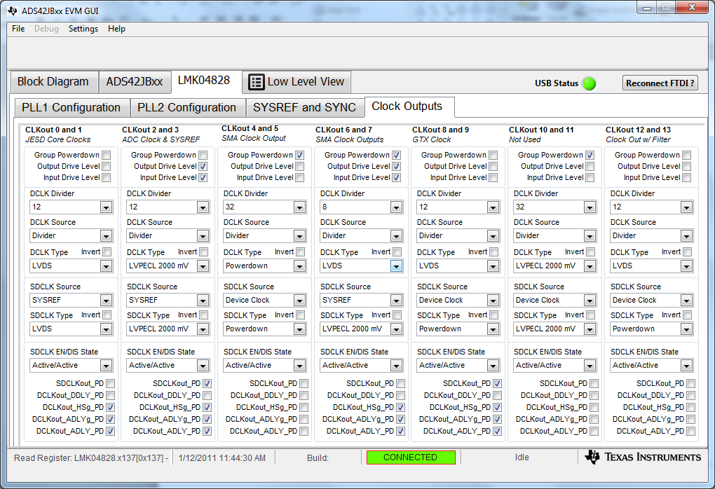
LMK Clock Outputs

Slide 6
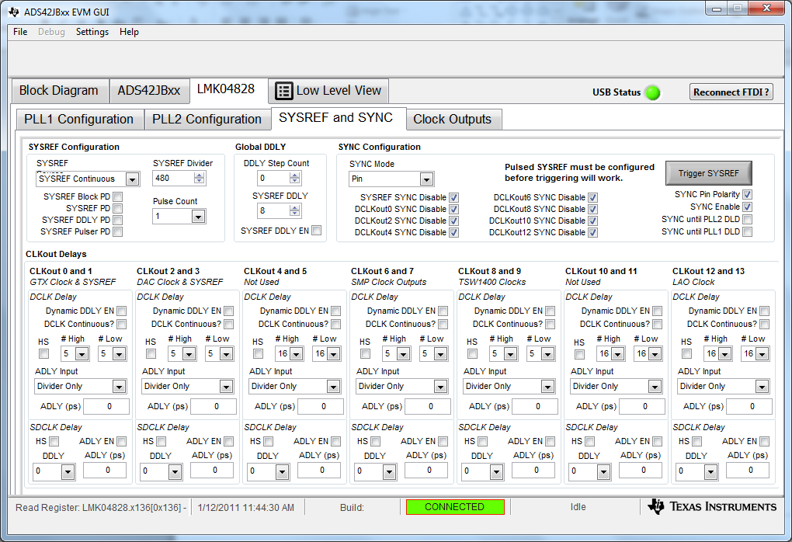
SYS and SYNC tab

