Slide 1
ADS42JB66 Test

Slide 2
ADS42JB66
Test conditions:
Fs = 100MHz
Fin = 15.5MHz
LMF = 222
K = 32
SYSREF = 3.125MHz (Fs/K)
Serdes rate = 2Gbps
TSW14J56EVM reference clock = 200MHz

Slide 3
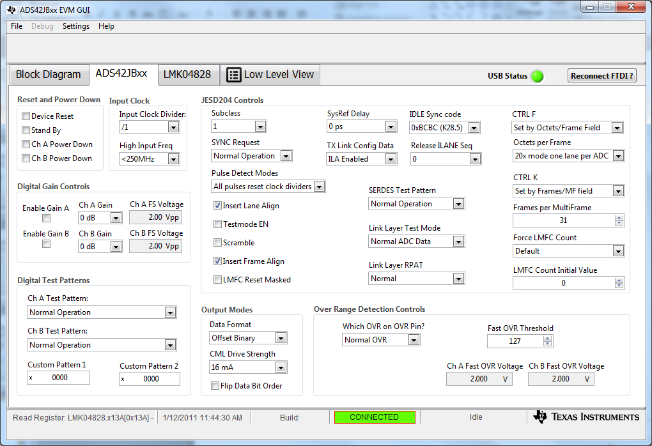
ADC Configuration

Slide 4
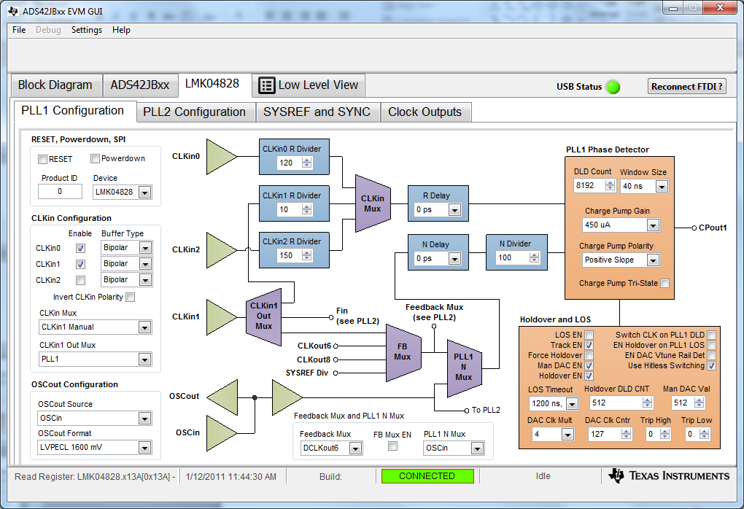
PLL1 Configuration

Slide 5
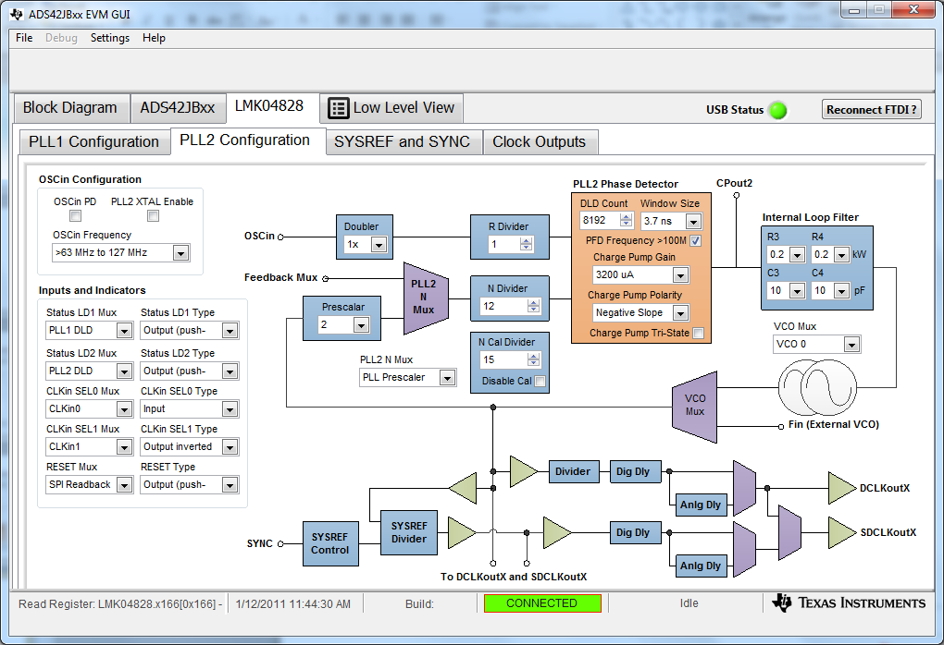
PLL2 Configuration

Slide 6
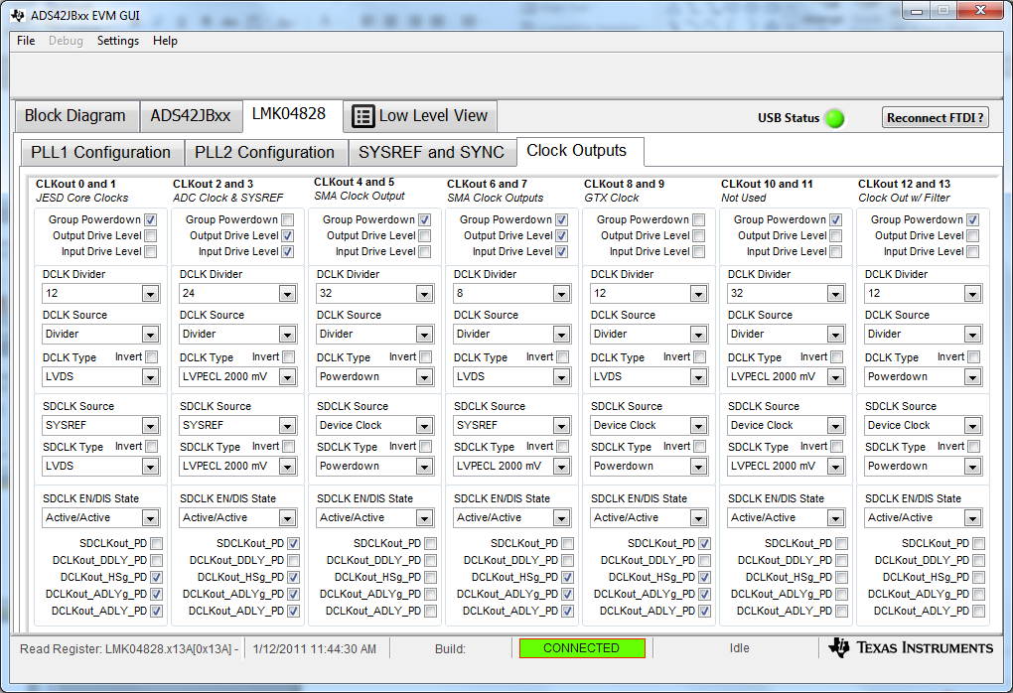
Clock Output Configuration

Slide 7
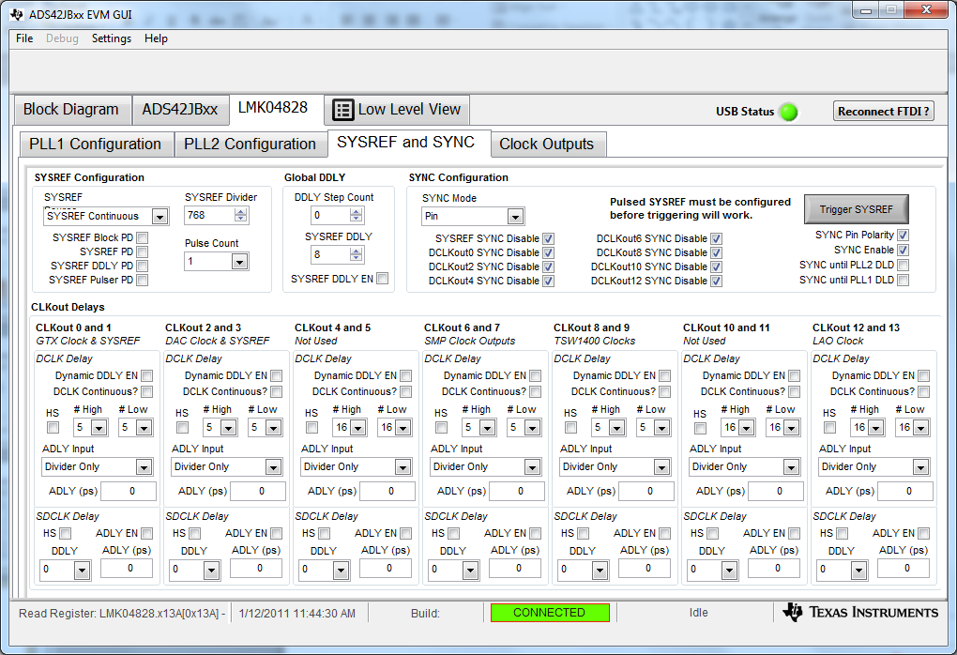
SYSREF Output Configuration

Slide 8
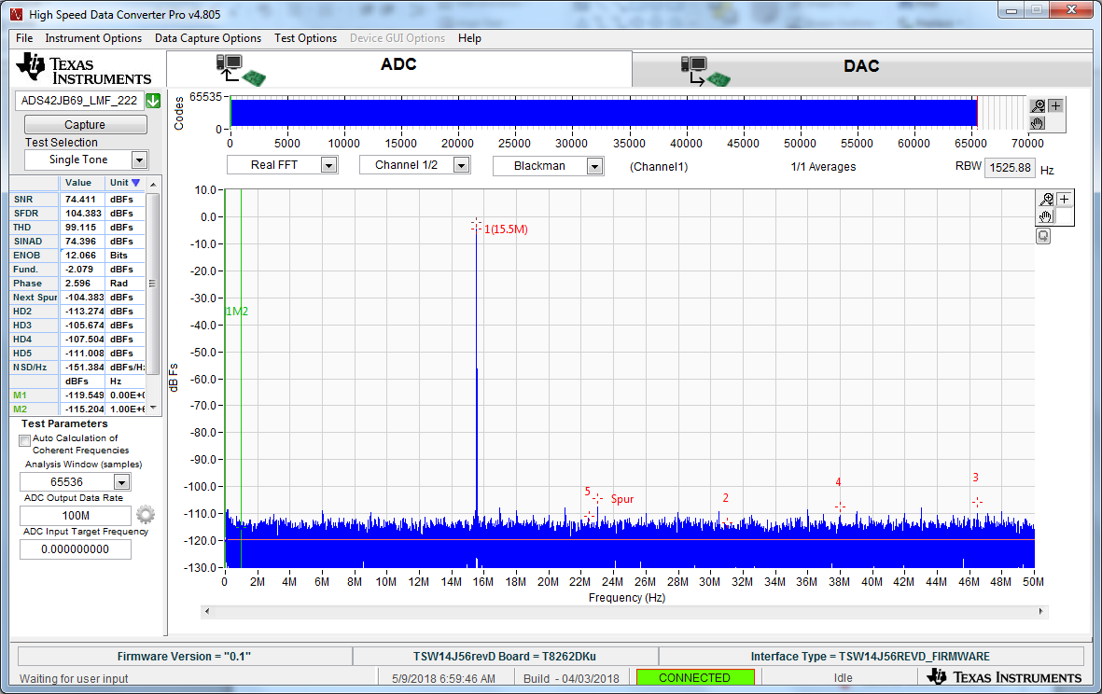
SYSREF Output Configuration

