Slide 1
ADS42JB69 Test

Slide 2
ADS42JB69
Test conditions:
Fs = 250MHz Int Clk, LMK04828
Fin = 180MHz
LMF = 421

Slide 3
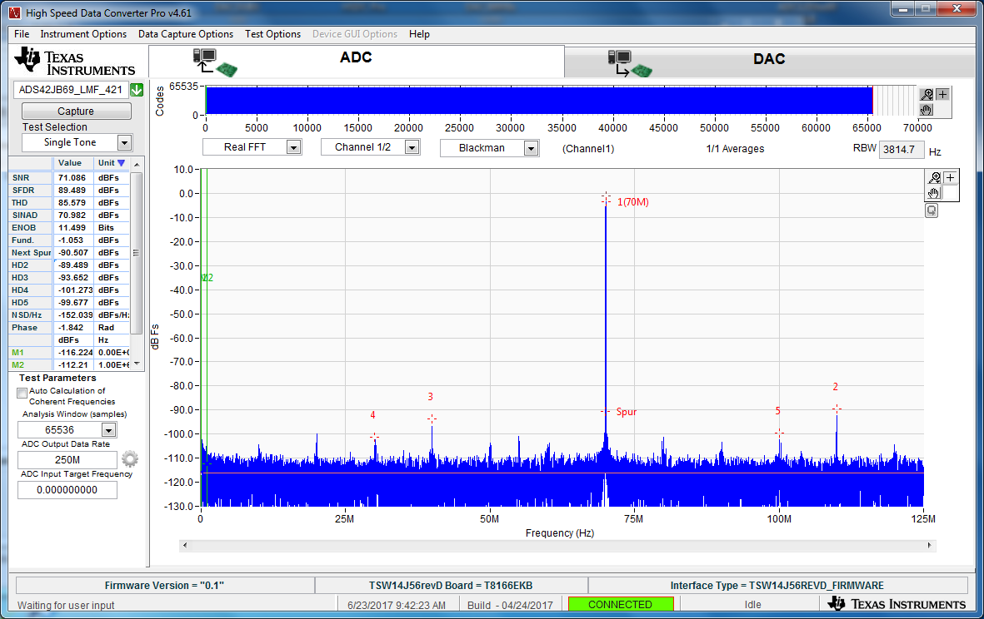
250MHz Fs, 180MHz IF, BP Filter, CHA

Slide 4
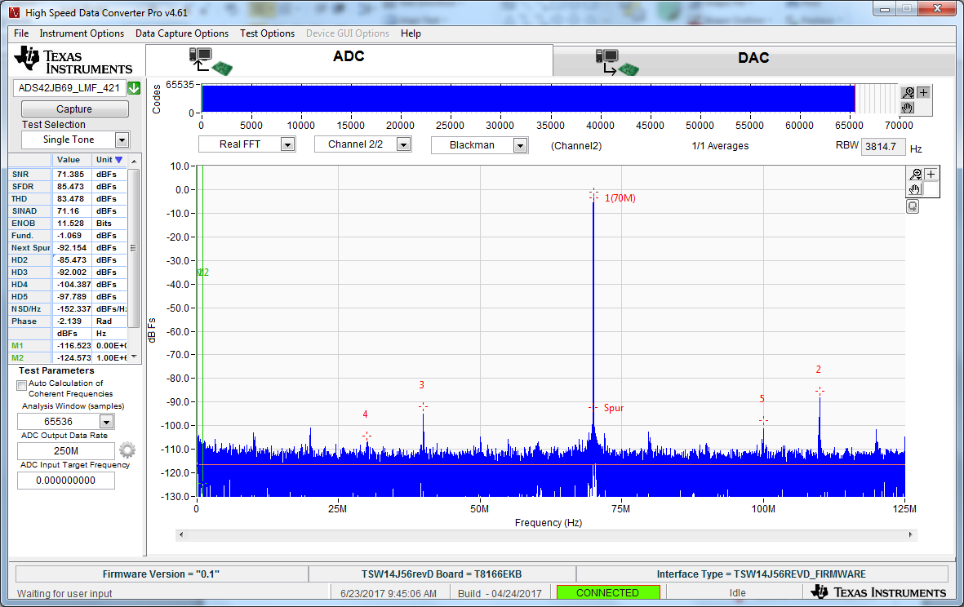
250MHz Fs, 180MHz IF, BP Filter, CHB

