Slide 1
ADS54J42 Test

Slide 2
ADS54J42
Test conditions:
Fs = 276.48MHz Ext Clk
Fin = 139MHz and 202MHz (no filter)
LMFS = 2242
Dec 2x
ADC data rate = 138.24MHz
FPGA Ref Clock = 69.12MHz
Lane rate = 2.7648Gbps

Slide 3
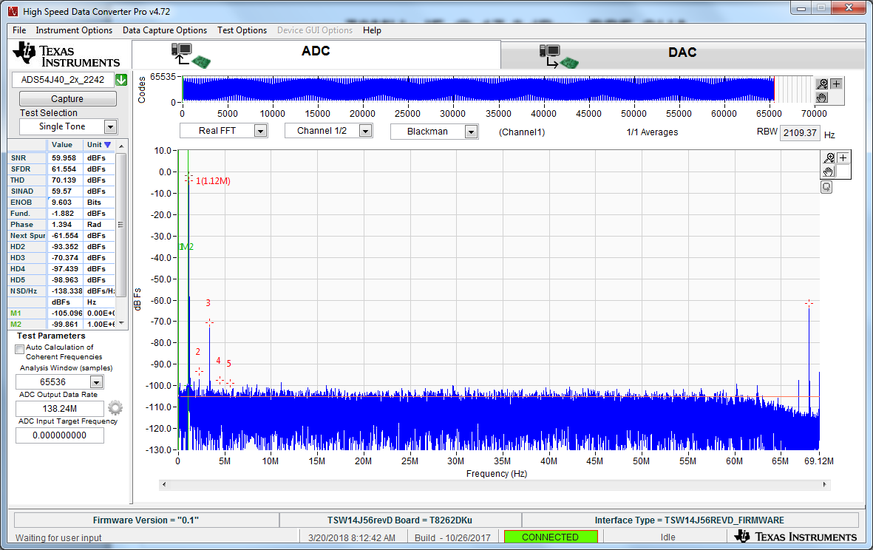
139MHz IF @ 9dBm, CHA

Slide 4
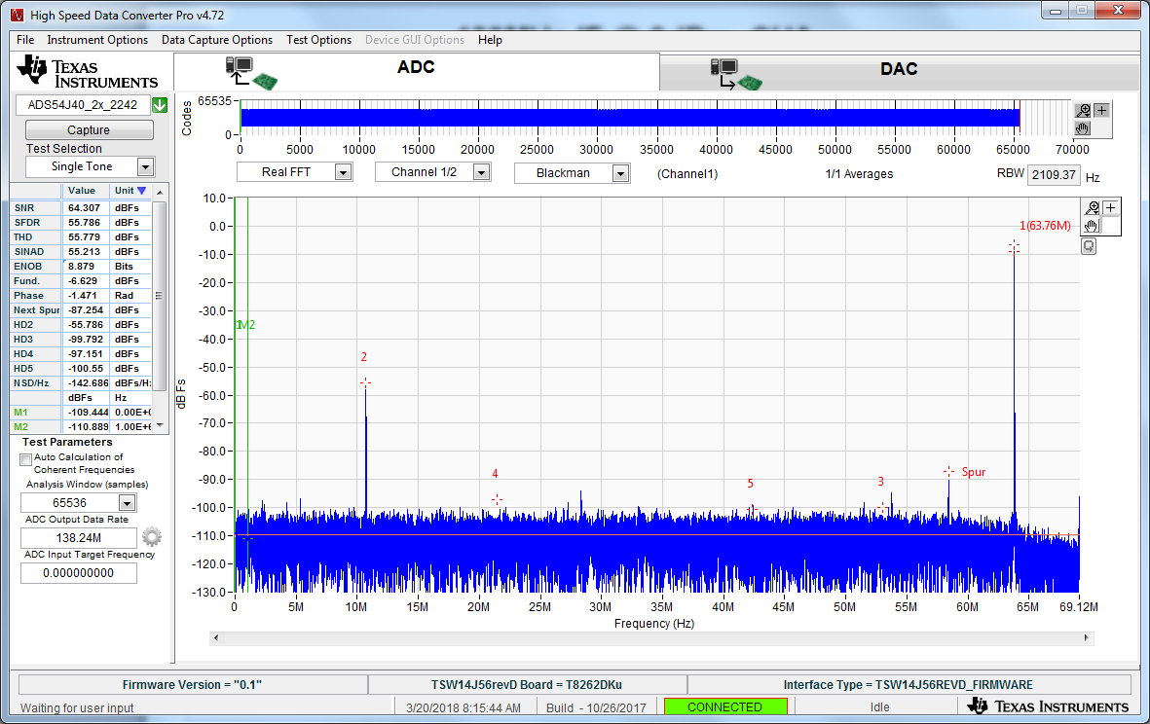
202MHz IF @ 9dBm, CHA

