Slide 1
ADS54J42 Test

Slide 2
ADS54J42
Test conditions:
Fs = 552.96MHz Ext Clk
Fin = 207MHz (no filter)
LMFS = 2242 HPF
Dec 2x
ADC data rate = 276.48MHz
FPGA Ref Clock = 69.12MHz
Lane rate = 2.7648Gbps

Slide 3
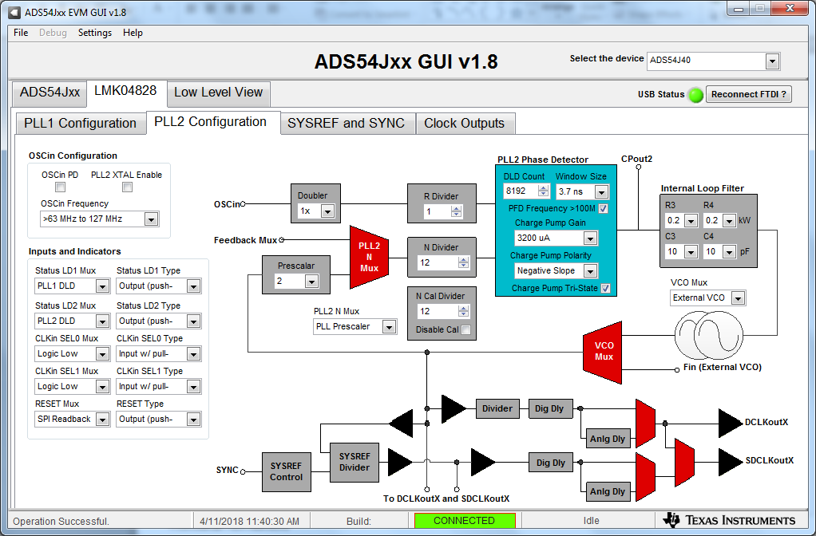
LMK clock distribution mode

Slide 4
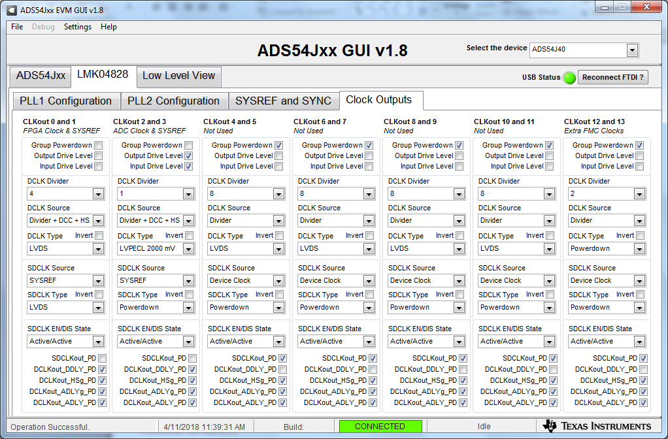
LMK output clock settings

Slide 5
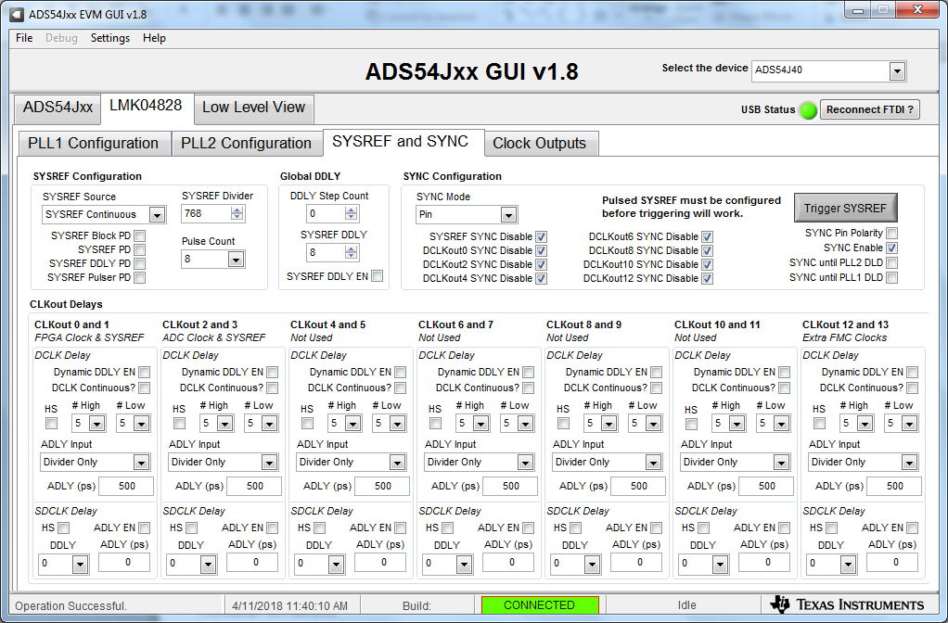
LMK output sysref settings

Slide 6
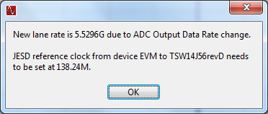
Lane rate and FPGA reference clock

Slide 7
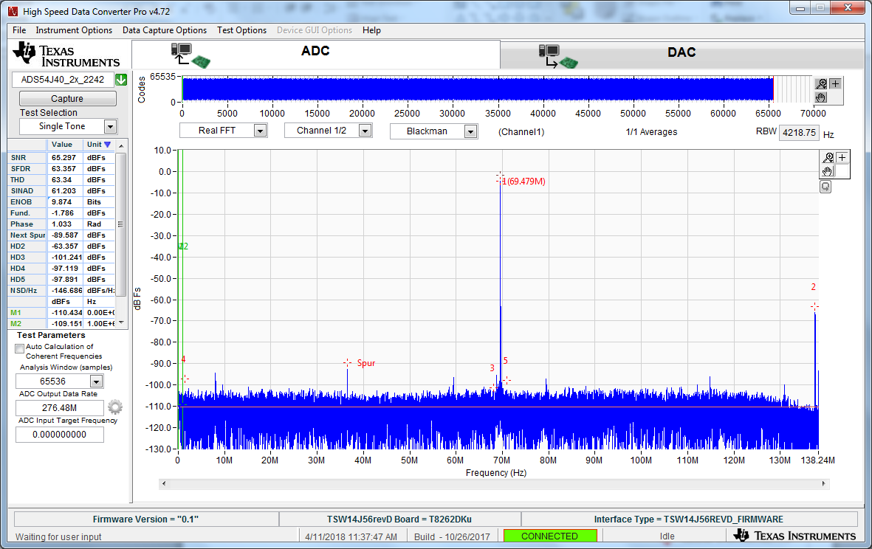
207MHz IF @ 10dBm, CHA

