Slide 1
ADS54J54 Test

Slide 2
ADS54J54EVM Setup
Test Setup:
Test conditions:
Fs = 500Msps internal clock
Fin =50MHz
No decimation
LMF = 841

Slide 3
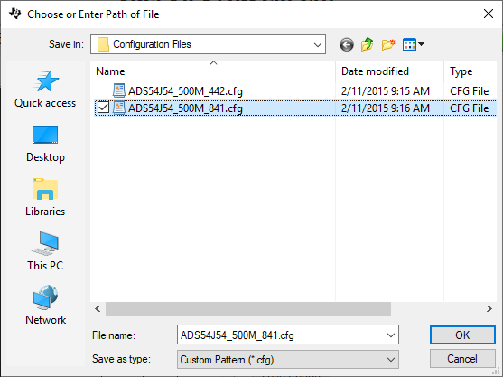
Open ADC GUI. Go to low level tab. Load “ADS54J54_500M_841.cfg” Verify LED’s D1 and D4 illuminate to indicate LMK PLL’s are locked

Slide 4
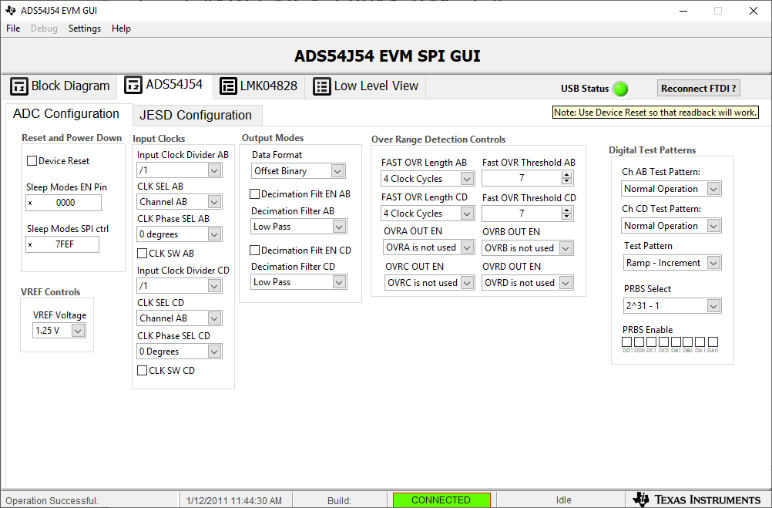
Go to ADS54J54 tab. Disable “Decimation Filt EN AB and CD.

Slide 5
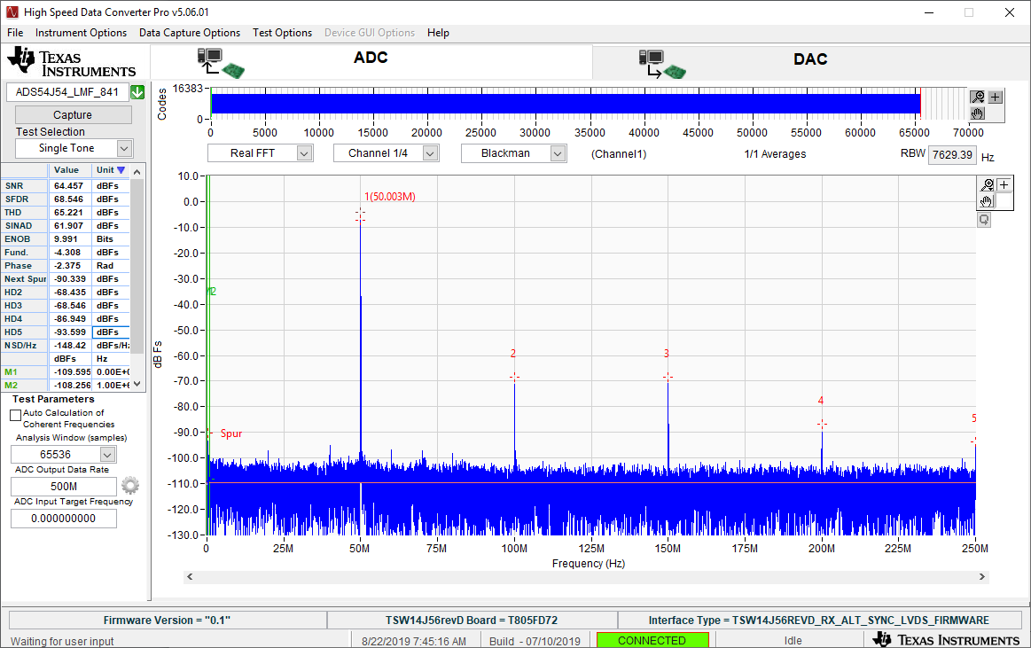
Open HSDC pro GUI. Select “ADS54J54_LMF_841” Set ADC Output Data Rate = 500MHz Click on capture

Slide 6
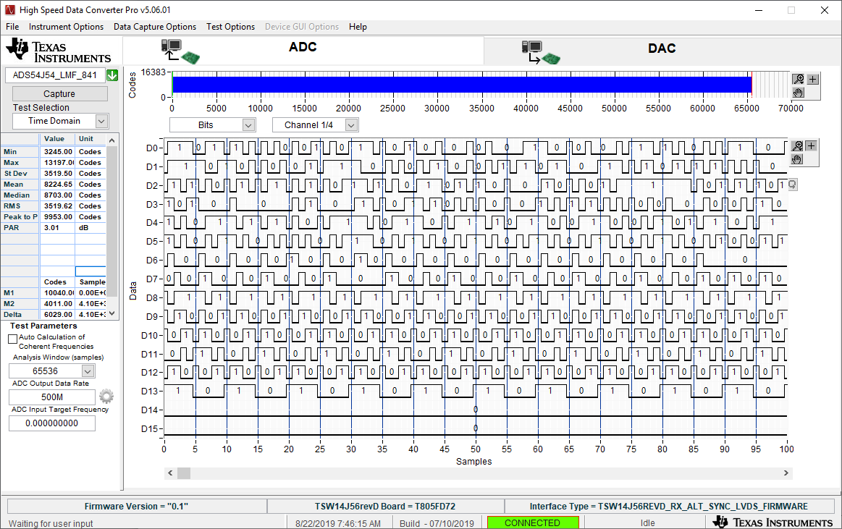
Select bits to see all of the data bits

