Slide 1
ADS54J60 Test

Slide 2
ADS54J60
Test conditions:
Fs = 1GHz Ext Clk no filter
Fin = 210MHz and 310MHz, Band Pass filter.

Slide 3
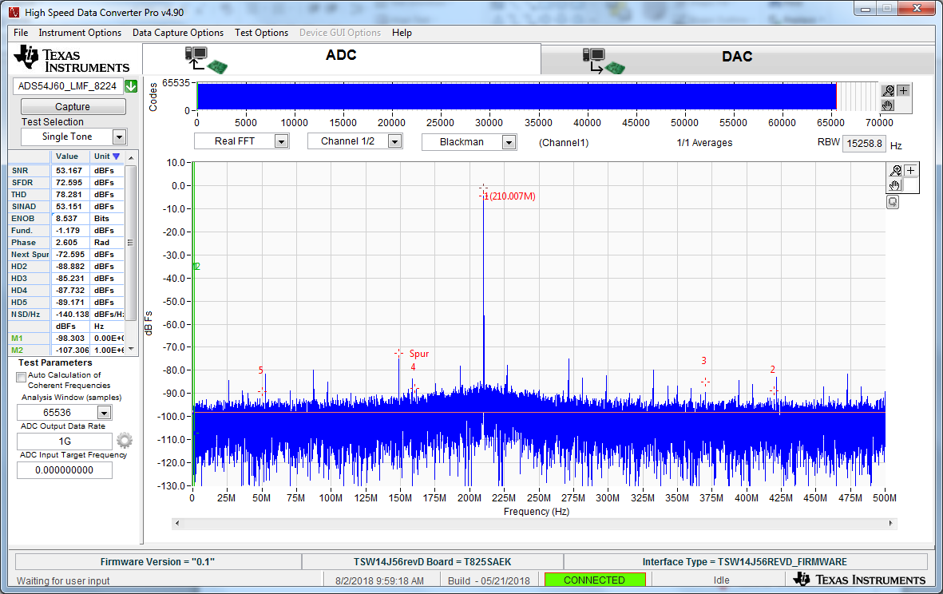
210MHz IF @ 15dBm, BPF CHA

Slide 4
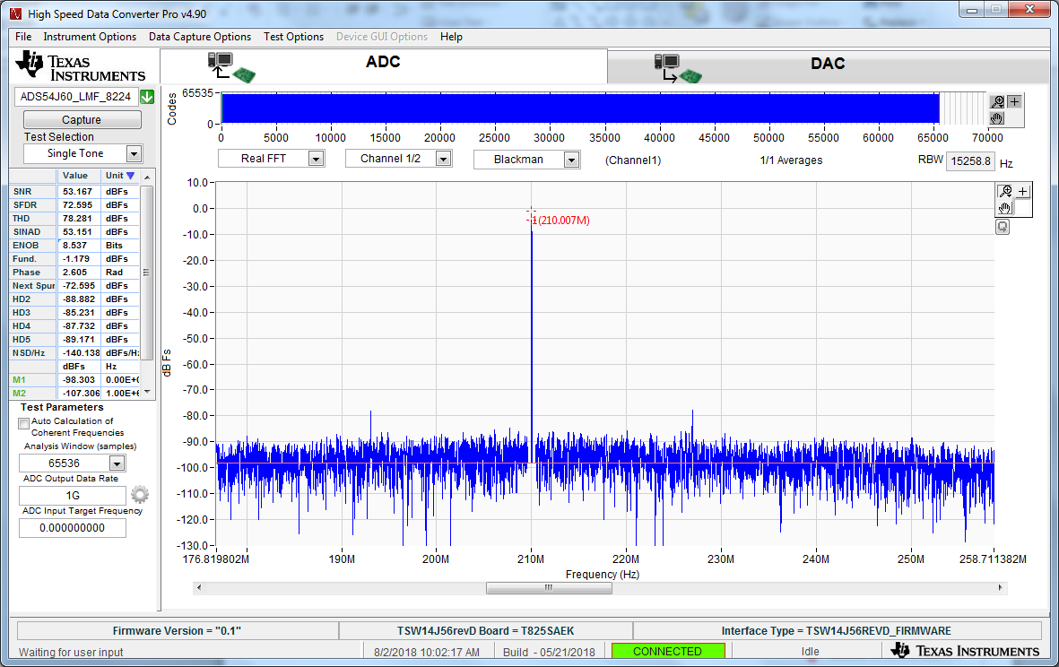
210MHz IF @ 15dBm, BPF CHA

Slide 5
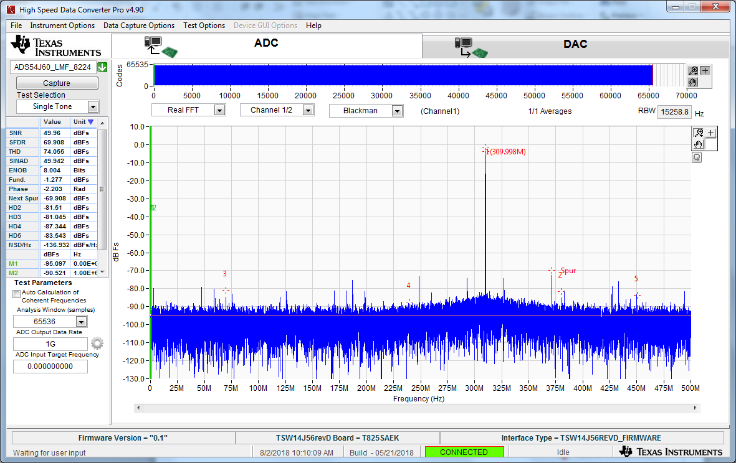
310MHz IF @ 12dBm, BPF CHA

Slide 6
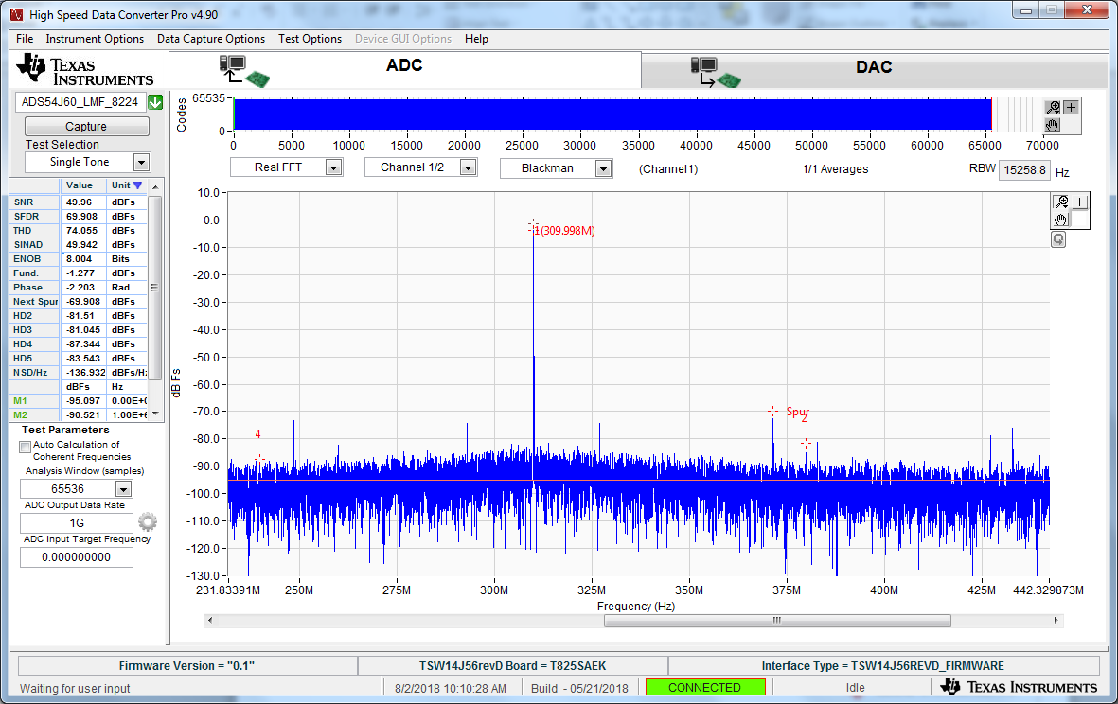
310MHz IF @ 12dBm, BPF CHA

Slide 7
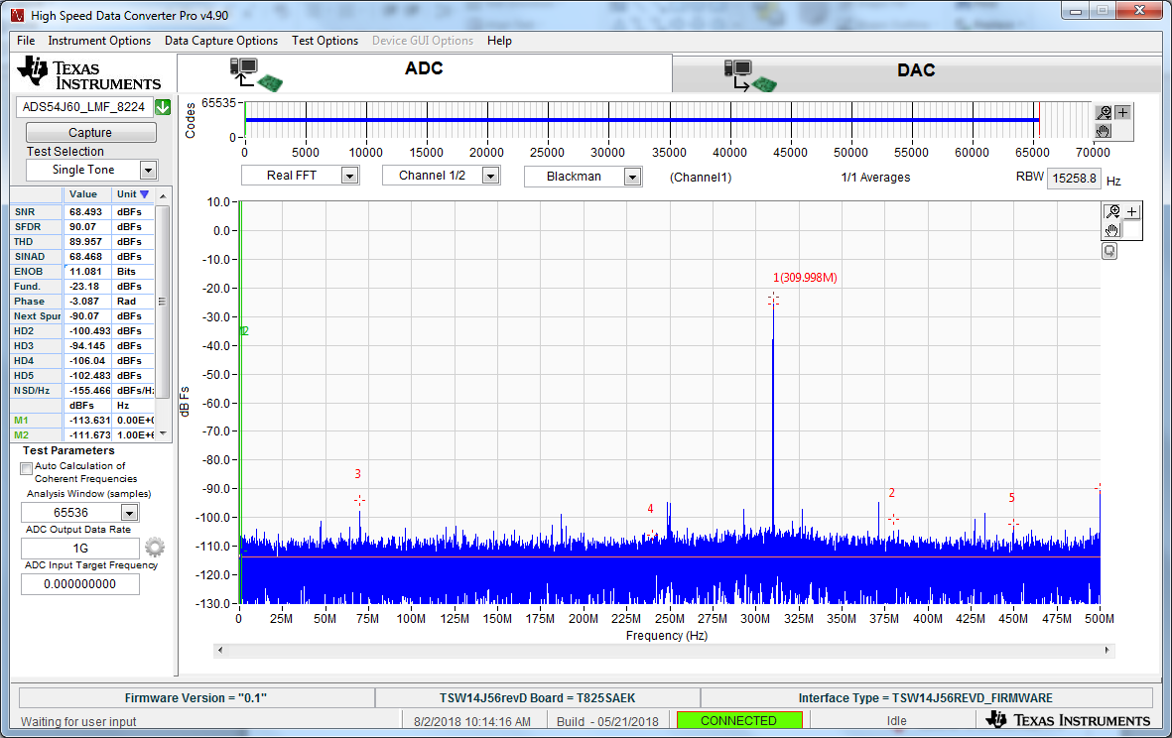
310MHz IF @ -10dBm, BPF CHA

Slide 8
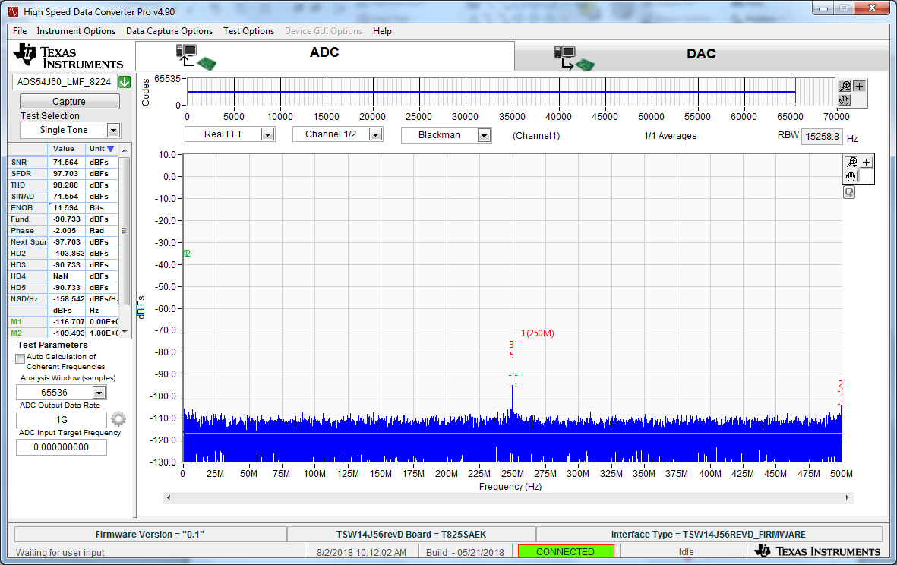
No input CHA

