Slide 1
ADS54J60 Test

Slide 2
ADS54J60
Test conditions:
Fs = 1GHz ext Clk
Fin = 210MHz

Slide 3
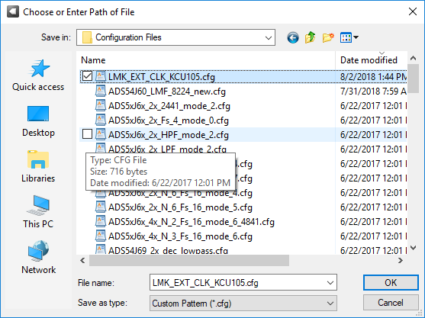
Using ADS54J60 GUI, load the file below

Slide 4
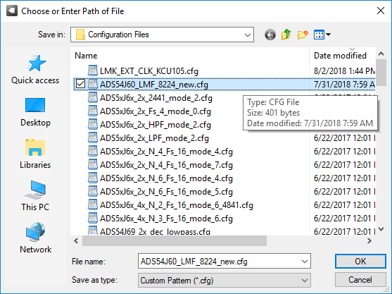
Press the board reset then load the file below

Slide 5
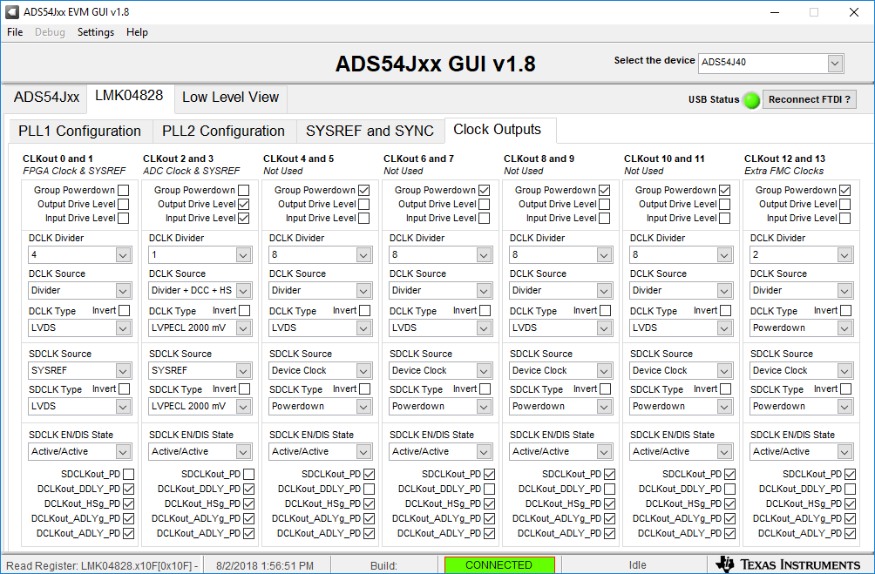
Set CLKout 3 SDCLK Type to “LVPECL 2000mV”

Slide 6
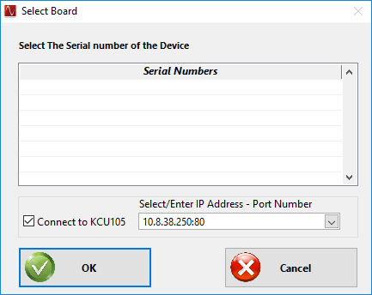
Open HSDC Pro GUI, connect to KCU105

Slide 7
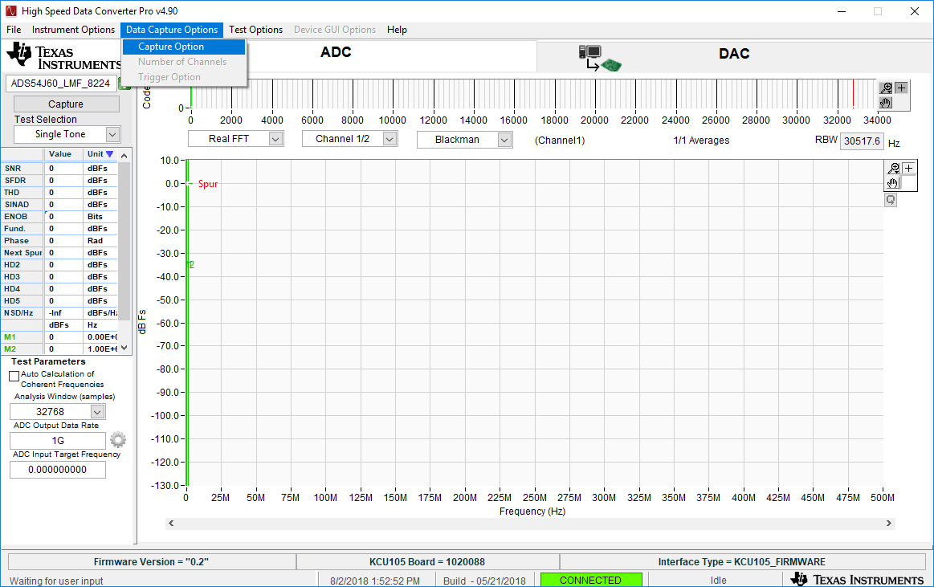
Click on “Data Capture Options” then “Capture Option”

Slide 8
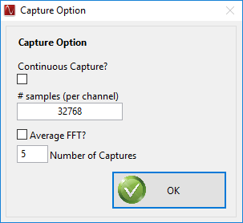
Set the # samples (per channel) to 32768

Slide 9
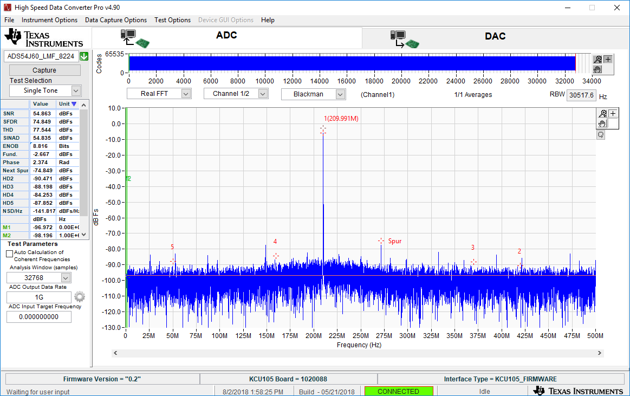
Select device, set ADC Output Data Rate to 1G, then set Analysis Window size to “32768”. Click on “Capture”
Results of 210MHz IF @ 17dBm, BPF CHA input shown below

